Slide 1
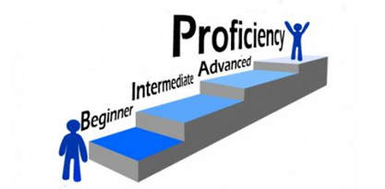

Reaching for Proficiency Across the Curriculum:
Grades 6-8 High-Impact Literacy Instruction in All Subject Areas
September 18, 2018
Notes:
Carole
Welcome and Introductions: Take count of teachers by grade level
Post this slide as participants have breakfast, meet and greet

Slide 2
“He who dares to teach, must never cease to learn. ”
~John Cotton Dana
Notes:
Carole
We owe this to the students we teach and future generations!

Slide 3



Social Studies
English/LA
Science
Notes:
Carole
Take a name tag from the box and using a marker, write what you teach on it, NOT your name
Must choose one of these three…

Slide 4

Work within the Kentucky Academic Standards for English/LA and Literacy in History/Social Studies, Science & Technical Subjects
Essential Writing Skills for passage-based writing in all subject areas in both timed/untimed tasks
Share High-Impact/Rigorous strategies and ideas for engaging students in the application of the standards in all subject areas
Notes:
Carole
Everything we do today addresses the skills students need to become better writers in timed and un-timed situations as well as learn the content!!!
To some, disciplinary literacy sounds like one more thing to do, but that is not the intention nor the case.
Academic learning for reading, writing, listening, speaking and thinking are not just in the realm of the language arts teachers. It happens in all grades and in all disciplines.
By helping your students become more literate in your discipline, you will strengthen their learning of the content and subject matter.

Slide 5
What Does It Mean to be College & Career Ready?
The larger goal of college and career readiness requires schools to enable all students to:
  master core content
  develop key cognitive strategies
  take ownership of their learning and become proficient with a range of learning strategies
  acquire the privileged knowledge necessary to make a successful transition from secondary to postsecondary education
David T Conley, PhD
CEO, Educational Policy Improvement Center (EPIC)
Professor, University of Oregon
Notes:
Carole

Slide 6

Prior to development of Standards, specific problems were identified…
Significant numbers of students who are deemed literate are not sufficiently literate to succeed in college or career
According to NAEP, there have been clear reading improvements among fourth-graders since 1992. And yet, middle school students are reading no better than 4th graders and high school students appear to have fallen
Many instructional strategies include ways of getting info to students without texts (e.g., lecture only, powerpoint, video) and omitting the reading of text
But, ACT research has found that the amount of text reading between 7th and 12th grades was the best preparation of later success
Notes:
Carole
Prior to and during development of the CCSS… Here are a few…
Avoiding Text

Slide 7
Elevating Literacy And Literacy Instruction
Up Through The Grade Levels
ACT found that state standards did not take specific
Reading standards through high school.
The Kentucky Academic Standards (KAS) for English/LA and Literacy in the Content Areas changed this fact.
  Grades 6-12:
  10 Reading and 10 Writing Standards specific to
  History/Social Studies, Science and Technical Subjects
Reading/Writing Standards are meant to complement the specific content demands of the disciplines, not replace them!
Notes:
Carole
Intent of the Literacy Standards
To have more students meet the requirements for post-secondary success, there needs to be greater clarity in what is expected of students each year during K-12 education.
Typical state standards that preceded the Common Core were too vague and too long to realistically inform instruction.
So the Common Core was designed to be a set of standards that are fewer in number, clearer in describing outcomes, and higher. What is included is what is expected for ALL students.
To help students achieve these standards, all practitioners must be honest about the time they require. Teaching less at a much deeper level really is the key to Common Core success.
The decisions surrounding how to focus the standards had to be grounded in evidence regarding what students in fact need in order to have a solid base of education and to be well prepared for career or college demands.
There had to be many decisions about what not to include. The focus was narrowed to what mattered most. You can look at the anchor standards and probably agree that all of them are skills you would really want every student you know and care about to leave school able to exercise.
So the CCSS represent that rarest of moments in education when an effort starts by communicating that we must stop doing certain things, rather than telling educators about one more thing they can add to their already overbooked agenda to help support their students. You can think of the standards and this focus on the shifts that really are at the center of what is different about them as the “power of the eraser” over the power of the pen.
Introduction Section of the KY Academic Standards:
Standards set requirements not only for ELA, but also for literacy in history/social studies, science, and technical subjects.
“Just as students must learn to read, write, speak, listen, and use language effectively in a variety of content areas, so too must the Standards specify the literacy skills and understandings required for college and career readiness in multiple disciplines.”

Slide 8
College and Career Readiness Standards
English Language Arts
Literacy in History/Social Studies, Science, and Technical Subjects
Reading (20)
1)Informational (10)
2)Literary (10)
Writing (10)
Speaking & Listening (6)
Language (6)
Reading (10)
Writing (10)
K-5 Reading Foundational Skills (4) (Encompass the 5 Essential Components of Reading)
Same Skills, Different Approach !
Notes:
Carole
Visual Chart of the key design…
Fewer and Broader… This means that teachers must design more rigorous tasks to help students achieve learning at a higher level… By themselves, the standards WILL NOT improve student learning!!!
The overarching skill emphasized in the ELA standards is COMPREHENSION at its highest level: ANALYSIS, CLASSIFICATION, ABILITY TO COMPARE/CONTRAST, SYNTHESIZE
Reading has 20 standards that are sub-divided into informational and literary text and each has10 standards (each connects back to its corresponding CCR anchor)
10 standards for writing
6 Standards for Speaking and Listening
6 Standards for Language
4 Reading Foundational Skills
10 standards for reading and 10 for writing: Content Specific Literacy Standards

Slide 9
Reading and Writing Standard #1
KY Academic Standards for English/LA and Literacy in the Content Areas
Notes:
Carole HANDOUTS
ELA Reading and Writing Standard #1 and Reading Standard #10
Full Progressions Document is posted on HOLLER

Slide 10
Distribution of Literary and Informational Passages by Grade in the NAEP Reading Framework
GRADE | LITERARY | INFORMATION
4 | 50% | 50%
8 | 45% | 55%
12 | 30% | 70%
The Standards aim to align instruction with this framework so that many more students than at present can meet the requirements of college and career readiness.
ELA CCSS Page 5
Notes:
Carole
Students who were successful on NAEP were found to spend a high percentage of time reading informational passages.
The percentages on the table reflect the sum of student reading, not just reading in ELA settings.
At the HS level: Because the ELA classroom must focus on literature (stories, drama, and poetry) as well as literary nonfiction, a great deal of informational reading in grades 6–12 must take place in other classes if the NAEP assessment framework is to be matched instructionally.
It is a shared responsibility!!

Slide 11

Why more informational text?
Increases students’ access to text that will help them increase their vocabulary, general knowledge, language and reasoning abilities
Student’s build knowledge of the world and the disciplines.
Is an opportunity for students to learn how to engage, interact, and have “conversations” with the text in ways that prepare them for the type of experiences they will encounter in college and careers and real life.
Notes:
Carole
Explain that in addition to the need for students to read college and career level text by the time they graduate,
informational text increases students’ access to text that will help them increase their vocabularies, general knowledge, language and reasoning abilities.

Slide 12
Distribution of Communicative Purposes by Grade in the NAEP Writing Framework
GRADE | TO PERSUADE Opinion/Argumentation | TO EXPLAIN Info./Exp. | TO CONVEY EXPERIENCE Narrative
4 | 30% | 35% | 35%
8 | 35% | 35% | 30%
12 | 40% | 40% | 20%
It follows that writing assessments aligned with the Standards should adhere to the distribution of writing purposes across grades outlined by NAEP.
ELA CCSS Page 5
Notes:
Carole Let’s now look at Writing
As with reading, the percentages in the table reflect the sum of student writing, not just writing in ELA settings.
ONE REASON FOR THIS SHIFT IN THE ORGANIZATION OF WRITING STANDARDS IS TO BETTER PREPARE STUDENTS COLLEGE AND CAREER WRITING
Notice the decreasing emphasis on narrative writing that students do in school. THOSE PERCENTAGES DO NOT REPRESENT AN ELA CLASSROOM IN ISOLATION.

Slide 13



Appendices
Appendix C:
Annotated Writing Samples at Various Grade Levels
Appendix A:
Supplementary Materials and Glossary
Appendix B:
Text Exemplars and Sample Performance Tasks
www.corestandards.org
Notes:
Carole
3 Appendices:
A: Supplementary materials and a glossary (43 pages)
B: Text exemplars illustrating complexity. text complexity is measured by 3 factors
qualitative evaluation (levels of meaning, structure, language conventionality, and clarity, and knowledge demands)
quantitative evaluation (readability, and other scores of text complexity), and matching reader to text and task (reader variables such as motivation, knowledge and experience, and task variables such as purpose and complexity generated by task assigned or question posed)
quality and range of reading for grade levels (includes text types for K-5 and 6-12 bands in these broad categories: stories, dramas, poetry and literary nonfiction/(historical, scientific and technical texts for K-5 only)
Accompanying Sample Performance Tasks (183 pages)
C: Annotated samples demonstrating at least adequate performance in writing at various grade levels (106 pages)

Slide 14

Summary of the “Biggest” Instructional Shifts
Regular practice with complex text and its academic language
Reading, writing and speaking grounded in evidence from text, both literary and informational
Building knowledge through content-rich nonfiction
Notes:
Carole: 6 Major Shifts…
This is a high-level summary of the biggest changes signified by the adoption of the CCSS.
The shifts are a high-level summary of the biggest changes signified by the adoption of the CCSS.
They represent the most significant shifts for curriculum materials, instruction, student learning, and thinking about assessment. Taken all together, they should lead to desired student outcomes. Communicate the shifts to everyone who will listen! Everyone working in your school and district should have a solid understanding of the shifts required in both ELA/Literacy and Mathematics. They are a great starting point for learning about and understanding the CCSS.
You can test any message or effort regarding the CCSS against these touchstones. From state, district, school, or classroom – how does X support the ideas of the shifts?
They are meant to be succinct and easy to remember.
We’ll discuss them each in turn.
They represent the most significant shifts for curriculum materials, instruction, student learning, and thinking about assessment. Taken all together, they should lead to desired student outcomes.
SHIFT #2:
Most college and workplace writing requires evidence.
Evidence is a major emphasis of the ELA Standards: Reading Standard 1, Writing Standard 9, Speaking and Listening standards 2, 3 and 4, all focus on the gathering, evaluating and presenting of evidence from text.
SHIFT #3:
Literary/Informational Reading: 50/50 balance K-5
ASSESSMENTS will require a high and increasing proportion of informational text as students advance through the grades.
Students learning to read should exercise their ability to comprehend complex text through read-aloud texts
Reading aloud texts that are well-above grade level should be done throughout K-5 and beyond!
In grades 2+, students begin reading more complex texts, consolidating the foundational skills with reading comprehension

Slide 15
What are the Qualitative Features of Complex Text?
Subtle and/or frequent transitions
Multiple and/or subtle themes and purposes
Density of information
Unfamiliar settings, topics or events
Lack of repetition, overlap or similarity in words and sentences
Complex sentences
Uncommon vocabulary
Lack of words, sentences or paragraphs that review or pull things together for the student
Longer paragraphs
Any text structure which is less narrative and/or mixes structures
Notes:
Carole HANDOUT
Complex text contains any and all combinations of these features in many combinations.
The complexity level is determined by both quantitative and qualitative measures.
The details of text complexity are well described in Appendix A of the Standards, one of the supplemental readings offered with this module.
New tools have been developed since the Standards were developed to help determine qualitative text complexity. Those materials are available on www.achievethecore.org
Students who struggle with reading almost always have gaps in their vocabulary and their ability to deal with more complex sentence structures. This too is well documented in research.
Too often, less proficient students are given texts at their level where they do not see these features, where the demands of vocabulary and sentence structure are lowered. Though this is done for the kindest of reasons, it has disastrous consequences. Day by day, differentiating by level of text during instructional time increases the achievement gap between high performers and those who struggle.
Students cannot address gaps in their vocabulary and develop skill with unpacking complex syntax text when they are not given the opportunity to work with material that provides these opportunities.
With that said, there is a place for providing students with text more appropriately matched to their individual reading abilities to build fluency and provide opportunity for increasing the volume of reading. But those texts cannot be the primary texts for instruction.

Slide 16
Scaffolding Complex Text
The standards require that students read appropriately complex text at each grade level – independently (Standard 10).
However there are many ways to scaffold student learning as they meet the standard:
Multiple readings
Read Aloud
Chunking text (a little at a time)
Provide support while reading, rather than before.
Notes:
Carole
This does not mean students do this without any support! It is essential that teachers and instructional material provide scaffolds to support ALL students in comprehending complex text.
These scaffolding types will reliably support many students and a has a strong research base:
Multiple readings. Complex text takes multiple reads to fully understand the layers of meaning provided by the author. Because of this, the text selected for close reading should be excellent or they will not be worthy of the time commitment they require to read fully. Re-reading assists fluency and is the primary way readers make sense of challenges encountered when reading.
Reading the text aloud while students follow along . Fluency challenges are rampant when students encounter grade level appropriate text. All teachers must be aware of this and reach in to help. The two best ways to help are having the students follow along while the text is read aloud and by reading text multiple times. (These two methods are systematically built into the close reading model included in this module.)
Read aloud of complex text is especially important for early readers K-2 because the work of the standards is too complex to apply to the texts students can read on their own, and students cannot develop academic language through the texts students can read on their own at these grades (levels); for all practical purposes read aloud provides students who come to kindergarten with less developed academic language with a way to catch up.
“Chunking” longer text into smaller and logical sections makes the text more manageable and helps demonstrate how the author structured the text.
Careful, text-specific questions point readers to challenging sentences and ask for special attention to be paid to them. They direct students to what matters most and asks them to examine those parts. They also pay particularly close attention to vocabulary that can be figured out in the context of the text. Because they require text evidence, they demand re-reading.
Pointing out text structures or features that will either provide comprehension support (like section headers) or challenges (like long paragraphs or sentences).
Supports that do not promote improved reading incomes and do not have research support behind them:
Previewing the topic of the reading in a text-free way (just “teacher talk”). A careful examination of the text is solid practice. But telling students what they will be reading before they read will remove any motivation for discovering it for themselves and it will teach students that learning from reading is not a central activity in that classroom.
Providing simple text to weak readers and complex texts to strong readers. Differentiation by text type, as opposed to providing a variety of supports for the same complex text, leads to the “Matthew Effect” – “to those who have, more will be given. To those who have little, even that little will be taken away,” a well-researched finding. This is particularly true because of the differences in vocabulary that students will see from simpler to more complex text. Words create much of the differences in texts.
The goal is growing independence with increasingly complex text. The strategies implemented should all aim at getting students stronger and more skilled – like exercises and scrimmages in a sports practice.

Slide 17
Close Analytic Reading
Requires prompting students with text-dependent questions to unpack complex text and gain knowledge.
Text dependent questions require text-based answers – evidence.
Not teacher summarizing text, but guiding students through the text for information.
Virtually every standard is activated during the course of every close analytic reading exemplar through the use of text dependent questions.
Supports fluency
Notes:
Carole
Close reading hones in on difficult portions of text, and provides students an opportunity to work with those sections.
Close reading opposes "think aloud," where teacher explain these difficult portions before students have had a chance to learn from them on their own.
Not only is virtually every standard evident when students close read – the 3 shifts required by the standards are evident as well! When reading appropriately complex non-fiction or literature, ask students to respond the text-dependent questions about the text.

Slide 18
Sample: Quick Annotation Strategy
? = Ask a question
“The text mentions a DNA study. What does DNA stand for?”
!!! = Note an interesting passage
“I didn’t realize that tapeworms can grow to 23 meters!”
C = connection to another text or piece of evidence
“The Ebola virus is like the AIDS virus we read about yesterday because….”
(check)= Access prior knowledge; I already knew that!
“I knew that photosynthesis required water.”
X = Challenge your own thinking, new information
“I had no idea that Nobel invented dynamite.”
* = Reason that looks important
“I’ll need this piece of evidence about Triceratops to support my thesis.”
"Box it" = Remember words you don't know, are repeated, or you just like
“I’ve seen the word ignominious several times, and I need to look it up.”
Notes:
Carole HANDOUT
Give students “Guidelines” to strategically guide them through the Annotation Process

Slide 19
Shift #2 Requires a Good Progression of
Text-Dependent Questions & Answers
Opinions/Arguments,
Intertextual Connections
Inferences
Author’s Craft and Purpose
Key Details
General Understandings
Vocab & Text Structure
What does the text mean?
TDQs are designed to cause students to return to the text.
How does the text work?
What does the text say?
Notes:
Carole
Shift 2 states: Reading, writing and speaking grounded in evidence from text, both literary and informational
Evidence is a major emphasis of the ELA Standards: Reading Standard 1, Writing Standard 9, Speaking and Listening standards 2, 3 and 4, all focus on the gathering, evaluating and presenting of evidence from text.

Slide 20




Characteristics/Intent of Text-Dependent Questions
Questions that can only be answered with evidence from the text.
Focus on difficult portions of text in order to enhance reading proficiency.
Frame inquiries in ways that do not rely on a mix of personal opinion, background information, and imaginative speculation.
Notes:
Carole

Slide 21

Text-dependent Questions and the Standards
Opinions, Arguments,
Intertextual Connections
Inferences
Author’s Purpose
Vocab & Text Structure
Key Details
General Understandings
Standards
8 & 9
3 & 7
6
4 & 5
2
1
Notes:
Carole: HANDOUT
CCSS Aligned Question Stems
Each type of TDQ in the Progression Process can be directly linked to a Reading Standard…

Slide 22
Summing Up the 3 “Biggest” Instructional Shifts
All Teachers Support Literacy
This interdisciplinary approach to literacy stems from extensive research establishing the need for college and career ready students to be proficient in reading complex informational texts, independently, in a variety of content areas.
Most of the required reading in college and workforce training programs is informational in structure and challenging in content.
Notes:
Carole
Postsecondary education programs typically provide students with both a higher volume of such reading than is generally required in K–12 schools and comparatively little scaffolding.
The reading framework of the National Assessment of Educational Progress (NAEP) requires a high and increasing proportion of informational text on its assessment as students advance through the grades.
The standards have followed the NAEP (National Assessment of Educational Progress) guidelines in establishing how much informational text students should read in school.

Slide 23
Argumentative Writing… | Informational/Explanatory Writing…
uses FACTS and OPINIONS to convince the reader that the author is right includes a type of thesis; the difference is that the thesis of argumentative writing is called a CLAIM. seeks to persuade by convincing the reader to perform an action or convince the reader of their point of view. the student’s job is to give reasons for believing or doing something with supporting evidence. | uses FACTS to explain to an audience a given topic/issue will include a THESIS STATEMENT; the author will explain the thesis to the reader in the body paragraphs does not allow for your own view about the topic/issue the student’s job is to EXPLAIN. That is it!
Narrative Writing is Embedded into Both
Adapted from: https://prezi.com/f9xymf6sfrki/informative-vs-argumentative/
Notes:
Carole
WRITING AND ASSESSMENT
There are 3 Modes of Writing in the KAS, but for MS/HS these are the most important modes!!
With argumentative writing, the aim is to get people to believe that something is true.
With explanations, the aim is to answer questions about why or how because truthfulness is assumed.
Argument seeks to persuade; explanation seeks to create understanding.

Slide 24
http://www.smekenseducation.com/Argumentative-v-Persuasive-Writ.html
Notes:
Carole: HANDOUT
Because Interpreting expectations among the types of argument (e.g., opinion, persuasive, argument, etc.) can be difficult, I want to share this handout with you…
Begin first by outlining the subtle, but significant differences among them. This chart is helpful to compare what students already know about persuasive writing as you introduce them to the new and less familiar concepts of argumentative writing

Slide 25
Literacy Design Collaborative (LDC) Rubrics
Create a Free Account!
www.ldc.org
Join Core Tools
Notes:
Carole
Share LDC rubrics as a resource

Slide 26
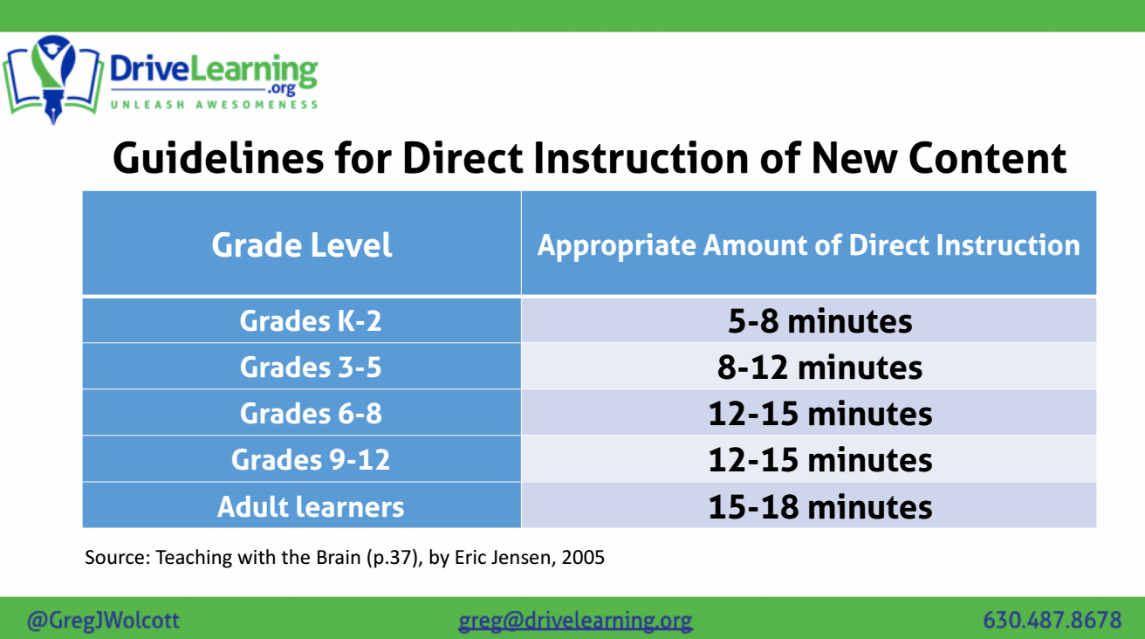
Notes:
Carole

Slide 27
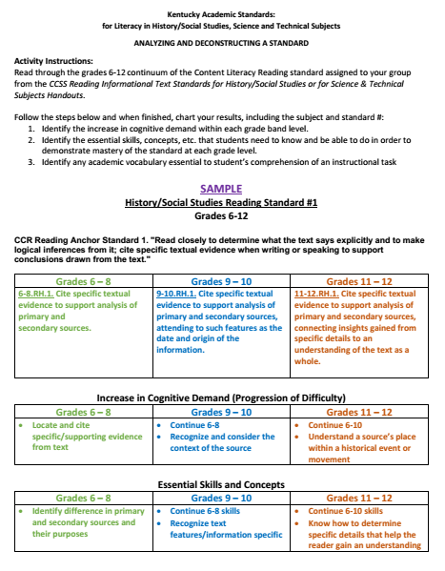
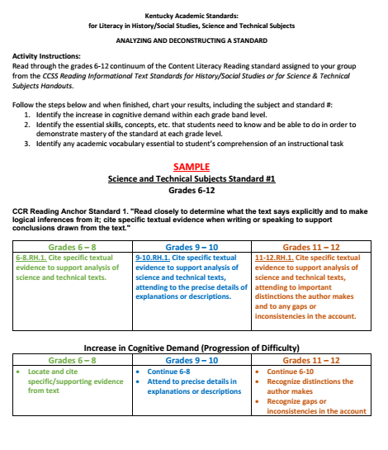
KAS for Literacy in History/Social Studies,
Science and Technical Subjects
Notes:
Carole HANDOUTS
PLACE TEACHERS IN GROUPS BY SUBJECT. Table tents will indicate which standard each group will analyze and deconstruct.
Samples and Standards Documents

Slide 28
Kentucky Academic Standards: for Literacy in History/Social Studies, Science and Technical Subjects
Activity Instructions:
Read through the grades 6-12 continuum of the Content Literacy Reading standard assigned to your group from the CCSS Reading Informational Text Standards for History/Social Studies or for Science & Technical Subjects Handouts.
Follow the steps below and when finished, chart your results, including the subject and standard #:
Identify the increase in cognitive demand within each grade band level.
Identify the essential skills and/or concepts that students need to know and be able to do in order to demonstrate mastery of the standard at each grade level.
Identify any academic vocabulary essential to student’s comprehension of an instructional task
Notes:
Dionne and Carole HANDOUTS
Science teachers get a science standard, SS/ELA get a history/ss standard
CCSS Reading Informational Text Standards for SS and Sci handouts

Slide 29

S. T. R. A. P
What essential WRITING SKILLS do students need in order to effectively respond to a timed/untimed writing task in any subject area?
Notes:
Rebecca

Slide 30


Determine the exact/specific question you need to answer.
S=
Notes:
Rebecca

Slide 31

Writing Task
Recent studies show that plastic straws are the 11th most found ocean trash and have a significant negative impact on marine life. Our city council is considering a measure to ban the use of straws in restaurants within the city limits. The local newspaper invites members of the community to agree or disagree with this measure in letters to the editor which will be printed in next week’s issue.
A. Straws
B. Plastic Straws
C. The city should or should not ban
plastic straws from restaurants
within the city limits.
Notes:
Rebecca
After explaining to students that they must determine the specific question which is being asked in the task. Read the task aloud and have students choose the correct answer from the multiple choice answers provided. Do this on individual cards or paper to help all students make a decision.

Slide 32

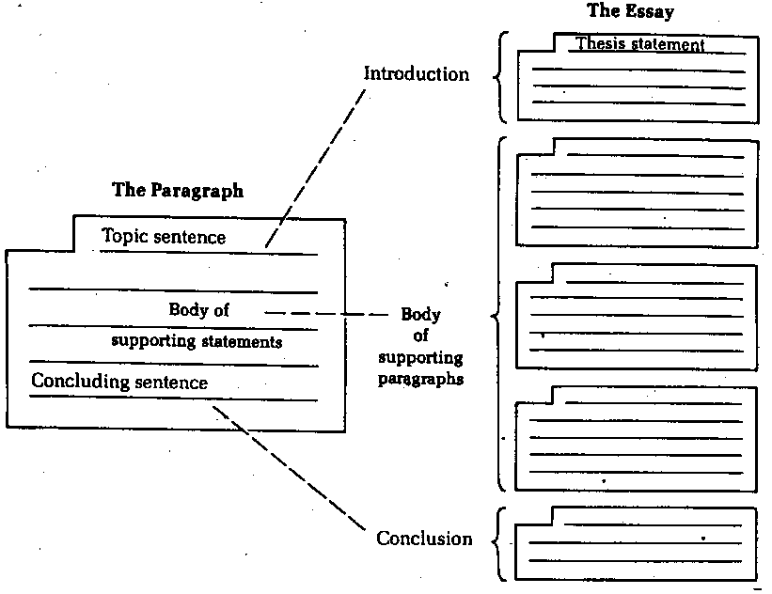
T=
Notes:
Rebecca
While there are many types or forms which writing may take, they all share the structure of an essay: Introduction, Body, Conclusion. These parts may be longer or shorter in various types of writing, but close analysis will show that letters, emails, blogs, articles, and editorials all contain these basic parts.
Because of this, helping students to master essay writing is the key to success in writing in a timed or untimed situation.
The next step is to help them recognize and apply the characteristics of different genres of writing. At each grade level, this work is different--but the goal is the same. For example, if K-1 students can learn to write a topic sentence the foundation is laid for 2-3 teachers to help them master a paragraph structure. In 4-5, students will have the skills needed to develop 3 paragraph essays and recognize and apply the characteristics of different genres of writing.

Slide 33

R=
The different roles
we play.
Notes:
Rebecca

Slide 34

#1
Notes:
Rebecca

Slide 35
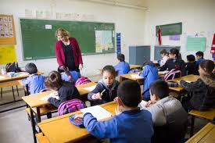
#2
Notes:
Rebecca

Slide 36

#3
Notes:
Rebecca

Slide 37


A=
A specific audience is one composed of people who share a common background or who have a common knowledge level.
A general audience is one composed of people from different backgrounds and with different knowledge levels.
Notes:
Rebecca
After defining each type of audience ask participants to work together to label each of the audiences on the yellow page as specific or general and be prepared to discuss answers.

Slide 38

General Specific Audience
Answers
A conference of English professors.
The listeners of a Top 40 radio show.
The attendees at a 4th of July fireworks display.
The developers for a particular website.
The readers of a newspaper.
SPECIFIC
GENERAL
GENERAL
SPECIFIC
GENERAL
Notes:
Rebecca
Discuss answers as whole group.

Slide 39

P=
To inform or explain
To support a point of view
https://www.youtube.com/watch?v=JKFu-2gjjo0
https://www.youtube.com/watch?v=ThIrw_LpuRA
Notes:
Rebecca
Strategy: Give participants a two column index card and ask them to decide which video is primarily informative/explanatory writing and which is persuasive---they should cite evidence from the video to support their choice.

Slide 40
STRAP | When considering a Writing Situation and Task, determine each of the following:
SUBJECT | What topic are you to address?
TYPE | What format should your writing take?--- essay, email, letter, article, etc.
ROLE | From what role will you write? student, son, daughter, volunteer, citizen, athlete, etc.
AUDIENCE | To whom are you writing? HINT: The writing situation will GIVE you this information.
PURPOSE | For what purpose do you write? To inform or explain or to support a point of view.
STRAP adapted from The Write Source. 2007
Notes:
Rebecca

Slide 41


Composing a Strong Thesis!
Provide a road map for your essay...
Notes:
Rebecca

Slide 42
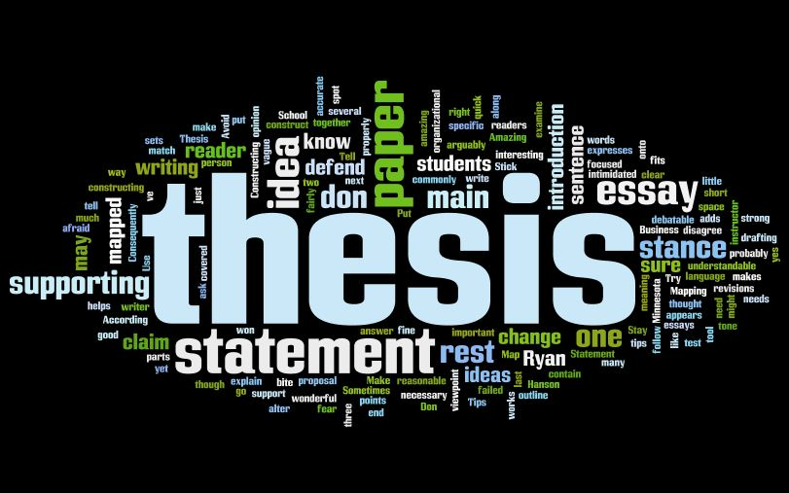
3-Part Thesis Statement
Although I grew up working on a tobacco farm, I knew from an early age farming was not for me because I loved reading and writing much more than cultivating tobacco.
OR
While many argue against the use of cellphones in school, they are useful classroom tools because they provide access to the Internet, to 911, and to online learning tools.
Notes:
Rebecca

Slide 43

Condition Phrase:
Acknowledges the opposing claim or creates a context for your main idea
Although I grew up working on a tobacco farm, I knew from an early age farming was not for me because I loved reading and writing much more than cultivating tobacco.
Notes:
Rebecca

Slide 44
Condition Phrase:
Acknowledges the opposing claim or creates a context for your main idea
While many argue against the use of cellphones in school, they are useful classroom tools because they provide access to the Internet, to 911, and to online learning tools.
Notes:
Rebecca

Slide 45

Claim: a statement of your position or main idea
Although I grew up working on a tobacco farm, I knew from an early age farming was not for me because I loved reading and writing much more than cultivating tobacco.
Notes:
Rebecca

Slide 46

Claim:
a statement of your position or main idea
While many argue against the use of cellphones in school, they are useful classroom tools because they provide access to the Internet, to 911, and to online learning tools.
Notes:
Rebecca

Slide 47

Support:
1-3 reasons, pieces of evidence, or examples to support your claim
Although I grew up working on a tobacco farm, I knew from an early age farming was not for me because I loved reading and writing much more than cultivating tobacco.
Notes:
Rebecca

Slide 48
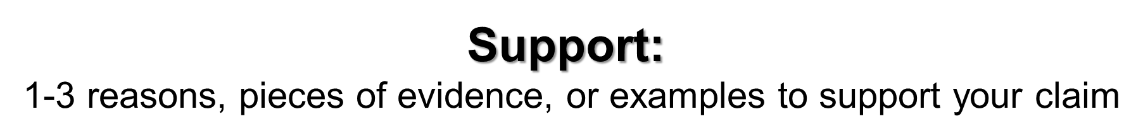

While many argue against the use of cellphones in school, they are useful classroom tools because they provide access to the Internet, to 911, and to online learning tools.
Notes:
Rebecca

Slide 49
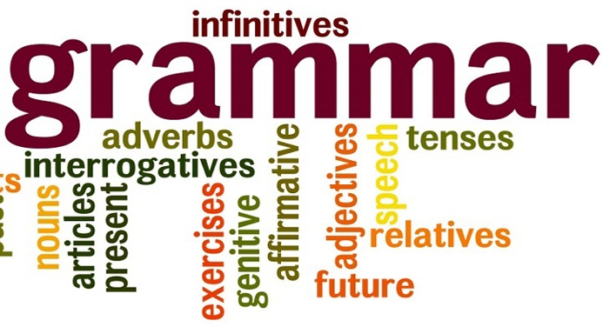
Grammatical Structure of the Thesis Statement
Dependent Clause: Although I grew up working on a tobacco farm,
Subordinating Conjunction comma
Independent Clause: I knew from an early age farming was not for me
Dependent Clause: because I loved reading and writing much
Subordinating Conjunction
more than cultivating tobacco. Period
Notes:
Rebecca

Slide 50

With the people at your table, read each thesis statement and decide if it is structured correctly according to Condition Phrase, Claim, and Support. Place those which are correct under the YES column and those that are incorrect under the NO column.
YES
NO
Notes:
Rebecca
ACTIVITY: Students will receive a chart and slips of paper with thesis statements on them to consider and sort.

Slide 51




T. E. A. A.
KKK
Notes:
Rebecca

Slide 52

Develop Your Thesis
Although many argue against the use of cellphones in school, they are useful classroom tools because they provide access to the Internet, to 911, and to online learning tools which improve the overall learning environment.
Notes:
Rebecca

Slide 53
TEAA | Develop Your Ideas! All Body Paragraphs Should include:
Topic Sentence | A sentence that expresses the main idea of the paragraph in which it occurs. Generally, a topic sentence will focus on one point established in the thesis statement. This helps create a cohesive essay.
Example | A direct quote from the text provided for the task, or a direct quote from an outside source, or a specific relevant example. Providing a direct quote helps establish authority of the author.
Analyze | To Analyze means to examine methodically and in detail the constitution or structure of (something, especially information), typically for purposes of explanation and interpretation. So, when we analyze the example provided, we must EXPLAIN how it proves the thesis statement.
Address the Question | A sentence or two that make it clear that you have answered the question posed by the task---this will clearly tie back to the thesis statement.
Notes:
Rebecca

Slide 54
Body Paragraph
Cell phones provide access to the Internet which has much information and many resources. According to “Cell Phones in School--Yes?,” “ With research capabilities, students may more quickly access information they need for the task they are completing.” As this article points out, research on the Internet is quick and easy. Students are able to use online dictionaries, databases, and library resources from their cellular devices. As well, Google and other search engines yield quick results. While students need to be taught to properly vet sources found online, there is little question that online research via cell phones is useful in a classroom setting.
Notes:
Rebecca
blue= topic sentence
orange=example
Green = analysis
yellow=address the question

Slide 55

Use the highlighters provided to color code the body paragraph which develops this thesis statement to determine if it meets the criteria outlined by TEAA:
TASK: Should nations use economic sanctions as a political tool?
THESIS STATEMENT: Though economic sanctions appear to be a powerful peacetime weapon, they actually do more harm than good because they often prolong bad situations, reduce dialogue between disputing nations, and harm innocent victims with little impact on those in power.
Notes:
Rebecca
Handout: Economic sanctions often prolong bad situations rather than end them. Political sanctions usually come about when an international dispute cannot be resolved by discussion and compromise. In order for one nation to get what it wants, it reduces or stops trade with another nation. It may also freeze any assets the “offending” nation has invested in its country. In 1962, for example, Communist leader Fidel Castro too power in Cuba. His government took control of U.S. businesses there. The United States imposed sanctions, cutting trade with Cuba, hoping this would speed the fall of Castro’s government (“United States Sanctions”). More than 40 years later, the sanctions remained in place, and Castro remained in power. Clearly, in this case, economic sanctions prolonged a bad situation which might have been reconciled through stronger efforts at diplomacy. Cuba is one example among many of why economic sanctions should not be a political tool.

Slide 56
Who says what? Make it clear for your reader!
They Say/I Say Templates
The Most Important Templates:
On the one hand, __________. On the other hand, __________. Author X contradicts herself.
At the same time that she argues __________, she also implies __________.
I agree that __________.
She argues __________, and I agree because __________. Her argument that __________ is supported by new research showing that __________.
In recent discussions of __________, a controversial issue has been whether __________. On the one hand, some argue that __________. On the other hand, however, others argue that __________.
Notes:
Rebecca
Why Templates? Academic writing requires presenting your sources and your ideas effectively to readers. According to Graff and Birkenstein, the first element in the process involves “entering a conversation about ideas” between you—the writer—and your sources to reflect your critical thinking (ix). The templates allow you, the writer, to organize your ideas in relationship to your thesis, supporting evidence, opposing evidence, and the conclusion of the argument.

Slide 57
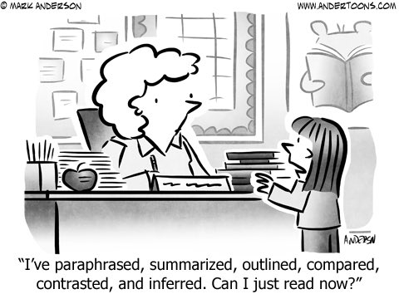

12:00 – 12:45 pm.
Notes:
Carole

Slide 58

Carole Mullins, NBCT
KVEC Literacy Instructional Specialist
carole.mullins2@hazard.kyschools.us
Dionne Bates, Ed. S.
KVEC Achievement Gap Specialist, Literacy
dionne.bates@hazard.kyschools.us
Kim Sergent
KVEC Social Studies Instructional Specialist
kimberly.sergent@letcher.kyschools.us
Katrina Slone, Ed. D
KVEC Science Instructional Specialist
katrina.slone@hazard.kyschools.us
Rebecca King
Teacher, Pikeville Independent Schools
rebecca.king@pikeville.kyschools.us
www,kvecelatln.weebly.com
Notes:
Carole

