Slide 1
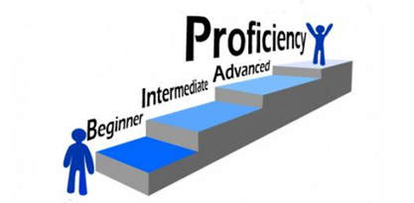

Reaching for Proficiency Across the Curriculum:
Grades 6-8 High-Impact Literacy Instruction in All Subject Areas
September 18, 2018 AFTERNOON SESSION
Notes:
Carole
Welcome and Introductions: Take count of teachers by grade level
Post this slide as participants have breakfast, meet and greet

Slide 2
Talk, Read, Talk, Write
Notes:
KATRINA

Slide 3
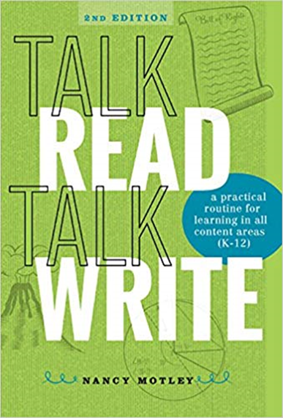
“Talk, Read, Talk, Write” Strategy:
Designed by Nancy Motley (Seidlitz Educational Consultants)
Designed to engage students directly within the text.
Four Stages:
One: Activate thinking visually, talk to partner
Two: Read, annotate, highlight the lesson text
Three: Talk with a partner about the reading
Four: Respond to task/prompt, brings learning together
Notes:
Katrina

Slide 4
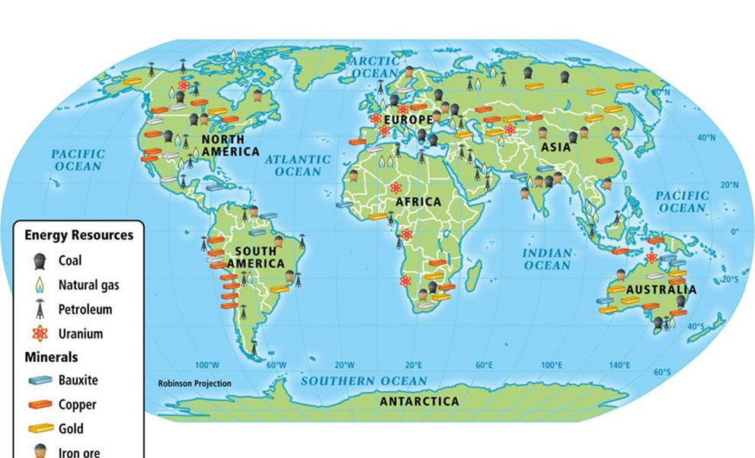
Now…Let’s TALK!
In your classroom, students would view the source individually, answering the question(s), then share answers with partner in the TALK stage.
Review the map in your packet.
Prioritize the resources in the legend from richest to the
least richest.
Using that list, determine the top five wealthiest nations.
Notes:
Katrina HANDOUT
Map for Prompt

Slide 5
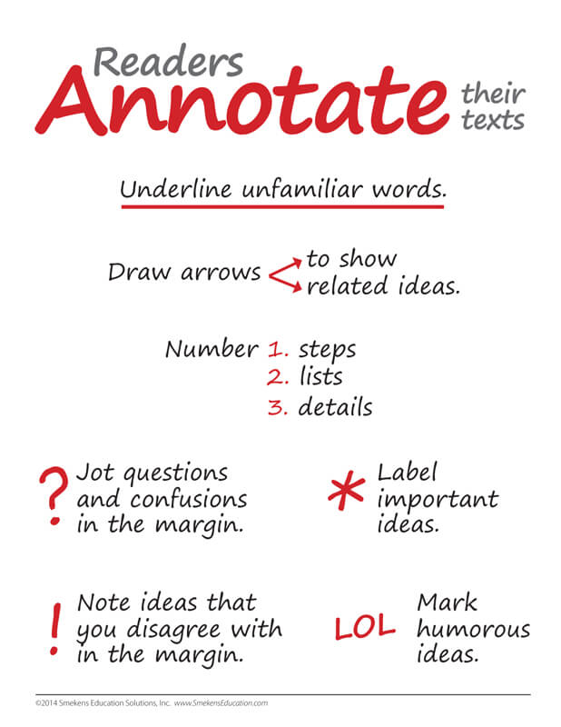
Next Step: Read
As you read the article individually:
Highlight information that supports your judgments on the map.
Annotate information that disagrees or would serve as a counterargument to your thoughts on the map.
Notes:
Katrina HANDOUT

Slide 6

Step Three: TALK
Turn to your A-B partner and share your discoveries from the reading.
First, share the evidence that supports your thesis.
Now – share the counterarguments!
Notes:
Katrina

Slide 7

Step Four: WRITE
Respond to this task:
Based on the information found in the sources, explain why countries need each other economically.
Be sure to use evidence from the sources to support and develop your thinking.
Notes:
Katrina

Slide 8
Looking at the TRTW format…
Planning within the format:
Backward design
Address the content first in the READING and the WRITING.
The TALK segments are determined by the content choices.
Additional Resource: https://achievethecore.org/aligned/welding-literacy-scientific-instruction/
Notes:
Katrina
HANDOUT

Slide 9
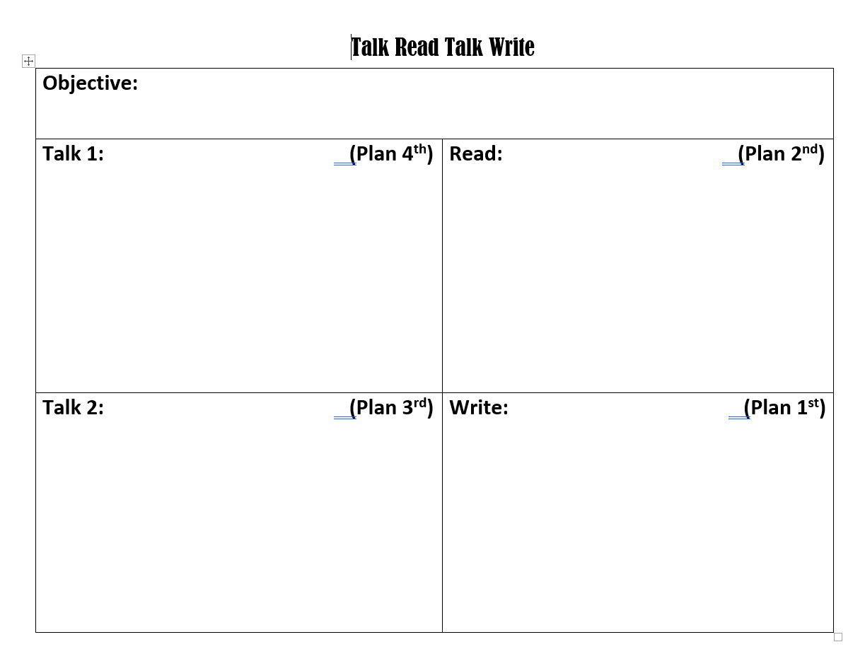
Explain how availability of natural resources has influenced human activity.
PAT
Why are there different natural resources on different places on Earth?
What happens to humans as a result of the uneven distribution of resources?
Highlight causes in yellow, effects in green.
What patterns do you notice in the distribution of different resources?
Why might these patterns occur?
How could you summarize why there are different natural resources in different places?
What are the most consequential effect and why?
Based on information found in the sources, explain how the availability of natural resources has influenced human activities.
Notes:
Katrina
Link to blog with strategy: http://www.thecurlyclassroom.com/search?q=talk+read+talk+write
Link to planning sheet: https://docs.google.com/document/d/1h9em7gXw1evsuN3awdRrOLgwAXtIemyblVu66QC0njY/edit?usp=sharing

Slide 10
Visual Thinking Strategy
Notes:
Kim

Slide 11
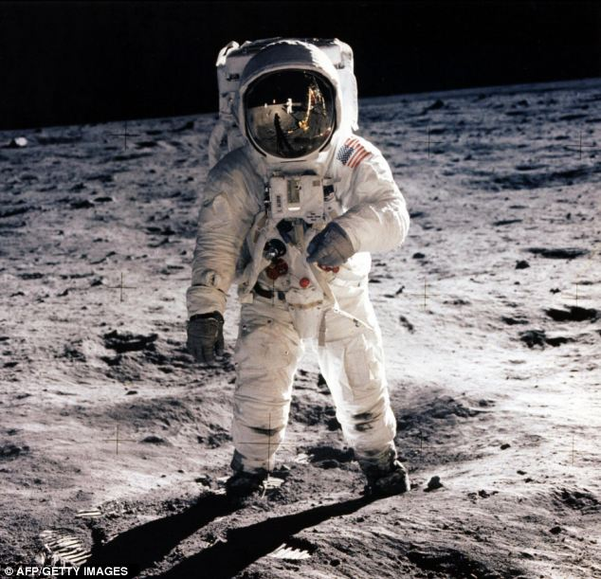
Visual Literacy
‘Foundational’ form of literacy, for primary and elementary grades
Can be done with artifacts and photographs, or the occasional painting (depending on grade/subject)
Visually connecting to the source
Sourcing with pictures, identifying what they see and inferring or making educated guesses.
Notes:
Kim

Slide 12
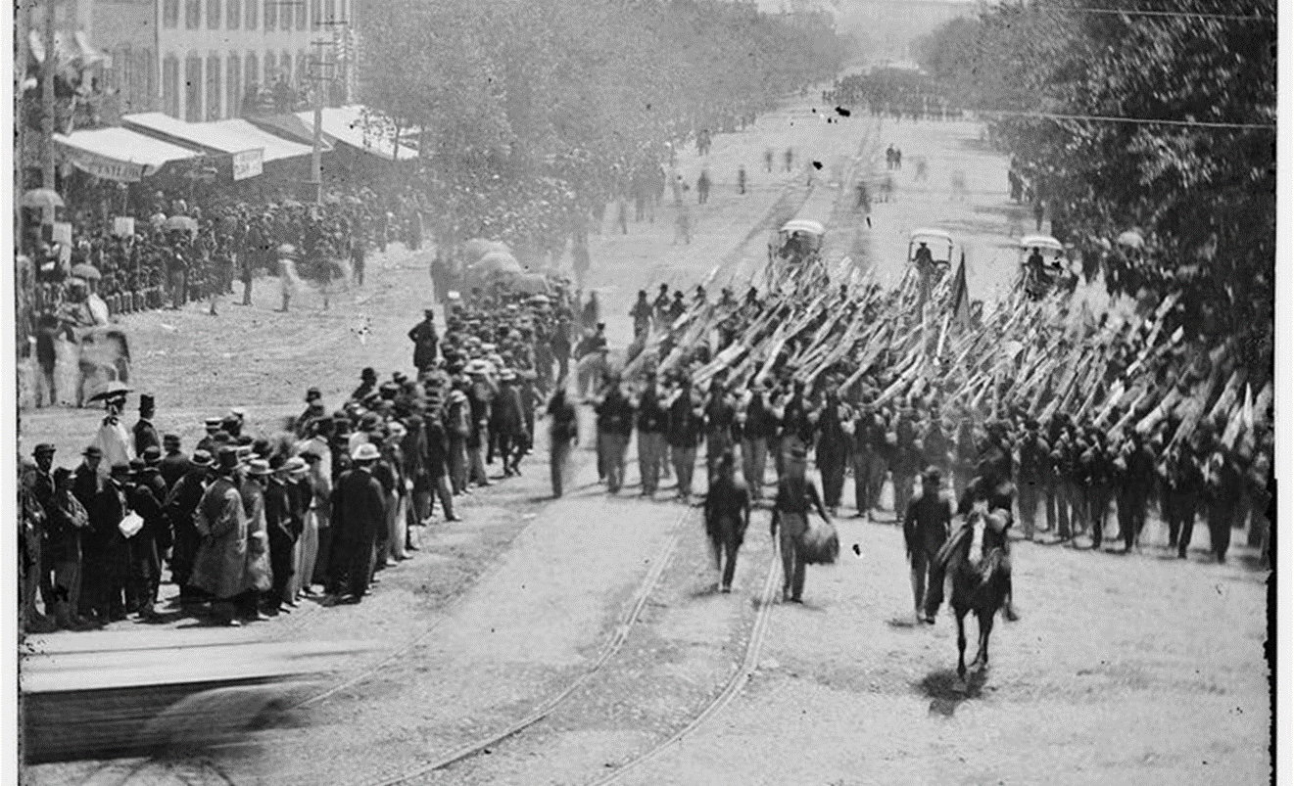
Visual Thinking Strategy (VTS)
#1: What is going on in this picture?
#3: What more can we find?
#2: What do you see that makes you say that?
For grades K-3 initially
Can be used at every grade and subject
You ask three questions to guide the students into the text.
Notes:
Kim

Slide 13
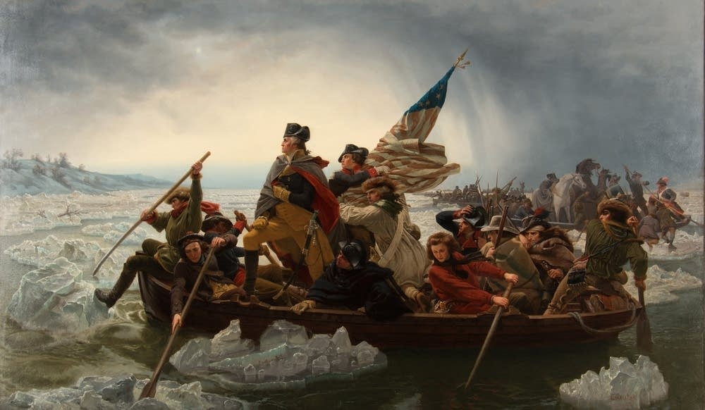
Now, it’s YOUR turn
Try VTS with your colleagues!
Notes:
Kim

Slide 14

Making Observations
Think of the four senses (not taste!) | Size, shape, color, lines, patterns, texture, weight, smell/odor, sound, behavior…. I observed ____________________. I noticed ____________________.
Connect it to what you know or have investigated. | It reminds me of ____________________ because ____________________.
Observe and record cause and effect. | When ____________________, it ____________________.
Note any changes. | At first ____________________. But now ____________________.
Be curious and ask questions you might investigate. | I am curious about ____________________. It surprised me that ____________________. I wonder what would happen if ____________________. What is the effect of ____________________ on ____________________?
Using templates helps student to organize their thinking. If they are taught how to use them and have the opportunity to practice using them often, they begin to internalize the structure so they no longer need the templates.
https://docs.google.com/document/d/1-WSxoeqkjji_C3KfcILuGWSFw4cFh29Boz7zqxuG17g/edit?usp=sharing
Notes:
Katrina
Link to observation template: https://docs.google.com/document/d/1-WSxoeqkjji_C3KfcILuGWSFw4cFh29Boz7zqxuG17g/edit?usp=sharing

Slide 15
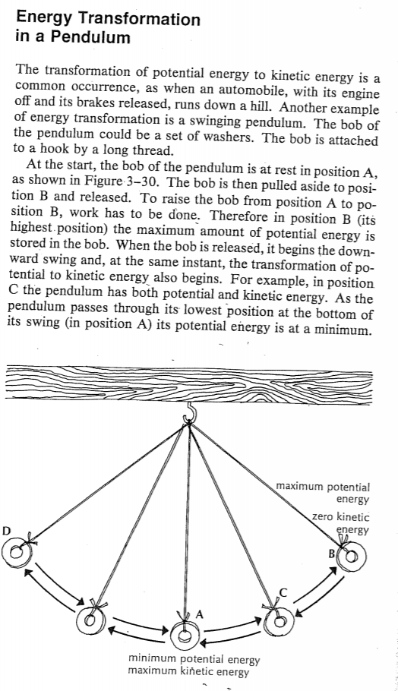
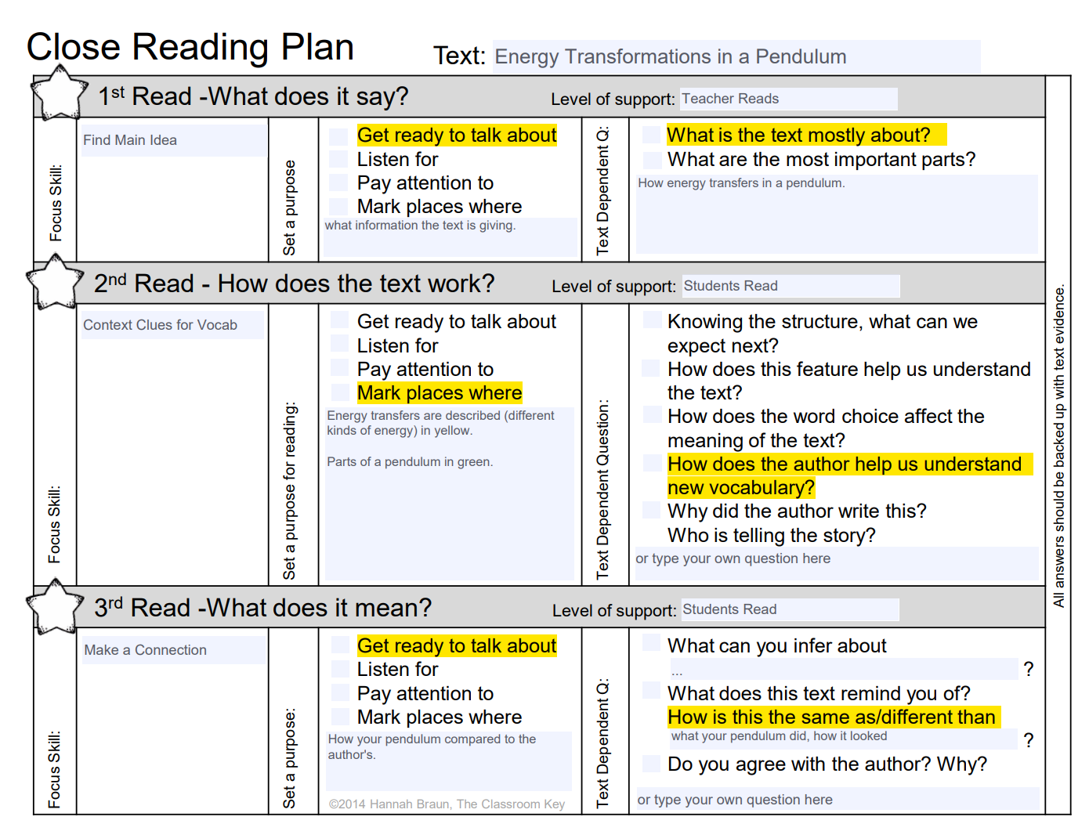
Close Reading
Notes:
Katrina
See “Planning for Close Reading” slide for link to editable planning sheet.

Slide 16
Visual Literacy
Describe to a partner what the diagram shows.
What do the arrows represent?
Based on the reading, what other labels could you add to the diagram?
Should you use arrows to point those out? Why or why not?
What should the title of the diagram be?
Notes:
Katrina

Slide 17
Vocabulary: Word Walls
Interactive
Should not be static “decorations” in the classroom.
Should be dynamic constructions that reflect the learning taking place.
Should be student generated and organized.
Should be used daily by students during whole group, small group, and individual work.
Video Resource for Interactive word walls along with examples: https://youtu.be/zuaOjtk9QoM
Notes:
Katrina
The Building Word Walls Article is only available in hard copy received today.
Excellent video that explains interactive word walls and shows examples: https://youtu.be/zuaOjtk9QoM

Slide 18
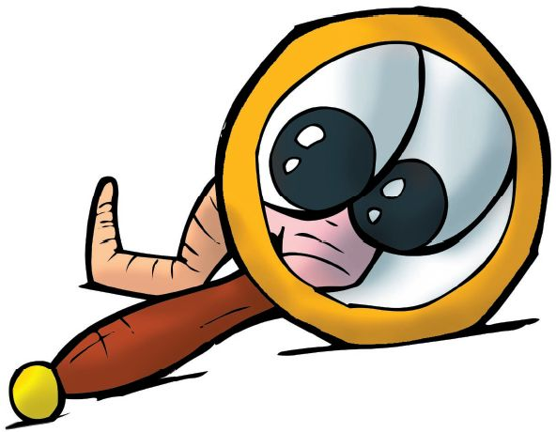
Writing a scientific observation
I observed
The reminds me of because . When
. When .
I am curious about . I wonder what would happen if .
Mini Lesson on Writing a Scientific Observation: https://docs.google.com/document/d/1Zhzpd9tcvYTHOZ7r5JjmrzuCgvvxavnfde91rvv8zcs/edit?usp=sharing
Notes:
Katrina
Link to Mini lesson on writing a scientific observation: https://docs.google.com/document/d/1Zhzpd9tcvYTHOZ7r5JjmrzuCgvvxavnfde91rvv8zcs/edit?usp=sharing

Slide 19
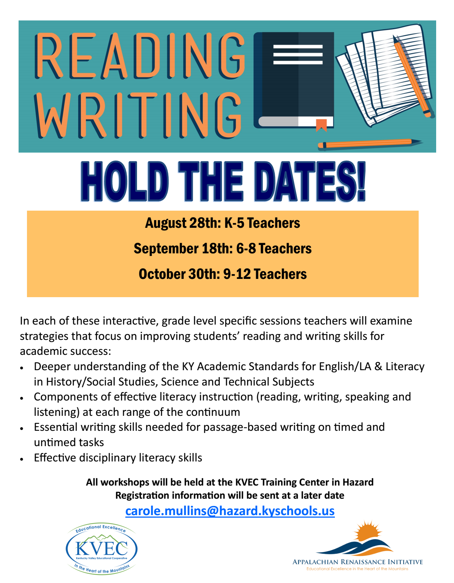
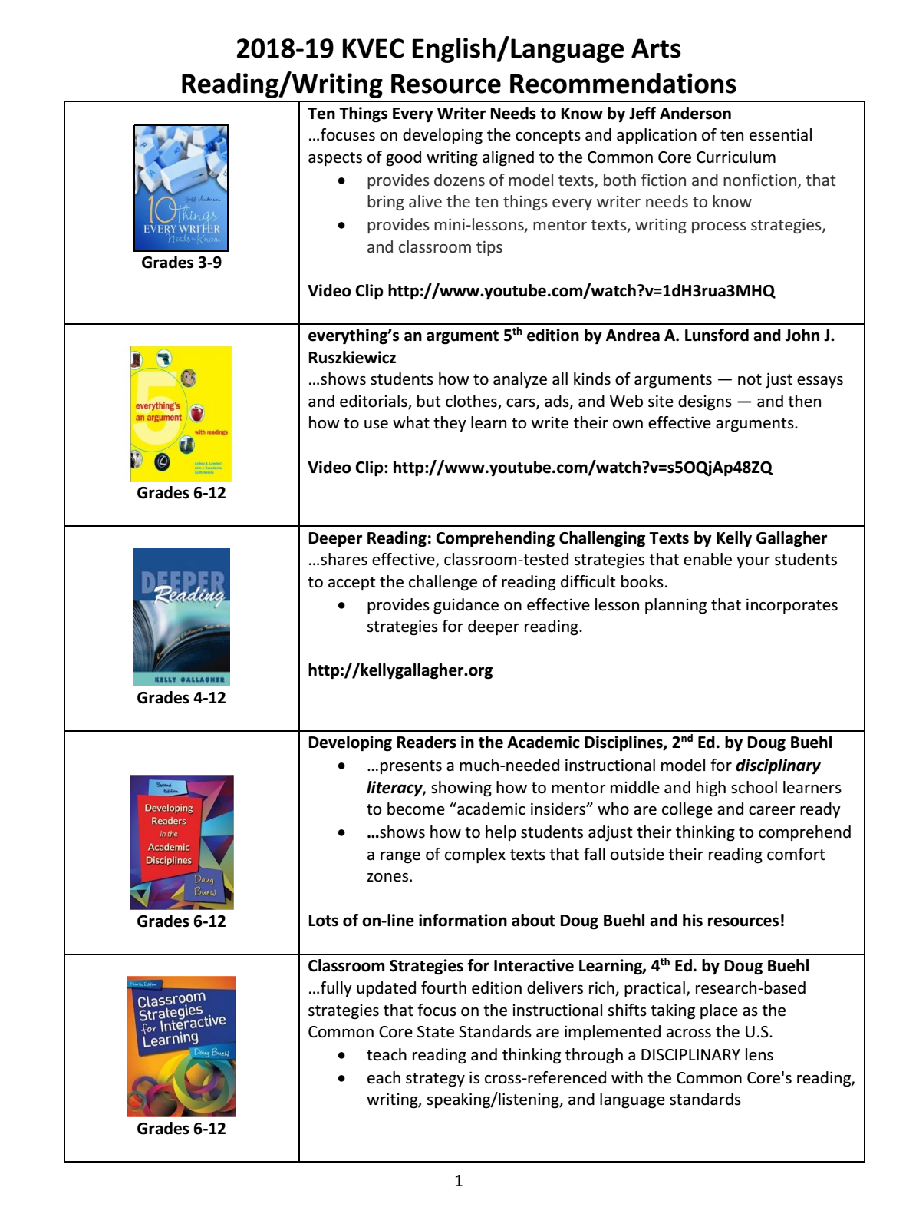

Additional Resources
What Close Reading Actually Means
By Grant Wiggins
https://www.teachthought.com/literacy/what-close-reading-actually-means/
www.kvecelatln.weebly.com
https://achievethecore.org
https://achievethecore.org/aligned/five-places-for-trusted-resource-recommendations/
https://achievethecore.org/aligned/welding-literacy-scientific-instruction/
Notes:
Carole DISTRIBUTE FEEDBACK HANDOUT!

Slide 20

Carole Mullins, NBCT
KVEC Literacy Instructional Specialist
carole.mullins2@hazard.kyschools.us
Dionne Bates, Ed. S.
KVEC Achievement Gap Specialist, Literacy
dionne.bates@hazard.kyschools.us
Kim Sergent
KVEC Social Studies Instructional Specialist
kimberly.sergent@letcher.kyschools.us
Katrina Slone, Ed. D
KVEC Science Instructional Specialist
katrina.slone@hazard.kyschools.us
Rebecca King
Teacher, Pikeville Independent Schools
rebecca.king@pikeville.kyschools.us
www,kvecelatln.weebly.com
Notes:
Carole

