Slide 1


Reaching for Proficiency Across the Curriculum:
Grades 9-12 High-Impact Literacy Instruction in English/LA,
Science and Social Studies
October 30, 2018
Notes:
Carole
Table Tents for Participant Seating: English/LA, Science and Social Studies
Welcome and Introductions:

Slide 2
“He who dares to teach, must never cease to learn. ”
~John Cotton Dana
Notes:
Carole
We owe this to the students we teach and future generations!

Slide 3

Work within the Kentucky Academic Standards for English/LA and Literacy in History/Social Studies, Science & Technical Subjects
Essential Writing Skills for passage-based writing in all subject areas in both timed/untimed tasks
Share High-Impact/Rigorous strategies and ideas for engaging students in the application of the standards in all subject areas
Notes:
Carole
Everything we do today addresses the skills students need to become better writers in timed and un-timed situations as well as learn the content!!!
To some, disciplinary literacy sounds like one more thing to do, but that is not the intention nor the case.
Academic learning for reading, writing, listening, speaking and thinking are not just in the realm of the language arts teachers. It happens in all grades and in all disciplines.
By helping your students become more literate in your discipline, you will strengthen their learning of the content and subject matter.

Slide 4

What Does It Mean to be College & Career Ready?
The larger goal of college and career readiness requires schools to enable all students to:
  master core content
  develop key cognitive strategies
  take ownership of their learning and become proficient with a range of learning strategies
  acquire the privileged knowledge necessary to make a successful transition from secondary to postsecondary education
David T Conley, PhD
CEO, Educational Policy Improvement Center (EPIC)
Professor, University of Oregon
Notes:
Carole

Slide 5

Prior to development of Standards, specific problems were identified…
Significant numbers of students who are deemed literate are not sufficiently literate to succeed in college or career
According to NAEP, there have been clear reading improvements among fourth-graders since 1992. And yet, middle school students are reading no better than 4th graders and high school students appear to have fallen
Many instructional strategies include ways of getting info to students without texts (e.g., lecture only, powerpoint, video) and omitting the reading of text
But, ACT research has found that the amount of text reading between 7th and 12th grades was the best preparation of later success
Notes:
Carole
Prior to and during development of the CCSS… Here are a few…
Avoiding Text

Slide 6

Elevating Literacy And Literacy Instruction
Up Through The Grade Levels
ACT found that state standards did not take specific
Reading standards through high school.
The Kentucky Academic Standards (KAS) for English/LA and Literacy in the Content Areas changed this fact. We now have…
  Grades 6-12:
  10 Reading and 10 Writing Standards specific to
  History/Social Studies, Science and Technical Subjects
These standards are meant to complement the specific content demands of the disciplines, not replace them!
Notes:
Carole
Intent of the KY Academic Standards for ELA and Literacy in the Content Areas:
Standards set requirements not only for ELA, but also for literacy in history/social studies, science, and technical subjects.
“Just as students must learn to read, write, speak, listen, and use language effectively in a variety of content areas, so too must the Standards specify the literacy skills and understandings required for college and career readiness in multiple disciplines.”

Slide 7
College and Career Readiness Standards
English Language Arts
Literacy in History/Social Studies, Science, and Technical Subjects
Reading (20)
1)Informational (10)
2)Literary (10)
Writing (10)
Speaking & Listening (6)
Language (6)
Reading (10)
Writing (10)
K-5 Reading Foundational Skills (4) (Encompass the 5 Essential Components of Reading)
Same Skills, Different Approach !
Notes:
Carole
Visual Chart of the key design…
Fewer and Broader… This means that teachers must design more rigorous tasks to help students achieve learning at a higher level… By themselves, the standards WILL NOT improve student learning!!!
The overarching skill emphasized in the ELA standards is COMPREHENSION at its highest level: ANALYSIS, CLASSIFICATION, ABILITY TO COMPARE/CONTRAST, SYNTHESIZE
Reading has 20 standards that are sub-divided into informational and literary text and each has10 standards (each connects back to its corresponding CCR anchor)
10 standards for writing
6 Standards for Speaking and Listening
6 Standards for Language
4 Reading Foundational Skills
10 standards for reading and 10 for writing: Content Specific Literacy Standards

Slide 8
Reading and Writing Standard #1
KY Academic Standards for English/LA and Literacy in the Content Areas
Notes:
Carole HANDOUTS
ELA Reading and Writing Standard #1 and Reading Standard #10
Full Progressions Document is posted on www.kvecelatln.weebly.com under the “Standards” tab

Slide 9
Distribution of Literary and Informational Passages by Grade in the NAEP Reading Framework
GRADE | LITERARY | INFORMATION
4 | 50% | 50%
8 | 45% | 55%
12 | 30% | 70%
The Standards aim to align instruction with this framework so that many more students than at present can meet the requirements of college and career readiness.
ELA CCSS Page 5
Notes:
Carole
Students who were successful on NAEP were found to spend a high percentage of time reading informational passages.
The percentages on the table reflect the sum of student reading, not just reading in ELA settings.
At the HS level:
Because the ELA classroom must focus on literature (stories, drama, and poetry) as well as literary nonfiction, a great deal of informational reading in grades 6–12 must take place in other classes if the NAEP assessment framework is to be matched instructionally.
It is a shared responsibility!!

Slide 10

Why more informational text?
Increases students’ access to text that will help them increase their vocabulary, general knowledge, language and reasoning abilities
Student’s build knowledge of the world and the disciplines.
Is an opportunity for students to learn how to engage, interact, and have “conversations” with the text in ways that prepare them for the type of experiences they will encounter in college and careers and real life.
Notes:
Carole
In addition to the need for students to read college and career level text by the time they graduate,
informational text increases students’ access to text that will help them increase their vocabularies, general knowledge, language and reasoning abilities.

Slide 11
Distribution of Communicative Purposes by Grade in the NAEP Writing Framework
GRADE | TO PERSUADE Opinion/Argumentation | TO EXPLAIN Info./Exp. | TO CONVEY EXPERIENCE Narrative
4 | 30% | 35% | 35%
8 | 35% | 35% | 30%
12 | 40% | 40% | 20%
It follows that writing assessments aligned with the Standards should adhere to the distribution of writing purposes across grades outlined by NAEP.
ELA CCSS Page 5
Notes:
Carole Let’s now look at Writing
As with reading, the percentages in the table reflect the sum of student writing, not just writing in ELA settings.
ONE REASON FOR THIS SHIFT IN THE ORGANIZATION OF WRITING STANDARDS IS TO BETTER PREPARE STUDENTS COLLEGE AND CAREER WRITING
Notice the decreasing emphasis on narrative writing that students do in school. THOSE PERCENTAGES DO NOT REPRESENT AN ELA CLASSROOM IN ISOLATION.

Slide 12
http://www.smekenseducation.com/Argumentative-v-Persuasive-Writ.html
Notes:
Carole: HANDOUT
Because Interpreting expectations among the types of argument (e.g., opinion, persuasive, argument, etc.) can be difficult, I want to share this handout with you…
Begin first by outlining the subtle, but significant differences among them.
This chart is helpful to compare what students already know about persuasive writing as you introduce them to the new and less familiar concepts of argumentative writing

Slide 13
Argumentative Writing has a Distinct Purpose in the standards: It forces a writer to evaluate the strengths and weaknesses of multiple perspectives.
When teachers ask students to consider two or more perspective on a topic/issue, something far beyond surface knowledge is required: students must think critically and deeply, assess the validity of their own thinking, and anticipate counterclaims in opposition to their own assertions”
“…the proper context for thinking about argument is one in which the goal is not victory, but a good decision. One in which all arguers are at risk of needing to alter their views, one in which a participant takes seriously and fairly the views different from his or her own”
CCSS Appendix A; Pages 24 and 26
Notes:
Carole
In the standards…

Slide 14
Argumentative Writing… | Informational/Explanatory Writing…
uses FACTS and OPINIONS to convince the reader that the author is right includes a TYPE OF THESIS; the difference is that the thesis of argumentative writing is called a CLAIM. seeks to persuade by convincing the reader to perform an action or convince the reader of their point of view. the student’s job is to give reasons for believing or doing something with supporting evidence. | uses FACTS to explain to an audience a given topic/issue will include a THESIS STATEMENT; the author will explain the thesis to the reader in the body paragraphs does not allow for your own view about the topic/issue the student’s job is to EXPLAIN. That is it!
Narrative Writing is Embedded into Both
Adapted from: https://prezi.com/f9xymf6sfrki/informative-vs-argumentative/
Notes:
Carole
WRITING AND ASSESSMENT
There are 3 Modes of Writing in the KAS, but for MS/HS these are the most important modes!!
With argumentative writing, the aim is to get people to believe that something is true.
With explanations, the aim is to answer questions about why or how because truthfulness is assumed.
Argument seeks to persuade; explanation seeks to create understanding.

Slide 15
Literacy Design Collaborative (LDC) Rubrics
Create a Free Account and Join Core Tools!
www.ldc.org
Notes:
Carole
We have the KDE ODW Rubric…
LDC rubrics as a resource: These rubrics are more aligned for use as a formative assessment tool during instruction of writing…

Slide 16
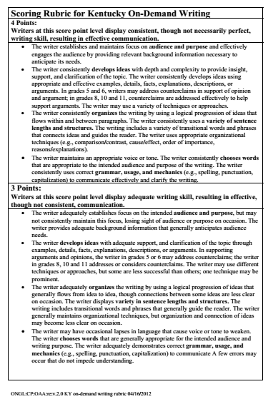
KY On Demand Writing Rubric
A student written response CANNOT score a 3 or 4 without a thesis/claim and appropriate supporting evidence from the text/task.
In to meet the criteria of a 3 or 4 the student MUST:
Establish and maintain a focus on the intended audience and purpose. Without a thesis statement/claim there is no focus!
Develop ideas with depth and complexity; Show evidence of deep analysis and insight; Something they learned/gleaned from the text/task.
Higher level vocabulary: Chooses words that are appropriate to the audience
Include logical progressions of ideas which includes transitional words and phrases
Demonstrates correct grammar, usage and mechanics
Notes:
Carole

Slide 17



Appendices of the Standards
Appendix C:
Annotated Writing Samples at Various Grade Levels
Appendix A:
Supplementary Materials and Glossary
Appendix B:
Text Exemplars and Sample Performance Tasks
www.corestandards.org
Notes:
Carole
3 Appendices:
A: Supplementary materials and a glossary (43 pages)
B: Text exemplars illustrating complexity. text complexity is measured by 3 factors
qualitative evaluation (levels of meaning, structure, language conventionality, and clarity, and knowledge demands)
quantitative evaluation (readability, and other scores of text complexity), and matching reader to text and task (reader variables such as motivation, knowledge and experience, and task variables such as purpose and complexity generated by task assigned or question posed)
quality and range of reading for grade levels (includes text types for K-5 and 6-12 bands in these broad categories: stories, dramas, poetry and literary nonfiction/(historical, scientific and technical texts for K-5 only)
Accompanying Sample Performance Tasks (183 pages)
C: Annotated samples demonstrating at least adequate performance in writing at various grade levels (106 pages)

Slide 18

Summary of the “Biggest” Instructional Shifts
Regular practice with complex text and its academic language
Reading, writing and speaking grounded in evidence from text, both literary and informational
Building knowledge through content-rich nonfiction
Always ask yourself this question!
HOW does my INSTRUCTION support the ideas of these shifts?
Notes:
Carole: 6 Major Shifts…
The shifts are a high-level summary of the biggest changes signified by the standards
They represent the most significant shifts for curriculum materials, instruction, student learning, and thinking about assessment.
Taken all together, they should lead to desired student outcomes.
Communicate the shifts to everyone who will listen! Everyone working in your school and district should have a solid understanding of the shifts required in ALL content areas.
SHIFT #1:
Increased emphasis on reading informational text and an increase in the level of text complexity
SHIFT #2:
Most college and workplace writing requires evidence.
Understand the importance of argument and evidence in the standards.
Evidence: Most of the Standards focus on the gathering, evaluating and presenting of evidence from text.
SHIFT #3:
ASSESSMENTS will require a high and increasing proportion of informational text as students advance through the grades.
Students learning to read should exercise their ability to comprehend complex text through read-aloud texts
Reading aloud texts that are well-above grade level should be done throughout K-5 and beyond!

Slide 19

What are the Qualitative Features of Complex Text?
Subtle and/or frequent transitions
Multiple and/or subtle themes and purposes
Density of information
Unfamiliar settings, topics or events
Lack of repetition, overlap or similarity in words and sentences
Complex sentences
Uncommon vocabulary
Lack of words, sentences or paragraphs that review or pull things together for the student
Longer paragraphs
Any text structure which is less narrative and/or mixes structures
Notes:
Carole HANDOUT
Complex text contains any and all combinations of these features in many different combinations.
The complexity level is determined by both quantitative and qualitative measures.
The details of text complexity are well described in Appendix A of the Standards, one of the supplemental readings offered with this module.
New tools have been developed since the Standards were developed to help determine qualitative text complexity. Those materials are available on www.achievethecore.org
Students who struggle with reading almost always have gaps in their vocabulary and their ability to deal with more complex sentence structures. This is well documented in research. Please remember that they cannot address gaps in their vocabulary and develop skill with unpacking complex syntax text when they are not given the opportunity to work with material that provides these opportunities.
Too often, less proficient students are given texts at their level where they do not see these features, where the demands of vocabulary and sentence structure are lowered. Though this is done for the kindest of reasons, it has disastrous consequences. Day by day, differentiating by level of text during instructional time increases the achievement gap between high performers and those who struggle.
With that said, there is a place for providing students with text more appropriately matched to their individual reading abilities to build fluency and provide opportunity for increasing the volume of reading. But those texts cannot be the primary texts for instruction.

Slide 20

Scaffolding Complex Text
Standard #10 requires that students read appropriately
complex text at each grade level – independently.
Instructional Practices that have a strong research base for effectively supporting student learning WHILE they read:
Multiple readings = Close Analytical Reading (Close Reading Strategy)
Read Aloud
Chunking text (a little at a time)
Notes:
Carole
This does not mean students do this without any support! It is essential that teachers and instructional material provide scaffolds to support ALL students in comprehending complex text.
These scaffolding types will reliably support many students and a has a strong research base:
Multiple readings. Complex text takes multiple reads to fully understand the layers of meaning provided by the author. Because of this, the text selected for close reading should be excellent or they will not be worthy of the time commitment they require to read fully. Re-reading assists fluency and is the primary way readers make sense of challenges encountered when reading.
Reading the text aloud while students follow along . Fluency challenges are rampant when students encounter grade level appropriate text. All teachers must be aware of this and reach in to help. The two best ways to help are having the students follow along while the text is read aloud and by reading text multiple times. (These two methods are systematically built into the close reading model included in this module.)
Read aloud of complex text is especially important for early readers K-2 because the work of the standards is too complex to apply to the texts students can read on their own, and students cannot develop academic language through the texts students can read on their own at these grades (levels); for all practical purposes read aloud provides students who come to kindergarten with less developed academic language with a way to catch up.
“Chunking” longer text into smaller and logical sections makes the text more manageable and helps demonstrate how the author structured the text.
Careful, text-specific questions point readers to challenging sentences and ask for special attention to be paid to them. They direct students to what matters most and asks them to examine those parts. They also pay particularly close attention to vocabulary that can be figured out in the context of the text. Because they require text evidence, they demand re-reading.
Pointing out text structures or features that will either provide comprehension support (like section headers) or challenges (like long paragraphs or sentences).
Supports that do not promote improved reading incomes and do not have research support behind them:
Previewing the topic of the reading in a text-free way (just “teacher talk”). A careful examination of the text is solid practice. But telling students what they will be reading before they read will remove any motivation for discovering it for themselves and it will teach students that learning from reading is not a central activity in that classroom.
Providing simple text to weak readers and complex texts to strong readers. Differentiation by text type, as opposed to providing a variety of supports for the same complex text, leads to the “Matthew Effect” – “to those who have, more will be given. To those who have little, even that little will be taken away,” a well-researched finding. This is particularly true because of the differences in vocabulary that students will see from simpler to more complex text. Words create much of the differences in texts.
The goal is growing independence with increasingly complex text. The strategies implemented should all aim at getting students stronger and more skilled – like exercises and scrimmages in a sports practice.

Slide 21

Close Analytic Reading
Requires prompting students with text-dependent questions to unpack complex text and gain knowledge
Rigorous text-dependent questions require high-level text-based answers
Not teacher summarizing text, but guiding students through the text
Virtually every standard is activated during the course of every close analytic reading exemplar through the use of text dependent questions.
Notes:
Carole
Close reading hones in on difficult portions of text, and provides students an opportunity to work with those sections.
Close reading opposes "think aloud," where teacher explain these difficult portions before students have had a chance to learn from them on their own.
Not only is virtually every standard evident when students close read – the 3 shifts required by the standards are evident as well!
When reading appropriately complex non-fiction or literature, ask students to respond the text-dependent questions about the text.

Slide 22

Standards that Directly Emphasize
Argument and Citing Textual Evidence
Reading Literary and Informational Standard 1
Read closely to determine what the text says explicitly-to make logical inferences from it; cite specific textual evidence when writing or speaking to support conclusions drawn from the text.
Writing Standard 1
Write arguments to support claims in an analysis of substantive topics or texts, using valid reasoning and relevant and sufficient evidence.
Writing Standard 9
Draw evidence from literary or informational texts to support analysis, reflection, and research.
*Speaking & Listening Standard 3
Evaluate a speaker’s point of view, reasoning, use of evidence and rhetoric.
*Speaking & Listening Standard 5
Present information, findings, and supporting evidence….
Notes:
Carole
FYIs for PLCs, etc.
*Not a part of the 6-12 standards in H/SS, Sci and Tech Subjs., but still important for CCR!

Slide 23

Classroom Instructional Practices that Support Text-Based Reading Instruction and Student Written Responses
Close reading
Select works that are worth teaching in depth
Create interesting sequences that draw students into the texts
Pre-teach vocabulary and/or background and scaffold the texts to make them accessible to students without pre-teaching the content of the texts
“Step back” and allow the readers space and time to experience the texts
Students have rich and rigorous conversations which are dependent on students reading a central text
Set up questions so students make their own judgments and back them up with evidence from the text
Notes:
Carole
FYIs for PLCs, etc.
These are several classroom practices that keep reading instruction closely connected to the text and allow students to generate their own judgments, supporting them with text-based answers.
Teacher modeling demonstrates what a “close read” might entail.
The literary and informational texts, or passages from longer works, merit the close attention and time devoted to them, and questions relating to them are ones worth consideration.
Pre-reading activities that activate prior knowledge and create a connection (or a “hook”) for students derive from the texts themselves rather than focus outward on external connections, experiences, etc.
Scaffolding and pre-teaching vocabulary and essential background make the text accessible to students; they do NOT pre-teach the content of the text.
Sufficient time is allotted for students to access, consider, and respond to texts.
Students have rich and rigorous conversations which are dependent on students reading a central text.
Among the myriad related activities possible, the teacher chooses ones that stay closely related to the texts.
“Finally, all students should have the opportunity to formulate and support with textual evidence their own conclusions – not just ones they have heard from the teacher or other students.”

Slide 24

Sample: Quick Annotation Strategy
? = Ask a question
“The text mentions a DNA study. What does DNA stand for?”
!!! = Note an interesting passage
“I didn’t realize that tapeworms can grow to 23 meters!”
C = Connection to another text or piece of evidence
“The Ebola virus is like the AIDS virus we read about yesterday because….”
(check)= Access prior knowledge; I already knew that!
“I knew that photosynthesis required water.”
X = Challenge your own thinking, new information
“I had no idea that Nobel invented dynamite.”
* = Reason that looks important
“I’ll need this piece of evidence about Triceratops to support my thesis.”
"Box it" = Remember words you don't know, are repeated, or you just like
“I’ve seen the word ignominious several times, and I need to look it up.”
Notes:
Carole HANDOUT
Give students “Guidelines” to strategically guide them through the Annotation Process

Slide 25

Why is Text-Dependent Questioning Important?
Students make meaning:
Text dependent questions ensure that discussions and writing prompts focus on the text itself to build a strong foundation of knowledge.
Text dependent questioning keep students in the text longer for deeper understanding of authors’ purpose, meaning and craft.
Text dependent questions move students from literal to inferential and critical levels of meaning
Text Dependent Questions moves students systematically across a continuum of increasingly complex cognition.
Notes:
Carole
Shift #2 Requires a Good Progression/Sequence of Text-Dependent Questions & Answers
This slide came directly from a CollegeBoard training power point

Slide 26
Shift #2 Requires a Good Progression/Sequence of
Text-Dependent Questions & Answers
Deep analysis
Opinions/Arguments; intertextual Connections
Inferences
Author’s Craft and Purpose
Key Details
General Understandings
Vocab & Text Structure
Standards
What does the text inspire you to do? “APPLICATION”
8 & 9
What does the text mean? “Interpretation”
3 & 7
6
How does the text work? “Investigation”
4 & 5
2
What does the text say?
“INSPECTION”
1
Fisher, D and Frey, N. Text-Dependent Questions. 2015
Basic, surface-level comprehension
Notes:
Carole (This info came from a CollegeBoard training power point that includes the work of Fisher/Frey)
Shift 2 states: Reading, writing and speaking grounded in evidence from text, both literary and informational
HANDOUTS : Creating TDQs and Types of TDQs and CCSS Aligned Text Dependent Questions
WHEN SEQUENCING QUESTIONS, LET THE TEXT BE THE GUIDE, START WITH WHAT’S EXPLICIT, MOVE TO WHAT’S IMPLICIT:
General understandings. These questions ensure that students grasp the overall view of the text.
Key details. These text-dependent questions require that readers pay attention to the details.
Vocabulary and text structure. These text-dependent questions focus on the specific words and phrases the author uses as well as the structure of the text.
Author’s purpose. Although often not specifically stated, there is a purpose for each text.
Inferences. Inferences are more than guesses or simply telling students to “read between the lines.” Text-dependent questions should allow students to consider the information that is provided and then make informed extrapolations from the information provided.
Opinions, arguments, and intertextual connections. The final category of text-dependent questions are often the questions that teachers like to ask because these questions tend to generate a lot of discussion and personal connections. When they follow a discussion built on text-dependent questions, they work well for this purpose. If they are used in place of text-dependent questions, the risk is that students will answer and not need to read the text.

Slide 27

A Brief Evaluation of a TDQ
Does the question take the student back to the text?
Does the student have to read the text to answer each question?
Is it clear to students that answering each question requires that they must use evidence from the text to support their claims?
Are the inferences students are asked to make grounded logically in the text (Can they be answered with careful reading rather than background knowledge)?
Do questions provide an opportunity for students to determine the meaning of academic vocabulary in context? When possible, do some of these questions explore some aspect of the text as well as important vocabulary?
Are the questions coherently sequenced? Do they build toward gradual understanding of the text’s meaning?
Notes:
Carole This slide also came directly from a CollegeBoard training power point
Evaluating a teacher-developed TDQ…

Slide 28

Summing Up Importance of the
3 “Biggest” Instructional Shifts
All Teachers Support Literacy
This interdisciplinary approach to literacy stems from extensive research establishing the need for college and career ready students to be proficient in reading complex informational texts, independently, in a variety of content areas.
Most of the required reading in college and workforce training programs is informational in structure and challenging in content.
Notes:
Carole
Postsecondary education programs typically provide students with both a higher volume of such reading than is generally required in K–12 schools and comparatively little scaffolding.
The reading framework of the National Assessment of Educational Progress (NAEP) requires a high and increasing proportion of informational text on its assessment as students advance through the grades.
The standards have followed the NAEP (National Assessment of Educational Progress) guidelines in establishing how much informational text students should read in school.
ACT and K-PREP

Slide 29
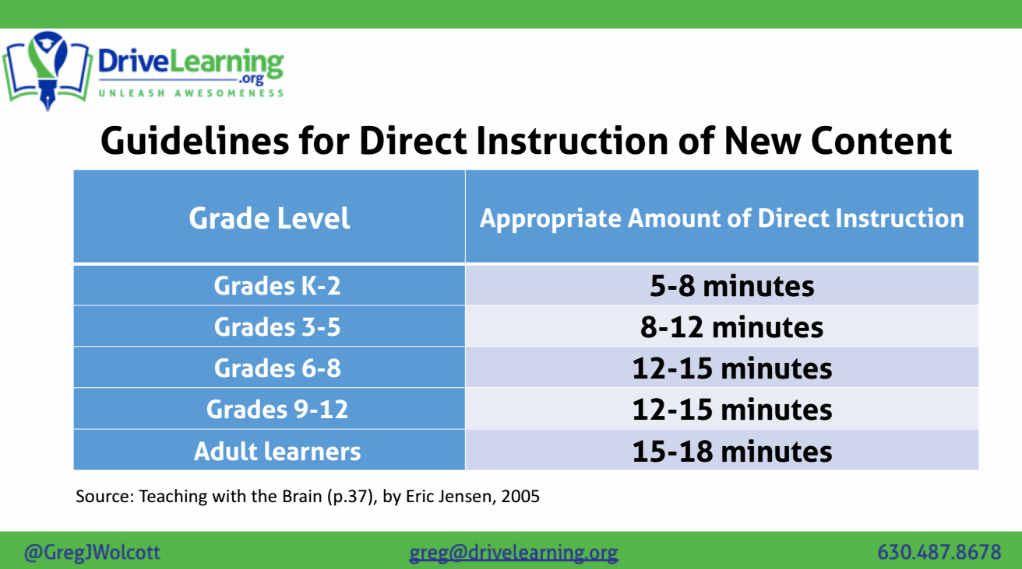
http://www.jensenlearning.com/wp-content/uploads/
2016/07/10MostEffectiveTips.pdf
Notes:
Carole
Article Link: Jensen Learning Guide To Brain-Based Teaching: TOP 10 Brain-Based Teaching Strategies
#6:
New evidence: value of teaching content in even smaller chunk sizes
Outdated science of thinking that brain can hold 7+ chunks of info in the head as capacity for working memory
New research says 2-4 chunks are more realistic
Here’s the guideline:
the less background the learner has and the greater the complexity of the content, make the time chunk of content shorter (use 4-8 minutes).
the greater the background knowledge, the less the complexity, the longer you can make the “input” stage (8-15 min. is acceptable).
“Under no condition, should there be more than 15 consecutive minutes of content input. Share this with your teachers. But share it in a small chunk, and then allow time for processing it.”

Slide 30

Kentucky Academic Standards
The standards consist of multiple dimensions or layers
MULTIDIMENSIONALITY
Green (italic) = Comprehension Purple (bold) = Analysis
MAROON (CAPS) = CONTENT
  CITE RELEVANT AND THOROUGH TEXTUAL EVIDENCE to support analysis of what the text says explicitly as well as inferences drawn from the text.
Notes:
Carole HANDOUTS: Packet of Standards 1-10
Refer participants to Handout:
“Think Time” Activity:
Have participants read the Multidimensional Explanation at bottom of page…
Share thoughts with others at table
Walk-through sample Sci/SS Standard #1 to explain multidimensionality

Slide 31

Analyzing the KAS for Literacy in History/Social Studies, Science and Technical Subjects
Instructions
Highlight the INCREASE IN COGNITIVE DEMAND (Progression of Difficulty)
Identify the ESSENTIAL SKILLS and CONCEPTS needed to master this standard
Identify the ACADEMIC VOCABULARY that must be taught by the teacher
Notes:
Carole: Packet Handout
ELA teachers will be divided to work with SS or Sci teachers
Standards #2-9 will be divided among each of the content groups
Using the assigned standard, teachers will follow directions on the screen and analyze one standard (Posters containing the grade 6-8 analysis will be available if a group chooses to review it…
Groups will chart their work and post on wall
Participants are encouraged to continue this work at their individual schools (PLCs, etc.)
Samples and Standards Documents

Slide 32
Ready.Set.Write.
Consider the Writing Situation and Task. Determine each of the following:
Subject- (What is the question you are asked to explain? Form this answer as a question!)
Type- (What type of writing will you do? Essay, speech, email, letter, article,blog?)
Role-(What is your role as the writer? Student, son, daughter, volunteer, citizen, athlete, friend, or employee)
Audience--(To whom are you writing? Hint: The writing situation will give you enough information to infer this.)
Purpose--(For what purpose will you write? To inform, to explain, to defend a position?)
Notes:
Rebecca: HANDOUT

Slide 33

S. T. R. A. P
What essential WRITING SKILLS do students need in order to effectively respond to a timed/untimed writing task in any subject area?
Notes:
Rebecca

Slide 34


Determine the exact/specific question you need to answer.
S=
Notes:
Rebecca

Slide 35

Writing Task
Recent studies show that plastic straws are the 11th most found ocean trash and have a significant negative impact on marine life. Our city council is considering a measure to ban the use of straws in restaurants within the city limits. The local newspaper invites members of the community to agree or disagree with this measure in letters to the editor which will be printed in next week’s issue.
A. Straws
B. Plastic Straws
C. The city should or should not ban
plastic straws from restaurants
within the city limits.
Notes:
Rebecca
After explaining to students that they must determine the specific question which is being asked in the task. Read the task aloud and have students choose the correct answer from the multiple choice answers provided. Do this on individual cards or paper to help all students make a decision.

Slide 36

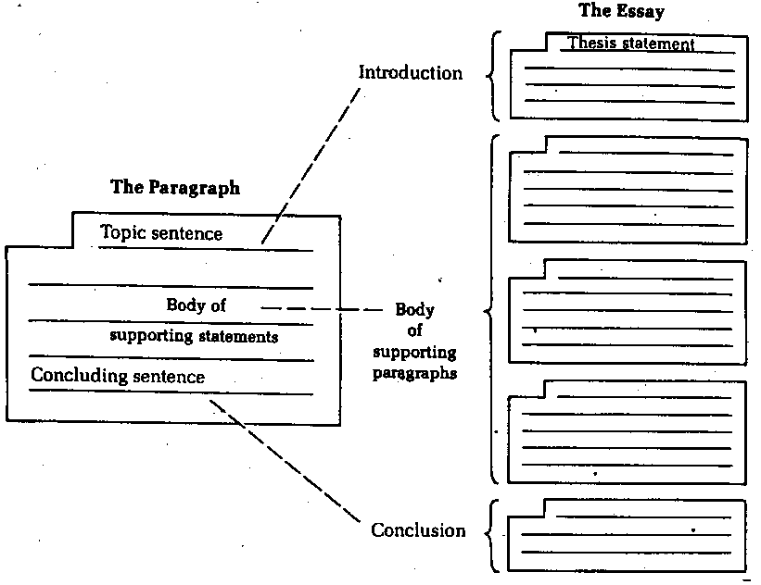
T=
Notes:
Rebecca
While there are many types or forms which writing may take, they all share the structure of an essay: Introduction, Body, Conclusion. These parts may be longer or shorter in various types of writing, but close analysis will show that letters, emails, blogs, articles, and editorials all contain these basic parts.
Because of this, helping students to master essay writing is the key to success in writing in a timed or untimed situation.
The next step is to help them recognize and apply the characteristics of different genres of writing. At each grade level, this work is different--but the goal is the same. For example, if K-1 students can learn to write a topic sentence the foundation is laid for 2-3 teachers to help them master a paragraph structure. In 4-5, students will have the skills needed to develop 3 paragraph essays and recognize and apply the characteristics of different genres of writing.

Slide 37

Becky King
3666 Millers Creek
Pikeville, Kentucky 41501
Rick Brown
26 May Street
Cambridge, NH. 5433
Dear Mr. Brown:
As a result of our meeting yesterday, I have decided to accept your offer to purchase my house because yours is the most reasonable and you seemed to genuinely love my house.
I have enjoyed many years of happiness in this home, and I feel that you recognized its charm immediately. It makes it easier for me to accept an offer from someone who appreciates the special qualities of this house.
As we discussed, I will expect 275,000.00 for my property. I am enclosing the contract which my lawyer has prepared. Please read it over, and if it meets your approval, sign and return it to me.
I look forward to hearing from you soon. Your purchase of this home will mark a new beginning for each of us.
.
Sincerely,
Becky King
Becky King
Notes:
Rebecca

Slide 38

R=
The different roles
we play.
Notes:
Rebecca
HANDOUT (Activity)

Slide 39


A=
A specific audience is one composed of people who share a common background or who have a common knowledge level.
A general audience is one composed of people from different backgrounds and with different knowledge levels.
Notes:
Rebecca After defining each type of audience ask participants to work together to label each of the audiences on the yellow page as specific or general and be prepared to discuss answers.

Slide 40

General Specific Audience
Answers
A conference of English professors.
The listeners of a Top 40 radio show.
The attendees at a 4th of July fireworks display.
The developers for a particular website.
The readers of a newspaper.
SPECIFIC
GENERAL
GENERAL
SPECIFIC
GENERAL
Notes:
Rebecca
Discuss answers as whole group.

Slide 41

P=
To inform or explain
To support a point of view
https://www.youtube.com/watch?v=JKFu-2gjjo0
https://www.youtube.com/watch?v=ThIrw_LpuRA
Notes:
Rebecca
Strategy: Give participants a two column index card and ask them to decide which video is primarily informative/explanatory writing and which is persuasive---they should cite evidence from the video to support their choice.

Slide 42
STRAP | When considering a Writing Situation and Task, determine each of the following:
SUBJECT | What topic are you to address?
TYPE | What format should your writing take?--- essay, email, letter, article, etc.
ROLE | From what role will you write? student, son, daughter, volunteer, citizen, athlete, employee, etc.
AUDIENCE | To whom are you writing? HINT: The writing situation will GIVE you this information.
PURPOSE | For what purpose do you write? To inform or explain or to support a point of view.
STRAP adapted from The Write Source. 2007
Notes:
Rebecca

Slide 43


Composing a Strong Thesis!
Provide a road map for your essay...
Notes:
Rebecca

Slide 44
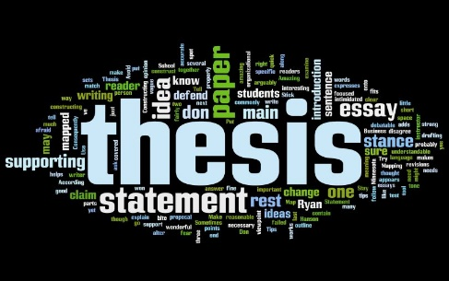
3-Part Thesis Statement
In Stephen King’s “Strawberry Spring”, the narrator is unreliable because he is an insane murderer.
OR
While many argue against the use of cellphones in school, they are useful classroom tools because they provide access to the Internet, to 911, and to online learning tools.
OR
Although I grew up working on a tobacco farm, I knew from an early age farming was not for me because I loved reading and writing much more than cultivating tobacco.
Notes:
Rebecca

Slide 45

Condition Phrase:
Acknowledges the opposing claim, creates a context for your main idea or gives the title and author of the text to which you will refer
Although I grew up working on a tobacco farm, I knew from an early age farming was not for me because I loved reading and writing much more than cultivating tobacco.
Notes:
Rebecca

Slide 46
Condition Phrase:
Acknowledges the opposing claim, creates a context for your main idea or gives the title and author of the text to which you will refer.
In Stephen King’s “Strawberry Spring”, the narrator is unreliable because he is an insane murderer.
Notes:
Rebecca

Slide 47
Condition Phrase:
Acknowledges the opposing claim, creates a context for your main idea or gives the title and author of the text to which you will refer.
While many argue against the use of cellphones in school, they are useful classroom tools because they provide access to the Internet, to 911, and to online learning tools.

Slide 48

Claim: a statement of your position or main idea
Although I grew up working on a tobacco farm, I knew from an early age farming was not for me because I loved reading and writing much more than cultivating tobacco.
Notes:
Rebecca

Slide 49

Claim:
a statement of your position or main idea
In Stephen King’s “Strawberry Spring”, the narrator is unreliable because he is an insane murderer.
Notes:
Rebecca

Slide 50

Claim:
a statement of your position or main idea
While many argue against the use of cellphones in school, they are useful classroom tools because they provide access to the Internet, to 911, and to online learning tools.

Slide 51

Support:
1-3 reasons, pieces of evidence, or examples to support your claim
Although I grew up working on a tobacco farm, I knew from an early age farming was not for me because I loved reading and writing much more than cultivating tobacco.
Notes:
Rebecca

Slide 52

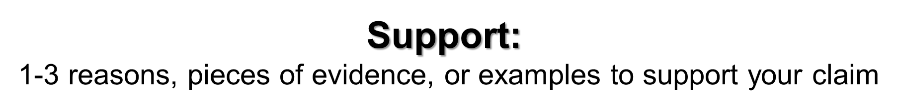
In Stephen King’s “Strawberry Spring”, the narrator is unreliable because he is an insane murderer.

Slide 53

While many argue against the use of cellphones in school, they are useful classroom tools because they provide access to the Internet, to 911, and to online learning tools.

Slide 54
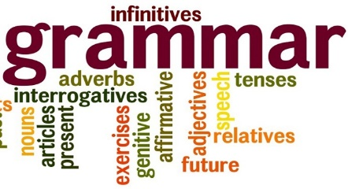
Grammatical Structure of the Thesis Statement
Dependent Clause: While some argue against the use of seatbelts,
Subordinating Conjunction comma
Independent Clause: seatbelts save lives
Dependent Clause: because they cut the risk of injury in a crash in
half and reduce the risk of ejection significantly. Period
Subordinating Conjunction
Notes:
Rebecca

Slide 55

Thesis Analysis Activity:
Read each thesis statement and label its parts.
If a statement is missing one of the 3 parts needed, as a group restructure the sentence so that is is correct.
Rank each thesis 1-10 with 10 being the STRONGEST thesis.
Be prepared to support your ranking.
Notes:
Rebecca: Handout for this activity---

Slide 56




T. E. A. A.
KKK
Notes:
Rebecca

Slide 57

Develop Your Thesis
While both William J. Brennan in his court opinion “from Texas vs. Johnson Majority Opinion” and Robert J. Allen in his editorial “American Flag Stands for Tolerance” agree that peaceful protest is protected by the First Amendment, the tone of each piece is different because Brennan uses formal language and Allen uses informal language.
Notes:
Rebecca

Slide 58
TEAA | Develop Your Ideas! All Body Paragraphs Should include:
Topic Sentence | A sentence that expresses the main idea of the paragraph in which it occurs. Generally, a topic sentence will focus on one point established in the thesis statement. This helps create a cohesive essay.
Example | A direct quote from the text provided for the task, a direct quote from an outside source, or a specific relevant example. Providing a direct quote helps establish authority of the author. Can also include statistics, facts, etc.
Analyze | To Analyze means to examine methodically and in detail the constitution or structure of (something, especially information), typically for purposes of explanation and interpretation. The analysis must answer this question: How do we know this supports/proves the thesis?
Address the Question | A sentence or two that make it clear that you have answered the question posed by the task---this will clearly tie back to the thesis statement.
Notes:
Rebecca HANDOUTS
TEAA and STUDENT ORGANIZER

Slide 59
Body Paragraph
Judge Brennan’s majority opinion is a legal document, and as such, it is written using formal language. For example, he uses words like, “conceded,” “constituted,” and “invoke.” While these words could easily have been substituted by simpler terms such as “gave in,” “made it,” and “appeal to,” respectively, he does not. The use of higher level word choice helps to reinforce the credibility of Brennan as a Supreme Court Judge, and it helps him to achieve his purpose of establishing a precedent for the issue of flag burning. Although Brennan’s diction is completely appropriate for his purpose, it creates a tone which is in stark contrast to that of Allen’s editorial.
Notes:
Rebecca
blue= topic sentence
orange=example
Green = analysis
yellow=address the question

Slide 60

Use the highlighters provided to color code the body paragraph which develops this thesis statement to determine if it meets the criteria outlined by TEAA:
Writing Task: Write an essay and analyze the difference in tone between the two texts. Please use specific, relevant evidence from the text to explain and support your thinking.
Thesis statement:
While both William J. Brennan in his court opinion “from Texas vs. Johnson Majority Opinion” and Robert J. Allen in his editorial “American Flag Stands for Tolerance” agree that peaceful protest is protected by the First Amendment, the tone of each piece is different because Brennan uses formal language and Allen uses informal language.
Notes:
Rebecca
Handout:

Slide 61

In my opinion…
I Feel…
I will be writing about…
I believe…
I think…
I am going to tell you…
Notes:
Rebecca

Slide 62
Who says what? Make it clear for your reader!
They Say/I Say Templates
The Most Important Templates:
On the one hand, __________. On the other hand, __________. Author X contradicts herself.
At the same time that she argues __________, she also implies __________.
I agree that __________.
She argues __________, and I agree because __________. Her argument that __________ is supported by new research showing that __________.
In recent discussions of __________, a controversial issue has been whether __________. On the one hand, some argue that __________. On the other hand, however, others argue that __________.
Notes:
Rebecca
Why Templates? Academic writing requires presenting your sources and your ideas effectively to readers. According to Graff and Birkenstein, the first element in the process involves “entering a conversation about ideas” between you—the writer—and your sources to reflect your critical thinking (ix). The templates allow you, the writer, to organize your ideas in relationship to your thesis, supporting evidence, opposing evidence, and the conclusion of the argument.

Slide 63
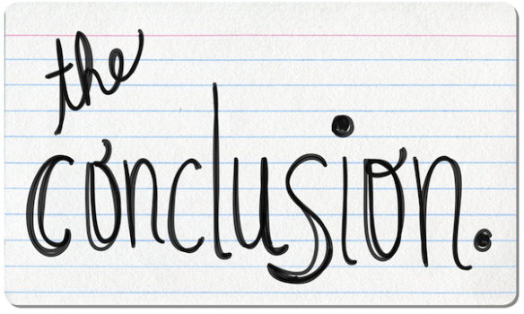
So What?

Slide 64

The end of an essay should therefore convey a sense of completeness and closure as well as a sense of the lingering possibilities of the topic, its larger meaning, its implications: the final paragraph should close the discussion without closing it off.
Why does what you said matter?
How does what you said address the question?

Slide 65

Different ways to get to the
Summarize the main point
Leave the reader with something to think about
Emphasize the main idea---circle back to thesis statement, perhaps by reiterating a word or phrase
Place your topic in history
Discuss the relevance of your topic to the world today
Use imagery and quotations to tug at reader’s emotions
A Call to Action
Notes:
Conclusion Activity---Handout with thesis and Conclusion---Identify technique.

Slide 66

The Key to Successful On-Demand Writing is INSTRUCTION AND PRACTICE.

Slide 67
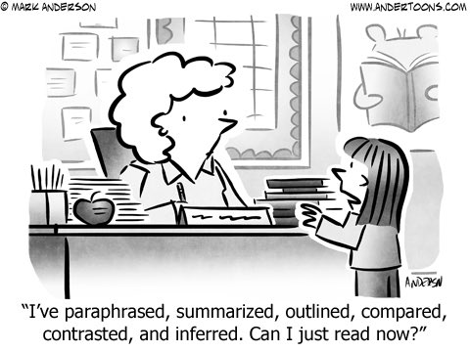

12:00 – 12:45 pm.
Notes:
Carole

Slide 68

Carole Mullins, NBCT
KVEC Literacy Instructional Specialist
carole.mullins2@hazard.kyschools.us
Dionne Bates, Ed. S.
KVEC Achievement Gap Specialist, Literacy
dionne.bates@hazard.kyschools.us
Kim Sergent
KVEC Social Studies Instructional Specialist
kimberly.sergent@letcher.kyschools.us
Katrina Slone, Ed. D
KVEC Science Instructional Specialist
katrina.slone@hazard.kyschools.us
Rebecca King
Teacher, Pikeville Independent Schools
rebecca.king@pikeville.kyschools.us
www,kvecelatln.weebly.com
Notes:
Carole
Distribute Participation Certificates

