Slide 1


Reaching for Proficiency Across the Curriculum:
Grades 9-12 High-Impact Literacy Instruction in English/LA,
Science and Social Studies
October 30, 2018
Notes:
Carole
Table Tents for Participant Seating: English/LA, Science and Social Studies
Welcome and Introductions:

Slide 2
“He who dares to teach, must never cease to learn. ”
~John Cotton Dana
Notes:
Carole
We owe this to the students we teach and future generations!

Slide 3

Work within the Kentucky Academic Standards for English/LA and Literacy in History/Social Studies, Science & Technical Subjects
Essential Writing Skills for passage-based writing in all subject areas in both timed/untimed tasks
Share High-Impact/Rigorous strategies and ideas for engaging students in the application of the standards in all subject areas
Notes:
Carole
Everything we do today addresses the skills students need to become better writers in timed and un-timed situations as well as learn the content!!!
To some, disciplinary literacy sounds like one more thing to do, but that is not the intention nor the case.
Academic learning for reading, writing, listening, speaking and thinking are not just in the realm of the language arts teachers. It happens in all grades and in all disciplines.
By helping your students become more literate in your discipline, you will strengthen their learning of the content and subject matter.

Slide 4
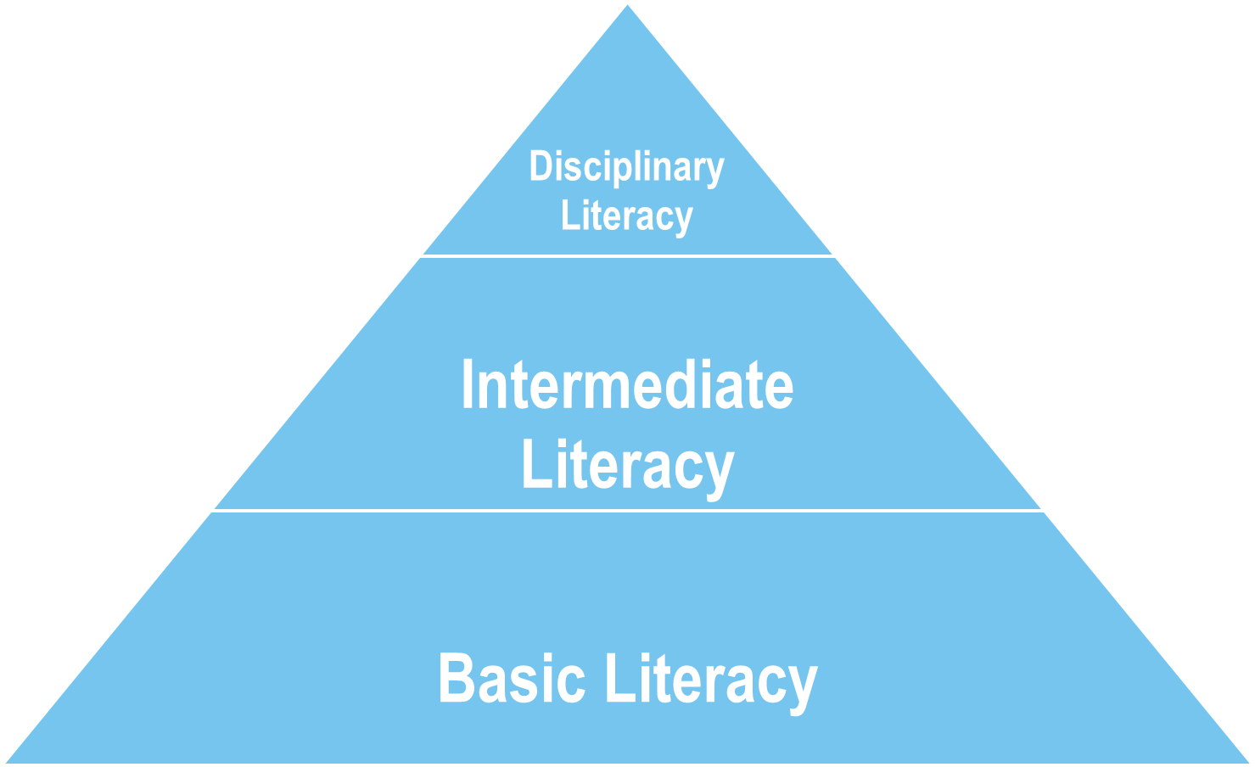
What is it?
Disciplinary Literacy is the confluence of:
content knowledge
experiences & skills
ability to read, write, listen & speak
thinking critically in a way that is meaningful within the content area
Each content or subject discipline has:
its own unique knowledge core
its own ways of inquiring, investigating, reasoning, representing, and questioning.
Shanahan, Shanahan
University of Illnois,
Chicago
Disciplinary literacy refers to the specialized skills that someone must master to be able to read and write in the various disciplines (science, math, literature, history, geography, economics, politics, government, law, sociology, psychology, etc. ) and technical fields.
Notes:
Kim
The emphasis on disciplinary literacy in many states’ educational standards is not aimed at increased integration of teaching across subject matters. It is aimed at teaching students how to engage in the special reading and writing routines inherent in the body of knowledge and inquiry approaches of the various disciplines.
Reading, as such, is neither a content area nor a discipline.
Disciplinary literacy is being emphasized because the reading and writing of the different disciplines is specialized and even unique. Those literacy routines are linked to the content and inquiry approaches of the disciplines, and as such require attention in each of those classes.
The ELA teacher should not be the one charged with the responsibility of fostering an ability to read like a scientist. That needs to come from the science teachers who will be teaching science content, assigning science texts and writing assignments, and engaging kids in scientific inquiry.
Teachers in the disciplinary subjects need to stop protecting their students from the reading requirements of their disciplines and start teaching them to engage in the discipline-specific literacy practices that won’t be learned elsewhere.

Slide 5
Close Reading
Notes:
Kim

Slide 6

Reading, Thinking, and Speaking to the Standards
Cite strong and thorough textual evidence to support analysis of what the text says explicitly as well as inferences drawn from the text.
Determine an author’s point of view or purpose in a text and analyze how an author uses rhetoric to advance that point of view or purpose.
Cite specific textual evidence to support analysis of primary and secondary sources, attending to such features as the date and origin of the information.
Compare and contrast treatments of the same topic in several primary and secondary sources.
Compare the POV of two or more authors for how they treat the same or similar topics, which details they include and emphasize in their respective accounts.

Slide 7
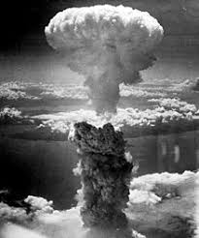
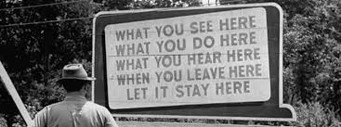
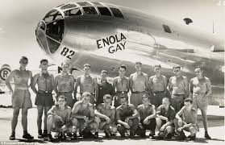
What is the legacy of the Manhattan Project?
https://sheg.stanford.edu/
Notes:
Kim
Handout

Slide 8

Round One – Setting the stage (Context)
Read and Source the anchor text.
Sourcing questions:
Who is the author?
Who is the audience?
When was this written?
Why was it written?
What is the author’s POV?
Is it reliable? Why or Why not?
Notes:
Kim
Handout

Slide 9
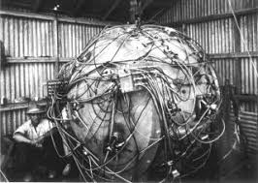
Round Two – Sourcing your table’s text
Applying the same questions for Sourcing the Anchor Text
Sourcing questions:
Who is the author?
Who is the audience?
When was this written?
Why was it written?
What is the author’s POV?
Is it reliable? Why or Why not?

Slide 10
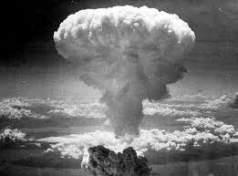
Round Three – Close Reading
Close Reading questions:
What claims does the author make?
What evidence does the author use?
What language (words, images, phrases, symbols) does the author use to persuade the document’s audience?
How does the document’s language indicate the author’s perspective?

Slide 11
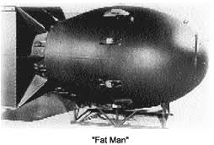
Round Four - Contextualization
Contextualization Questions:
When and where was the document created?
What was different then? What is the same?
How might the circumstances in which the document was created affect its content?

Slide 12
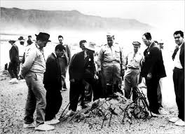
Round Five – Corroboration
A member from each group now goes to their COLOR group.
The group will discuss the corroboration questions:
What do the other documents say?
Do the documents agree?
If they do not agree, why?
What documents are most reliable? Why?

Slide 13

Why use multiple texts?
Students will:
Grasp more information being exposed to more sources.
Think more critically.
Learn to synthesize when they read many texts on one topic.
Contribute on a richer, deeper level in class discussions.
Source: The Case for Multiple Texts by Sunday Cummins, ASCD Educational Leadership, Feb. 2017

Slide 14
Where can I find text sets?
Library of Congress https://www.loc.gov/education/
Stanford History Education group https://sheg.stanford.edu/
Digital Public Library https://dp.la/
EDSITEment edsitement.neh.gov
Historical Scene Investigation hsi.wm.edu/
Common Lit https://www.commonlit.org/

Slide 15
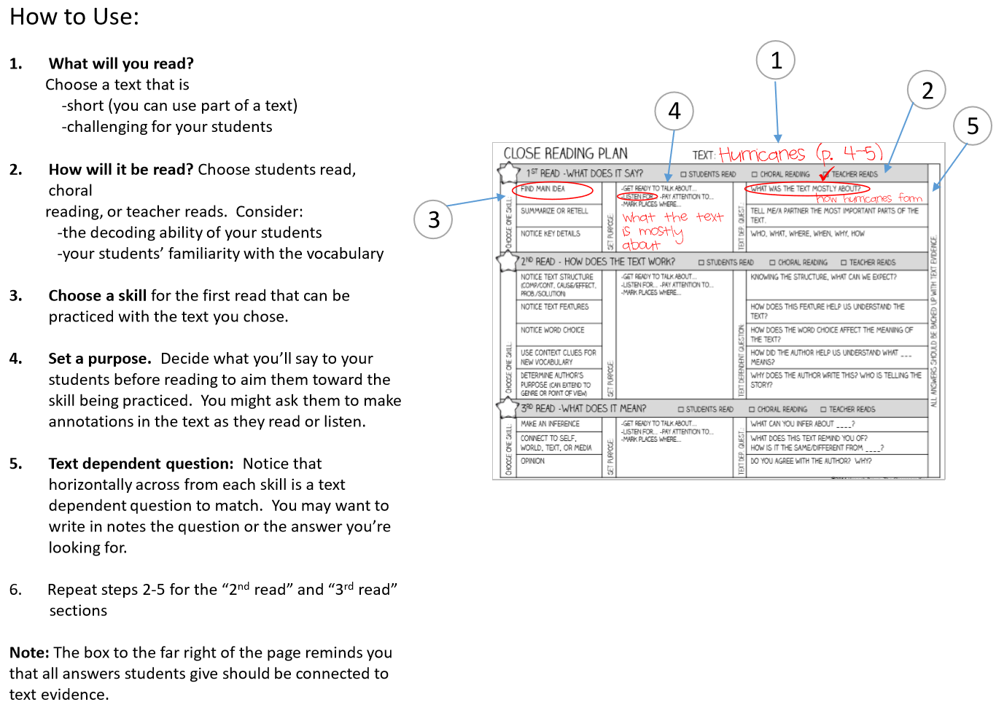
Planning for Close Reading
https://www.theclassroomkey.com/2014/12/taking-the-rocket-science-out-of-close-reading.html (Free download of planner and editable planner!)
Notes:
Katrina HANDOUT
Link to science example: file:///C:/Users/Katrina/Desktop/Science/Reading%20in%20Science/Close%20Reading%20Planner%20Editable.pdf

Slide 16
Talk, Read, Talk, Write
Notes:
KATRINA

Slide 17

Reading, Thinking, Speaking and
Writing to the Standards
Cite strong and thorough textual evidence to support analysis of what the text says explicitly as well as inferences drawn from the text.
Analyze in detail how an author’s ideas or claims are developed and refined by particular sentences, paragraphs, or larger portions of a text (e.g., a section or chapter).
Draw evidence from literary or informational texts to support analysis, reflections, and research.

Slide 18

“Talk, Read, Talk, Write” Strategy:
Designed by Nancy Motley (Seidlitz Educational Consultants)
Designed to engage students directly within the text.
Four Stages:
One: Activate thinking visually, talk to partner
Two: Read, annotate, highlight the lesson text
Three: Talk with a partner about the reading
Four: Respond to task/prompt, brings learning together
Notes:
Katrina

Slide 19
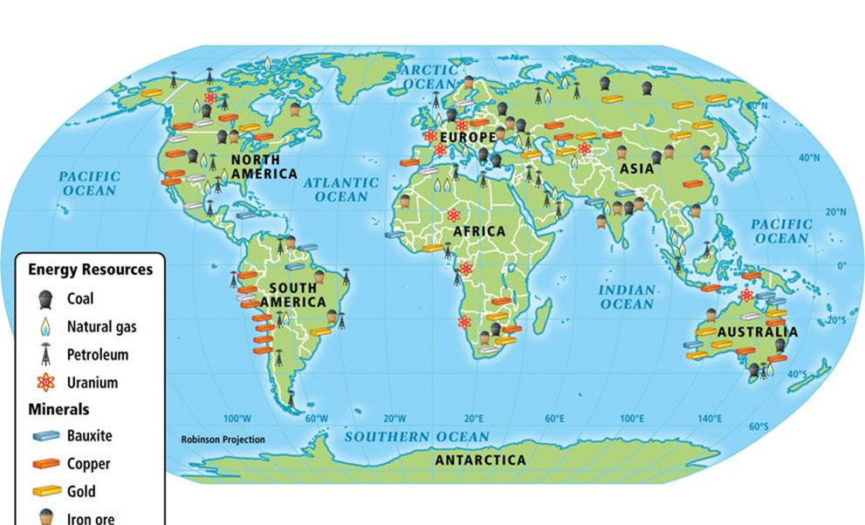
Now…Let’s TALK!
In your classroom, students would view the source individually, answering the question(s), then share answers with partner in the TALK stage.
Review the map in your packet.
Prioritize the resources in the legend from richest to the
least richest.
Using that list, determine the top five wealthiest nations.
Notes:
Katrina HANDOUT
Map for Prompt

Slide 20
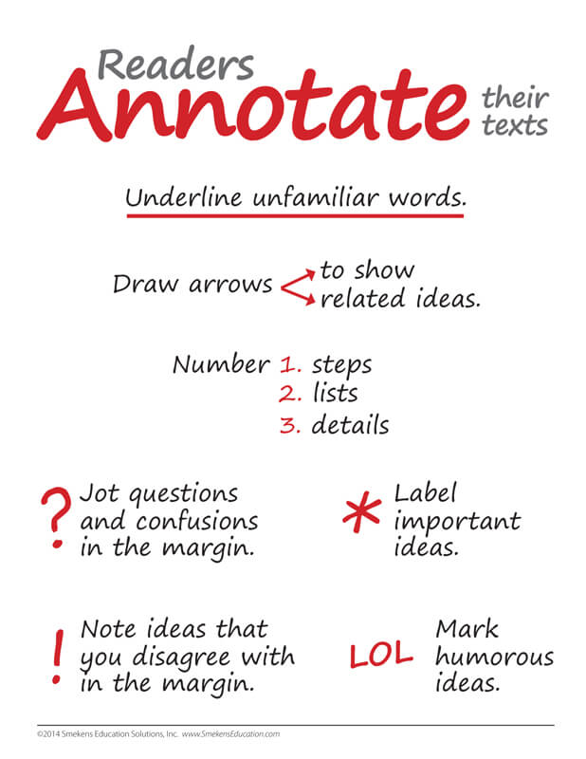
Next Step: Read
As you read the article individually:
Highlight information that supports your judgments on the map.
Annotate information that disagrees or would serve as a counterargument to your thoughts on the map.
Notes:
Katrina HANDOUT

Slide 21

Step Three: TALK
Turn to your A-B partner and share your discoveries from the reading.
First, share the evidence that supports your thesis.
Now – share the counterarguments!
Notes:
Katrina

Slide 22

Step Four: WRITE
Respond to this task:
Based on the information found in the sources, explain why countries need each other economically.
Be sure to use evidence from the sources to support and develop your thinking.
Notes:
Katrina

Slide 23
Looking at the TRTW format…
Planning within the format:
Backward design
Address the content first in the READING and the WRITING.
The TALK segments are determined by the content choices.
Additional Resource: https://achievethecore.org/aligned/welding-literacy-scientific-instruction/
Notes:
Katrina
HANDOUT

Slide 24
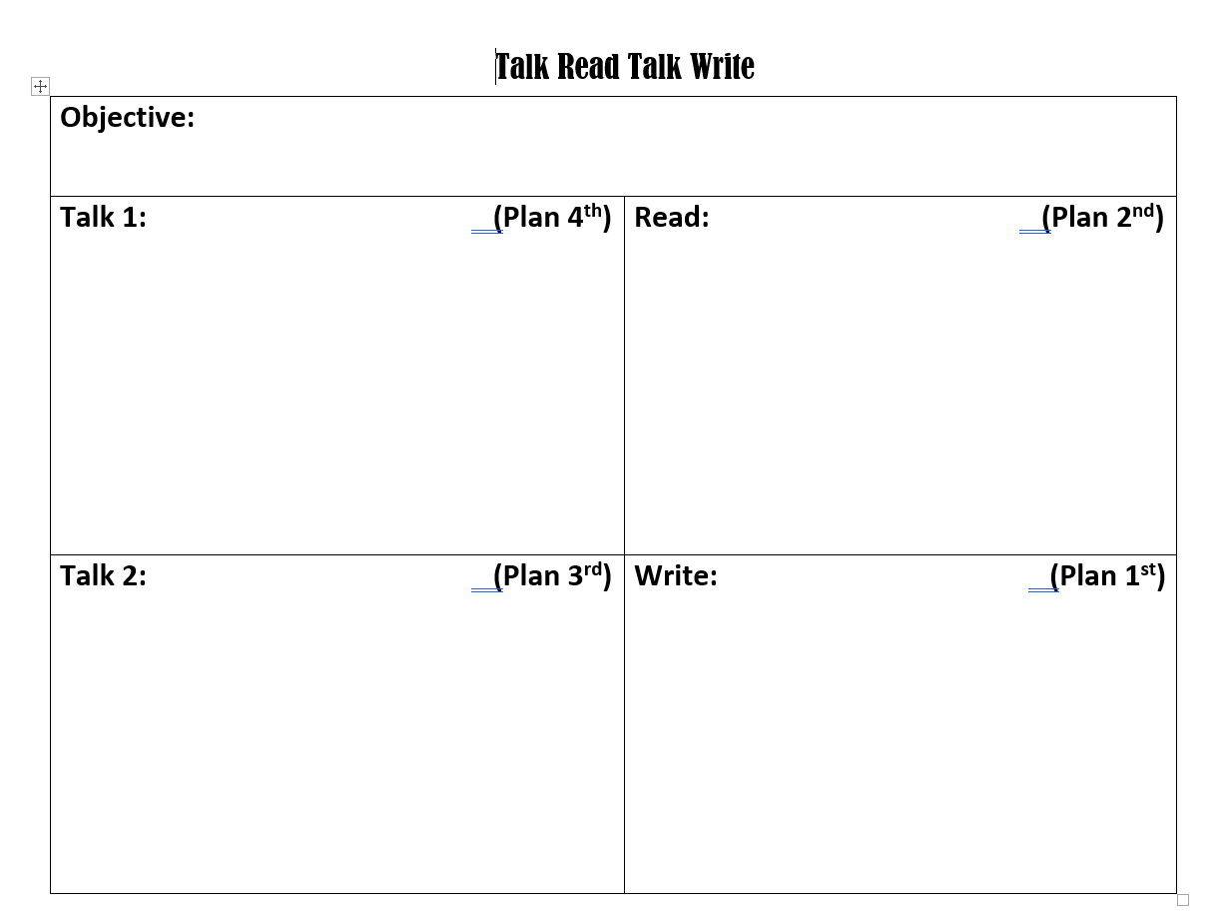
Explain how availability of natural resources has influenced human activity.
PAT
Why are there different natural resources on different places on Earth?
What happens to humans as a result of the uneven distribution of resources?
Highlight causes in yellow, effects in green.
What patterns do you notice in the distribution of different resources?
Why might these patterns occur?
How could you summarize why there are different natural resources in different places?
What are the most consequential effect and why?
Based on information found in the sources, explain how the availability of natural resources has influenced human activities.
Notes:
Katrina
Link to blog with strategy: http://www.thecurlyclassroom.com/search?q=talk+read+talk+write
Link to planning sheet: https://docs.google.com/document/d/1h9em7gXw1evsuN3awdRrOLgwAXtIemyblVu66QC0njY/edit?usp=sharing

Slide 25
Visual Thinking Strategy
Notes:
Kim

Slide 26
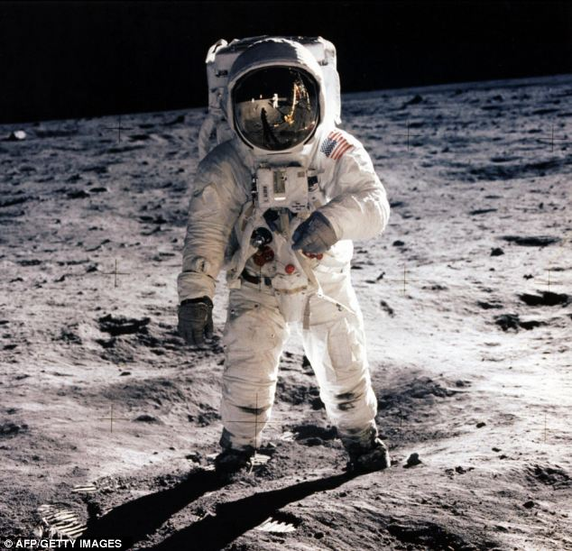
Visual Literacy
‘Foundational’ form of literacy, for primary and elementary grades
Can be done with artifacts and photographs, or the occasional painting (depending on grade/subject)
Visually connecting to the source
Sourcing with pictures, identifying what they see and inferring or making educated guesses.
Notes:
Kim

Slide 27
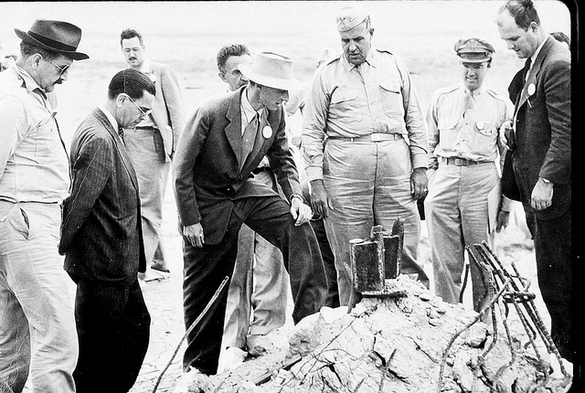
#1: What is going on in this picture?
#2: What do you see that makes you say that?
#3: What more can we find?
Visual Thinking Strategy (VTS)
Notes:
Kim
For grades K-3 initially
Can be used at every grade and subject
You ask three questions to guide the students into the text.

Slide 28
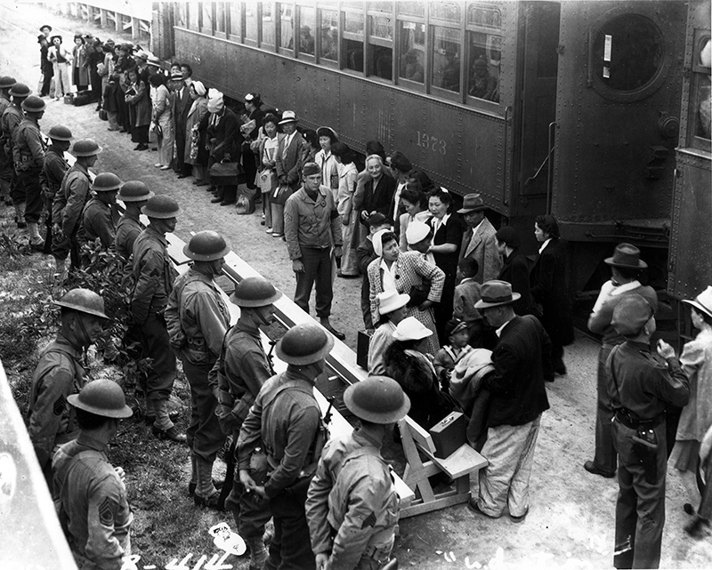
Now, it’s YOUR turn!
#3: What more can we find?
#1: What is going on in this picture?
#2: What do you see that makes you say that?
http://www.fdrlibraryvirtualtour.org/page07-15.asp
Notes:
Kim
Try VTS with your colleagues!

Slide 29
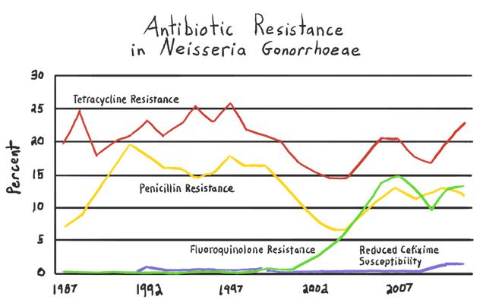
#2: What do you see that makes you say that?
#1 What’s going on in this graph?
#3 What questions can we ask?
Visual Thinking Strategy
Antibiotic resistance of pathogens graphed over time

Slide 30


Making Meaning
Notes:
Probe to help students begin to articulate their mental model of antibiotic resistance.
Initial simple model of antibiotic resistance to begin to understand the process.

Slide 31
Templates for Understanding and Communicating
Writing about Models
Merits and limitations of the model | A way this model showed how __________ really works is __________. A limitation of this model is __________. A way this model is unlike __________ is__________.
Use model to illustrate or predict relationships | The components of the model (_____, _____, and _____) represent the components of the __________ because _________________________. The model helps to predict __________ because __________.
Compare two models to see which is most useful for a given situation | The __________ model allows us to __________ because __________, whereas the __________ model allows us to __________ because ________.
Using templates helps student to organize their thinking. If they are taught how to use them and have the opportunity to practice using them often, they begin to internalize the structure so they no longer need the templates.
Notes:
Katrina
Link to writing about models template: https://docs.google.com/document/d/1v3kgjzbBaeO4Sk-A9yRr3N_PafHW4PWbtwcE7xSckZ8/edit?usp=sharing

Slide 32
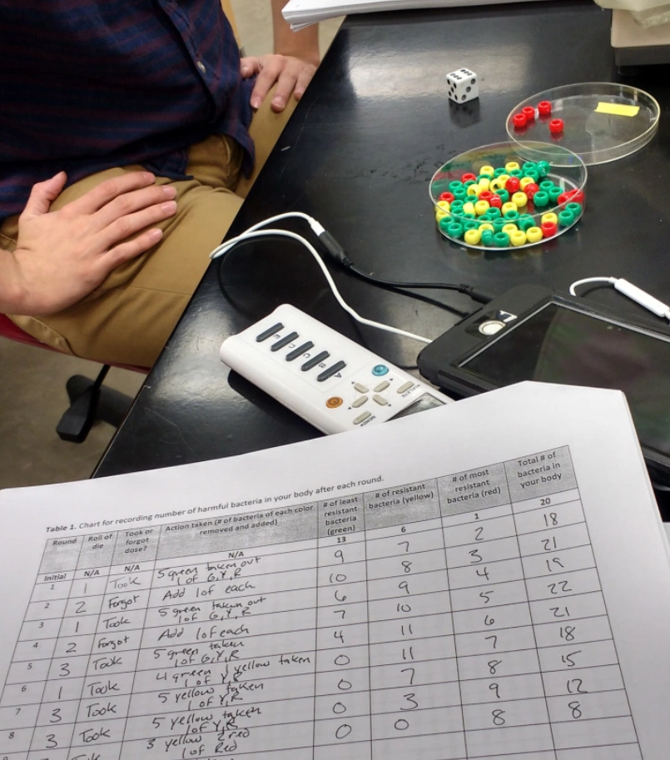
Another model of antibiotic resistance
Notes:
Link to article that describes activity: https://nonmajorsbiology.wordpress.com/2017/12/20/antibiotic-resistant-bacteria-a-simple-realistic-lab-activity/

Slide 33
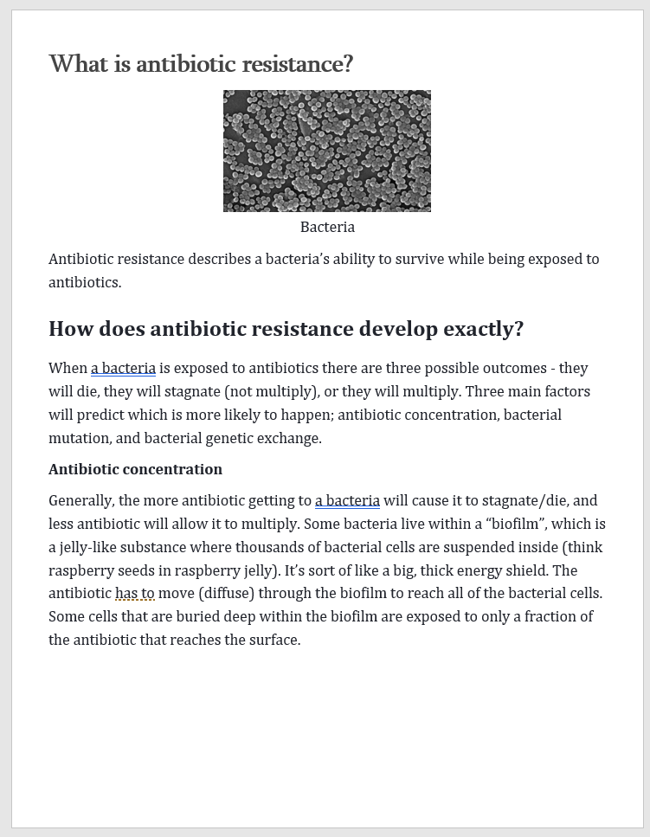
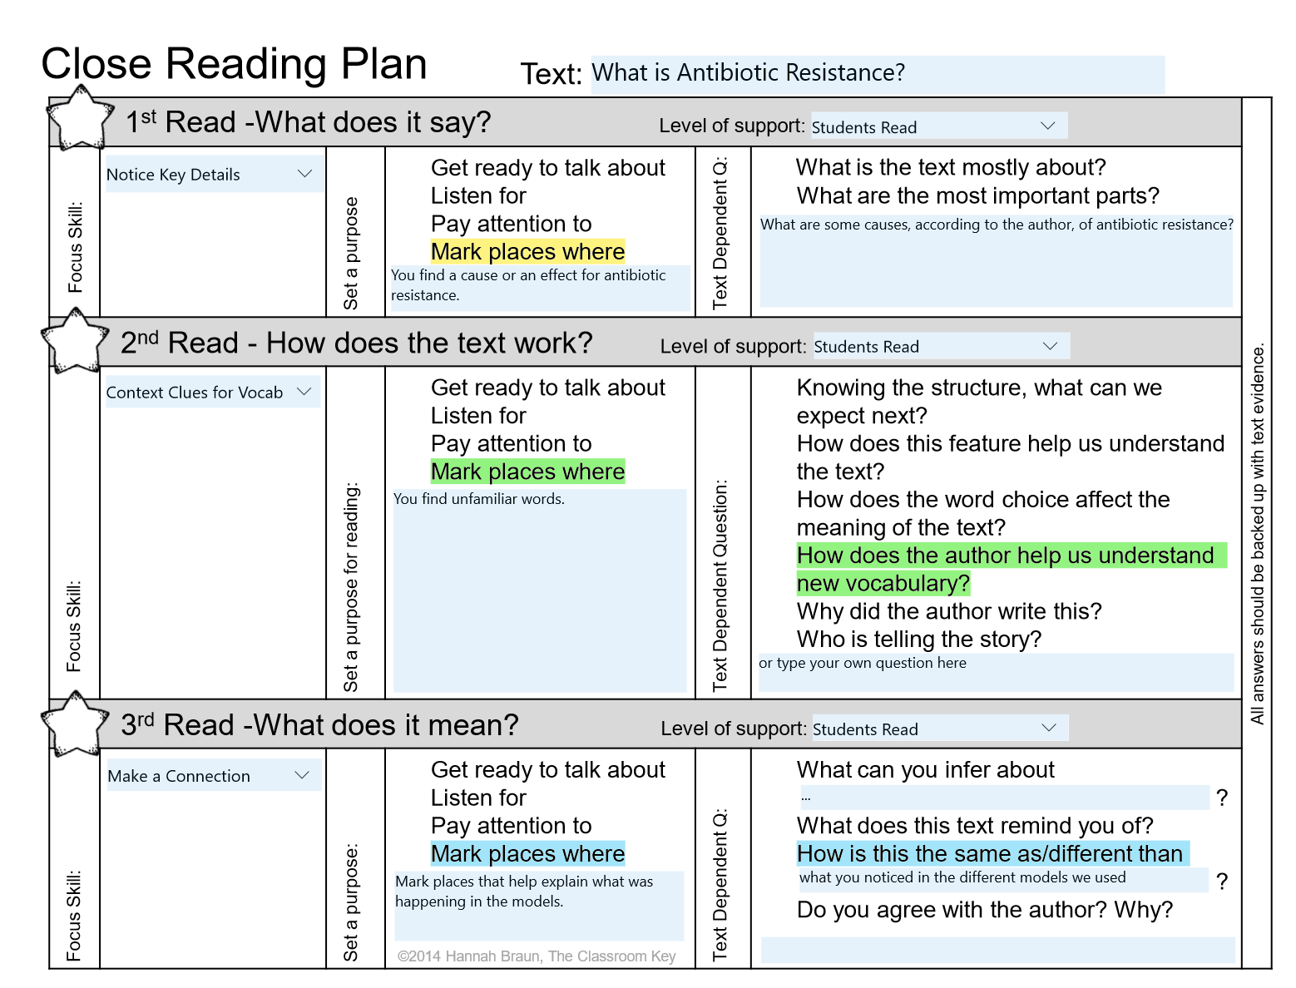
Close Reading
Notes:
Katrina
See “Planning for Close Reading” slide for link to editable planning sheet.

Slide 34
Vocabulary: Word Walls
Interactive
Should not be static “decorations” in the classroom.
Should be dynamic constructions that reflect the learning taking place.
Should be student generated and organized.
Should be used daily by students during whole group, small group, and individual work.
Video Resource for Interactive word walls along with examples: https://youtu.be/zuaOjtk9QoM
Notes:
Katrina
Excellent video that explains interactive word walls and shows examples: https://youtu.be/zuaOjtk9QoM

Slide 35
Opportunities for Writing
Write to Explain
Write to Argue
What is the cause of antibiotic resistance?
What are the effects of antibiotic resistance?
How can antibiotic resistance be mitigated?
How do the models of antibiotic resistance compare to the real thing?
Should antibiotic resistance be addressed? If so, how?

Slide 36

Upcoming Training
Echoes and Reflections –
“Teaching Night: Creating
Historical Context”
Monday, November 12th
KVEC Offices, 9 am – 3 pm
We will also be hosting author and Holocaust survivor, Alice Goldstein, who will speak to participants.

Slide 37

What Close Reading Actually Means
By Grant Wiggins
https://www.teachthought.com/literacy/what-close-reading-actually-means/
www.kvecelatln.weebly.com
https://achievethecore.org
https://achievethecore.org/aligned/five-places-for-trusted-resource-recommendations/
https://achievethecore.org/aligned/welding-literacy-scientific-instruction/
Notes:
Carole DISTRIBUTE FEEDBACK HANDOUT!

Slide 38

Carole Mullins, NBCT
KVEC Literacy Instructional Specialist
carole.mullins2@hazard.kyschools.us
Dionne Bates, Ed. S.
KVEC Achievement Gap Specialist, Literacy
dionne.bates@hazard.kyschools.us
Kim Sergent
KVEC Social Studies Instructional Specialist
kimberly.sergent@letcher.kyschools.us
Katrina Slone, Ed. D
KVEC Science Instructional Specialist
katrina.slone@hazard.kyschools.us
Rebecca King
Teacher, Pikeville Independent Schools
rebecca.king@pikeville.kyschools.us
www,kvecelatln.weebly.com
Notes:
Carole
Distribute Participation Certificates

