Slide 1

Close Reading Strategies
KVEC Teacher Leader Network
Breakout Session
March 28, 2013
Carole Mullins, NBCT
KDE Eng/LA Content Specialist
carole.mullins@education.ky.gov

Slide 2

Text Complexity
“The Common Core Standards hinge on students encountering appropriately complex texts at each grade level in order to develop the mature language skills and the conceptual knowledge they need for success in school and life” (p. 3).

Slide 3
Let every nation know, whether it wishes us well or ill, that we shall pay any price, bear any burden, meet any hardship, support any friend, oppose any foe to assure the survival and the success of liberty.
We want every country in the world, whether it is our friend or our enemy, to know that we will do whatever is necessary to make sure that freedom survives in the United States and around the world.
Complex
Simple
Notes:
Read and decide which is consider Complex and which is considered Simple.
This slide provides a sample of complex and simple text based on the same social studies passage. The vocabulary and sentence structure have been simplified. The facilitator may wish to discuss distinct differences in vocabulary and sentence structure.

Slide 4
What constitutes a complex text?
“Complex text is typified by a combination of longer sentences, a higher proportion of less-frequent words, and a greater number and variety of words with multiple meanings.”
PARCC Model Content Frameworks

Slide 5
What Complex Text Demands of Readers
A Willingness to Pause and Probe
  Students must be patient as they read complex texts and be willing to devote time to contemplation of the text
The Capacity for Uninterrupted Thinking
  Time devoted to the text and thinking about the text exclusively - single-tasking rather than multi-tasking
A Receptivity to Deep Thinking
  Contemplation of the meaning of the text and not a quick response voicing an opinion based on a shallow interpretation
Mark Bauerlein, 2011
Notes:
Mark Bauerlein is a professor of English at Emory University in Atlanta.
His article in Educational Leadership “Too Dumb for Complex Texts? emphasizes that students that are so used to multi-tasking and hopping from link to link have difficulty tackling complex texts and college level reading.
We need to use print copies to help students develop the habits of reading they will need to negotiate texts they will use in college.

Slide 6
Shorter, Challenging Texts
The study of short texts is useful to enable students at a wide range of reading levels to participate in the close analysis of more demanding text.
Place a high priority on the close, sustained reading of complex text. Such reading emphasizes the particular over the general and strives to focus on what lies within the four corners of the text.
Close reading often requires compact, short, self-contained texts that students can read and re-read deliberately and slowly to probe and ponder the meanings of individual words, the order in which sentences unfold, and the development of ideas over the course of the text.

Slide 7
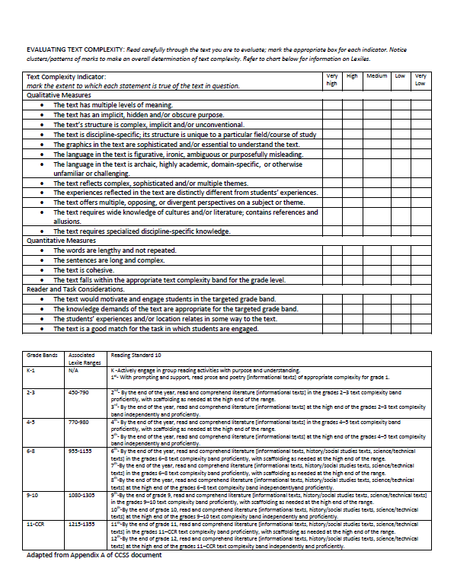
Text Complexity
Resource
Notes:
Text Complexity Activity for I Have A Dream: HANDOUT
QUANTITATIVE:
LEXILE: 1070 (Grade Band: 6-8)
QUALITATIVE:
Use the Text Complexity Resource and 1 Page adapted from CCSS Appendix A
READER AND TASK CONSIDERATIONS:
Review and Use with I Have a Dream

Slide 8

Focus on Instruction – Close Reading and Text-Dependent Questions
Attributes of Close Reading lessons:
Selection of a (brief), high quality, complex text
Individual reading of the text
Rereading the text
Text-based questions and discussion that focus on discrete elements of the text
Discussion among students
Writing about the text

Slide 9


Excerpt (1963)
By Martin Luther King, Jr.
Close Reading Activity
Notes:
Modeling and Guided Practice
HANDOUTS:
I Have A Dream Text (Lexile 1070)
Close Reading Graphic Organizer
Read the text and complete GO
Stress CR is NOT something you do with students every time they read!

Slide 10
Additional Resources
The Road Not Taken, by Robert Frost
Weather, by Eve Merriam
The Voice That Challenged a Nation, by Russell Freedman
  www.kvecelatln.weebly.com
    CCSS ELA Text Exemplars: 21 Pages
    Close Reading Exemplars and the CCSS Article
    Videos and Resources for Close Reading
Notes:
HANDOUTS and link to other resources

Slide 11



Answering the Dilemma of Increasing Writing Scores!
Close Reading
Text Dependent Questions
Congruent Assessments
Text Complexity:
Regular practice with complex text and its academic language.
Close Reading:
Despite its name, close reading has a lot more to do with writing than reading!
Why is it important?
“Close reading” is an essential college skill, regardless of a writer’s discipline.
Text-dependent questions:
Draw the reader back to the text to discover what it says.
Teachers frame questions in ways that do not rely on a mix of personal opinion, background information, and imaginative speculation.

Slide 12

From Lagging Literacy to College and Career Readiness:
Navigating the CCSS Shifts in Literacy Instruction
Notes:
Handout

