Slide 1
Disciplinary Literacy
Thinking, Reading, and Writing like a Historian

Slide 2
Agenda
Work within the Kentucky Academic Standards for Literacy in History/Social Studies.
Define the meaning and establish the intent of disciplinary literacy.
Demonstrate strategies and ideas for engaging students in the application of the Kentucky Academic Standards for Literacy in History/Social Studies.
Planning instruction around disciplinary literacy and inquiry through the use of the Kentucky Academic Standards for Literacy in History/Social Studies.

Slide 3
Disciplinary Literacy
Defining and Designing

Slide 4
Why the shift from Content-Area Reading?
The shift in emphasis is not to content area reading.
Content area reading is an idea long advanced in education (“every teacher a teacher of reading”).
Focus is teaching general reading and study skills in the different subject matter classes.
However, the underlying idea of this format does not meet all demands or needs of reading in all disciplines.
Shanahan, Shanahan
University of Illinois, Chicago

Slide 5
What is it?
Each content or subject discipline has:
its own unique knowledge core and …
its own ways of inquiring, investigating, reasoning, representing, and questioning.
Shanahan, Shanahan
University of Illnois,
Chicago
Disciplinary literacy refers to the specialized skills that someone must master to be able to read and write in the various disciplines (science, math, literature, history, geography, economics, politics, government, law, sociology, psychology, etc. ) and technical fields.

Slide 6
Comparing Content Area Reading and Disciplinary Literacy
 | Content Area Reading | Disciplinary Literacy
Source | Reading experts since 1920s | Wider range of experts since 1990s
Nature of skills | Generalizable | Specialized
Focus | Use of reading and writing to study/learn information | How literacy is used to make meaning within a discipline
Students | Remedial | Whole distribution
Texts | Often encourages use of literary text | Only focuses on disciplinary text
Role of graphics | Ignored or taught generally | Specific to the discipline
Shanahan, Shanahan, University of Illinois, Chicago

Slide 7
Thinking, Reading, and Writing Like a Historian
Disciplinary Literacy for Social Studies

Slide 8
When historians read, they…
Interpret primary and secondary sources
Identify bias
Think sequentially
Compare and contrast events, accounts, documents and visuals
Determine meaning of words within context
Disciplinary Literacy: A Shift that Makes Sense. ReLeah Lent (ASCD)

Slide 9
When historians write, they…
Create timelines with accompanying narratives
Synthesize information/evidence from multiple sources
Emphasize coherent organization of ideas
Grapple with multiple ideas and large quantities of information
Create essays based on argumentative principles

Slide 10
When historians think, they…
Create narratives
Rely on valid primary and secondary sources to guide their thinking
Compare and contrast or ponder causes and effects
Consider big ideas or inquiries across long periods of time
Recognize bias

Slide 11
Stand up, Hand up, Pair up
Individually, write down on your index card what learning looks like in our Social Studies classrooms today.
How do your students show their thinking?
How do you know they have learned the material?
Now – on my signal,
Stand up
Put your hand up
And find a partner.
Give that partner a high five and SHARE YOUR REFLECTIONS!

Slide 12
The WHAT we teach
Diving into the Standards

Slide 13
Kentucky Academic Standards for History/Social Studies
Group by grade level(s) taught.
For that standard, summarize each grade (6-8, 9-10, 11-12) progression, highlighting the demands of that standard for your grade.
Identify curriculum markers you would use to teach that standard.
At the bottom of your group’s chart paper, identify what you will need to work within that standard.

Slide 14
How do we encourage our students to think, read, and write like historians?

Slide 15
The HOW we teach
Thinking like a Historian

Slide 16
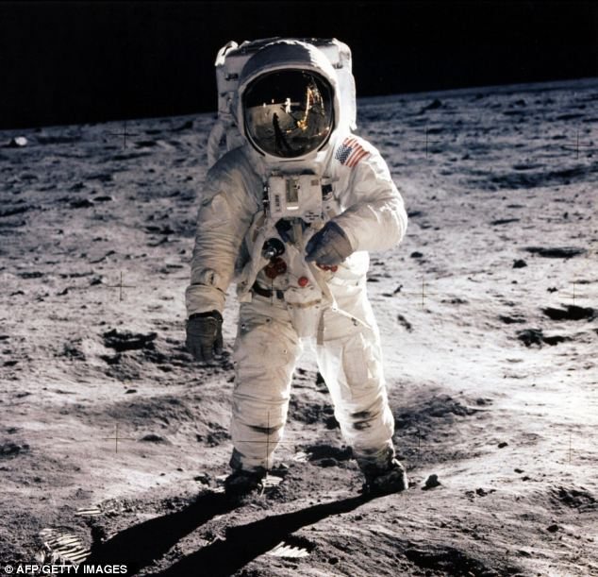
Visual Literacy
‘Foundational’ form of literacy, for primary and elementary grades
Can be done with artifacts and photographs, or the occasional painting (depending on grade/subject)
Visually connecting to the source
Sourcing with pictures, identifying what they see and inferring or making educated guesses.

Slide 17
Library of Congress: Washington, Jefferson, and Lincoln
Students will compare and contrast the lives of these three presidents by visually analyzing their portraits.
Facilitation:
a. K-2: Teacher facilitates the conversation, taking notes
b. 3-5: Small groups with designated scribe, reporting out

Slide 18
Student-driven Inquiry: QFT
Students will identify questions about a topic, based on a brief Qfocus (Question Focus)
For younger grades (K-2), the teacher directs the discussion, serving as scribe.
For grades 3-12, students are more autonomous within the activity.

Slide 19
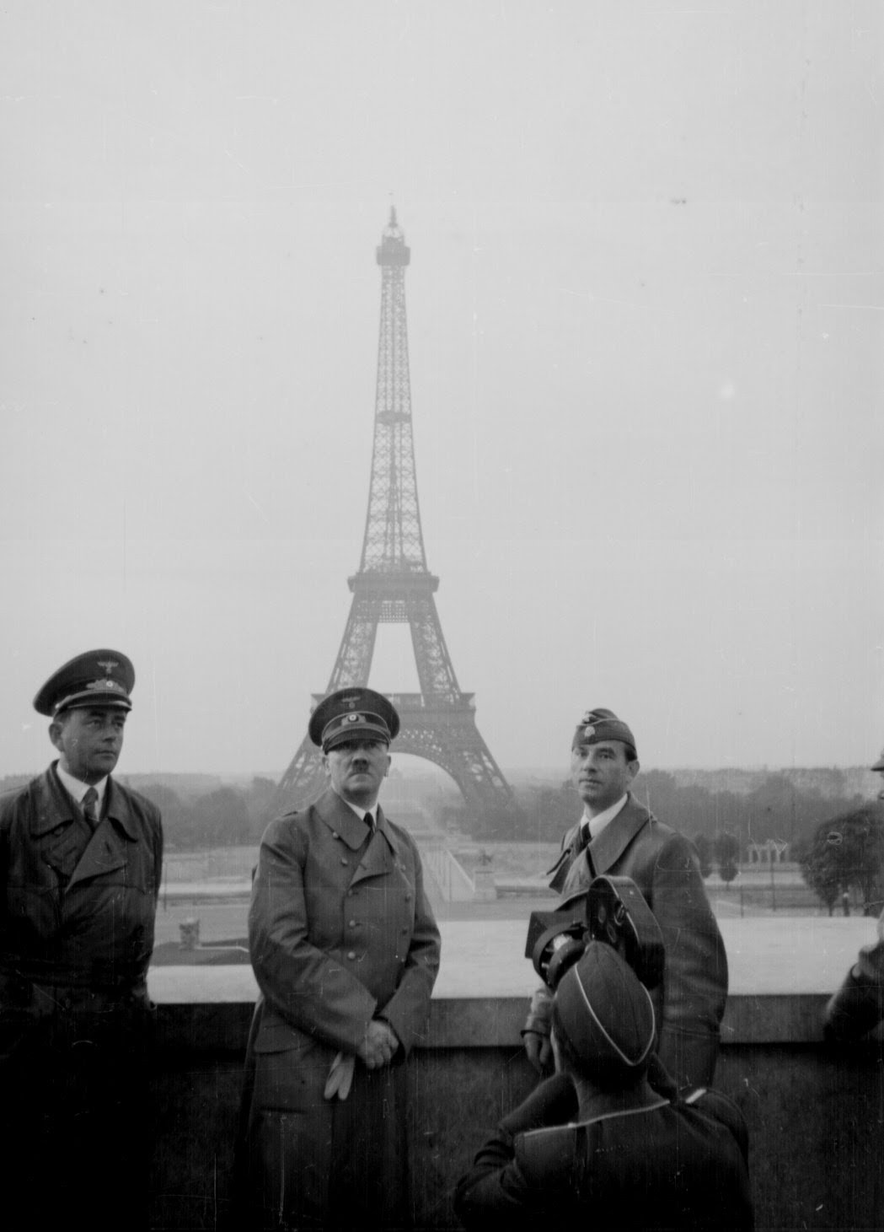
QFT: Student inquiry, agency, and voice
This protocol creates an atomosphere free of judgment, an opportunity for every voice to be heard, and through prioritization, students take ownership of the inquiry, increasing rigor through increased relevance for the student.
Components of the Protocol:
Question Focus
Producing questions
Improving questions
Prioritizing questions
Discussing next steps
Reflecting

Slide 20
Rules for Producing Questions

Slide 21
Qfocus – 3 minutes
Ask as many questions as you can.
Don’t forget the rules!

Slide 22
Use of Student Questions in QFT
Engage students in the lesson
Student-driven inquiry
Increases rigor and relevance
Can be used to:
-Direct later learning in content
-Use questions to preview, review learning
-Create homework assignment, discussion

Slide 23
Using Student Questions
Student's name | Question #1 What is an ecosystem? | Question #2 What are the critical elements of an ecosystem? Why? | Question #3 What are examples of ecosystems?
What I already know about the topic | • I think it's an area in a park or in the woods and all the animals that live there | • I don't know | • photosynthesis?
Resource #1 Ecosystems, by Nancy Finton (National Geographic Learning, 2007), pp. 7–9 | • soil, rocks, plants, water, animals, and all the processes that connect these things • the living things are adapted to the climate and land | • the living things in the ecosystem rely on each other for food • sometimes they share the same home, like when snakes and lizards live in abandoned prairie dog tunnels • sometimes they help each other, like when insects spread pollen from flower to flower | • dry grass prairie east of the Rocky Mountains with bison, prairie dogs, short grasses, sunflowers, butterflies, etc.
Resource #2
Resource #3
Summary
Once questions are prioritized, identifying the questions the class wants “answered,” the teacher is able to design instruction around those questions.
Figure 1. Sample Inquiry Chart
Source: The Case for Multiple Texts by Sunday Cummins, ASCD Educational Leadership, Feb. 2017

Slide 24
QFT in the Primary classroom

Slide 25
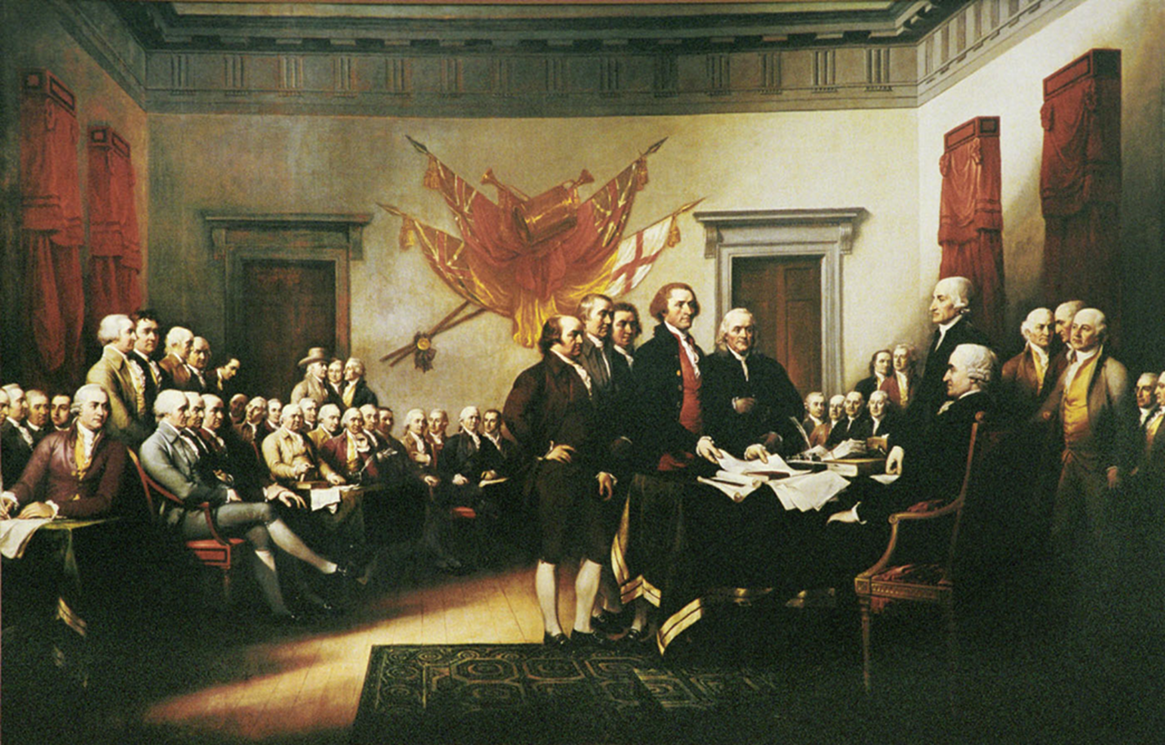

Slide 26
Student questions: 1st GRADE
Who are they?
Where are they?
Is there an American flag?
Why are the people standing?
Do they live there?
Why are they wearing fancy clothes?
Are they having a feast?
Why are they there?
Do they live in the city or the country?
Why are there so many people?
What are their names?
Do they work?
Why are they all men?

Slide 27
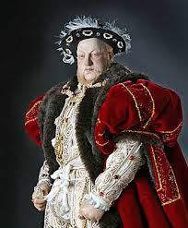
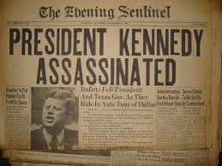
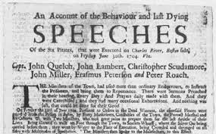
History Reading
History is interpretative, and authors and sourcing are central in interpretation (consideration of bias and perspective)
Often seems narrative without purpose and argument without explicit claims (need to see history as argument based on partial evidence; narratives are more than facts)
Single texts are problematic (no corroboration)
Shanahan, Shanahan
University of Illinois, Chicago

Slide 28
Literacy in History
History Reading (Fang & Schleppergrell)
History text constructs time and causation
Attributes agency (readers need to focus on the reasons for actions and the outcomes of those actions—cause/effect)
Presents judgment and interpretation (argument)
Often narratives with lack of clear connections to thesis
History texts construct meaning about time, place, manner through “grammatical circumstances”

Slide 29
Reading like a Historian (Wineburg)
Sourcing: considering the author and author perspective
Contextualizing: placing the document/info within its historical period and place
Corroboration: evaluating information across sources
Close Reading: staying connected to the source

Slide 30
Reading like a Historian
http://sheg.stanford.edu/
We are going to experience a lesson from the Stanford History Education Group (SHEG)
Montgomery Bus Boycott
Central Question:“Why did the Montgomery Bus Boycott succeed?”

Slide 31
Why use multiple texts?
Students will:
Grasp more information being exposed to more sources.
Think more critically.
Learn to synthesize when they read many texts on one topic.
Contribute on a richer, deeper level in class discussions.
Source: The Case for Multiple Texts by Sunday Cummins, ASCD Educational Leadership, Feb. 2017

Slide 32
Inquiry Circles
Students are given specific roles in regards to a source, or sources.
Each role addresses the content or curricular needs for the teacher.
This model is inspired by and adapted from: Literature Circles: Voice and Choice in Book Clubs and Reading Groups by Harvey Daniels, 2002, Stenhouse Publishers (Nonfiction Literature Circle model)

Slide 33
Roles for today’s activity
Instructions
Round One: Selected member of the group will read the selection aloud.
Round Two: Each team member will re-read the selection, focusing on the demands of the role.
Round Three: Share out within group
Round Four: Share out with Large group
Roles:
Context Connections
Sourcing
Past Connections
Vocabulary

Slide 34
Context Connector
Read this source to connect this source to the time period we are studying, connecting to events, news stories, people, or movements from the time. You are not limited to the U.S. – does this source connect to world events or people?
Sourcing
You will study this source using SOAPST(one):
S-Who is the author?
O-Occasion of the text
A-Who is the audience?
P-Purpose What does the author hope to achieve by writing/delivering this source
S-Subject What is the text about?
T(one)-How does the author feel about the
subject he/she has written about here?
Vocabulary Enricher
You will be on the lookout for important words in the source that connect to the content we are studying, or words you need defined as you read the passage. Write these words down, using your textbook or a dictionary to define the words.
Past Connections
You will look deeper into the source, linking it to an event, person, or movement previously studied.
Inspired by and adapted from Literature Circles: Voice and Choice in Book Blubs and Reading Groups, 2nd ed., by Harvey Daniels, 2002, Stenhouse Publishers. Adapted from Nonfiction Literature Circle Model

Slide 35
Instructional shifts
Disciplinary Literacy

Slide 36
Meeting the Standards
Common core state standards for the English Language Arts and Literacy in Social Studies/History and Science/Technological Subjects, (or in Kentucky, the Kentucky Academic Standards for Literacy in History/Social Studies)
Includes a specific focus on what literacy abilities to foster in history/social studies, literature, and science/technical subjects
Other states joining in, too
Shanahan, Shanahan, University of Illinois, Chicago

Slide 37
Educational Implications
Shifts in teacher preparation and professional development for existing teachers
Need for programs, instructional materials, and other curriculum supports
Need for assessments that include science, history, mathematics, and literary texts (with disciplinary specific questions)
Remediation alone insufficient to meet needs of remedial readers (so literacy learning opportunities in subject areas is essential)
Shanahan, Shanahan, University of Illinois, Chicago

Slide 38
Resources for Primary Sources
American Memory at the Library of Congress – http://memory.loc.gov/ammem/index.html
Smithsonian Institute – http://collections.si.edu/search/
National Archives – http://www.archieves.gov/research/search/
Digital History – http://www.digitalhistory.uh.edu/index.cfm
Famous Speeches in History (audio) – http://www.history.com/speeches
C3 Teachers (Inquiry-based lessons) – www.c3teachers.org
Teaching with Primary Sources – http://loc.gov/teachers
Digital Public Library of America – https://dp.la

