Slide 1
Disciplinary Literacy is MORE than
Reading in the Content Areas
Carole Mullins, KDE
English/LA Regional Content Specialist
carole.mullins@education.ky.gov
Notes:
Introduction and Agenda
Disciplinary Literacy is NOT the New Name for Content Area Reading. It involves much more …

Slide 2
Session Goals
To explain the concept of disciplinary literacy and the Common Core standards
Give an overview of the KCAS reading/writing standards in all content areas
Activate thinking as to how all of this will translate into classroom practice within your district/school
Notes:
Provide an introduction to the ‘What’ and ‘Why’ of Disciplinary Literacy
ELA Kentucky Core Academic Standards (ELA CCSS)
RESOURCES for further assistance embedded into session-will refer to them as we proceed through the presentation

Slide 3

What is meant by College and Career Readiness (CCR) Anchor Standards?
…the acquisition of the knowledge and skills a student needs to enroll and succeed in credit-bearing, first-year courses at a postsecondary institution (such as a two- or four-year college, trade school, or technical school) without the need for remediation. (ACT)
The standards were built on this vision for every single student who graduates from high school.
Notes:
Let’s begin with the “end in mind”…
Our goal is to graduate students that are prepared to continue their education without the need for remediation!

Slide 4
Some of the “Big” Shifts Demanded in ELA/Literacy Standards
Increased reading of Informational Texts (in elementary balance the reading of info and literary texts and vary the topics, making sure they are developmental)
Work on Content Area Literacy—sharing it among ALL teachers
Attend to TEXT COMPLEXITY—discern ideas of more and more complex texts
Focus on TEXT DEPENDENT QUESTIONS – those that REQUIRE close reading of the text (vs ‘text-free’—which rely on prior knowledge instead of the actual text)
Focus on WRITING –Argumentation with Evidence and Narrative Writing (to inform)
Emphasize Domain-Specific Vocabulary
Emphasize Short and Sustained Research Projects.
Mantra—we need students that “read like detectives and write like reporters” (Coleman)
Karen Kidwell, Highly Effective Teaching, Learning and Assessment: 2011 KAAC Presentation
English Language Arts Big Shifts Document - http://ideas.aetn.org/commoncore/strategic-plan
Notes:
Let’s begin by looking at the BIG shift demands for instruction of the CCSS ELA and Literacy Standards …
Text Complexity: “we should not be so dependent on leveled readers especially with struggling students” (Coleman)
Text dependent questions – This DOES NOT mean read the chapter and answer the questions at the end!!!

Slide 5
Why do we need literacy standards for History/ Social Studies, Science, and Technical Subjects?
8th Grade:
Only one third were able to perform at a proficient level involving more sophisticated disciplinary comprehension expectations.
Only 3% scored advanced.
12th Grade:
Only 5% scored at advanced levels, able to read specialized and complex texts.
NAEP, 2009
Notes:
Part of the motivation behind the interdisciplinary approach to literacy promulgated by the Standards is extensive research establishing the need for college and career ready students to be proficient in reading complex informational text independently in a variety of content areas.
Most of the required reading in college and workforce training programs is informational in structure and challenging in content; postsecondary education programs typically provide students with both a higher volume of such reading than is generally required in K–12 schools and comparatively little scaffolding.
The Standards are not alone in calling for a special emphasis on informational text. The 2009 reading framework of the National Assessment of Educational Progress (NAEP) requires a high and increasing proportion of informational text on its assessment as students advance through the grades.

Slide 6
International Studies
4th grade U.S. students performed among the best in the world
8th grade U.S. students performed considerably lower
10th grade U.S. students ranked among the lowest of the nations studied
Carnegie Council on Advancing Adolescent Literacy, 2010

Slide 7
“Only 51 percent of 2005 ACT-tested high school graduates are ready for college-level reading – AND, WHAT’S WORSE, more students are on track to being ready for college-level reading in eighth and tenth grade than are actually ready by the time they reach twelfth grade.”
American College Testing Program, 2006

Slide 8
The reading level of documents, technical manuals, and other materials required by entry level positions in most fields far exceed the reading level of many students.
Meeting the Challenge of Adolescent Literacy, Judith Irvin, et al

Slide 9
“All courses in high school, not just English and social studies but mathematics and science as well, must challenge students to read and understand complex texts.”
American College Testing Program (2006)

Slide 10
What IS Disciplinary Literacy?
Disciplinary Literacy is defined by Shanahan and Shanahan (2008) as advanced literacy instruction embedded within content-areas.
Disciplinary Literacy instruction engages learners with content in ways that mirror what scientists and mathematicians do to inquire and gain understanding in their disciplines.
Timothy and Cynthia Shanahan, University of Illinois at Chicago
www.shanahanonliteracy.com

Slide 11
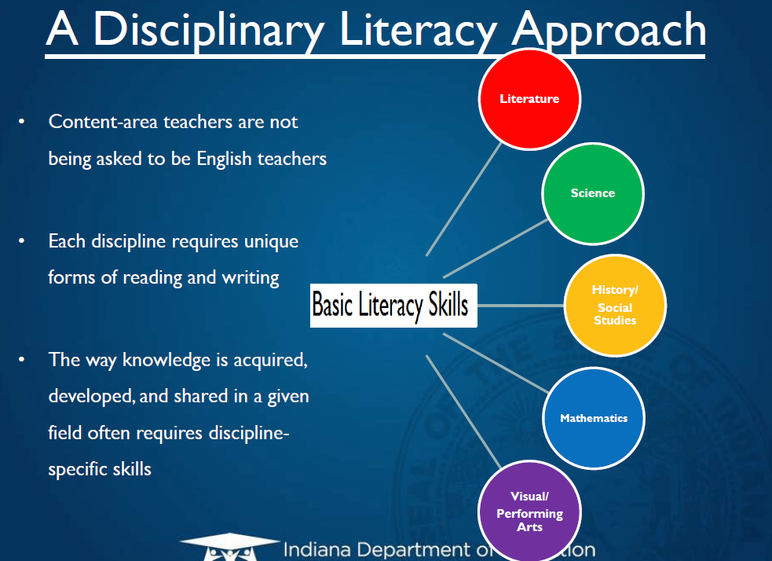
Notes:
All content areas have basic literacy skills that are unique to their subjects….
School Improvement Conference, Salt Lake City, UT this past summer: Speaker said that 40% of problems missed by students on ACT were READING errors
Examples from the Lit Standards
6-8.RSCI.8: Distinguish among facts, reasoned judgment based on research findings and speculation in a text.
9-10.RH-SS.3: Analyze in detail a series of events described in a text; determine whether earlier events caused later ones or simply preceded them.
11-12.RTECH.8: Evaluate the hypotheses, data, analysis ,and conclusions in a technical subject, verifying the data when possible and corroborating or challenging conclusions with other sources of information

Slide 12
  Disciplinary Literacy is NOT the
  New Name for Content Area Reading!!!
  DISTINGUISHING DISCIPLINARY LITERACY FROM CONTENT AREA LITERACY
  Content area literacy focuses on study skills that can be used to help students learn from subject matter specific texts.
  Disciplinary literacy emphasizes the unique tools that the experts in a discipline use to engage in the work of that discipline.
Notes:
“Instruction must place a greater emphasis on disciplinary literacy (i.e., the specific skills, dispositions, and strategies that facilitate student learning in the discipline).” …National Comprehensive Center for Teacher Quality, Washington, D.C.

Slide 13

A Shared Responsibility
English Language Arts & Literacy in History/Social Studies, Science, and Technical Subjects
“The Standards insist that instruction in reading, writing, speaking, listening, and language be a shared responsibility within the school.”
ELA CCSS, page 4

Slide 14
“…ultimately, our students are expected to develop as competent readers, writers, and thinkers in all academic disciplines.”
“…ability to “read, write, and think in ways that are characteristic of discrete academic disciplines”
Developing Readers in the Academic Disciplines, Doug Buehl
Notes:
A shared responsibility because… information from slide
Additional notes from CCSS page 4:
Most of the required reading in college and workforce training programs is informational in structure and challenging in content;
Postsecondary education programs typically provide students with both a higher volume of such reading than is generally required in K–12 schools and comparatively little scaffolding.
We must remember that…
Districts and schools must be aware of the shift demands of the ELA and Literacy CCSS adopted by Kentucky and that these shifts must be addressed and implemented within the content areas.
Classroom teachers will need support in order to effectively make the transition

Slide 15
Distribution of Literary and Informational Passages by Grade in the
2009 NAEP Reading Framework
GRADE | LITERARY | INFORMATION
4 | 50% | 50%
8 | 45% | 55%
12 | 30% | 70%
The Standards aim to align instruction with this framework so that many more students than at present can meet the requirements of college and career readiness.
ELA CCSS Page 5
Notes:
The Standards are not alone in calling for a special emphasis on disciplinary literacy and informational text. The 2009 reading framework of the National Assessment of Educational Progress (NAEP) requires a high and increasing proportion of informational text on its assessment as students advance through the grades.
The percentages on the table reflect the sum of student reading, not just reading in ELA settings.
Teachers of senior English classes, for example, are not required to devote 70 percent of reading to informational texts. Rather, 70 percent of student reading across the grade should be informational.
Because the ELA classroom must focus on literature (stories, drama, and poetry) as well as literary nonfiction, a great deal of informational reading in grades 6–12 must take place in other classes if the NAEP assessment framework is to be matched instructionally.

Slide 16
Distribution of Communicative Purposes by Grade in the 2011 NAEP Writing Framework
GRADE | TO PERSUADE | TO EXPLAIN | TO CONVEY EXPERIENCE
4 | 30% | 35% | 35%
8 | 35% | 35% | 30%
12 | 40% | 40% | 20%
It follows that writing assessments aligned with the Standards should adhere to the distribution of writing purposes across grades outlined by NAEP.
ELA CCSS Page 5
Notes:
As with reading, the percentages in the table reflect the sum of student writing, not just writing in ELA settings.

Slide 17
Reading Standard #1
Anchor Standard: RL & RI.RH/SS.RS/T.CCR.1
Read closely to determine what the text says explicitly and to make logical inferences from it; cite specific textual evidence when writing or speaking to support conclusions
drawn from the text.
K-12 Progressions
Notes:
Let’s take a closer look at the both the ELA and Literacy Standards
Reading Literature , Reading Informational and SS/Sci Reading Standard #1 Progression Handout
Ask participants to compare the ELA and SS/Sci Standard #1 by highlighting similar skills needed in both ELA and Content Areas

Slide 18
Writing Standard #1
Anchor Standard: W.WH/SS.WS/T.CCR.1
Write arguments to support claims in an analysis of substantive topics or texts, using valid reasoning and
relevant and sufficient evidence.
K-12 Progressions
Notes:
Let’s take a closer look at the both the ELA and Literacy Standards
Writing Standard #1 Progression Handout and Content Literacy Writing Standard 1 Progression Handout
Ask participants to compare the ELA and SS/Sci Standard #1 by highlighting similar skills needed in both ELA and Content Areas
REINFORCE TO PARTICIPANTS:
READING AND WRITING STANDARDS ARE “CONNECTED” TO THE SAME OUTCOME FOR STUDENTS.
The reading/writing package produces the critical thinking student’s need to achieve at higher levels

Slide 19
Teaching Literacy in the Disciplines and
Teaching Disciplinary Literacy
Timothy and Cynthia Shanahan: University of Illinois at Chicago www.shanahanonliteracy.com
Disciplinary Literacy
Disciplinary Reading Instruction
Emphasis on Informational Text
Emphasis on Challenging Text
Close Reading
Notes:
Let’s get started gathering additional information and addressing the Disciplinary Literacy needs of your school/district.
Refer participants to Disciplinary Literacy Handout
Give participants a few minutes to review the format/organization of the handout: It is divided into 5 SPECIFIC SECTIONS related to DL.
We’ve already reviewed some of the first category (DL) information
You will now obtain further important information related to specifics for providing instruction to students through an activity
Refer participants to Disciplinary Literacy Activity Handout (It Says, I Think)
Move to next slide for instructions

Slide 20
“It Says” – “I Think”
Activity
Read Section 2: Disciplinary Reading Instruction
Identify ONE important point “It Says” and record it
Record your thoughts, based on knowledge about your school, in the “I Think” column
Share your work with an elbow partner
Notes:
The purpose of this activity to identify areas of need concerning DL within your school/district. Once the needs are identified what actions can you take to integrate literacy into disciplinary areas to build deeper understanding?
Follow Directions on Screen: Modified from the handout instructions!
Review instructions on handout to clarify how this should/can be done with an entire faculty:
After reading the handout silently, identify one point from each section and complete the columns.
Next, work in small groups (determined by the participants) and come to consensus on at least one important issue that your school could address this year.
Record your group’s ideas on a wall chart created for the entire faculty.
Once all groups have added information to the chart, the entire faculty will come to consensus on what points can be addressed this school year. Share strategies/resources, etc.
This can become a part of your CSIP, Literacy Plan, Writing Plan, Writing program review evidence, etc.

Slide 21
Common Core You Tube Videos
Videos Produced by
James B. Hunt, Jr. Institute for Educational Leadership and Policy
And the Council of Chief State School Officers (CCSSO)
Example:
Literacy in Other Disciplines: (3:61)
http://www.youtube.com/watch?v=1zHWMfg_8r0&feature=related
Notes:
Resources to gather additional information about the ELA/Literacy Standards.
12 You Tube Videos – explaining intent of standards, etc. – longest one is about 10 minutes. Presenters worked on standards development

Slide 22
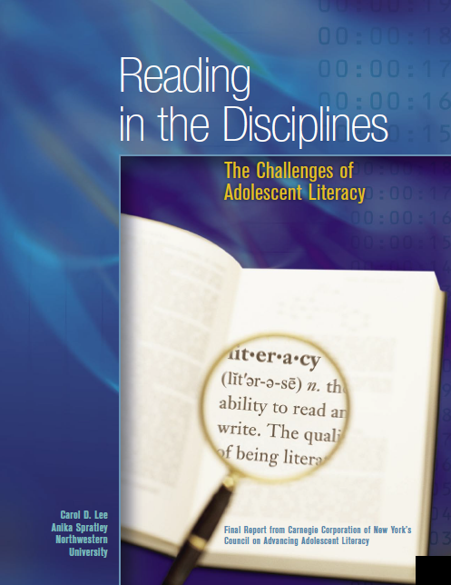
http://carnegie.org/fileadmin/Media/Publications/PDF/tta_Lee.pdf
Notes:
Another great resource for understanding the difference between DL and RICA…
…In this paper we focus on one foundational aspect of adolescent literacy that has been relatively ignored by recent reports on the problem. Our starting point is the fact that the major difference between reading in grades K-5 and reading in grades 6-12 is the transition from learning to read to reading to learn.
…Adolescents often need more sophisticated and specific kinds of literacy support for reading in content-areas, or academic disciplines.
We call this more advanced form of literacy required of adolescent readers “disciplinary literacy” because each academic discipline or content-area presupposes specific kinds of background knowledge about how to read texts in that area, and often also requires a particular type of reading.
In this paper, we will address the following:
define and illustrate what is entailed in comprehending texts within and across academic disciplines;
examine what the empirical research base says about reading comprehension generally and reading in the disciplines specifically;
briefly discuss the implications of this research base for teaching and assessments.
We conclude with some recommendations for improving policy and practice in the area odisciplinary literacy.

Slide 23

HAVE A GREAT SCHOOL YEAR!

