Slide 1


Presented by:
The KVEC/ARI English/Language Arts: Professional Action Network www.kvecelatln.weebly.com
The Reading Writing Connection: What’s All the Hype?
October 11, 2016
Conducted by ARI Literacy Fellows:
Renee’ Buchanan, Pike County
Laura Carroll, Paintsville Independent
Notes:
Carole
Welcome and Introductions
Ask participants to write down the website url…

Slide 2


Agreements for Learning
Be open to new ways of thinking about how to implement classroom instruction utilizing the Kentucky Academic Standards for English/Language Arts.
During group work be respectful of others’ opinions and points of view.
Don’t forget your e-manners (phones on silent, use of electronic devices, etc.).
Keep side conversations to a minimum.
Recognize that this is very important work and deserves
your full attention and commitment!
Notes:
Carole
Review Information on Slide

Slide 3


Want to teach a child to read? Give him a pencil.
Want to teach a child to write? Give him a book.

Slide 4
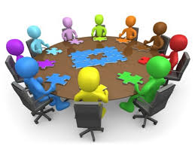
Jig Saw Activity
“The Reading – Writing Connection”
by: Rebecca Olness
Notes:
Is this a specific article they are going to read?
Might have a discussion question that follows the jigsaw activity

Slide 5
Children appear to be more likely to derive learning benefits across reading and writing when they understand that a connection exists.
Reading is the receptive side of knowledge, while writing is the productive side. Thus, reading and writing are reciprocal processes.
Writing skill is a predictor of academic success along with reading comprehension.
~Reading Research in Action, 2008.

Slide 6
Reading + Writing = Literacy
Each skill contributes to the other.
Both skills enhance engagement and reasoning.
Reading and writing involve using knowledge of language structure, including word structure, and text structure (syntax and style).
~Reading Research in Action, 2008.

Slide 7
Traits of Proficient Readers
Make connections
Self-question
Visualize
Determine importance
Make inference
Synthesize
Monitor comprehension

Slide 8
How do the reading traits translate to writing?
Make connections
Self-question
Visualize
Determine importance
Connects to topic/thesis
Writing process organization/draft
Creates a plan, outline, draft
Must determine the evidence/supporting details

Slide 9
How do the reading traits translate to writing?
Audience, readers’ concerns, counter-arguments
Research/include/create
Diction, syntax, cohesiveness
Make inference
Synthesize
Monitor comprehension

Slide 10
The Reading-Writing Connection:
What the research says…
Literacy instruction needs to explicitly present the relationship between reading and writing.
(Goodman & Goodman 1983; Shanahan 1988)
Children need to view themselves as readers and writers to build knowledge about the forms and functions of the language.
(Goodman & Goodman 1983; Mayo 2000; Miller 1982)

Slide 11
The Reading-Writing Connection:
What the research says…
As writing improves through daily communicative use, reading is enhanced.
(Goodman & Goodman, 1983)
The relationship between reading and writing is based on communication. Both should develop as a natural extension of the child's need to communicate.
(Wilson, 1981)

Slide 12
The Reading-Writing Connection:
What the research says…
Reading and writing should occur naturally to construct meaning in everyday situations.
(Miller 1982; Wilson 1981)
Reading and writing are interdependent processes that are essential to each other and mutually beneficial.
(Holt and Vacca 1984)
Notes:
12

Slide 13
The Reading-Writing Connection:
Implications for Practitioner
Implement the reading-writing connection by integrating instruction (Morrow, Pressley, Smith & Smith, 1997), preferably in collaboration with classroom teachers.
Inquiry projects involve writing, as well as reading, in the various stages of the inquiry as well as in the final learning outcomes.

Slide 14

To summarize the research…
Reading and writing can be described as parallel processes.
There is a connection between what readers do and what writers do.
Writers want to give information and readers want to seek information---metaphorically, readers and writers meet at the text.

Slide 15
Shifts in ELA/Literacy
Shift 1 | Balancing Informational & Literary Text | Students read a true balance of informational and literary texts.
Shift 2 | Knowledge in the Disciplines | Students build knowledge about the world (domains/ content areas) through TEXT rather than the teacher or activities
Shift 3 | Staircase of Complexity | Students read the central, grade appropriate text around which instruction is centered. Teachers are patient, create more time and space and support in the curriculum for close reading.
Shift 4 | Text-based Answers | Students engage in rich and rigorous evidence based conversations about text.
Shift 5 | Writing from Sources | Writing emphasizes use of evidence from sources to inform or make an argument.
Shift 6 | Academic Vocabulary | Students constantly build the transferable vocabulary they need to access grade level complex texts. This can be done effectively by spiraling like content in increasingly complex texts.
Notes:
Give participants this as a handout

Slide 16
Review of the ELA Instructional Shifts
Katie Gerson
Common Core Fellows
Explanation of Shifts
https://www.engageny.org/resource/quick-explanation-of-the-shifts-by-kate-gerson
Notes:
Stop at 5:45
Most of her examples are secondary, but elementary can make connections

Slide 17
ELA Appendix A Pages 23-25
How do the Common Core Standards (Kentucky Academic Standards) connect reading and writing?
Highlight reading and writing connections
Discussion Roundtable
Notes:
Read through the introduction of The Common Core
http://www.corestandards.org/ELA-Literacy/introduction/students-who-are-college-and-career-ready-in-reading-writing-speaking-listening-language/
highlight all the connections you find between reading and writing. Discuss these connections at your table using a collaborative learning technique called Discussion Roundtable. Next, using another collaborative learning technique called “Three Stay One Stray” have one of your group members stray to another group to learn how those group members feel they already make the reading writing connection in their classrooms. Return to your group and record this information on chart paper to be hung around the room. Once all the chart papers are displayed walk around individually and add to you Strategies Collection Chart.

Slide 18
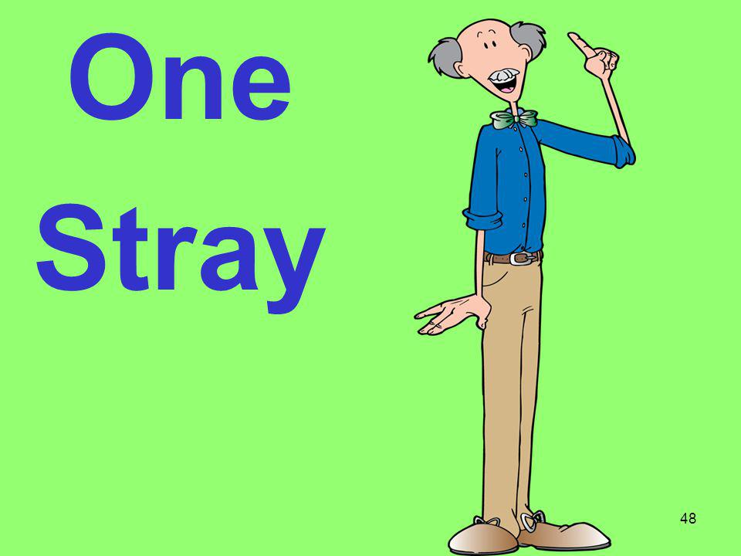
Three Stay, One Stray
One group member “strays” to another group
In the mixed groups, share your own strategies for making the connection between reading and writing
Collect ideas from others
Notes:
collaborative learning technique called “Three Stay One Stray” have one of your group members stray to another group to learn how those group members feel they already make the reading writing connection in their classrooms. Return to your group and record this information on chart paper to be hung around the room. Once all the chart papers are displayed walk around individually and add to you Strategies Collection Chart.

Slide 19


Return to your group
Chart strategies for connecting reading and writing
Gallery Walk
Strategies Collection Chart

Slide 20
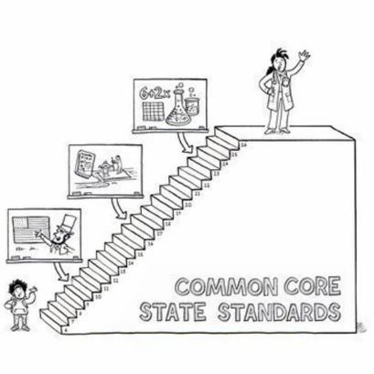
English/LA Progressions
Notes:
Activity with the progressions?

Slide 21
Where to Start?
“Students need to become stronger writers, and to do that, they need expert instruction, time to write, and meaningful opportunities for writing a wide range of informational, argumentative, and narrative texts. They also must be proficient readers of more complex texts, and that means they need expert instruction and opportunities to read a wide range and very deep volume of texts.”
Calkins Page 18

Slide 22
How do we help our students develop and use these habits ?
Model it!
Metacognition is one of the core Novice Reduction strategies
Teachers model Read Aloud, Think Aloud (RATA) in class.
This involves reading aloud a small portion of text and modeling (or thinking out loud) the strategies that you use to comprehend text.

Slide 23


Students who engage in frequent discussions about what they read are more motivated and have higher achievement scores than students who do not interact with books.
Mullis, Campbell & Farstrup, 1993
Engaging students in writing about their responses to reading leads to better reading achievement.
Tierney & Shanahan, 1991

Slide 24
Kentucky Academic Standards for English/LA Emphasis on Text Complexity
Students should be exposed to complex texts and should be taught strategies for how to grapple with these types of texts.
Kentucky Academic Standards for ELA also call for teaching students how to read a text more deeply.
For instance, no longer are students being asked to identify characters and plot. Students now are asked to compare and contrast, evaluate, and reason. Also, students are no longer just reading for information. Instead, they are being asked to compare author’s perspectives and points of view.

Slide 25
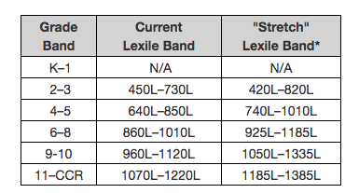
Determining Text Complexity
Lexile Level

Slide 26
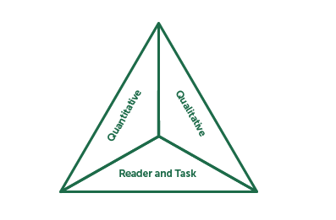
Text Complexity…
Notes:
5 min video
Have teachers turn their attention to the text complexity planning sheet and discuss what qualitative measures are

Slide 27

LDC
Navigating LDC Modules
Notes:
The most powerful way to combine the reading and writing standards into daily instruction is by giving students a meaningful purpose for reading that will ultimately lead to them writing.
Share experience of developing LDC modules
One of the best ways to see how to combine the reading standards is to analyze LDC Modules
Look at blank templates so teachers can start seeing how they could create their own module and then let that lead into how icurio could be a helpful resource in putting your own module together.

Slide 28

icurio
icurio
icurio is a valuable resource to support LDC module development and instruction
Provided at no cost to KVEC districts
icurio is a source for specific resources aligned to reading and writing standards.

Slide 29


Slide 30
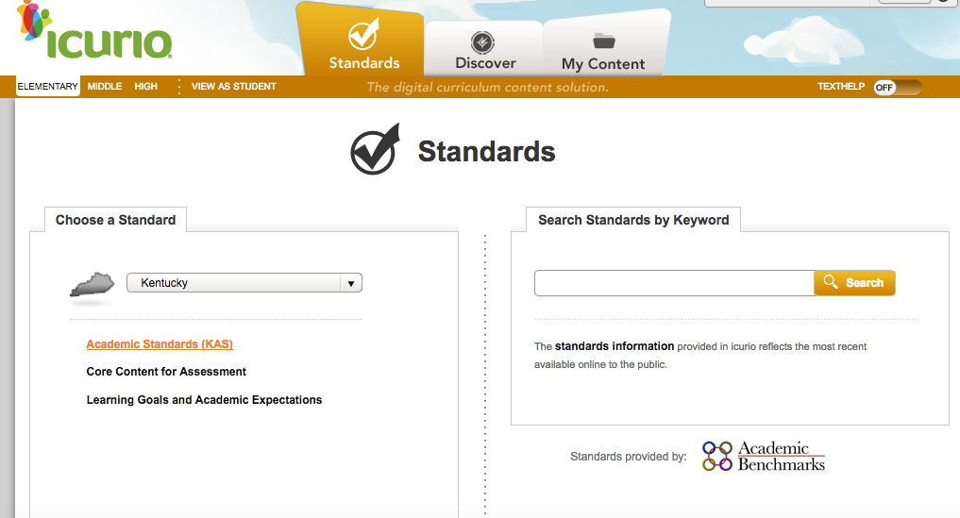

Slide 31
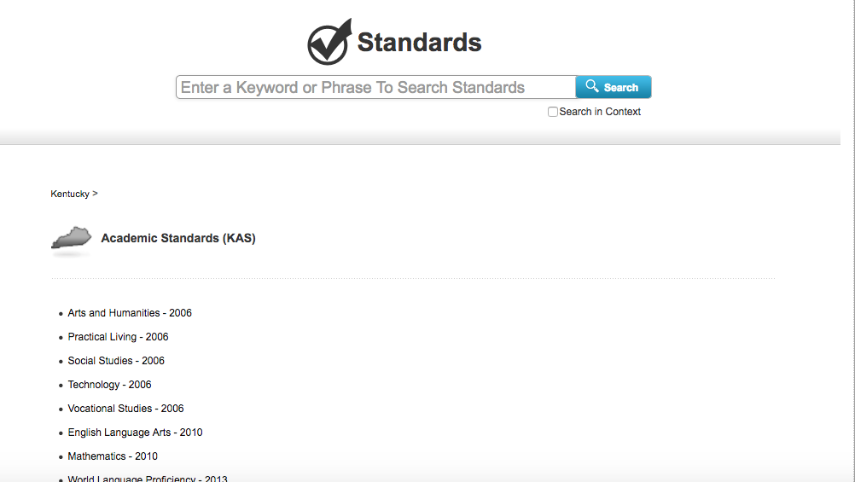

Slide 32


Slide 33
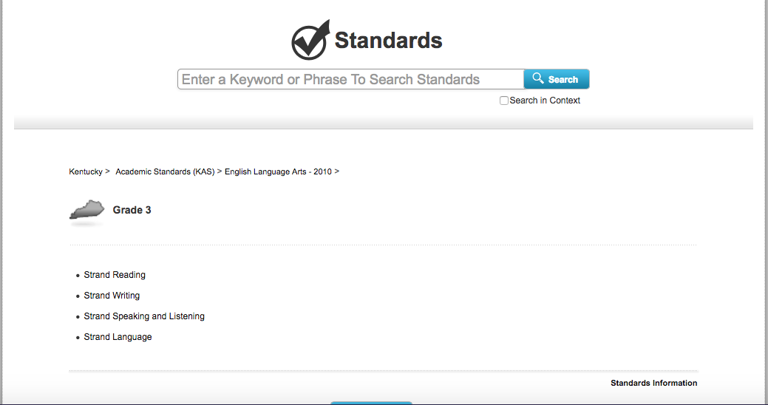

Slide 34
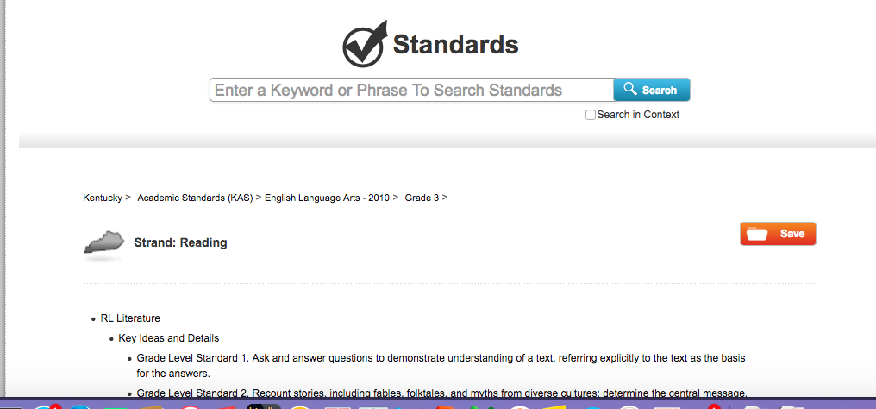

Slide 35
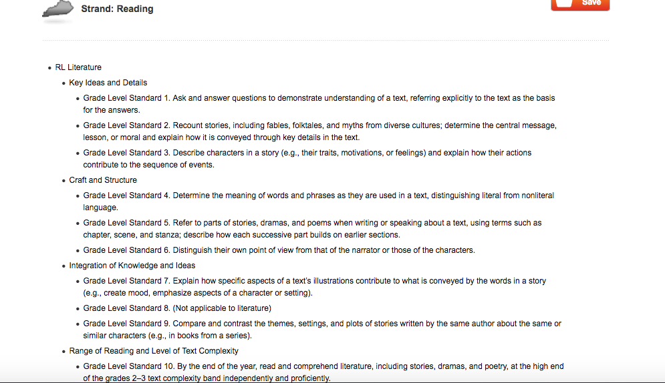

Slide 36
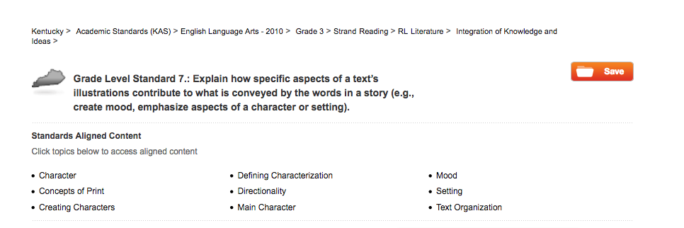

Slide 37
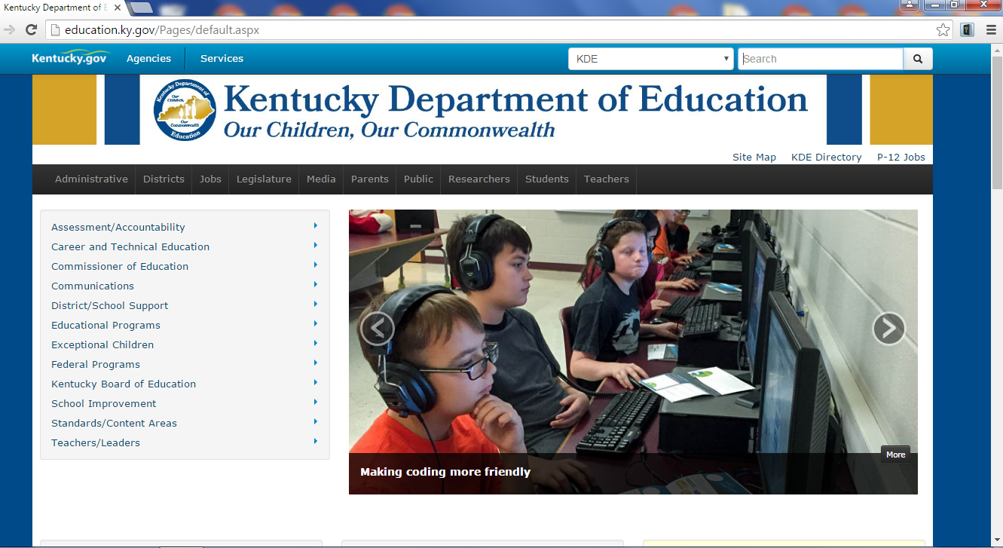
Kentucky Marker Papers http://education.ky.gov/Pages/default.aspx

Slide 38
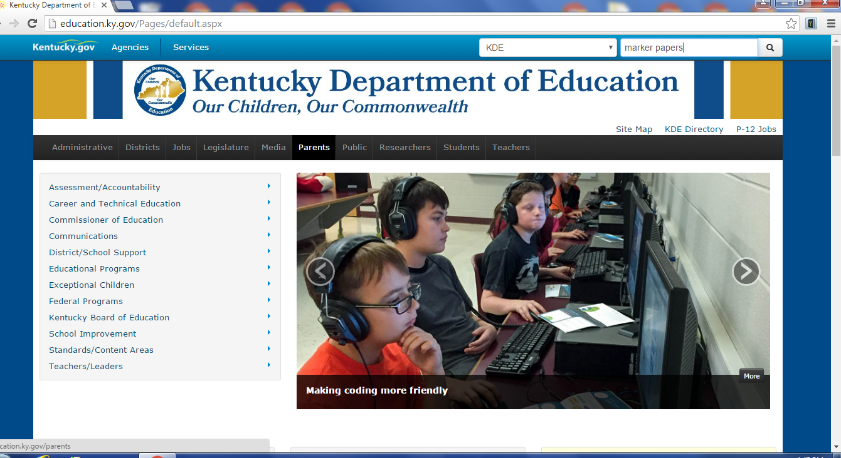

Slide 39
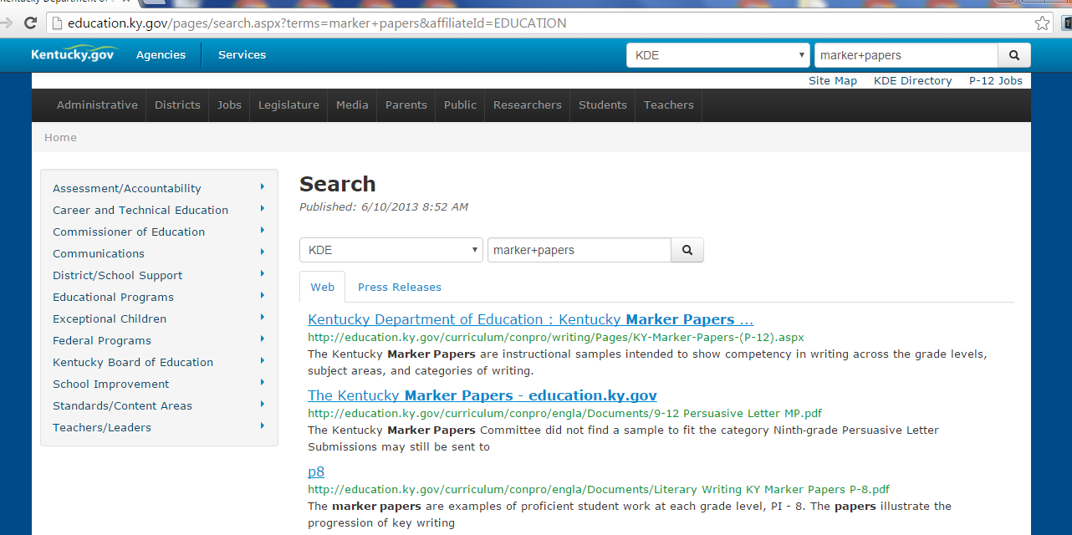

Slide 40
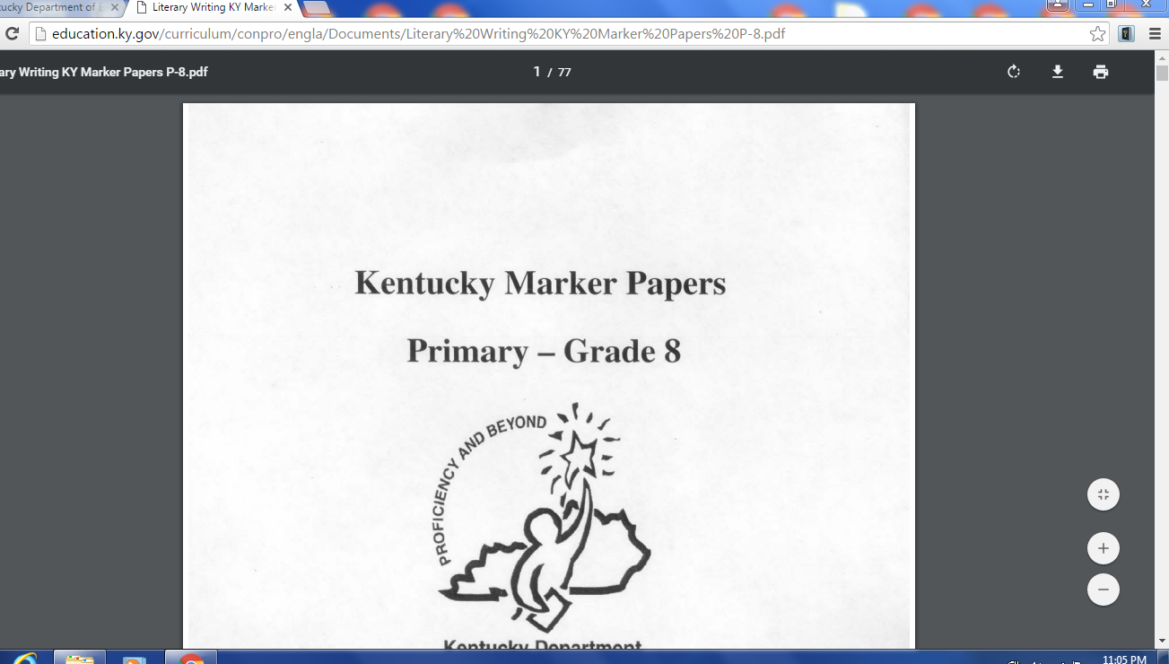

Slide 41
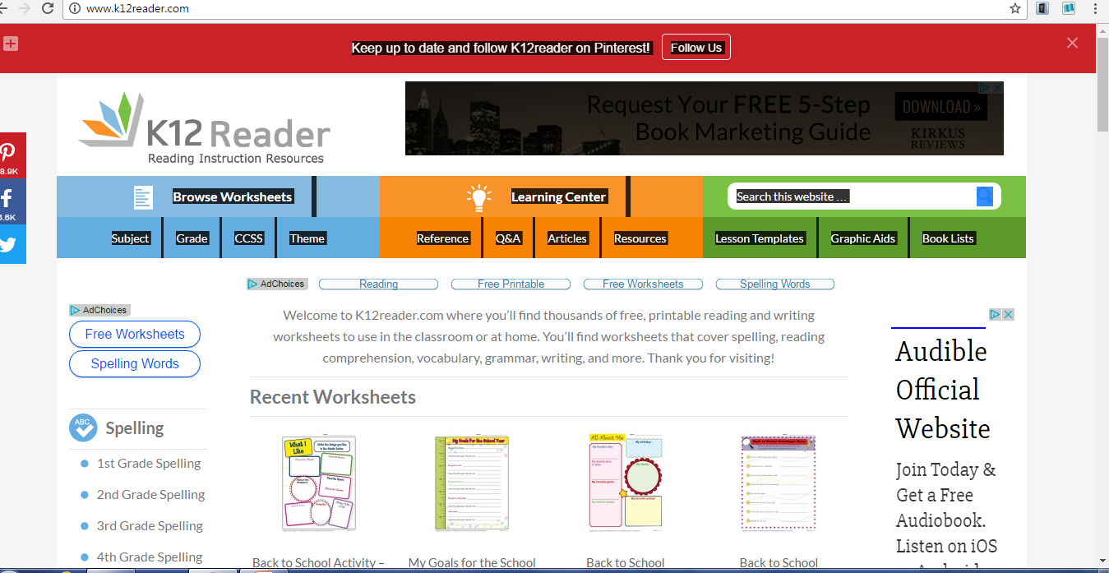
http://www.k12reader.com/

Slide 42
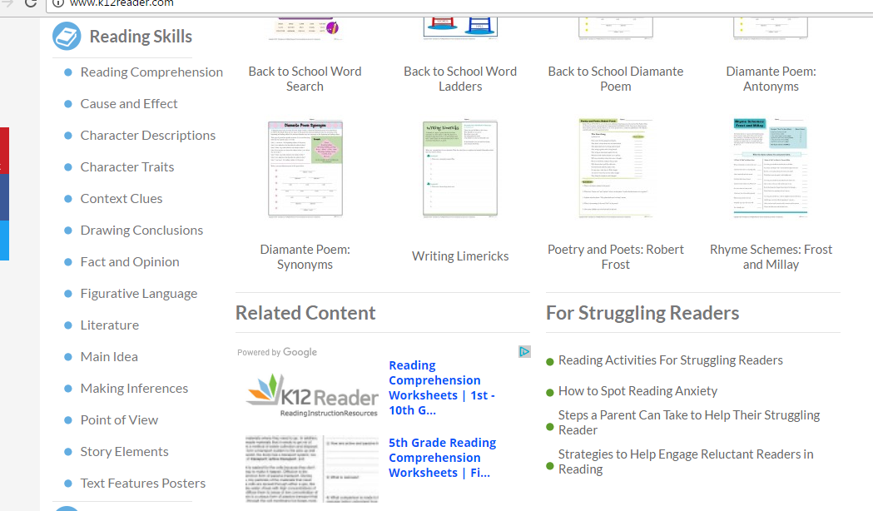

Slide 43
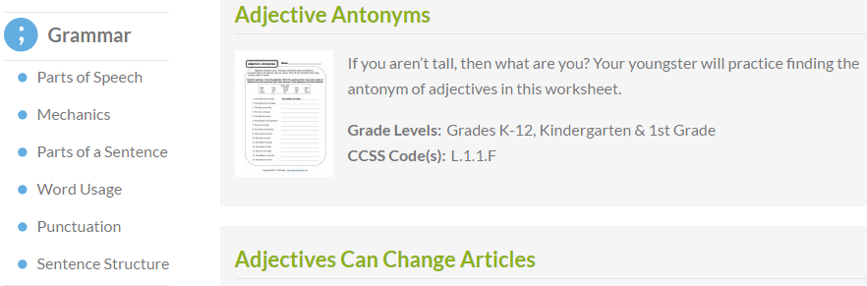

Slide 44
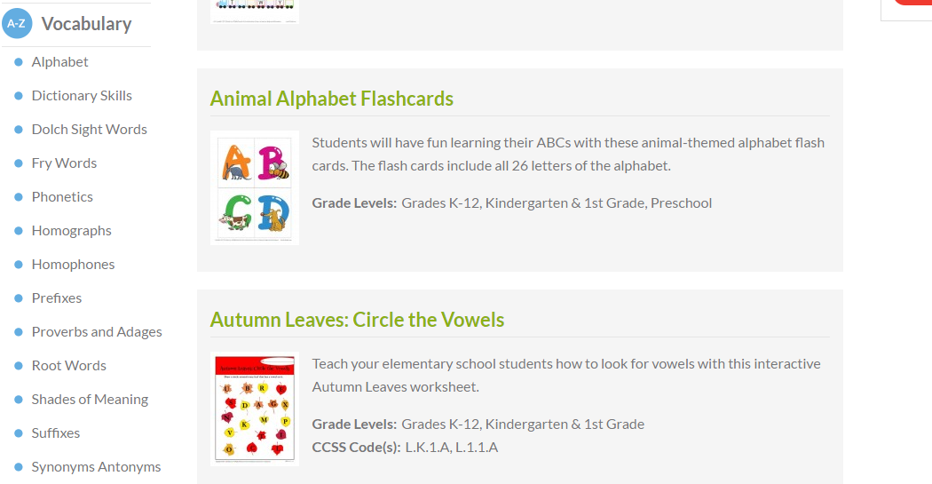

Slide 45
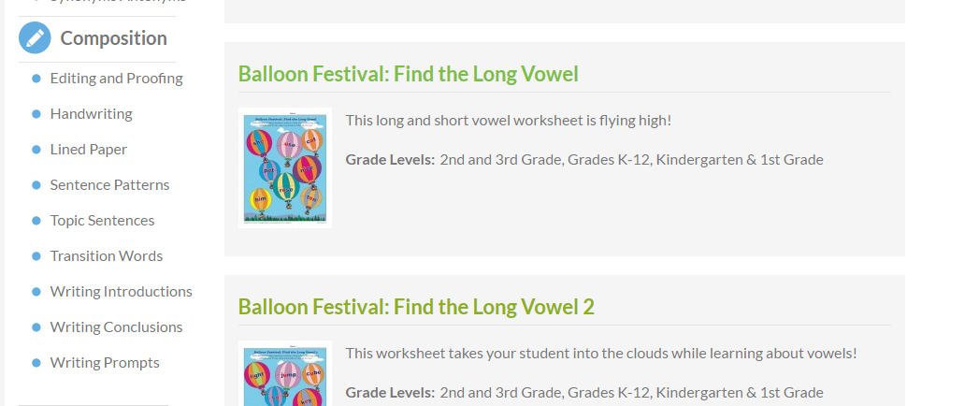

Slide 46
Literacy Plan Summary
Students should all be exposed to rigorous, complex texts during shared reading time.
Students should be asked to read these texts deeply and to engage in meaningful writing tasks as a result of these texts.
Students should also have 45 minutes a day in which they are reading books at their personal reading level. This is what I refer to as guided reading time.

Slide 47

Appendix C
Appendix C
Each of the samples exhibits the level of quality required to meet the Writing standards for that grade.
Notes:
You might rethink how you do the ordering activity…that is a LOT of copying Maybe just include one from each grade level

Slide 48
“Of course, in order for students to make necessary progress, they need at least forty-five minutes in school and more time at home to read books that they can read with 96% accuracy, fluency, and comprehension.”
Calkins pg. 18
Notes:
This is the type of reading students should be doing during guided reading instruction. Also, pair up with parents to make sure students are reading the right material at home. Reading A-Z is a great site that offers leveled readers you could copy and send home.

Slide 49
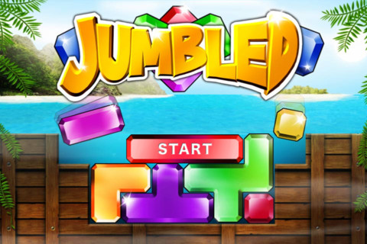
Marker Paper Jumble
Activity

Slide 50
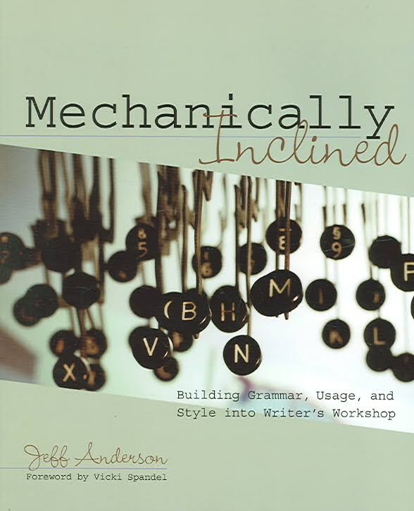
Mentor Texts/Sentences
“Mechanically Inclined” by Jeff Anderson

Slide 51
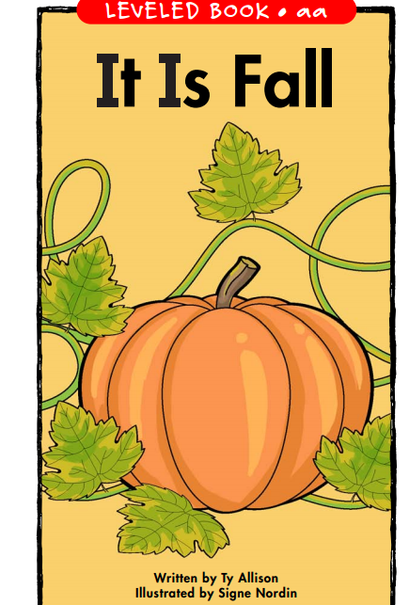
“It Is Fall ”
Grades K-1
Mentor Sentence
Reading – Writing Connection
https://www.readinga-z.com/

Slide 52

“Jack-o’-Lanterns”
Grades 2-3
Mentor Sentences
Reading-Writing Connection
https://www.readinga-z.com/

Slide 53
Narrative Endings Mentor Texts
Read Aloud “Alexander and the Terrible, Horrible, No Good, Very Bad Day”
Discuss Reflection Ending
Model: Old Navy Story
As I sat on the cold, lonely bench outside of Old Navy I looked up and saw my mother and sister walking out of the store laughing. While I sat there humiliated, they were somehow able to find humor in our current situation. Luckily, laughter is contagious. It wasn’t long until I too joined in and realized that sometimes you have to laugh at life.

Slide 54
Narrative Ending Mentor Texts
In groups of 4, choose a personal experience that would make a good narrative.
Write an ending to this experience using the reflection ending technique.
Work collaboratively with your partners to come up with a great ending!

Slide 55
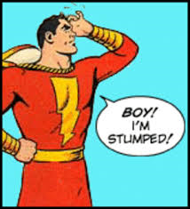
Stump Your Partner
Activity

Slide 56


Contact Information
Carole Mullins, KVEC Literacy Instructional Specialist
carole.mullins@hazard.kyschools.us
Renee’ Buchanan, Ari Literacy Fellow
renee.Buchanan@pike.kyschools.us
Laura Carroll, ARI Literacy Fellow
laura.carroll@paintsville.kyschools.us
WEBSITE
www.kvecelatln.weebly.com
Notes:
Carole

Slide 57

Notes:
Carole, Renee’ and Laura

