Slide 1
Presented by: The KVEC/ARI English/Language Arts: Professional Action Network www.kvecelatln.weebly.com
The Reading Writing Connection: How Can I Possibly Do It All ?
November 18, 2016
Conducted by ARI Literacy Fellows:
Renee’ Buchanan, Pike County
Laura Carroll, Paintsville Independent
Notes:
Carole
Welcome and Introductions
Ask participants to write down the website url…

Slide 2
Agreements for Learning
Be open to new ways of thinking about how to implement classroom instruction utilizing the Kentucky Academic Standards for English/Language Arts.
During group work be respectful of others’ opinions and points of view.
Don’t forget your e-manners (phones on silent, use of electronic devices, etc.).
Keep side conversations to a minimum.
Recognize that this is very important work and deserves
your full attention and commitment!
Notes:
Carole
Review Information on Slide

Slide 3
Shifts
LDC/Close Reading
On-Demand/Color Coding
Argumentative/Opinion Writing
Mentor Sentences
Giving Students Feedback on Writing

Slide 4
Moving away from the Basal: Readworks, Engage NY, LDC, Read Write Think
Combining reading, writing, and content aides a teacher in obtaining success with the ELA shifts the common core demands
Guided Reading Instruction
Notes:
Have Renee add her talking points to this slide

Slide 6
Design of the KAS English/LA Standards
College and Career Readiness
English Language Arts
Reading (20)
1)Informational (10)
2)Literary (10)
Writing (10)
Speaking & Listening (6)
Language (6)
Literacy in History/Social Studies, Science, and Technical Subjects
Reading (10)
Writing (10)

Slide 7
Distribution of Communicative Purposes by Grade in the NAEP Writing Framework
GRADE | TO PERSUADE Opinion/Argument | TO EXPLAIN Informative/ Explanatory | TO CONVEY EXPERIENCE Narrative
4 | 30% | 35% | 35%
8 | 35% | 35% | 30%
12 | 40% | 40% | 20%
It follows that writing assessments aligned with the Standards should adhere to the distribution of writing purposes across grades outlined by NAEP.
ELA CCSS Page 5
Notes:
Carole
Impact of Shift 1 in terms of the 3 Modes of writing and WRITING ASSESSMENTS…
As with reading, the percentages in the table reflect the sum of student writing, not just writing in ELA settings.

Slide 8
Notes:
Handout: Shifts from Nov 16th training with Carole

Slide 9
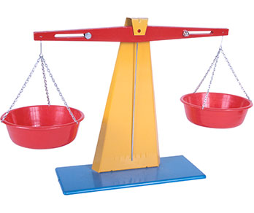

Slide 12
Notes:
LDC makes it a point to have students engage in conversations regarding what they are reading in class.

Slide 14
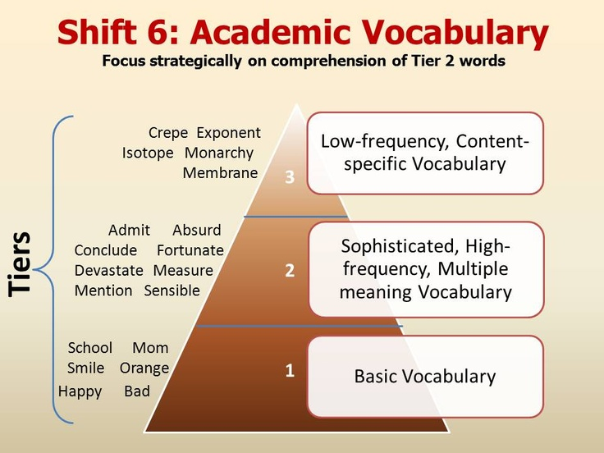
Notes:
14

Slide 15
Shifts at the Heart of the Standards
Complexity: Regular practice with complex text and its academic language.
Evidence: Reading and writing grounded in evidence from text, literary and informational.
Knowledge: Building knowledge through content

Slide 17
The Components of an LDC Module
Task
Task Engagement
Task Analysis
Active Reading
Academic Integrity
Essential Vocabulary
Note-Taking
Transition to Writing
Writing Process

Slide 18
Helpful LDC Tips…
It is always a good idea to give each student a folder. Explain that this folder will count for a grade just like their culminating task will count for a grade. The folder’s purpose is to give the student a place to keep all of their articles and graphic organizers.
Allow students to decorate their folder based on the task they are trying to complete. This gives the students more ownership over their project.
Think of each of the PowerPoint slides as a different lesson plan! Although they are called tasks they are really just various lesson plans that make up the unit.

Slide 19
LDC: The Changing of Earth’s Surface
What causes the surface of the Earth to continually change? After reading a variety of informational texts, write an essay in which you explain the processes of weathering, erosion, and deposition and their effect on the surface of the Earth. Support your response with evidence from the text.
LDC

Slide 21
Close Reading Steps
1st Read:
Read the text without stopping to get the “gist”.
2nd Read:
Number the Paragraphs
Chunk the Text
Identify unfamiliar words.
3rd Read:
In the left margin summarize each chunk in 10 words or less.
In the right margin write any questions or comments you have.
Find a place on the paper to write what you think the main idea or theme of the text is.

Slide 23
Notes:
KDE
iCurio

Slide 24
Click on Assessment/Accountability
Click on Assessments
Click on K-PREP
http://education.ky.gov/AA/Assessments/Pages/K-PREP.aspx

Slide 25
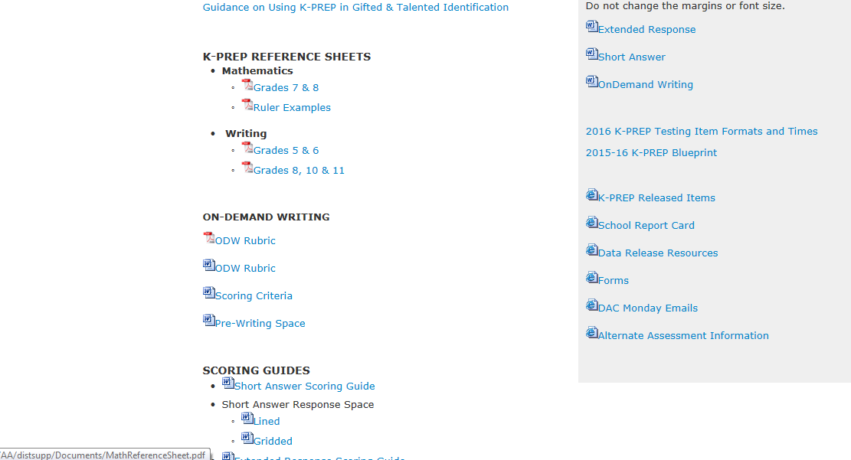
http://education.ky.gov/AA/Assessments/Pages/K-PREP.aspx

Slide 26
http://education.ky.gov/AA/items/Pages/K-PREPItems.aspx

Slide 28
Color Coding Writing

Slide 29
In 1890, N. Dale in his book , “Reading by Rainbow and Color Story”, introduced color as a learning tool. Gattegno, in 1966, in his book, “Words in Color”, described the system to teach color coding to teach phonics for the first time. Color coding is: - Mulit-sensory - Supports scaffolding, clustering and association [Lamberski & Dwyer, 1983] - Is research based - Involves kinesthetic and tactile modalities for learning [Winters & Hoats, 1984]

Slide 30
Paragraph Color Coding
“If I Were President”
Topic Sentence - Blue
Detail 1 - Green
Detail 2 - Purple
Detail 3 - Red
Concluding (Closing) Sentence that repeats the Main Idea/Theme - Blue

Slide 31
My Dog, Romeo
Paragraph 1: Introduction
Eye Catchy Introductory Sentence/Main Idea/Theme of your paper - Blue
Detail #1/Sentence you will later develop into a paragraph in more detail - Green
Detail #2/Sentence you will later develop into a paragraph in more detail -Purple
Detail #3/Sentence you will later develop into a paragraph in more detail - Red
Thesis/Concluding Sentence that repeats the Main Idea/Theme of your paper - Blue

Slide 32
Paragraph 2: Detail #1 - Green
Topic Sentence Example #1 (from the Introduction) Yellow
3 Example Sentences that support your Topic Sentence – Green
Concluding Sentence that restates Example #1 – Green

Slide 33
Paragraph 3: Example #2 – Purple
Topic Sentence Example #2 (from the Introduction) – Yellow
3 Example Sentences that support your Topic Sentence – Purple
Concluding Sentence that restates Example #2 – Purple

Slide 34
Paragraph 4: Example #3 –Red
Topic Sentence Example #3 (from the Introduction) - Yellow
3 Example Sentences that support your Topic Sentence – Red
Concluding Sentence that restates Example #3 – Red

Slide 35
Paragraph 5: Conclusion
Reword Eye Catchy Introductory Sentence /Main Idea of your paper - Blue
Reword Detail #1- Green
Reword Detail #2 – Purple
Reword Detail #3- Red
Concluding Sentence that restates the Thesis/Main Idea – Blue

Slide 36
Remember that after you have your ideas down in this format, you can make your writing stronger by: expanding sentences combining sentences varying sentence structure using a thesaurus to find synonyms to keep your vocabulary interesting adding dialogue adding flasbacks, thoughtshots, fore-shadowing textual evidence

Slide 38
Stump Your Partner Activity

Slide 39
Gradual Release of Responsibility
Teacher will pretend she has already completed this activity. She will have her Stump Your Partner Graphic Organizer Filled Out. Next, she will show students how to use the information she gathered to write an argumentative paragraph that includes a claim, counterclaim, and rebuttal using a paragraph frame. Students only watch this focused instruction.
Stump Your Partner Activity: Students will engage in conversation about the different view points they hold on a certain issue. They will take notes of the opposing view in order to help them develop their counterclaim.
Teacher brings students back and allows them to work on their paragraph using guided instruction.
Students will return back to their partners to work collaboratively on developing another paragraph using the paragraph frame provided.
Finally students will take their notes from the Stump Your Partner Activity in order to develop their own paragraph independently.
“I do, We do it, You do it together, You do it alone”

Slide 41
Mentor Texts/Sentences
“Mechanically Inclined” by Jeff Anderson

Slide 42
Where do I find them?
https://www.readinga-z.com/
http://textproject.org/
http://www.corestandards.org/assets/Appendix_B.pdf
http://www.readworks.org/
https://k12.thoughtfullearning.com

Slide 43
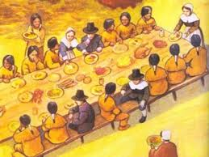
Mentor Text Modeling “The First Thanksgiving” http://www.readworks.org/passages/first-thanksgiving

Slide 46
Kahoot
Providing Student Feedback Quiz
Teacher Login: https://create.kahoot.it/#login?next
Student Login:
https://kahoot.it/#/

Slide 51
Time to…
Share
Plan
Discuss
Review Websites
Ask Questions

Slide 52
Contact Information
Carole Mullins, KVEC Literacy Instructional Specialist
carole.mullins@hazard.kyschools.us
Renee’ Buchanan, Ari Literacy Fellow
renee.buchanan@pike.kyschools.us
Laura Carroll, ARI Literacy Fellow
laura.carroll@paintsville.kyschools.us
WEBSITE
www.kvecelatln.weebly.com
Notes:
Carole

Slide 53
Notes:
Carole, Renee’ and Laura

