Slide 1
Socratic seminar
Inner and Outer Circle Model

Slide 2
Standard Alignment
Standard One Speaking and Listening: Prepare for and participate effectively in a range of conversations and collaborations with diverse partners, building on each others’ ideas and expressing their own clearly and persuasively.
Notes:
Socratic Seminar is an effective way to meet this standard in all grade levels. Other standards from ELA will also be met according to the nature of the discussion. For example, my students discussed “Strawberry Spring” by Stephen King and in doing so met Reading Literature Standard Three: Analyze how and why individuals, events, and ideas develop and interact over the course of a text, and Reading Literature Standard Six:Assess how point of view or purpose shapes the content and style of a text.

Slide 3
Protocol: Structure is the key to a successful seminar.
Analyze primary text
Question Generation
Organized Space for Discussion
Specific Guidelines for Discussion
Roles for Everyone
Minimal Teacher Guidance During Discussion
Time Limit
Reflection
Notes:
Seminars should be centered around a primary text. That said, the text could be a video, cartoon, commercial, article, story, or photograph; however, it is essential for the discussion to be rooted in a text.
Students should generate questions prior to the seminar. There are guidelines for the independent generation of the questions in your packet, but I have recently discovered that using QFT with students prior to seminar is also an excellent way to produce effective questions.
Organize desks so that you have two circles one inside the other. This allows for fluid discussion and keeps students focused.
Guidelines for discussion- Dialogue is collaborative, Listen to others, it is not about right or wrong, share your great ideas, participate but don’t dominate.
Roles for everyone—For those inside the circle, their role is to participate fully in the discussion. For those outside the circle, their role is evaluator/observor. Assign each student a partner to watch during the discussion. Provide form for them to mark participation and make notes on.
Unless students are stuck, go entirely off course, or ask a direct question, the teacher should allow them to negotiate the conversation without interfering. Teacher’s role is to monitor participation primarily.
Giving students a specific amount of time for each round of conversation is imperative for success. I usually give 12 minutes per round. This allows plenty of time for set-up and follow-up discussion and reflection.
Ask students to reflect on seminar content and their participation. Provide specific question or questions to direct reflection.

Slide 4
Seminar Really Works! Watch This…
Contact Rebecca King: rebecca.king@pikeville.kyschools.us for access to the Socratic Seminar video.
Notes:
Video clip of seminar.

Slide 5
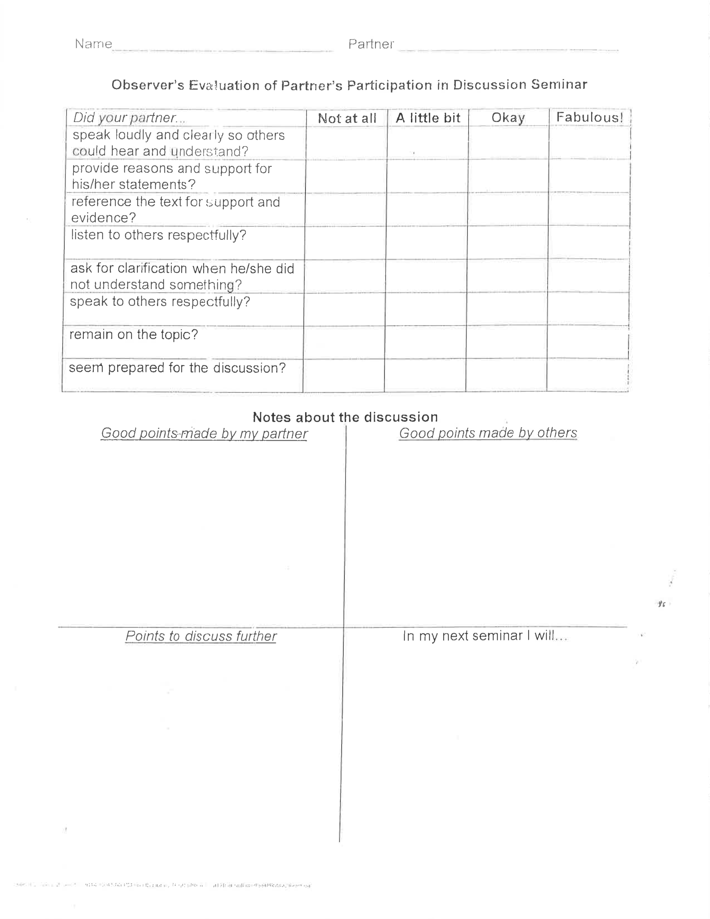
Inner/Outer Circle Logistics

Slide 6
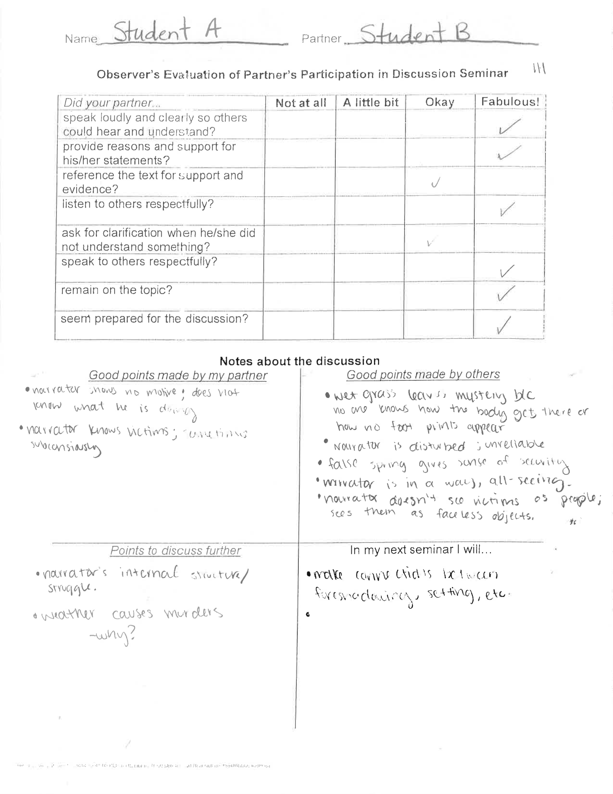
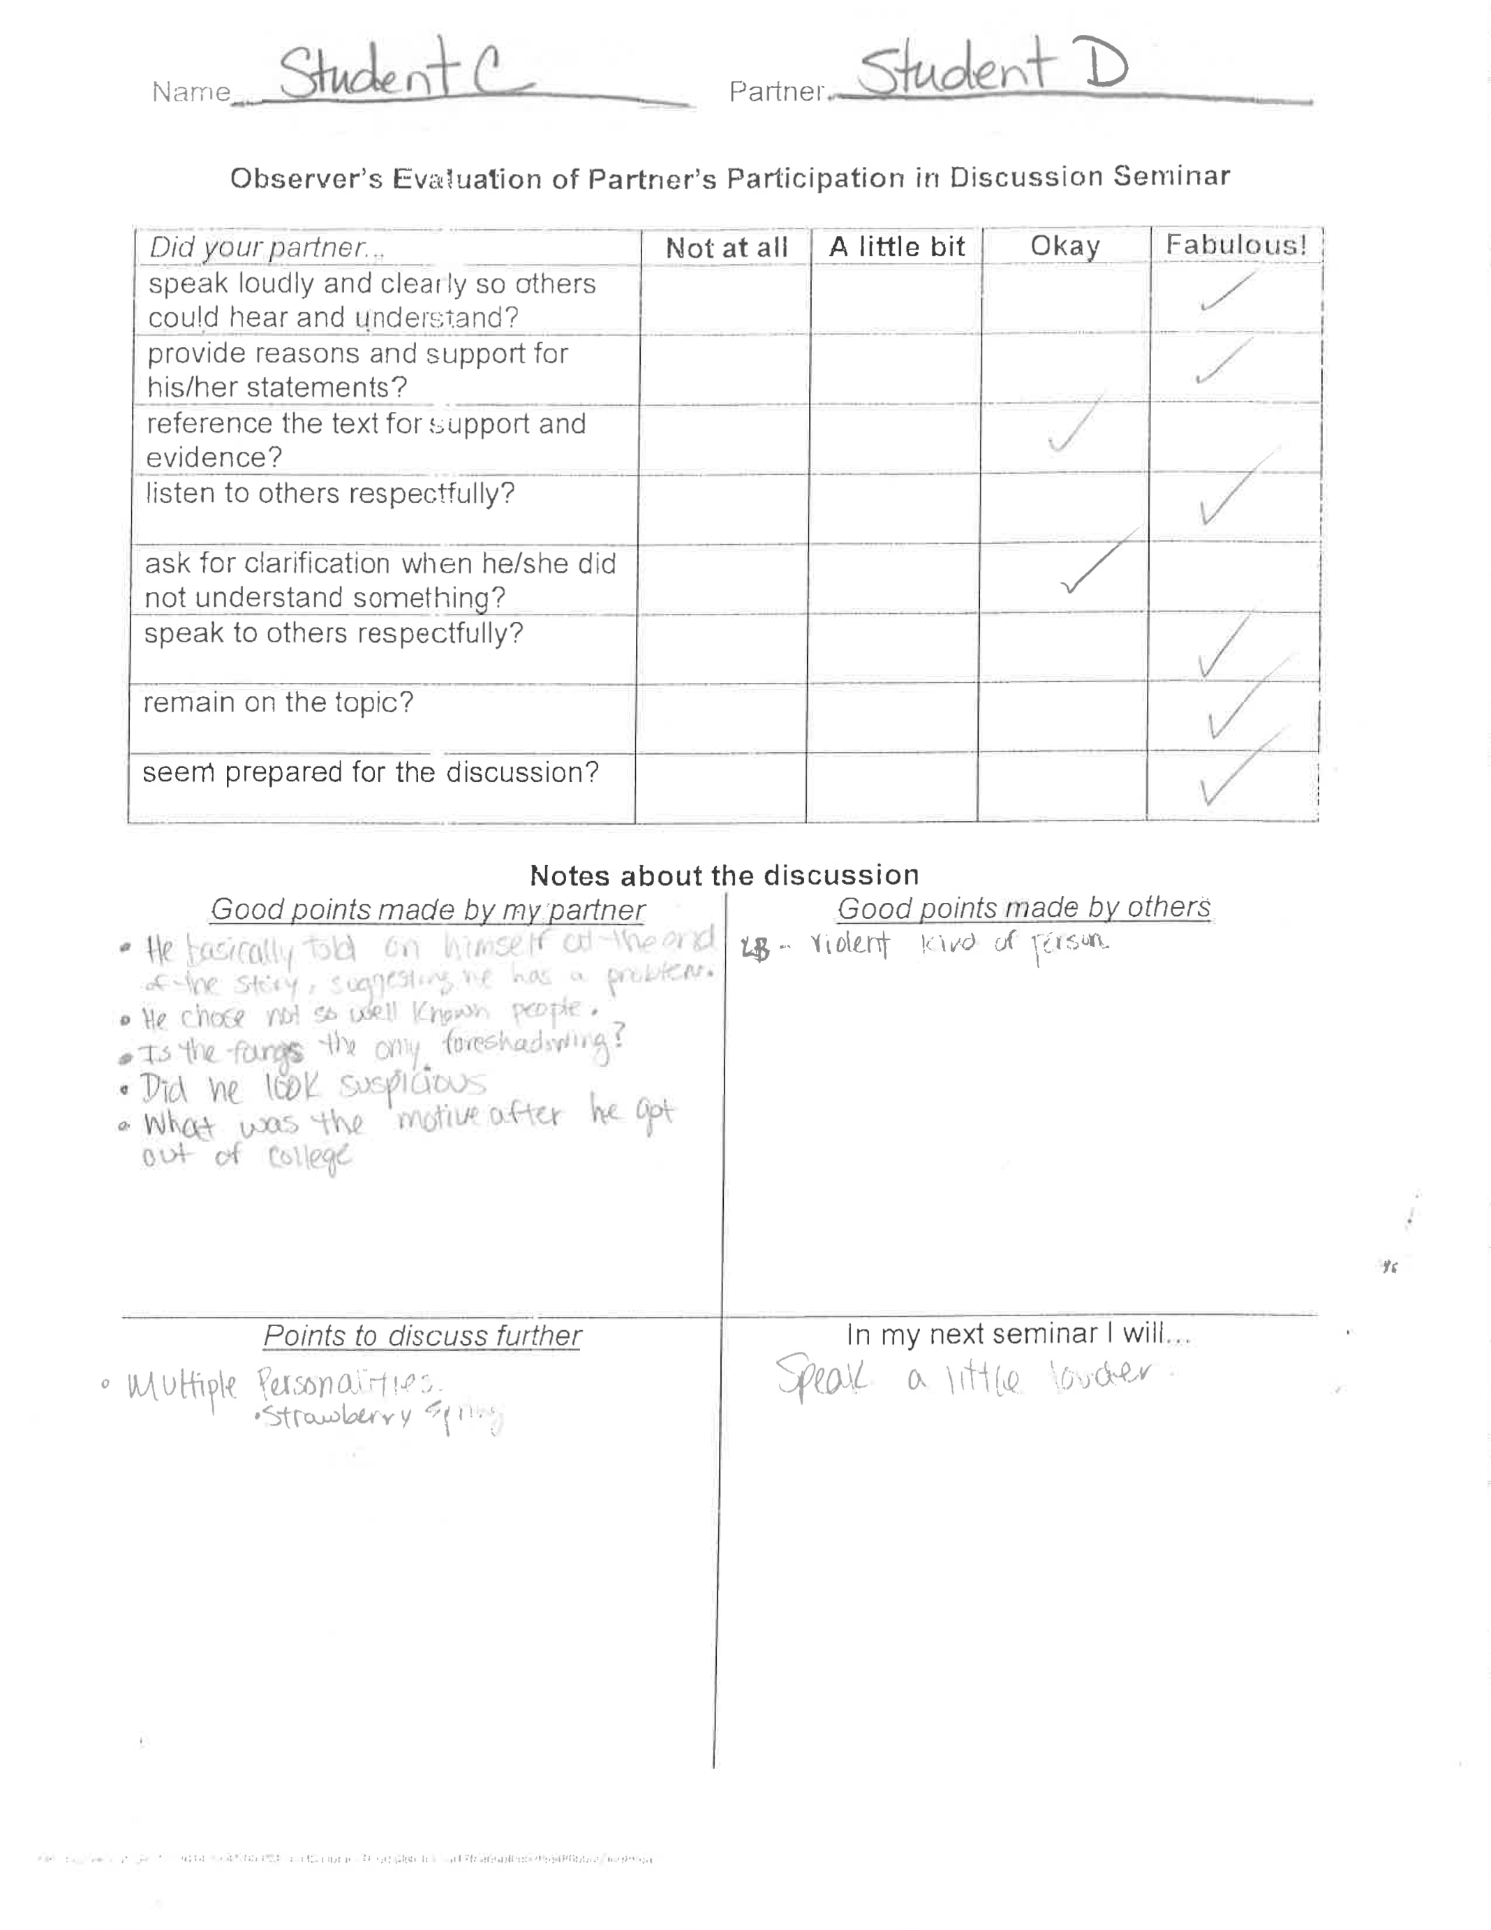

Slide 7
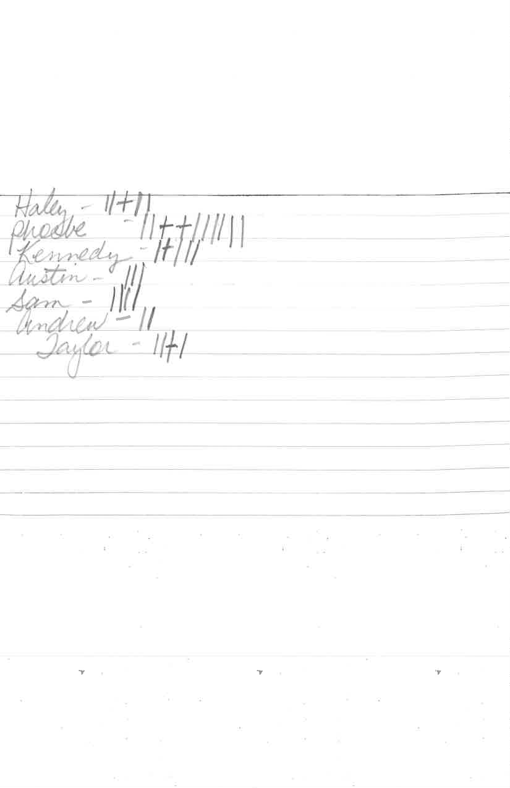
Grading
Notes:
There are many rubrics and forms on the AVID website for marking student participate, but primarily, it is just a matter of keeping track which can be done informally.

Slide 8


Contact Information
Carole Mullins, KVEC Literacy Instructional Specialist
carole.mullins@hazard.kyschools.us
Diedra Carpenter, ARI Literacy Fellow, Magoffin County, Herald Whitaker Middle School Curriculum Coach diedra.carpenter@magoffin.kyschools.us
Rebecca King, NBCT, ARI Literacy Fellow, Pikeville Independent High School 11th and 12th grade AP Language & AP Literature rebecca.king@pikeville.kyschools.us
Sonya Slone, NBCT, ARI Literacy Fellow, Allen Central High School 10th-12th English sonya.slone@floyd.kyschools.us
Rachel Holbrook, Ed.D., NBCT, ARI Literacy Fellow, Johnson County Schools Technology Integration Specialist & Johnson County Middle School Language Arts rachel.holbrook@johnson.kyschools.us
Notes:
Carole

