Slide 1
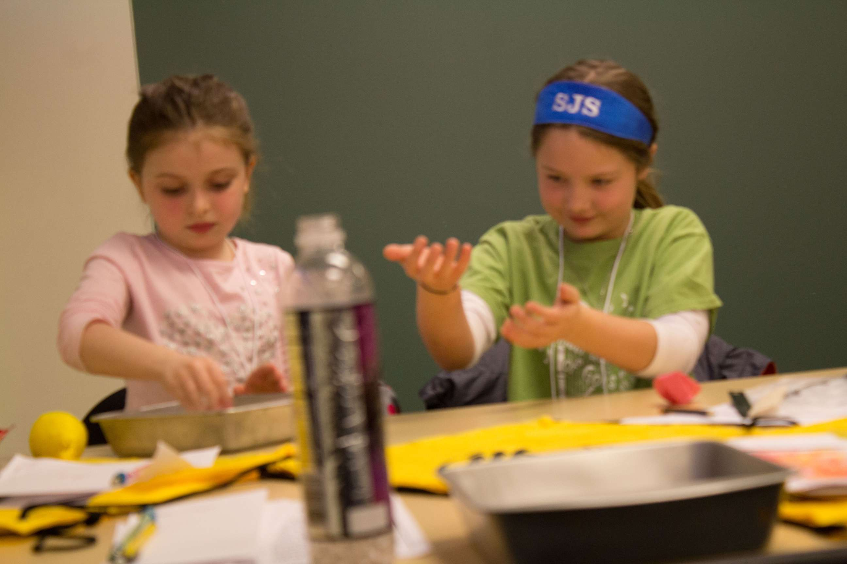
STEAM and Social Studies in Elementary Classrooms
Kimberly Code, PhD
Northern Kentucky University
codek@nku.edu

Slide 2
Multiple Intelligences BINGO
Find someone in the room who can answer each of the questions on your BINGO card.
Have each of them sign the card in the box with the question they answered.
Cover all – Must get autographs in each box
Curricular Connections

Slide 3
Using Primary Sources
Engage Students with Primary Sources
Who created this source?
When was it created?
Where does your eye go first?
What do you see that you didn’t expect?
What powerful words and ideas are expressed?
What feelings and thoughts does the primary source trigger in you?
What questions does it raise?
Promote Student Inquiry
What was happening during this time?
What was the purpose in creating this source?
What does the creator do to get his/her point across?
What was the audience?
What biases or stereotypes do you see?
What questions does this source raise for you?

Slide 4
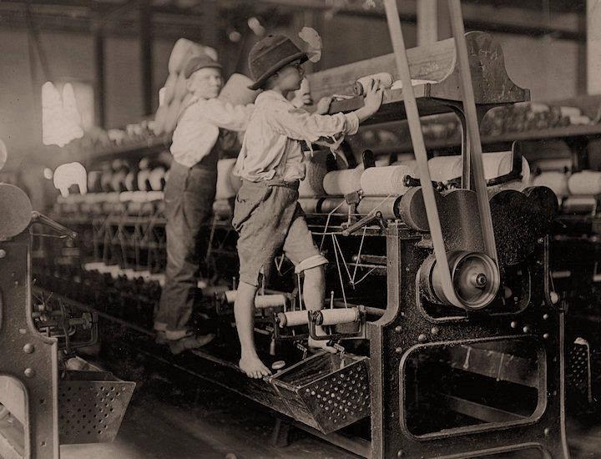
Comparing My Life with Children 100 Years Ago

Slide 5
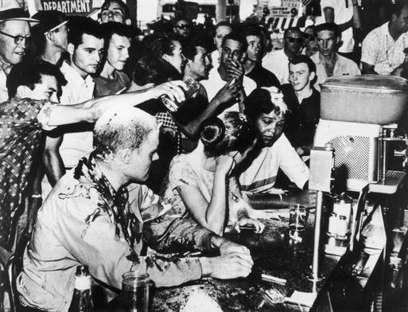
Freedom on the Menu
Woolworth’s Lunch Counter
Think of something you’re not allowed to do.
Why can’t you do it?
Who keeps you from doing it?
What could you do to convince someone to let you do it?
Reading Helpers
Look for new vocabulary
Guess what comes next
How does _____ feel?
Looking for more facts
Readers’ Theater

Slide 6
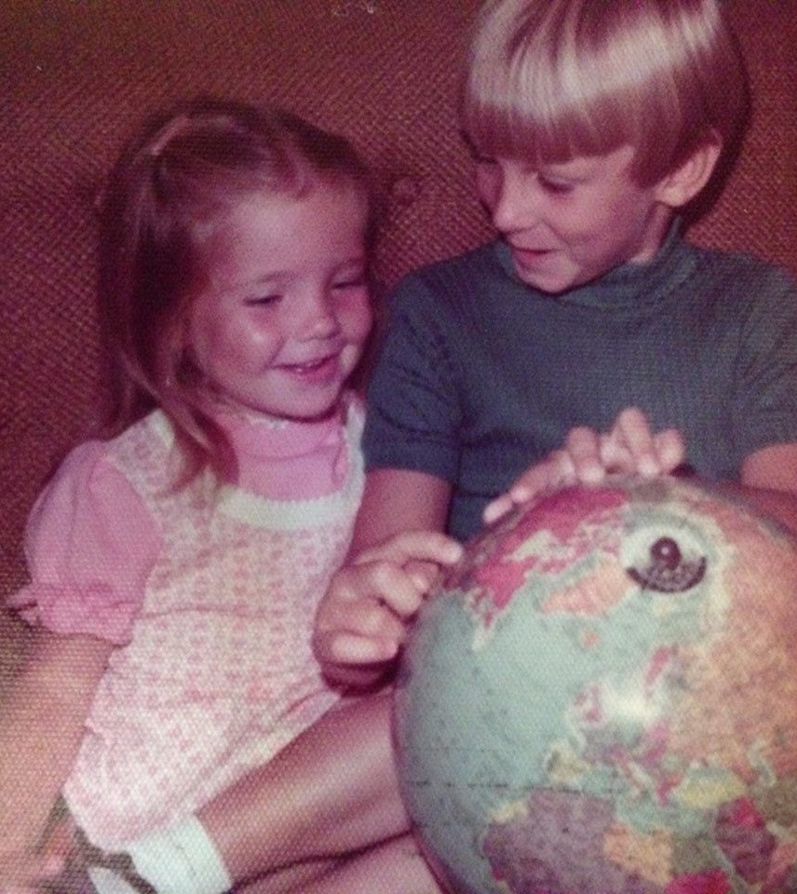
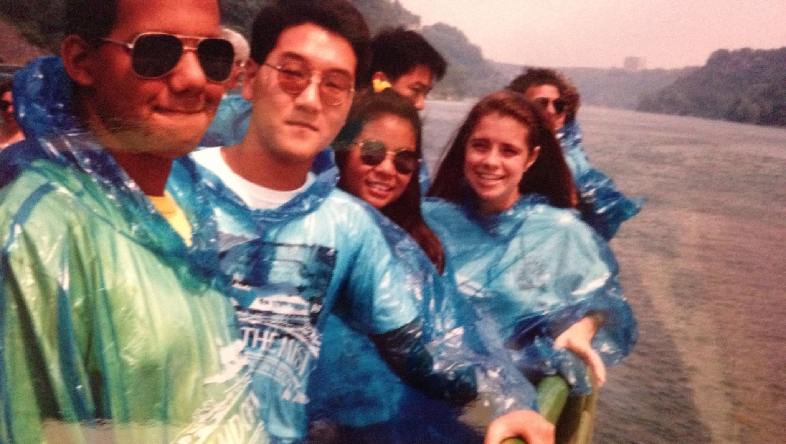
Your Historical RecorD
What kind of historical records do you leave behind in your daily life?
Think about all the activities you were involved in during the past 24 hours. List as many of these activities as you can remember…….
Did you create any records of your activities? – diary, notes to yourself, letter or email to friend or relative
Would traces of your activities appear in records someone else created? – diary, notes, calendar entry, letter or email
Would traces of your activities appear in school records?

Slide 7
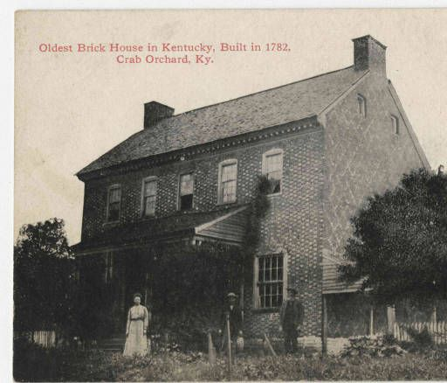
Your Historical RecorDS
Did you write a check or use a charge card?
Would anyone be able to offer testimony (oral history) about your activities (who and why)?
What’s in your trash?
Which of your daily activities were most likely to leave trace evidence behind?
If future archaeologists had the materials mentioned, what could they infer or conclude about your life?
What could they conclude about your family, community, region or nation?

Slide 8
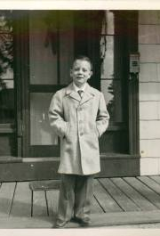
Your Historical Record - Assignment
Choose one primary source document that you have with you today.
Who is the author of this item?
What is the place and time of this item?
What prior knowledge do you have about the item?
Who is the audience for this item?
Why was this item developed?
What is the main idea of this item?
What is the item’s significance?

Slide 9
Rationale for Using Primary Sources
Expose students to multiple perspectives of issues past and present.
01
Most issues were furiously debated at the time – why stop now?!
02
Help students develop knowledge, skills and analytical abilities – think critically, make intelligent inferences, develop reasoned explanations
03

Slide 10
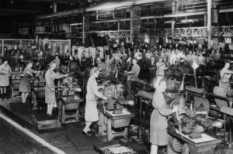
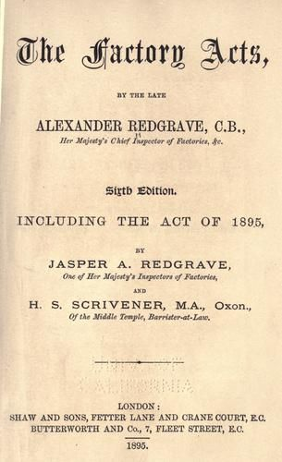
LeARNING Through Primary Sources
Jackdaw
Teaching with Primary Sources/Library of Congress
Kentucky Resources
Student Discovery Sets
Baseball Across a Divided Society
American Memory
EDSITEment!
DocsTeach
The Gilder Lehrman Institute of American History
Teachinghistory.org
World History Matters
Our Documents
Letters of Note
Civil Rights Digital Library
Documenting the American South
Children and Youth in History
This I Believe
Notes:
http://www.socialstudiescentral.com/using-primary-sources/
http://www.socialstudiescentral.com/instructional-resources/primary-sources/
http://www.bbc.co.uk/ahistoryoftheworld/
http://www.socialstudiescentral.com/instructional-resources/
http://www.socialstudiescentral.com/reading-and-writing-in-the-social-studies/
https://historytech.files.wordpress.com/2015/11/evidence-based-terms.pdf print this one
https://historytech.wordpress.com/2015/04/10/tip-of-the-week-the-problem-with-history-classes-the-civil-war-and-hexagons/
http://www.learningspy.co.uk/english-gcse/hexagonal-learning/
http://writingprompts.tumblr.com/post/30655462866/writing-prompts-for-social-studies-history
https://www.teachervision.com/lesson-planning/graphic-organizer

Slide 11
Mission US
Notes:
http://www.socialstudiescentral.com/instructional-resources/video-games-sims/

Slide 12
Stopping to Think
What are the historical priorities for your grade level and how might you teach about them in a meaningful way?

Slide 13
Where I’m From Writing Activity
“If you don’t know where you’re from, you’ll have a hard time saying where you’re going”
Wendell Berry

Slide 14
Discussion Web
Examining Year-Round Schooling

Slide 15
Double-Up, Double-Down
An Economics IQ Quiz

Slide 16
Economics IQ
Most millionaires are college graduates.
Most millionaires work fewer than 40 hours a week.
More than half of all millionaires never received money from a trust fund or estate.
More millionaires have American Express Gold Cards than Sears Cards.
More millionaires drive Fords than Cadillacs.
From: Financial Fitness for Life, NCEE

Slide 17
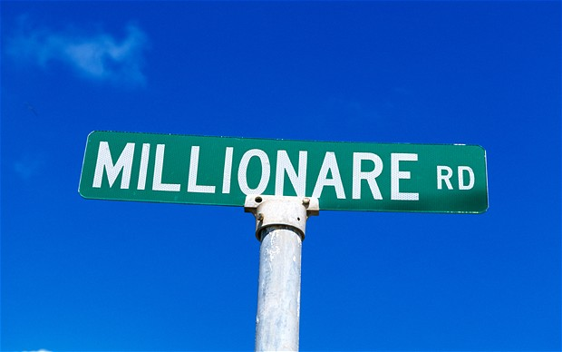
Economics IQ
Most millionaires work in glamorous jobs, such as sports, entertainment, or high tech.
Most millionaires work for big Fortune 500 companies.
Many poor people became millionaires by winning the lottery.
College graduates earn about 65% more than high school graduates earn.
If an average 18-year-old high school graduate spends as much as an average high school dropout until both are 67 years old, but the high school graduate invests the difference in his or her earnings at 8% annual interest, the high school graduate would have $5,500,000.
From: Financial Fitness for Life, NCEE

Slide 18
Economics IQ
If you want to be a millionaire, avoid the risky stock market.
If you save $2000 a year from age 22 to age 65 at 8% annual interest, your savings will be over $700,000 at age 65.
From: Financial Fitness for Life, NCEE

Slide 19
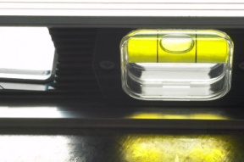
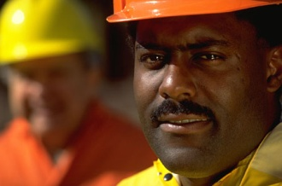
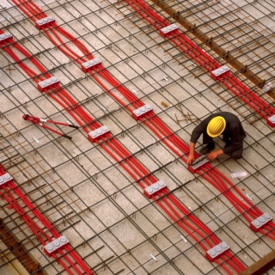
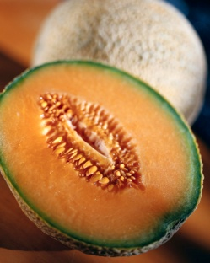
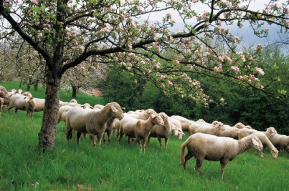
Economic Resources Are A Snap
Productive resources
Natural resources
Capital resources
Human resources
Durable and non-durable goods

Slide 20
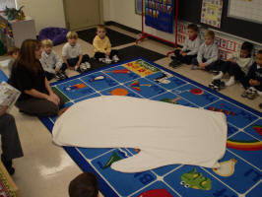
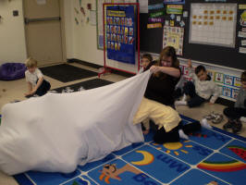
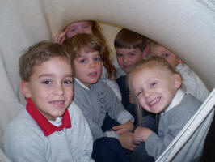
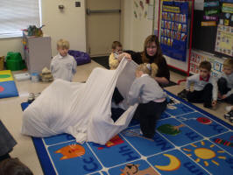
Teaching Scarcity
The Mitten, Jan Brett

Slide 21
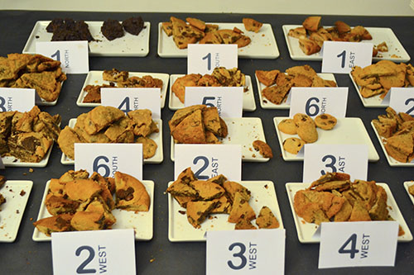
PACED Model—Cookie Testing
Cookie A
24 cookies in package
Package cost = $3.79
$0.16 per cookie
Cookie B
35 cookies in package
Package cost = $2.79
$0.08 per cookie
Cookie C
30 cookies in package
Package cost = $1.99
$0.07 per cookie
Cookie D
30

Slide 22
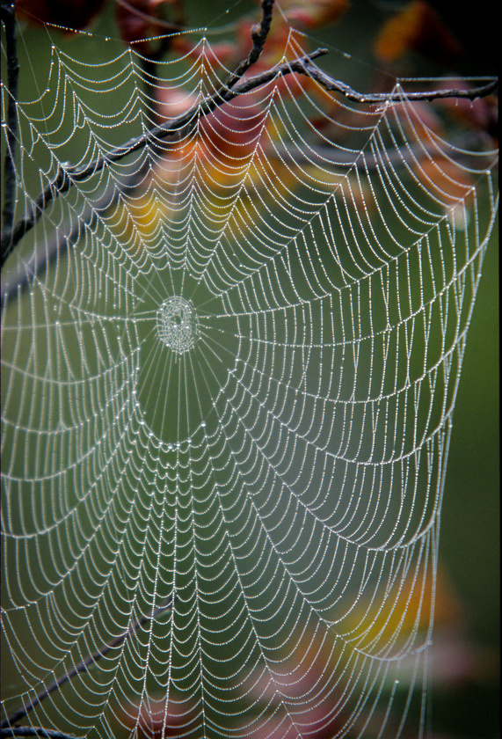
Interdependence Web

Slide 23
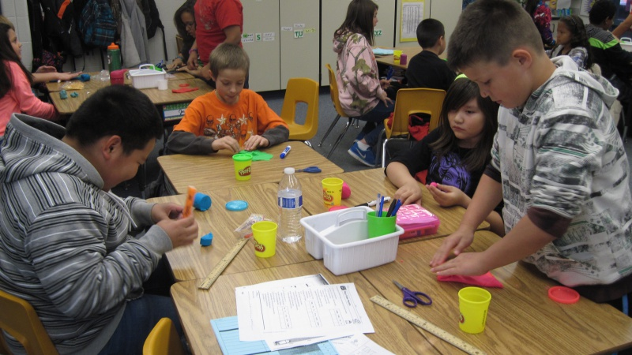
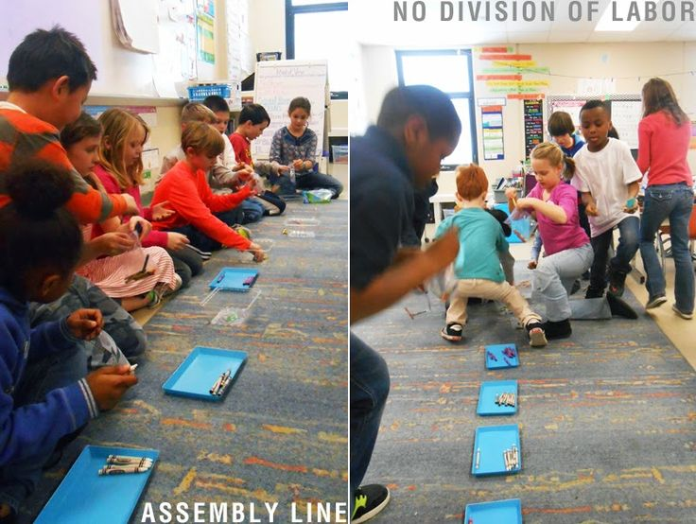
Playdoh Economics

Slide 24
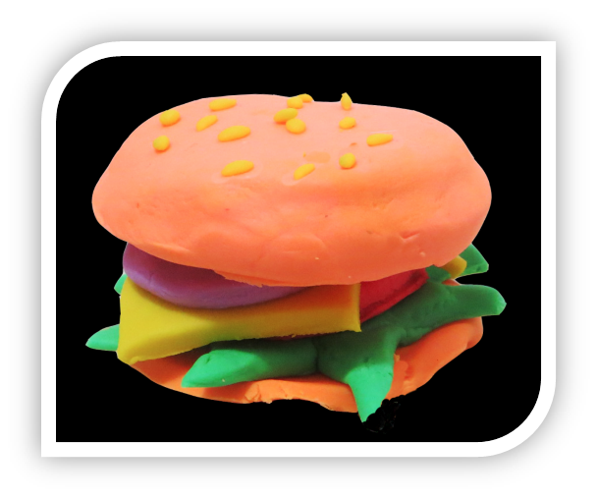
Hamburger Assembly Line
2 buns 2” in diameter
1 piece of hamburger 1 ½” in diameter
3 dabs of ketchup
3 dabs of mustard
2 pickles
16 sesame seeds on top of each bun (made with pencil)

Slide 25
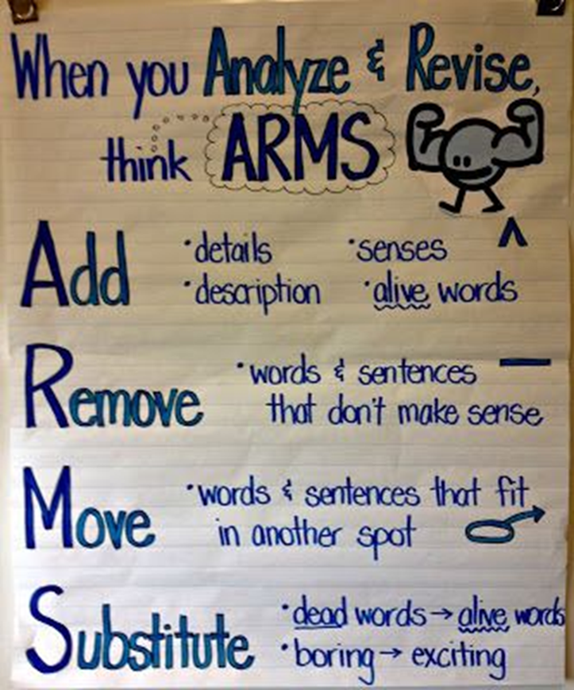
ARMS Writing Activity

Slide 26
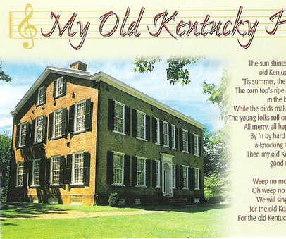
Songs, Websites, and More
http://www.kidseconposters.com/
http://www.kidseconposters.com/activites-and-games/sing-a-longs/
http://wisepockets.umsl.edu/
http://econ.org/
http://abdullahalbahrani.com/econbeats/
http://econshark.com/
Song Analysis Activity

Slide 27
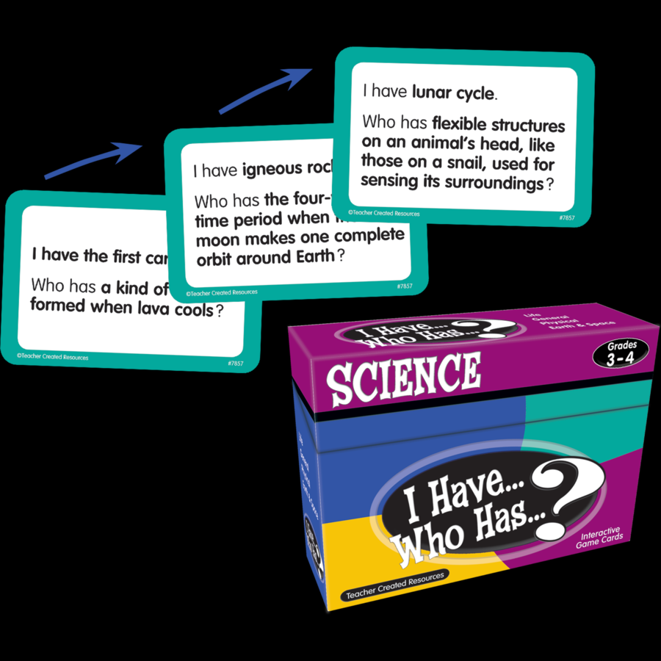
I Have… Who Has …?

Slide 28
Mystery Entrepreneur

Slide 29
Ice Cream InnovatORS

Slide 31
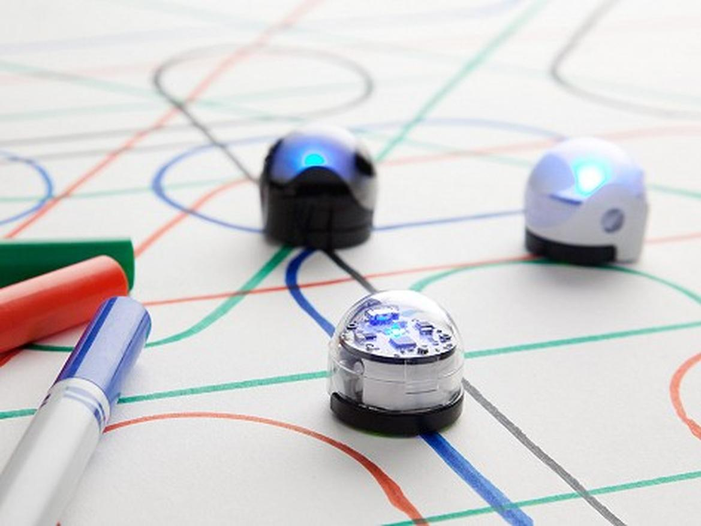

Slide 34
The Challenge
Build the Tallest Freestanding Structure: The winning team is the one that has the tallest structure measured from the table top surface to the top of the marshmallow. That means the structure cannot be suspended from a higher structure, like a chair, ceiling or chandelier.
The Entire Marshmallow must be on top: The entire marshmallow needs to be on the top of the structure. Cutting or eating part of the marshmallow disqualifies the team.
Use as Much or as Little of the Kit: The team can use as many or as few of the 20 spaghetti sticks, as much or as little of the string or tape. The team cannot use the paper bag as part of their structure.
Break up the Spaghetti, String or Tape: Teams are free to break the spaghetti, cut up the tape and string to create new structures.
The Challenge Lasts 18 minutes: Teams cannot hold on to the structure when the time runs out. Those touching or supporting the structure at the end of the exercise will be disqualified.

Slide 35
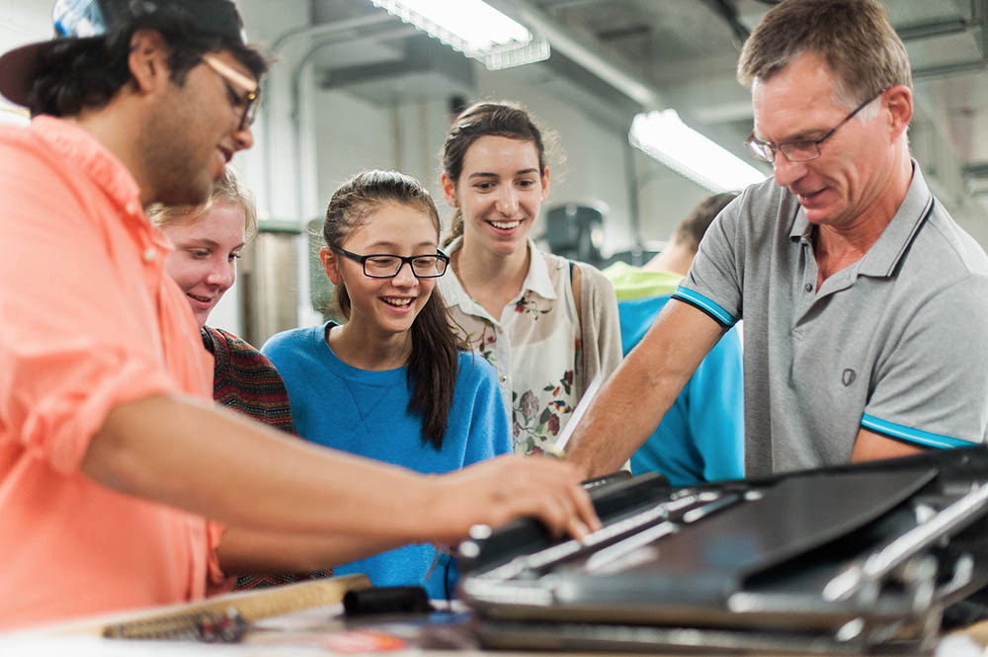
More FREE STEM Resources
James Dyson Foundation
Ideas Box
Design Process Box
Engineering Box
Hot Wheels Speedometry
Math and science curriculum
Educational Innovations
PhysicQuest Kits
Swift Playgrounds App
Coding on the Ipad

Slide 36
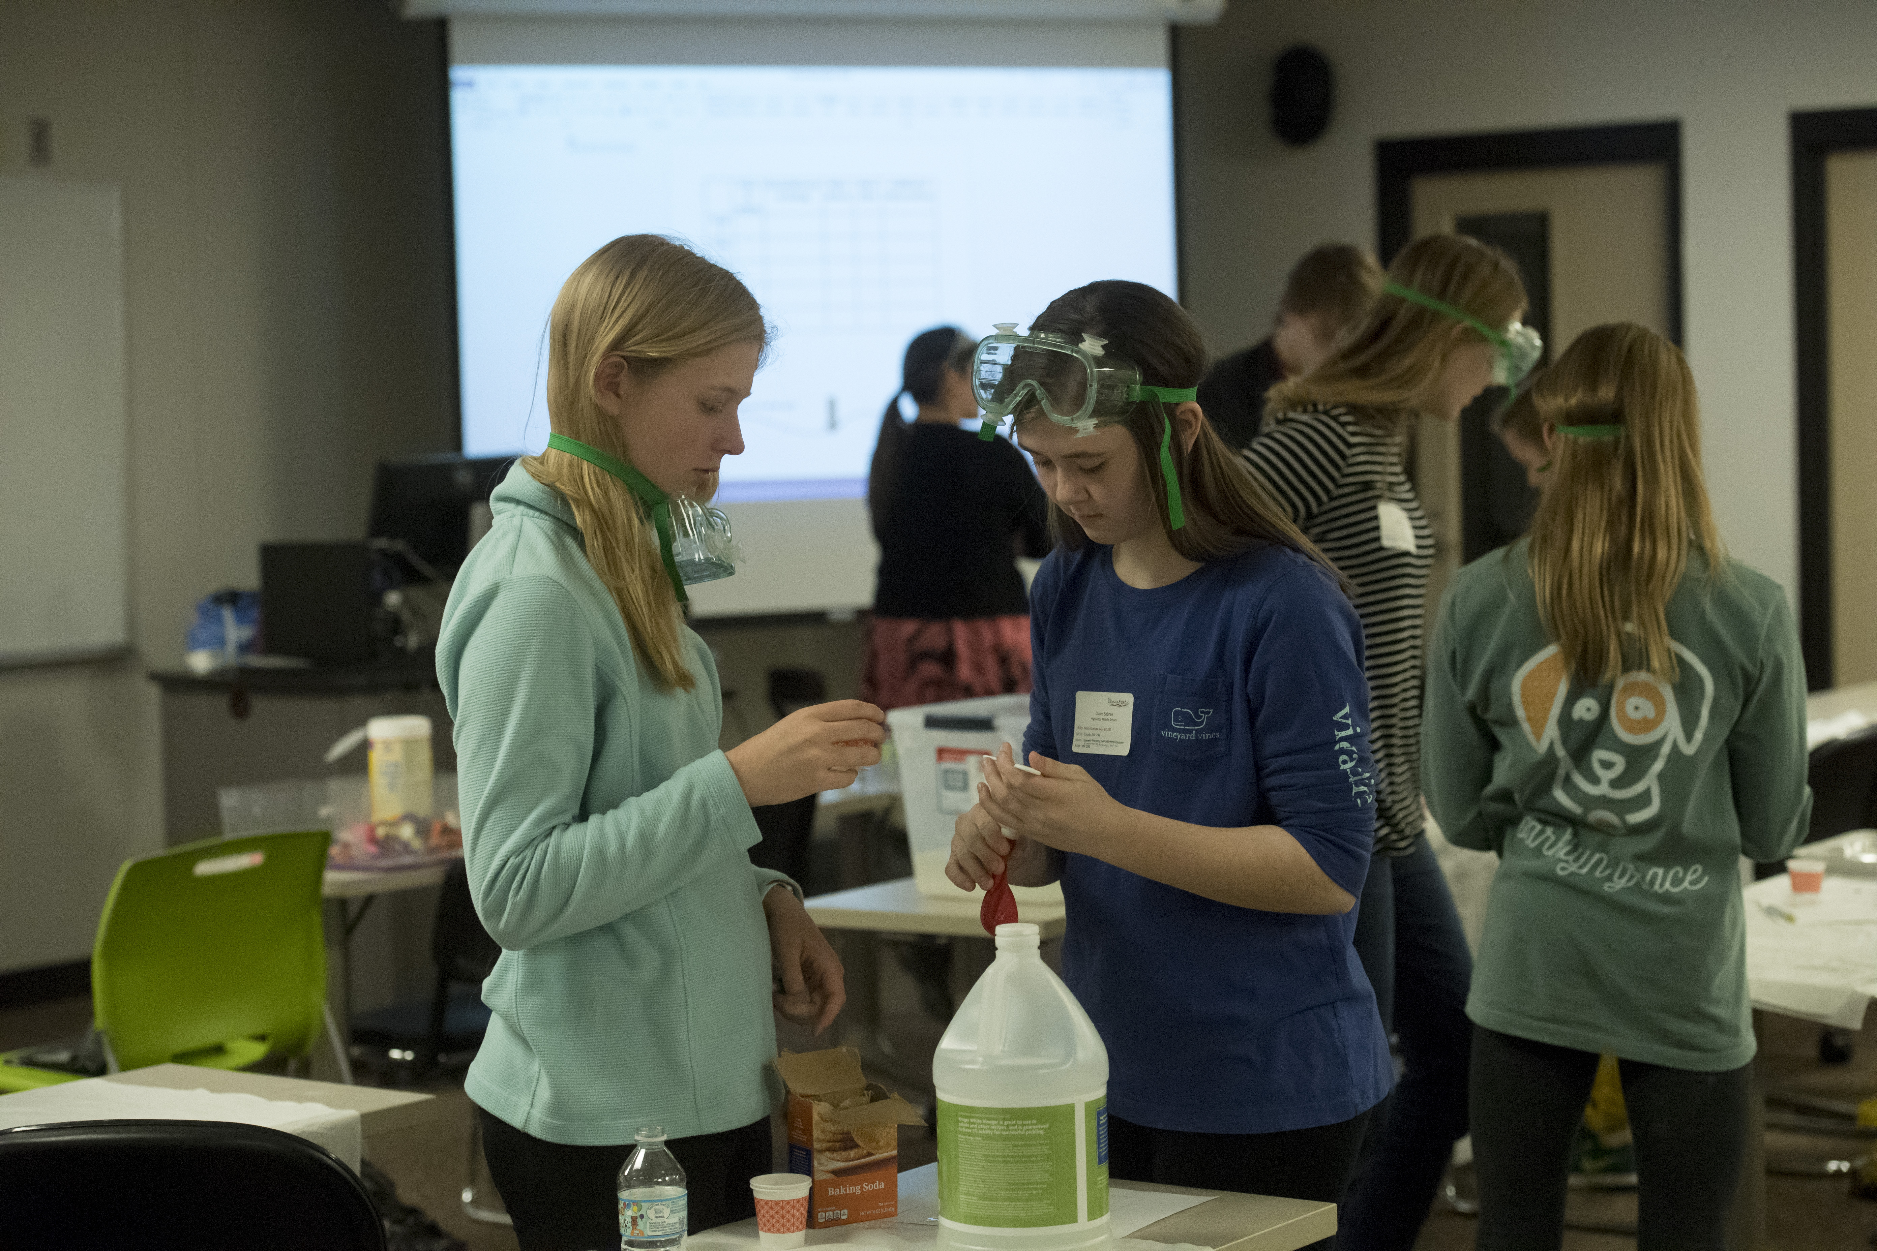
Creating a Makerspace
Funding Resources
Curricular Resources
Double the Donation
GoFundMe
How to Get Free Materials
National Arts and Humanities Youth Programs
The Big List of Grants and Resources
STEM Resources for Any Classroom
Cultivating Creators through Coding and STEAM
Defined STEM

Slide 37
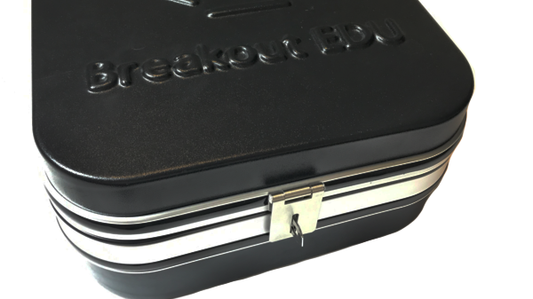
Breakout EDU

Slide 38
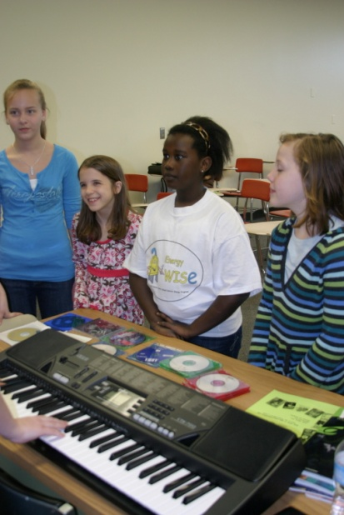
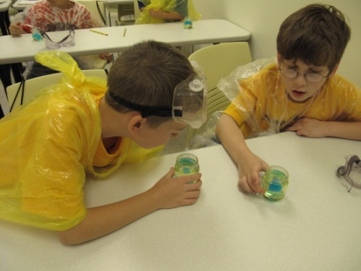
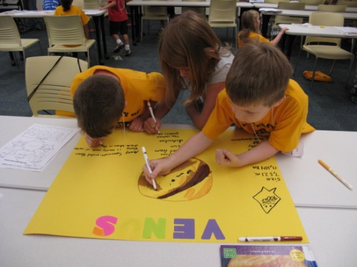
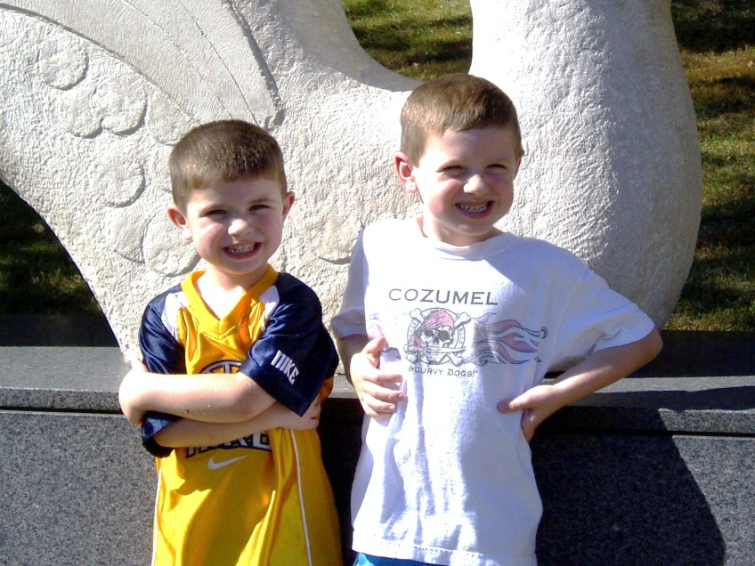
Questions, Comments, Ideas
Kimberly P. Clayton-Code, PhD
Northern Kentucky University
codek@nku.edu
http://gifted.nku.edu

