Slide 1

ELA Teacher Leader
Network Meeting
March 29, 2012
Keeping Students at the
Heart of the Work!
Notes:
Carole (9-9:10)
Welcome
Norms
T-Chart
Targets
Schedule for the Day
Names for Drawing

Slide 2
Your Facilitators for Today
Carole Mullins
Regional Network Content Specialist, English/LA
Mary McCloud
KVEC Literacy Consultant
Linda Holbrook
KDE Literacy Consultant
Jennifer Carroll
Instructional Supervisor, Wolfe County Schools
Katrina Slone
Regional Network Content Specialist, Mathematics
Notes:
Carole

Slide 3
Agenda and Targets
Instructional Ladder
Grade Level Work Groups
Lunch
Break Out Sessions
Notes:
Carole

Slide 4
Our Targets for Today
I can evaluate the implementation level of the KCAS within my school.
I can create an LDC instructional ladder/plan for my task.
I can evaluate my LDC Informational/Explanatory teaching task.
I can critically examine the rigor and congruency of an ELA assessment.
I can scaffold learning by narrowing the focus of a lesson so that students have a manageable number of learning targets.
I can identify rigorous highly effective teaching and learning practices and their connections to CHETL.
I can set personal goals to advance the vision of 21st Century Learning.
Notes:
Carole End at 9:10

Slide 5
Comparison Table
School Instructional Practices
Instructional Practices Before KCAS and the Networks | Current Instructional Practices
LEADERSHIP
CURRICULUM
RIGOR
INSTRUCTION
ASSESSMENT
Notes:
Carole: (9:10 – 9:30)
5 minutes to discuss this…

Slide 6
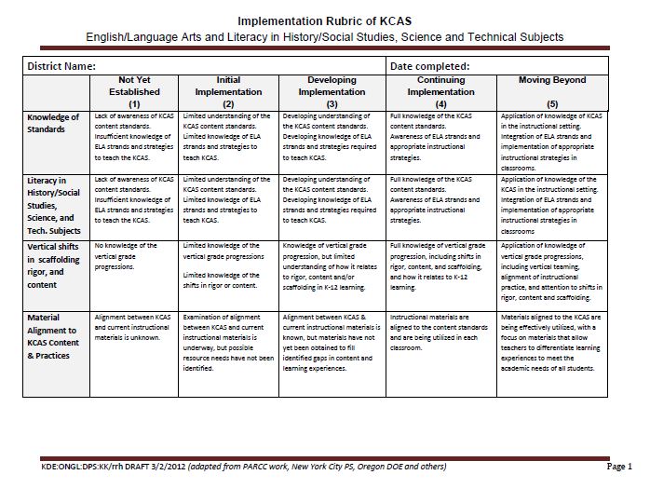
What is the implementation level of the ELA KCAS in my district?
Notes:
Carole
Refer to HANDOUT in Packet. Implementation Rubric
Explanations:
KDE has requested that all TLN and districts participating in ISLN complete an “Implementation Rubric of KCAS in ELA and Math”.
The purpose of the rubric requirement is NOT to judge or compare schools or districts. It is to provide state-wide feedback to KDE so that appropriate decisions concerning next year’s work can be made. ISLN did the rubric, too.
Your results will be anonymous. You are being asked to include your district name today FOR ONLY ME! I must let KDE know districts that do not submit one to me today.
**Please note: Districts not submitting a completed rubric to the regional content special will be contacted by a Frankfort –based consultant and requested to complete a rubric for both ELA and Math.

Slide 7
Implementation Rubric Instructions
Review the rubric independently.
With your district’s team, discuss each indicator (such as “Knowledge of Standards”). Think about specific accomplishments your district has made.
Agree on a rating for each indicator. (Use the “ELA possible evidence” handout to help you make decisions.)
Circle the group’s rating decision on your individual rubric so that all team members will have a record of your decisions.
Each district team will complete a rubric (color copy) to submit to me TODAY.
District TL Teams that do not submit a completed rubric: Your district office contact will be contacted by a Frankfort –based consultant and requested to have the team complete a rubric.
Notes:
Carole: End at 9:30
Walkthrough Instructions reminding participants that this is a KDE requirement. Refer to HANDOUT in packet (ELA possible evidence)
Your results will be anonymous. You are being asked to include your district name today FOR ONLY ME! I must let KDE know districts that do not submit one to me today.
**Please note: Districts not submitting a completed rubric to the regional content special will be contacted by a Frankfort –based consultant and requested to complete a rubric for both ELA and Math
After allowing districts time for discussion, Give each district a COLORED copy of the rubric to complete and return to me TODAY

Slide 8
Let’s Get Ready
You will need:
Your Informational/Explanatory Teaching Task
“Brown Border” Handouts (stapled together)
Deconstructed Standards/Grade Level Targets
Planning Guide for LDC Ladder
Notes:
Linda 9:30 – 10:30 (All facilitators will assist)
Colored Packet Handout Includes:
Stapled together: LDC Guidebook Pages-23, 46, 53, 54, 90, 91, 92 (Ladder Organizer, Standards, Sample Module, Requirements for LDC Ladder)
Planning Guide H/O (Should say “What Mini-Task instead of What Task)

Slide 9
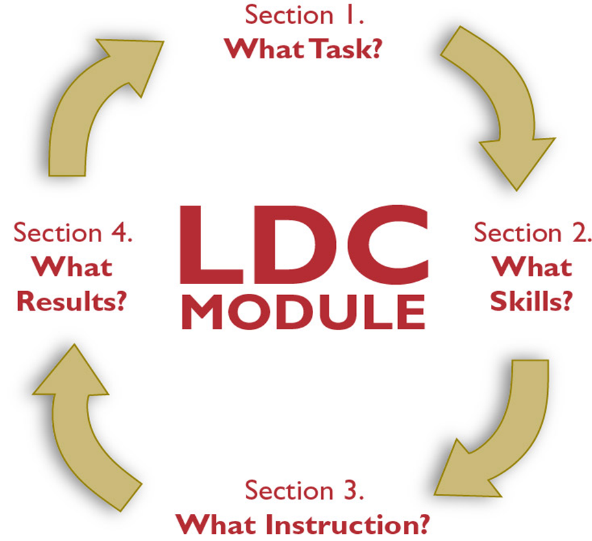

Let’s Review the Instructional
Planning Process
Notes:
Linda

Slide 10

Take A Break!
10:30 – 10:40 a.m.

Slide 11
Grade Level Groups
K-5: Room 1
6-8: Room 2
9-12 : Main Room

Slide 12
Critiquing A Teaching Task
Number off at your table.
Place your number in the upper right hand corner of the “Critiquing a Teaching Task” handout.
Clip or staple your Teaching Task to the handout.
Notes:
All Facilitators (Critiquing Tasks and Development of Ladder Session 10:40 – 12:00)
“Critiquing a Teaching Task” HANDOUT

Slide 13
Instructions
Pass your task packet to the person on your left
Review the task. Place your comments in the box that corresponds to your appropriate TL#
When completed, pass the task packet to your left
Continue reviewing and passing until all tasks have been reviewed
Notes:
All Facilitators (Critiquing Tasks and Development of Ladder Session 10:40 – 12:00)

Slide 14
Critiquing Your Own Task
Read all comments made on your task and request clarifications, suggestions, etc., if wanted.
You can use this information for any revisions/adjustments you might want to make.
Notes:
All Facilitators (Critiquing Tasks and Development of Ladder Session 10:40 – 12:00)

Slide 15
Instructional/Explanatory Module
Work Time!
Develop or revise your Informational/Explanatory Teaching Task.
Begin development of the Instructional Ladder/Plan for the Teaching Task.
Refer to I/E task resources that have been provided as well as any grade level specific resources you have brought today.
Be sure to include grade level specific learning targets from the deconstructed standards in your ladder/plan.
Notes:
Grade Level Facilitator (END AT 12:00 FOR LUNCH)
Teachers should use the Informational Rubric, Teaching Task Collection Document, Deconstructed Standards Pkt., etc. while working

Slide 16
Informational/Explanatory Requirement
  Design and Teach Instructional Ladder for Informational/Explanatory Teaching Task.
  Score student work from Teaching Task.
  Bring 2 samples of scored student work aligned to each of the Informational/Explanatory Rubric Performance Levels.
Notes:
All Facilitators:
REMIND TEACHERS OF HOMEWORK FOR LAST MEETING OF 2011-2012 SCHOOL YEAR

Slide 17
Three 50 Minute Breakout Sessions
Session #1: Room 1
“Enabling Student Learning One Bite at a Time!”
Session #2: Room 2
CHETL and RIGOR
“I’ll Know It When I See It!”
Session #3: Room 119P
“Looking for Congruency in Curriculum”
K-5
12:45-1:35
6-8
1:45-2:35
2:45-3:30
9-12
Notes:
All Facilitators: INFORM PARTICIPANTS WHAT WILL OCCUR AFTER LUNCH…
Distribute HANDOUT: Schedule for Breakout Sessions (Participants will rotate through the 3 sessions. If your grade level begins in Session 3, you will then move to Session 1, etc… as we did last meeting)
Make notes on the P-D-R form after each session…
Inform Teachers: Take all belongings back to the main with them because Breakout sessions begin at 12:45 p.m.

Slide 18

TIME FOR LUNCH!
12:00 – 12:45 p.m.

Slide 19
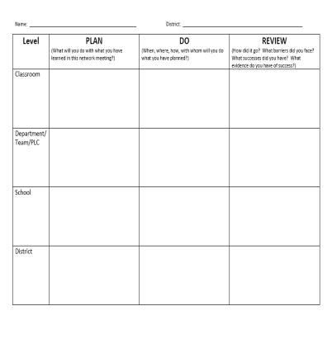
Plan-Do-Review
Take a moment and add notes to your P-D-R
Guiding Questions
  What information will you share?
  How will you share the information?
  What concerns do you still have?
Notes:
All Facilitators
HANDOUT: EVALUATION
February P-D-R

Slide 20
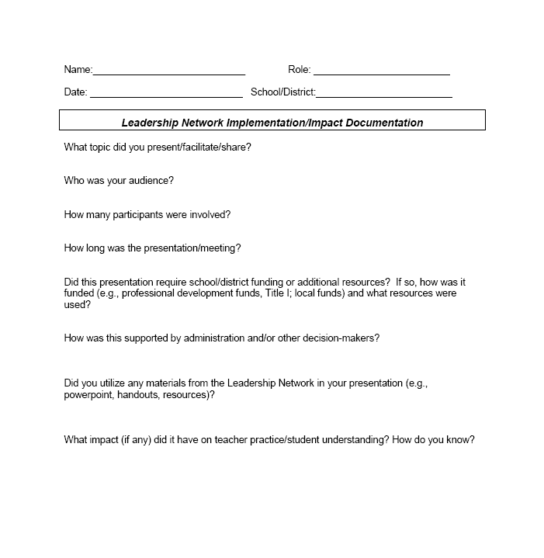
Impact Logs
Logs should be submitted to Carole Mullins in hard copy or via e-mail at the end of each month.
Notes:
Carole
Very important that your work is documented and submitted to KDE…
Complete a log for any work you have done in your district. This includes, but is not limited to, meetings attended/participated, trainings and informational sessions conducted, etc. In other words, anything you do that is related to the work of the network initiative. (If you don’t have documentation of specific dates, just include the month)
The documentation log asks very specific questions and some of them will NOT pertain to every activity you have done and/or will do in the future. The point is that you work is documented!
Logs should be submitted to me by the end of each month. Electronic version is available on Bb.

Slide 21
Extended Learning
  Design and Teach Instructional Ladder for Informational/Explanatory Teaching Task.
  Score student work from Teaching Task.
  Bring 2 samples of scored student work aligned to each of the Informational/Explanatory Rubric Performance Levels.
  Read the article “Rigor Redefined” and complete the 3-2-1 reading guide.
Notes:
All Facilitators:
Distribute the Rigor Redefined article and 3-2-1 reading guide to teachers.

Slide 22
OUR NEXT MEETING
ELA Teacher Leader Network Meeting
Hazard Community & Technical College
9:00 a.m. – 4:00 p.m.
June 5, 2012
Notes:
Evaluation
Certificate of Participation
End at 3:45 p.m.

