Slide 1


ELA Teacher Leader Network Meeting
Hazard Community and Technical College November 4, 2010
Keeping Students at the Heart of the Work
While Preparing Them for College and Career!
Notes:
CAROLE
9:00 a.m.

Slide 2
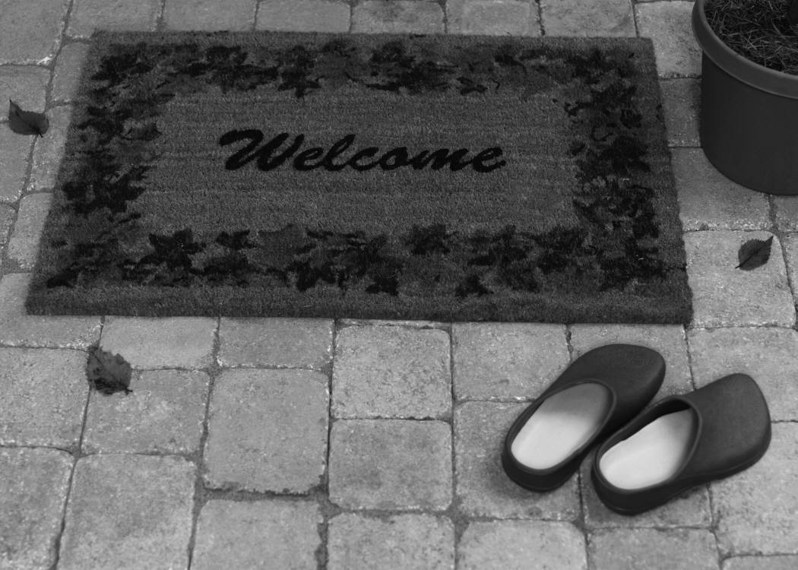
YOUR FACILITATORS
FOR TODAY
Carole Mullins
Regional Network Content Specialist,
English/Language Arts
Dr. David Elias
Eastern Kentucky University
Mary McCloud
KVEC Literacy Consultant
Linda Holbrook
KDE Literacy Consultant
Notes:
CAROLE

Slide 3

November Agenda
Welcome
Revisiting Deconstruction: RL Standard #2
Today’s Learning Targets
Deconstructing Kentucky Core Academic Standards
Formative Assessment and The CHETL Connection
Debrief CASL Chapter 4
Leadership: “Standards to Targets for Leaders”
Extended Learning
Notes:
CAROLE – 5 min.
Return Folders
T-Chart
Name for Drawings
Flash Drive

Slide 4

Maximizing Productivity
Revisiting Group Norms:
Be present and be engaged in the work
We are all equal partners in this work
Seek first to understand, and then to be understood
Complete assignments before coming to next meeting
Be willing to negotiate and compromise
Use the law of “Two Feet”
Be courteous, respectful and positive
Keep side conversations to a minimum
Be mindful of time
No surprise expectations
Phones on Silent and No Text Messaging!
Notes:
CAROLE – 5 Min
Remind how intense the deconstruction process will be how they will need to remember the True Colors activity if they feel frustrated, etc…
Revisit Group Norms: Remind participants they have them in their notebook…
WE MUST REMEMBER THAT SB1 WAS NOT WRITTEN WITH THE NEEDS OF ADULTS IN MIND! (Right now, 45% of KY students must take a Remedial Course in college.)
SB1 is a PROFESSIONAL CALL for us to continue to grow and maximize our education efforts – FOCUS on the important
Value the work – Professional Obligation

Slide 5
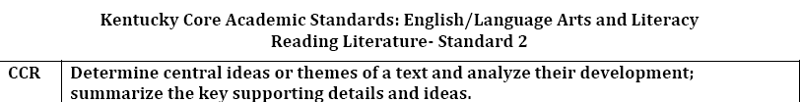
Revisit October Deconstruction Process: Progression of Results
Notes:
CAROLE – 30 min. (2 Slides)
A good way to think of deconstruction:
WE ARE CLARIFYING INSTRUCTIONAL TIME and this is CRITICAL; some things we’ve done in the past will have to go
We are practicing Action Research
Refer participants to (RL St. 2 Activity Handout)
Walkthrough progression of deconstructed standard (6-8 and 11-12 not completed because of issue with determining target level of 7 and 9-10)
Refer to next slide for clarification and further discussion of October deconstruction issue at middle/high

Slide 6
PRODUCT TARGETS
Be careful when determining product targets. They can often be confused with tasks.
A task is an activity in which students will engage. A target is what students will learn by engaging in the task.
For example a product target is not to create a diorama or write a summary. These are tasks we give students as evidence they have attained mastery of the target. The vehicle to do this is the diorama or summary.
Notes:
Review and Discuss/Clarify information on slide REMEMBER THAT THE “INTENDED LEARNING” IS THE MOST IMPT. PART OF A STANDARD.
Discussed in our Network Specialist meeting on October 11-12. Karen had discussion with Rick Stiggins and Jan Chappius to further clarify deconstruction process in several areas. This is just one of them…
Always err on the high end! If we had left this standard as a Performance/Skill or Product target it would not necessarily have been detrimental to the student’s achieving the target because the REASONING would have been included and you had determined it was the most important part of the instruction.

Slide 7
TODAY’S LEARNING TARGETS:
Deconstruct standards in order to understand the underpinning learning targets/intended learning
Identify connections between formative assessment and Characteristics of Highly Effective Teaching and Learning
Recognize that all assessment development proceeds through the same 5 stages
Notes:
Carole – 5 min

Slide 8
Move into Grade Level Work Groups
K-5: Breakout Rm. 1
6-8: Breakout Rm. 2
9-12: Main Room
Notes:
9:45
15 min. (Make Table Tents by Grade Levels for break out rooms so participants will know where to sit)
Take a 10 min break then move to your grade level work group room
REMIND PARTICIPANTS TO SIT TOGETHER AS A GRADE LEVEL (e.g. 6th grade teachers all sit together, etc.) TABLE TENT WILL SHOW THEM…
Once in grade level groups, break into smaller groups if at all possible!! Our goal is to assign all KVEC standards to a group so that we have samples of all of them completed at the end of the day.

Slide 9
DECONSTRUCTING STANDARDS IS…
…a systematic process to identify embedded learning targets in standards and objectives so that nothing essential is missed during instruction.
Notes:
10:00 a.m.
20 min. (10 Slides)
This slide is for Review and Clarification
Kentucky is using Learning Team Approach – using the CASL text as the “instructor” or “expert”
Please remember that there is POWER in action research as well as FIDELITY… This is what the network orgranization represents and is doing…
Refer to CASL POINT #1 Handout as guide for further clarifications

Slide 10
LEARNING TARGETS
(aka learning intentions, objectives, etc.)
A learning target is simply a clear description of what is to be learned. It should provide a clear vision of the ‘destination’ for student learning.
It should focus on describing what is to be LEARNED vs what is to be ‘DONE’ (activity).
A learning target can take from “five seconds to five weeks” depending of the complexity of the knowledge, skill, reasoning and/or product called for and its overall importance in the curriculum–as well as the age/abilities (prior experience and cognitive development) of your students.
Notes:
Information Karen shared with Superintendents and others at Co-Op Board Meeting(s)
Remind that we are using the term ‘learning target’ because that is the terminology used in CASL…
In order to make targets clear to students, they must first be clear to teachers. (Some schools require that teachers have the LT posted daily in the classroom which is good. However, some administrators are under the misconception that the LT should always be DIFFERENT EACH DAY…)
Refer to CASL POINT #3 Handout for further clarification

Slide 11
WE NEED CLEAR TARGETS TO. . .
Correctly identify what students know and don’t know
Select appropriate assessments
Plan effective instruction
Keep track of student learning target by target or standard by standard
Have students self-assess or set goals likely to help them learn more
Notes:
Why should we deconstruct? TO MAKE CONTENT/LEARNING TRANSPARENT FOR STUDENTS!
REMIND AGAIN: In order to make targets clear to students, they must first be clear to teachers!!!

Slide 12
Students who can identify
what they are learning
significantly outscore
those who cannot.
Robert Marzano

Slide 13
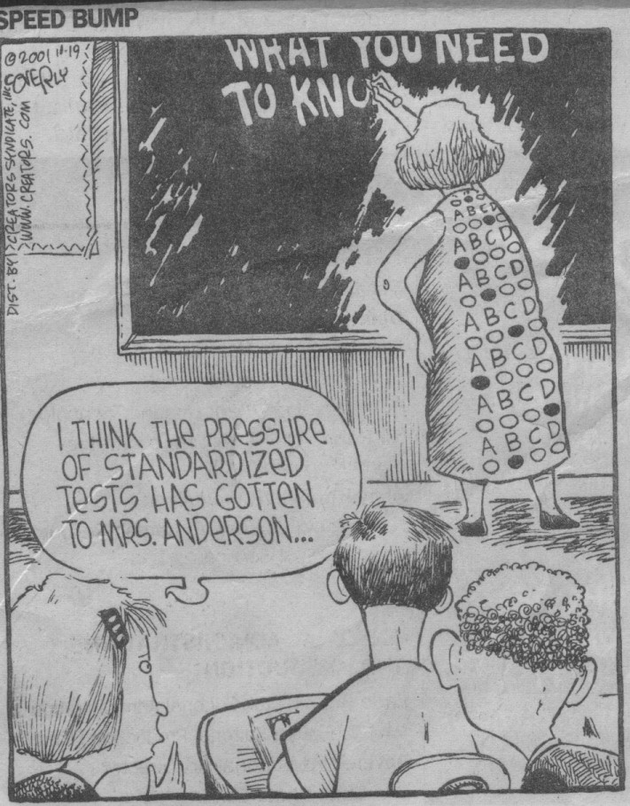
No longer will teachers be able to “check off” Standards as being “covered” in one class period.
Notes:
Discuss cartoon and teacher feelings, pressure, etc.
Depth of the Kentucky Core Academic Standards requires extended learning experiences in order to master them.
The next slide is a picture that represents a teacher trying to teach a 21st Century skill (KCAS) in one class period.

Slide 14
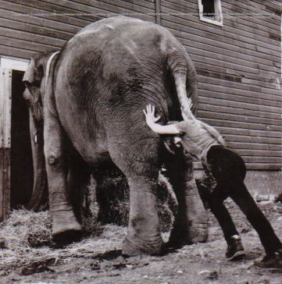
Notes:
Ever felt like this during or at the end of a work day??!!
This a picture that represents a teacher trying to teach a 21st Century skill (KCAS) in one class period.
This is another reason why the KCAS need to be deconstructed!!!

Slide 15
TYPES OF LEARNING TARGETS
Knowledge
  knowing and understanding facts and concepts
  learned outright or via reference
Reasoning
  mental processes we want students to engage in
  USING knowledge to solve problems
Performance Skills
  process is most important
Products
  using knowledge, reasoning, and skills to create a product
Notes:
Clarify and Review Learning Targets
Knowledge: New knowledge that’s required to access that particular reasoning cognition (Explain What)
Reasoning: (Explain How and Why)
Refer to CASL POINT #2 Handout for further clarification

Slide 16
Product Target
Product
Performance Skill
Reasoning
Knowledge
Learning Target
Hierarchy
Performance/Skill Target
Performance Skill
Reasoning
Knowledge
Reasoning Target
Reasoning
Knowledge
Knowledge Target
Knowledge
Notes:
There is a hierarchy to learning targets.
Knowledge targets have no reasoning, performance, or product underpinnings.
Reasoning targets require knowledge but no performance or products.
Performance requires underlying knowledge and reasoning but not products.
Product targets may be underpinned by all four types of learning targets. The exception is that sometimes there may not be a performance/skill target needed…
Some standards may contain more than a single type of learning target. When this happens, each part needs to be deconstructed separately.

Slide 17
WHAT MAKES A DECONSTRUCTED STANDARD ‘WRONG’ OR ‘WEAK’?
It is wrong if there is a misunderstanding of the intent of the standard -which is why many “experts” are needed to ensure consistency in interpretation.
The deconstruction would be considered weak if it lacks developmental continuity (ability to scaffold learning based on the developmental needs of the learners) or if it fails to adequately address the content/concept(s) in the standard.
Notes:
Information Karen shared with Superintendents and others at Co-Op Board Meeting(s)
CASL Point #3 Handout

Slide 18

DOING IT RIGHT: QUALITY CONTROL
Each target should clearly align to and support attainment of the standard.
Each should be clear to the teacher (and to the students) and focused on what is to be LEARNED – not just an activity.
In looking at the ‘set’ of deconstructed targets for the standard collectively, others with expertise in the same content area should generally agree that the overall intent of the standard is met and that the targets would, in fact, scaffold the learner toward mastery/attainment of the overall standard.
Notes:
This is the quality control piece. (Karen shared with Superintendents and others at Co-Op Board Meeting(s)
…and why we’ve involved content leaders K-16 in this work…
An external group of reviewers will be convened (at the recommendation of the Core Advisory Team) to do a final review of the deconstruction of standards before the release of the first draft (which will occur by the end of December 2010) and prior to the completed set (due by the end of May 2011).
Will also review in teams at Frankfort meetings in November/December before they are posted on the KDE website
Jan Chappius will be with us in December

Slide 19
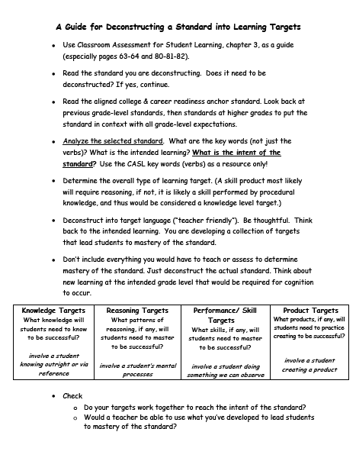
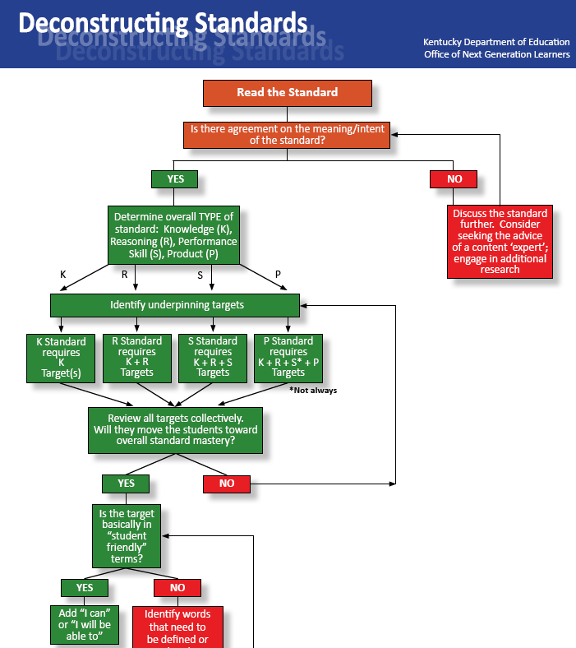
Deconstructing Standards Resource Guides
Notes:
10:20 a.m.
5 - 10 min.
Review Deconstructing Standards Resource Guides: (Deconstructing Handout and Flowchart Handout)
Everyone learns/works in different ways and we want to provide as many resources as possible…
Emphasize that VERBS and KEY WORDS are only a guide for deconstruction and WILL NOT always identify the “ultimate” target of a
standard.
Ask participants to get out their blue UK folder with other Deconstruction Materials and add these guides to it

Slide 20

HOMEWORK:
ELA WRITING STANDARD #7
Share completed homework in grade level groups
Collaborate to deconstruct the final version of Writing Standard #7 per grade level
Place finished standard onto the provided chart and post on wall
Place finished standard onto the electronic ELA standards template and save to flash drive. Provide electronic version of the standard to Carole Mullins carole.mullins@education.ky.gov
Provide electronic version to the group leader’s flash drive
Conduct Gallery Walk: Use post-it notes for questions or to provide feedback.
Notes:
10:30 a.m.
30 min.
Work in grade level groups - Share homework Writing Standard #7
Follow directions on slide: Give each grade level their corresponding chart
Post-it note comments/questions will be reviewed by content specialists, KDE consultants, etc. during final quality control session in Frankfort.

Slide 21
DECONSTRUCTION OF REMAINING STANDARDS
Use provided “Grade Level Standard Guide” for Standard # and page # to deconstruct
Collaborate to complete the deconstruction process of each standard within your grade level group
Place first finished standard onto the provided chart and post on wall.
Place all finished standards onto the electronic ELA standards template and save to flash drive. Provide electronic version of the standard to Carole Mullins carole.mullins@education.ky.gov
Provide electronic version to the group leader’s flash drive
Notes:
11:00 - Noon
Follow directions on slide - 60 min.
“Grade Level Standards Guide” HANDOUT will help participants know which standards they are to deconstruct as well as the page to find them . (By grade level, it includes the number of the standard and page where it is located in order to deconstruct it)
FACILITATORS: MARK THEM OFF YOUR LIST AS THEY ARE COMPLETED. ALSO FOLLOW UP WITH EACH GROUP TO MAKE SURE THEY GET IT ON YOUR FLASH DRIVE AND E-MAIL A COPY TO ME. (This way we have 3 back-ups!! – paper, flash drive, e-mail)

Slide 22
LUNCH
12:00-12:45
Notes:
Lunch: 45 min.

Slide 23
DECONSTRUCTION OF REMAINING STANDARDS
Use provided “Grade Level Standard Guide” for Standard # and page # to deconstruct
Collaborate to complete the deconstruction process of each standard within your grade level group
Place first finished standard onto the provided chart and post on wall.
Place all finished standards onto the electronic ELA standards template and save to flash drive. Provide electronic version of the standard to Carole Mullins carole.mullins@education.ky.gov
Provide electronic version to the group leader’s flash drive
Notes:
12:45 – 1:45
Follow directions on slide - 60 min.
“Grade Level Standards Guide” HANDOUT will help participants know which standards they are to deconstruct as well as the page to find them . (By grade level, it includes the number of the standard and page where it is located in order to deconstruct it)
FACILITATORS: MARK THEM OFF YOUR LIST AS THEY ARE COMPLETED. ALSO FOLLOW UP WITH EACH GROUP TO MAKE SURE THEY GET IT ON YOUR FLASH DRIVE AND E-MAIL A COPY TO ME. (This way we have 3 back-ups!! – paper, flash drive, e-mail)

Slide 24
FORMATIVE ASSESSMENT
“THE CHETL CONNECTION”
With an “elbow partner” share at least one success/challenge you encountered when conducting the two formative assessment activities with students
Review the following CHETL Sections:
1: Learning Climate
2: Classroom Assessment and Reflection
3: Instructional Rigor & Student Engagement
Reflect on the assessments you conducted, and identify both teacher and student CHETL characteristics that were evident
Write the connecting CHETL # and letter of the characteristic on a post-it note and place each one on the corresponding wall chart in the appropriate section
Whole Group Discussion About Chart Results
Notes:
1:45 p.m. (Post Charts prior to Activity)
Formative Assessment Homework Activity: Successes/Challenges and CHETL Connection – 20 min.
Remind participants to use their copy of CHETL located in their notebook
Refer to CHETL 1 Pg. Handout from Carter County… Just another resource…
Follow Directions on Slide

Slide 25
CLASSROOM ASSESSMENT:
MINUTE BY MINUTE, DAY BY DAY
Follow the directions below and complete adapted version of the
“It Says, I Say” strategy. The chart is provided.
Read | It Says | I Say
Read each section of the article then… | Discuss the article section and summarize into one sentence. Write it on your handout | Combine what the article section says with what you know to come up with a one sentence summary. Write it on your handout
Notes:
2:05 p.m.
Read article and follow “It Says, I Say” Strategy – 30 min. (It Says, I Say Act. Handout:GREEN)
Share out: Each group will share out their “It Says, I Say” sentence for a particular section. (Ex. Do all Section 1 sentences before moving to S-2, etc.) If group’s sentence is basically the same as another groups they can state that and you can move on to the next group…
Refer participants to It Says, I Say Instructions Handout WHITE for classroom use that is in their print packet.

Slide 26
BREAK TIME
10 Minute Break
Return to Whole Group in Main Room
Notes:
2:35 – 2:45 p.m.

Slide 27

CASL Chapter 4:
Extended Learning Revisited
“Comprehension Constructor Activity”
Adapted from I Read It, But I Don’t Get It by Cris Tovani
Notes:
2:45 p.m.
LINDA – 5-8 min
Review Homework Guide (Comprehension Constructor Activity) Draw a few names from “prize cup” names and ask them to share…

Slide 28
Inside-Outside Circle
Take 3 minutes and individually skim/scan the bottom of CASL page 106 and all of page 107
Find your content level group: K-5, 6-8, or 9-12; take the 5 Stages of Assessment Graphic Organizer and a Pen
In your content level group, number off 1,2: 1,2: etc.
Group 1 forms a circle and turns around to face outward.
Group 2 creates an outside circle by facing a peer from the inner circle.
Begin with Stage 1 in the Assessment Cycle and share your “To me this means” and “Examples of how you already do this in some way” with your partner.
When given the signal to move, the outside circle will move one person to the right and share their “To me this means” and “Examples of how you already do this in some way” for Stage 2 of the Assessment Cycle with their new partner.
Continue in this manner until all 5 Stages are shared.
.
Notes:
Carole 10-12 min
Additional Instructions: If your partner shares something you want to remember write it on the graphic…
The Inside-Outside Circle (Kagan, 1994) is a technique in which students move around and interact with each other. It can be used as a cooperative strategy and a summarizing strategy.
Formative Assessment Strategy: Refer participants to handout in packet explaining it…
Will address assessment in more depth in January

Slide 29
REVISIT LEARNING TARGETS
Deconstruct standards in order to understand the underpinning learning targets/intended learning
Identify connections between formative assessment and Characteristics of Highly Effective Teaching and Learning
Recognize that all assessment development proceeds through the same 5 stages
Notes:
3:15 p.m.
CAROLE – 5 min.

Slide 30
LEADERSHIP RESOURCE
Deconstructing Standards into Classroom-Level
Achievements Targets:
Practice for School Leaders
The Required Skills for Assessment Balance and Quality
Thinking About Assessment: Activity 14
2004 Assessment Training Institute
Notes:
3:20 p.m.
LINDA – 10 min
CASL Activity 14 Handout: Highlight Key Points of Resource… Remind about language (e.g. benchmark=standard, etc.)

Slide 31

EXTENDED LEARNING
  Read CASL Chapters 5-6 using the “Guide-O-Rama”
  Bring copy of a Teacher-Made test to the next meeting
Next Network Meeting:
Jenny Wiley State Park
January 11, 2011
Notes:
3:30 p.m.
Carole – 5 min.
Go over homework assignments
Refer back to Content Leadership Networks Year-At-A-Glance for January “work”

Slide 32
How Can I Support You?
Carole Mullins
Eng/LA Regional Content Specialist
606-854-2329
carole.mullins@education.ky.gov
Notes:
End: 3:35 p.m.
CAROLE
HAVE A WONDERFUL HOLIDAY SEASON!!

