Slide 1

November 2012 ELA Network
Welcome!
Please sit in grade level groups.
www.kvecelatln.weebly.com
Notes:
Carole
9:00-9:15
Welcome
Binder: Remind TLs that they were given a 2012-13 Teacher Leader Binder Cover at the Sept. meeting.

Slide 2

Your Facilitators for Today
Carole Mullins
KDE/KVEC English/LA Content Specialist
Mary McCloud
KVEC Literacy Consultant
Linda Holbrook
KDE Literacy Consultant
Jennifer Carroll
Instructional Supervisor, Wolfe County Schools
Notes:
Carole

Slide 3



Kentucky’s Framework For Teaching
Domain 3
Teaching With Complex Texts: Close Reading & Text Dependent Questions
LUNCH
Congruent Assessments
Breakout Sessions
Notes:
Carole
Review Today’s Agenda

Slide 4

Inclement Weather Procedure
If Perry County Schools are closed for inclement weather, the KVEC ELA Network will not meet.
Please check WYMT or the Lexington TV stations and/or websites for school closing information.
Meetings will be rescheduled ASAP and you will be contacted via email with the new meeting date.
Notes:
Carole
If Perry County is not closed, but your district is please contact your central office person and then make your own best judgment as to whether you should attend the meeting. We don’t want anyone risking their life on treacherous roads!
Next meeting date is January 31, 2013

Slide 5
Maximizing Productivity
Revisiting Group Norms:
Be present and be engaged in the work
We are all equal partners in this work
Complete assignments before coming to next meeting
Use the law of “Two Feet”
Be courteous, respectful and positive
Keep side conversations to a minimum
Phones on Silent and No Text Messaging!
Notes:
CAROLE
Value the work – It’s a Professional Obligation

Slide 6
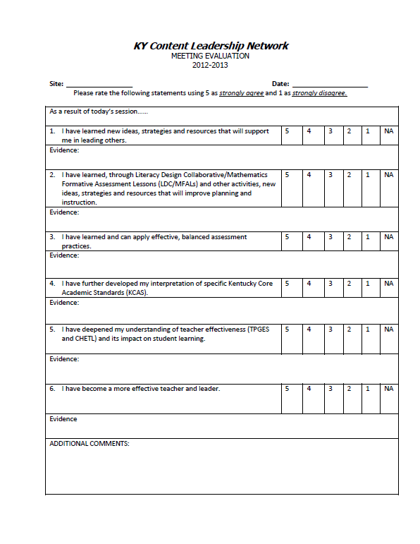
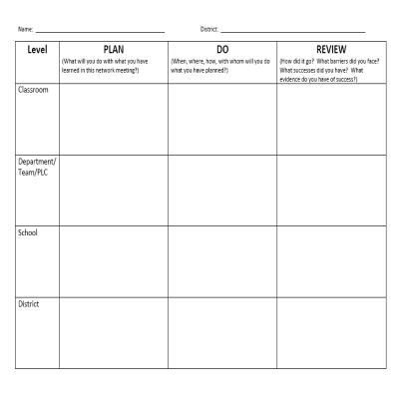
Through-out the Day, please complete the:
Evaluation
Plan/Do/Review
Gather evidence about what you are learning today.
Plan how you could share what you learned today:
in your school
in your district

Slide 7

2012-13 Teacher Leader Network Target
I can use careful planning to improve instruction in order
to become an effective
teacher and leader.
Notes:
Carole
Everything we do today focuses on ways to plan for effective instruction that meets the criteria of the ELA/Literacy KCAS
End at 9:15

Slide 8

DRAFT
Domain 3: Instruction
Component b: Questioning and Discussion Techniques
Notes:
Carole 9:15 - 10:00
Reminder: Kentucky is using Charlotte Danielson’s Framework for Teaching with one modification – we added student growth. You can find the Framework for Teaching and several resources for understanding the TPGES on KDE’s website.
Using the Kentucky Framework for Teaching, the data can be aligned to one of five domains in September we focused on Domain 1: Planning & Preparation, overviewing the entire domain.
Today we will look at Domain 3 Instruction and focus only on Component b.

Slide 9



The Art of Effective Questioning
Notes:
Carole
In the Framework, under domain 3, Instruction, we find component 3b Questioning and Discussion Techniques. 8 X 14 DOMAIN 3B HANDOUT
Draw participants attention to the domain description paragraph at the top of the front side of the framework page. Give them 2 minutes to read and highlight important details. Tell them we will return to this document.
Share that a lot of the information shared in this PowerPoint comes from the facilitator notes on this component out of the TeachScape Proficiency System and is also available online from TeachScape.com

Slide 10


CHETL & 3b: Questioning & Discussion Techniques
Instructional Rigor & Student Engagement
C - Teacher orchestrates effective classroom discussions, questioning, and learning tasks that promote higher-order thinking skills.
E -Teacher challenges students to think deeply about problems and encourages/models a variety of approaches to a solution.
G -Teacher structures and facilitates ongoing formal and informal discussions based on a shared understanding of rules and discourse.
Notes:
Carole
Before we get into 3b, Questioning & Discussion, let’s make a connection to what you already know about Highly Effective Teaching and Learning.
Participants will use their copy of CHETL and identify indicators that relate to questioning and discussion techniques. Share the indicators (on the slide) that we chose.
(If there is not enough time to do this activity, you might note that that is a quick activity they could do with their teachers to make the connection explicit, especially if they have been sharing/discussing CHETL in their school.)

Slide 11
Domain 1: Planning and Preparation
Knowing Components
Doing Components
1a: Demonstrating Knowledge of Content and Pedagogy
1b: Demonstrating Knowledge of Students
1d: Demonstrating Knowledge of Resources
1c: Setting Instructional Outcomes
1e: Designing Coherent Instruction
1f: Designing Student Assessments
Notes:
Carole
Let’s ALSO make a connection to what you learned about Domain 1 at our last meeting.
Talk to an elbow partner and determine which of the components connect to Effective Questioning and Discussion
Techniques.
You can refer back to the Domain 1 handouts given to you at our last meeting, if needed.
Extra Notes:
The “Knowing Components” serve as a good foundation before a teacher begins to design instruction. OFF STAGE
“The Doing Components” follow Wiggins and McTighe’s Understanding by Design, philosophy that many teachers are familiar with. ON STAGE

Slide 12


3b. Questioning & Discussion Techniques
Why Focus on Questioning?
Notes:
Carole
Why focus on questioning?
Questioning and discussion are the only instructional strategies specifically referred to in the Framework for Teaching; this reflects their central importance to teachers’ practice.
In the framework, questioning and discussion are used as techniques to deepen student understanding, rather than serving merely as recitation or a verbal "quiz."

Slide 13

Think about it . . .
What is the relationship between Effective Questioning and Effective Class Discussion?
Notes:
Carole
Pause to think for a moment about this question, What is the relationship between effective questioning and effective class discussion?
Surely, the designers of the Framework had a reason for putting these together.

Slide 14
Effective Questioning + Discussion
Leads students to . . .
Deeper understanding of content
Rethinking hypotheses and viewpoints
Making connections
Effective questioning also . . .
Sets the stage for engaging discussions
Notes:
Carole
Working together, questioning and discussion deepens student understanding, … (review slide)
(below are facilitator notes from The Framework for Teaching Evaluation Instrument posted on TeachScape.com Proficiency System)
Deepens student understanding
Invites students to formulate hypotheses, make connections, or challenge previously held views.
Encourages students to make connections among concepts or events previously believed to be unrelated and to arrive at new understanding of complex material.
Leads to animated class discussion and engages all students in considering important issues.
You can see that questioning and discussion at this level would certainly lead to higher levels of student learning.

Slide 15
Elements of Questioning & Discussion
Quality of questions
Discussion techniques
Student participation
Notes:
Carole
Let’s look at the elements of questioning and discussion shown in the Framework for Teaching.
They are located in the first column on the left side of your 8 x 14 handout

Slide 16
Quality of Questioning/Prompts
High Quality Prompts
Cause students to think and reflect
Deepen student understanding
Test student ideas against those of their classmates.
Framework for Teaching Proficiency System. ©2011 Teachscape, Inc
Notes:
Carole
Let’s take a closer look at each of these elements.
The first element is Quality of Questions. These are also sometimes referred to as prompts.
Questions of high quality cause students to think and reflect, to deepen their understanding, and to test their ideas against those of their classmates.

Slide 17

Think about it . . .
What is the difference between high cognitive level and low cognitive level questions?
Notes:
Carole
When teachers ask questions of high quality, they ask only a few of them, and they provide students with sufficient time to think about their responses, to reflect on the comments of their classmates, and to deepen their understanding.
Occasionally, for the purposes of review, teachers ask students a series of (usually low-level) questions in a type of verbal review. This may be helpful for the purpose of establishing the facts of an historical event, for example, but they should not be confused with the use of questioning to deepen student understanding
An accomplished teacher who is working toward high levels of understanding will use high quality questions, but he/she may use lower level questions in order to scaffold or check for understanding. The accomplished teacher integrates high level questioning into the lesson.

Slide 18

Think about it . . .
Should all questions be
high level questions?
Remember if questions are at a high level, but only a few students participate in the discussion, the teacher
has not really used questioning effectively.
Notes:
Carole
Not all questions must be at a high cognitive level in order for the teacher to use effective questioning.
When exploring a topic, a teacher might begin with a series of questions of low cognitive challenge to provide a review or to ensure that everyone in the class is on board.
CLICK: Remember if questions are at a high level, but only a few students participate in the discussion, the teacher has not really used questioning effectively.

Slide 19
High Quality
Questions
Low Level
Questions
Are open-ended
Allow multiple answers
Allow multiple approaches to the answer
Cause students to think critically
Are challenging
Short answer
Usually a single “right” answer
Single line of inquiry
Usually recall questions which do not require critically thinking
Notes:
High quality questions are generally open-ended and allow multiple answers and multiple approaches to the answer. High level questions cause students to think critically. Additionally, they often challenge students’ understanding.
On the other hand, low level questions usually require short responses and typically there is a single “right” answer. These often form a single line of inquiry that doesn’t allow for deep thinking or for extending on the discussion. Low level questions are generally recall questions which do not require critically thinking.
Note here that if we want students to ask higher level questions, we must teach students how to formulate them. This begins by including them regularly in instruction.

Slide 20

Discussion Techniques
“In a true discussion, the teacher poses a question and invites all students’ views to be heard, and also enables students to engage in discussion directly with one another, not always mediated by the teacher.”
How often do I mediate discussion among my students?
Framework for Teaching Proficiency System. ©2011 Teachscape, Inc
Notes:
Carole
Let’s look at the next element of 3b, discussion techniques. Read this statement, think about your own discussion techniques and answer this question: How often do I mediate discussion among my students?
Some teachers report that "we discussed x" when what they mean is "I said x.“
That is, some teachers confuse discussion with explanation of content; as important as explanation is, it’s not discussion.
What is best practice? In a true discussion, a teacher poses a question and invites all students’ views to be heard, and also enables students to engage in discussion directly with one another, not always mediated by the teacher.

Slide 21

Student Participation
”Experienced teachers use a range of techniques to ensure that all students contribute to the discussion, and they enlist the assistance of students to ensure this outcome.”
Framework for Teaching Proficiency System. ©2011 Teachscape, Inc
Notes:
Carole
The 3rd element for 3b is student participation. At your table share some discussion techniques that you have used successfully.
In some classes a few students tend to dominate the discussion; other students, recognizing this pattern, hold back their contributions.
Experienced teachers use a range of techniques to ensure that all students contribute to the discussion, and they enlist the assistance of students to ensure this outcome.
In-order for students to formulate high-level questions, they must learn how to do so. High-level questions from students (full class or small group) provide evidence that these skills have been taught. Hold your thoughts because we will return to this very important topic.

Slide 22
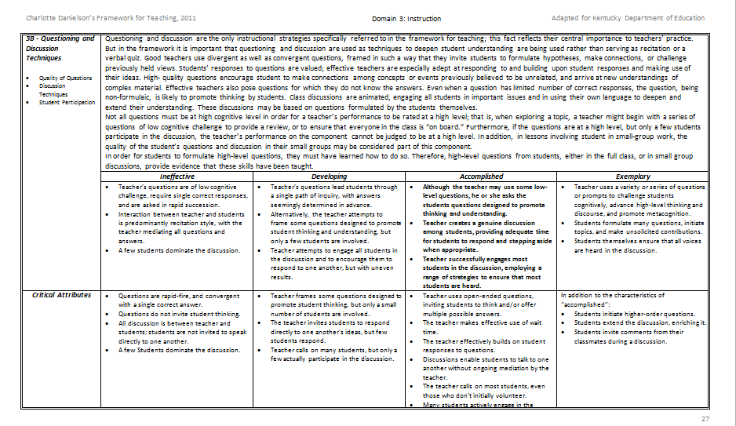
Domain 3: Instruction
3b – Questioning & discussion techniques
Notes:
Carole
Focus teacher’s attention to the circled section of 3b on the slide in preparation for the activity on the next slide.

Slide 23

Effective Questioning Skills
What is Accomplished?
1. Read the 3b Performance Levels.
2. Highlight the language that
differentiates the levels.
3. Discuss with your table group.
Notes:
Carole
Making Comparisons… Read directions on the slide.

Slide 24

Accomplished
Although the teacher may use some low-level questions, he or she asks the students questions designed to promote student thinking and understanding.
The teacher creates a genuine discussion among students, providing adequate time for students to respond and stepping aside when appropriate.
The teacher successfully engages most students in the discussion, employing a range of strategies to ensure that most students are heard.
Notes:
Carole
These are just examples of words you may have highlighted.

Slide 25

Exemplary
Teacher uses a variety or series of questions or prompts to challenge students cognitively, advance high-level thinking and discourse, and promote metacognition.
Students formulate many questions, initiate topics, and make unsolicited contributions.
Students themselves ensure that all voices are heard in the discussion.
Notes:
Carole
…examples of words you may have highlighted.
Notice Exemplary moves beyond challenging students to advancing high-level thinking/discourse and promotes metacognition.
Most importantly, notice that students take responsibility when at the Exemplary level.
This is true throughout the Framework. Often, it is that student ownership piece that pushes practice to Exemplary

Slide 26

Developing
Teacher’s questions lead students through a single path of inquiry, with answers seemingly determined in advance.
Alternatively, the teacher attempts to frame some questions designed to promote student thinking and understanding, but only a few students are involved.
Teacher attempts to engage all students in the discussion and to encourage them to respond to one another, but with uneven results.
Notes:
Carole
…examples of words you may have highlighted.
Review highlighted language.

Slide 27

Ineffective
Teacher’s questions are of low cognitive challenge, require single correct responses, and are asked in rapid succession.
Interaction between teacher and students is predominantly recitation style, with the teacher mediating all questions and answers.
A few students dominate the discussion.
Notes:
Carole
…examples of words you may have highlighted.

Slide 28

Consider this…
The teacher is usually the person who asks the questions during a discussion. In a longitudinal study of elementary and secondary school classes, Dillon (1990) found that each student asks only one question per month on average. Teachers must take deliberate steps to get their students to ask questions.
Notes:
Carole
Ask participants to guess how often students ask questions.

Slide 29

Additionally…
Teachers often pose a question to the whole class but then call on only a few hands…
Ask- is the question you are asking one that you want the whole class to consider?
Yes? Then why call on volunteers to answer?
Pose the question to the whole class and indicate how you want students to answer:
  Think, Pair, Share
  Think , Write, Share
  Think, Write, Show
Notes:
Carole
If we ask students a question that everyone can and wants to answer: “Have you ever felt scared before you face a challenge?” or “Does anyone have a pet?” or “What kind of advice would you give a friend in this situation?” Why not let them all answer?

Slide 30

Critical Attributes and
Possible Examples
With your table group:
Identify the specific differences in the Critical Attributes of a Developing and Accomplished question.
Do the Possible Examples help to clarify the
Critical Attributes between the two levels of
Developing and Accomplished?
Notes:
Carole
Chosen to focus on Developing and Accomplished levels because this is new… CA and PE located on back page of Framework

Slide 31


Let’s practice.
Read the scenarios on the handout provided.
Using page 3B of the framework, decide which performance level each scenario reflects.
Talk with your table group.
Notes:
Carole

Slide 32

Check your accuracy.
Continue your discussion.
1 - Accomplished
2 - Exemplary
3 - Ineffective
4 - Developing
5 - Developing
6 - Ineffective
7 - Accomplished
8 - Exemplary
Notes:
Carole End at 10:00
QUESTION SCENARIO HANDOUT
REMIND PARTICIPANTS:
In Part 1. the levels can be readily identified. #1-4
However, Part 2 presents a bit more of a challenge! #5-8

Slide 33

The CCSS Requires Three Shifts in ELA/Literacy
Building knowledge through content-rich nonfiction
Reading, writing and speaking grounded in evidence from text, both literary and informational
Regular practice with complex text and its academic language
Notes:
Carole 10:00 – 11:00
TRANSITION: Now that we’ve analyzed Component 3b Q and D, we’re going to move into the standards and the instructional practices that will help you…
The shifts are a high-level summary of the biggest changes signified by the adoption of the CCSS.
They represent the most significant shifts for curriculum materials, instruction, student learning, and thinking about assessment. Taken all together, they should lead to desired student outcomes.
They are meant to be succinct and easy to remember.

Slide 34

Communicate the shifts to everyone who will listen!
Everyone working in your school and district should have a solid understanding of the shifts required in both
ELA/Literacy and Mathematics.
They are the starting point for learning about and understanding the
CCSS in ALL subject areas.
Notes:
Carole
THE INFORMATION PERTAINS TO ALL SUBJECT AREAS!

Slide 35
DIGGING
THE
POST-HOLE
KCAS
DIGGING THE POST-HOLE DEEPER
LDC STRATEGY
CONTINUE DIGGING DEEPER
CLOSE READING & TEXT DEPENDENT QUESTIONS
Year 1
Year 2
Year 3
SPECIALIZED EQUIPMENT NEEDED
Notes:
Carole
Let’s use an analogy of digging a post hole: Where and how do we start addressing the 3 Big Shifts at the level we should…?
We dug the post hole with TC : for addressing the KCAS Reading/Writing Standards by learning how to identify complex text
YEAR 1: Started on the surface by getting to know the standards. We began the post-hole in year 1 when the new standards were rolled out-Deconstructed the standards began to make sense of them.
YEAR 2: Our post hole digger helped us to go a little deeper when We Introduced LDC as a instructional strategy for teaching the ELA standards
YEAR 3: As we continue to dig deeper, we realize we need some specialized equipment to help us teach students to dig deeper
Close Reading and Text Dependent Questions
Let’s get started on the follow-up strategies once Text Complexity has been determined…

Slide 36

Assessing Texts
Text Complexity
Quantitative measures
Qualitative values
Task and Reader considerations
Notes:
Carole
Quick Reminder about the Three Legs of the TC process learned at the September meeting

Slide 37

Homework Activity:
OPINIONNAIRE
50 Instructional Routines to Develop Content Literacy, 2nd Ed.
Fisher, Brozo, Frey & Ivey
Each table number off 1-5
Number 1 will share their answer to #1 and lead the group’s discussion.
Number 2 will then share their answer to #2 and lead the group’s discussion
Continue this process until all 5 items have been discussed.
Note: If there is more than one of any #, both TLs will share their answer and co-lead the discussion.
Notes:
Carole
Instruct TLs to first number the statements on their opinionnaire worksheet 1-5

Slide 38

Grades 6-12 Reading Standards
Notes:
WRITE ON POST IT: What connections can you make from the content of this slide? (3 mins) HANDOUT OF SLIDE IN PACKET
TURN AND TALK
Each grade level choose 3-5 words that are symbolic of your ELA standards. Write your words on a post-it note and place on the appropriate grade band chart.
It is very important that teachers of grades K-5 have a working knowledge of the 6-12 reading standards because you are the building blocks for students’ success
A priority of the Common Core State Standards is that students must closely read texts of increasing complexity to acquire knowledge.
The standards strongly focus on students gathering evidence, knowledge, and insight from what they read and therefore require that a majority of questions and tasks that students ask and respond to (both orally and in writing) be based on the text under consideration.
Questions and tasks should require thinking about the text carefully and finding evidence in the text itself to support the response.

Slide 39

Do my students spend more class time in text or out of text?
Notes:
Carole
BEFORE GOING TO NEXT SLIDE:
Ask yourself: Do my students spend more class time in text or out of text?
Talk with the person sitting next to you about this.

Slide 40


Time – In and Out of the Text
More instructional time spent outside the text means less time inside the text.
Departing from the text in classroom discussion privileges only those who already have experience with the topic.
It is easier to talk about our experiences than to analyze the text—especially for students reluctant to engage with reading.
The CCSS are College and Career Readiness Standards.
Notes:
Carole
1st bullet – The shifts require experience within the text – building knowledge primarily through reading, using evidence that can only be found in text, and exposure to academic vocabulary found in those very texts.
2nd bullet – For example, reading about tornadoes, then asking students to talk about a time when they were in a tornado only allows the students who have had this experience to engage. The expectations outlined by the CCSS are requirements for ALL students. By grounding the discussion in the text itself, all students are given an equal opportunity to engage. The text becomes a shared experience in learning about any topic.
3rd bullet – As texts and reading becomes challenging – it’s easier for students to disengage with the text and go to what they know (or think they know based on their experience.) Requiring students to persevere through difficult text builds critical reading muscles.
4th bullet – Those reading muscles are what students will need to be successful in college and career – reading difficult subject matter or technical job related information without anybody to support them is the critical skill necessary for success.

Slide 41

Teaching with
Complex Texts
Notes:
Carole
The rest of our day will focus on background information and strategies for teaching with complex texts.

Slide 42

What Makes Text Complex?
Vocabulary: Knowledge of word meaning
Sentence Structure: How the words operate together
Coherence: How particular words, ideas, and sentences in text connect with one another
Organization: The patterns authors use to communicate complex information
Background Knowledge: The reader’s prior knowledge
Educational Leadership, March 2012
The Challenge of Challenging Text
Timothy Shanahan, Douglas Fisher and Nancy Frey
Notes:
Carole: Article is posted on our website
How is reading complex text like lifting weights? Just as it's impossible to build muscle without weight or resistance, it's impossible to build robust reading skills without reading challenging text. The common core state standards in language arts treat text difficulty as akin to weight or resistance in an exercise program.
Vocabulary:
Studies show that higher-order thinking in reading depends heavily on knowledge of word meanings… Students' ability to comprehend a piece of text depends on the number of unfamiliar domain-specific words and new general academic terms they encounter.
Sentence Structure:
Words are not the whole picture. Sentence structure matters, too, because it determines how the words operate together. In some cases, complex sentence structures are necessary to communicate the complexity of the information itself—thus the long noun phrases common in science.
Coherence:
How particular words, ideas, and sentences in text connect with one another, a feature referred to as coherence.
Organization:
The patterns authors use to communicate complex information… Ideas can be arranged across text in many ways, some more straightforward than others.
Background:
Vocabulary, sentence structure, coherence, and organization can all be determined by closely analyzing the text itself. A final determinant of text difficulty, however, depends on the reader's prior knowledge. Students' background knowledge, including developmental, experiential, and cognitive factors, influences their ability to understand the explicit and inferential qualities of a text.

Slide 43
Plan-Do-Review
Take a moment and add notes to your P-D-R
Guiding Questions
  What information will you share?
  How will you share the information?
  What concerns do you still have?
Notes:
Carole
While we transition to a video think about what you have learned so far today and note it on your PDR
We understand that the time allowed to do this on a large scale is not determined by you; however, share in a PLC, with a colleague, a department, principal, etc…

Slide 44

Close Reading
Dr. Douglas Fisher
Close Reading and the CCSS, Part 1
http://www.youtube.com/watch?v=5w9v6-zUg3Y&feature=relmfu
Notes:
Carole
2:30 min video and VIDEO VIEWING GUIDE HANDOUT
Refer back to fall 2011 Publisher’s Criteria activity (Write Around Activity using the butcher paper) At that time Close Reading was used multiple times in the PC. Linda spent a little time discussing the impact CR would eventually have on instruction, but little did we know how much!
"Close reading is an instructional approach that requires readers to re-read a text several times and really develop a deep understanding of the content contained in the text. The purpose is to build the habits of readers as they engage with the complex texts and to build their stamina and skills for being able to do so independently. However, close reading doesn’t mean that you simply distribute a complex reading and then exhort them to read it again and again until they understand it. As part of a close reading, students "read with a pencil" and learn to annotate as they go. In addition, they are asked text-dependent questions that require that they produce evidence from the text as part of their responses. - Dr. Douglas Fisher

Slide 45




Why focus on “Close Reading”?
(A Specialized Piece of Equipment)
“One of the key requirements of the Common Core State Standards for Reading is that all students… must be able to read and comprehend independently and proficiently the kinds of complex texts commonly found in college and careers.”
--CCSS Appendix A, pg. 2
Notes:
Carole

Slide 46
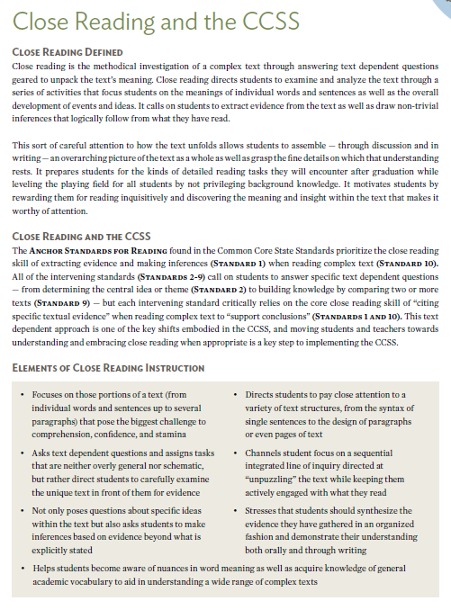
Why Depth through
“Close Reading” Matters
Close reading instruction:
Requires careful attention to how the text unfolds through asking text-dependent questions.
Focuses on building knowledge through the strategic use of text-dependent questions.
Can prepare students for the kinds of reading tasks they will encounter after graduation.
Despite its name, close reading has a lot more to do with writing than reading!
Notes:
Carole
Go over slide and refer TLs to the article posted on our website for additional information: Close Reading and the CCSS

Slide 47

“Every book has a skeleton hidden between its covers. Your job as an analytic reader is to find it.”
Adler and Van Doren, 1940/1972
Notes:
Carole

Slide 48
Close Reading
Dr. Douglas Fisher
Close Reading and the CCSS, Part 2
http://www.youtube.com/watch?NR=1&v=JhGI5zdjpvc&feature=endscreen
Notes:
Carole
2:37 min video

Slide 49

Use a short passage
“Read with a pencil”
Note what’s confusing
Pay attention to patterns
Give your students the chance to
struggle a bit
Creating a Close Reading
Notes:
Carole
Follow-up to video
Suggested process from Fisher and Frey

Slide 50
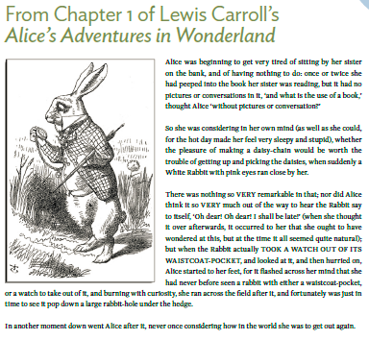
Close Reading of a Sample Text
Notes:
Carole
Read the AAIW excerpt using Close Reading strategies…

Slide 51

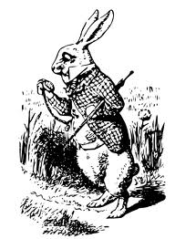
What did you do as a “Close Reader” when you read the excerpt from
?
Reflect on this question then explain it to someone at another table how you could teach this skill to your students.
Notes:
Carole
End at 11:00

Slide 52

11:00 – 11:10 a.m.
Notes:
Carole
When we return from break we are going to continue Close Reading and add TDQs…

Slide 53

Moves from literal to interpretive
Requires students to return to the text to formulate responses
Text-dependent Questioning
(Another Specialized Piece of Equipment)
Notes:
Carole 11:10 – 12:00
Now we’re going to add TDQ another specialized piece of equipment for

Slide 54

Why Ask Text Dependent Questions
80 to 90% of the ELA Reading Standards in each grade level require text dependent analysis
One of the first and most important steps to implementing the ELA Common Core Standards is to focus on identifying, evaluating, and creating text-dependent questions
Deep Reading, the kind encouraged by the common core standards, asks students to “read like a detective”, looking closely for details
Rather than asking students questions about their prior knowledge or experiences, the standards expect students to struggle with text-dependent questions
www.achievethecore.org/steal-these-tools/text-dependent-questions
Notes:
Carole

Slide 55

80-90% of (CCSS) reading standards require text-dependent analysis yet over 30% of questions in major textbooks do not.
Sue Pimentel, Lead Author of Common Core State Standards for ELA/Literacy
Notes:
Carole

Slide 56
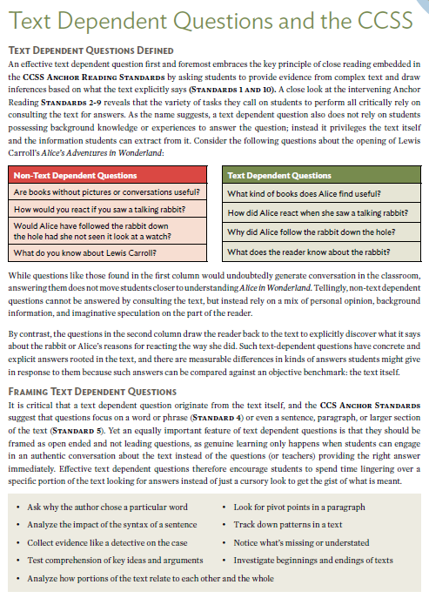
What are Text-Dependent Questions?
Text-dependent questions:
Draw the reader back to the text to discover what it says.
Have concrete and explicit answers rooted in the text.
Frame inquiries in ways that do not rely on a mix of personal opinion, background information, and imaginative speculation.
Notes:
Carole
Go over slide and refer TLs to the article posted on our website for additional information

Slide 57

Inferences
Probe each argument in persuasive text, each idea in informational text, each key detail in literary text, and observe how these build to a whole.
Notes:
Carole
Fisher and Frey sum up TDQs this way…

Slide 58
Differences in Depth:
Text versus Non-Text-Dependent Questions
Non-Text-Dependent Questions | Text-Dependent Questions
Are books without pictures or conversations useful? | What kind of books does Alice find useful?
How would you react if you saw a talking rabbit? | How did Alice react when she saw a talking rabbit?
Would Alice have followed the rabbit down the hole had she not seen it look at a watch? | Why did Alice follow the rabbit down the rabbit-hole?
What do you know about Lewis Carroll? | What does the reader know about the rabbit?
Notes:
Carole
Let’s go back to Alice…
Selecting: there’s work to be done beyond identifying lexile scores and grade bands
Sorting: almost all schools are way out of balance with respect to literary and informational text
Share: the equity issues for Els are complex
AFTER REVIEWING QUESTIONS…
Refer TLs to “A Guide to Creating Text Dependent Questions for Close Analytic Reading” HANDOUT

Slide 59

“Close Reading” of a Stand-Alone Text
Notes:
Carole
BATS AT THE BEACH HANDOUT

Slide 60

Activity
Read the opening of Brian Lies’ Bats at the Beach
With a partner write one Text-Dependent Question
Share your question with others at your table
Evaluate your TDQ based on the samples provided
Notes:
Carole
After TLs have written their TDQs and shared out, distribute the TDQ for BATB excerpt handout and have them evaluate their question based on the samples and discuss with your colleagues

Slide 61
Progression of
Text-dependent Questions
Opinions, Arguments,
Intertextual Connections
Inferences
Author’s Purpose
Vocab & Text Structure
Key Details
General Understandings
Whole
Across texts
Entire text
Segments
Paragraph
Sentence
Word
Part
Notes:
IRA Publication: ENGAGING THE ADOLESCENT LEARNER BY DOUGLAS FISHER AND NANCY FREY Text Dependent Questions Article posted on the website that explains this graphic in detail. I will provide an overview of it today…
Types of Text-Dependent Questions:
there are a number of different topics for which text-dependent questions can be developed. There are questions that focus on parts of texts, and there are questions that focus on whole texts.
Have one thing in common: They require that readers have read and understood the text. Some TDQs will require that they return to the text and reread to find evidence.
Figure 1 also suggests something about the frequency of types of text dependent questions.
For example, general understanding and key detail questions occur more frequently than inferences and opinions.
This should not be seen as a rigid hierarchy or that the questions must be asked in this order.
However, it is essential to understand that different types of knowledge are utilized when deeply understanding a text.
Fisher and Frey provide this graphic and explanation of each type of question so that teachers can plan lessons that include TDQs.
General understandings.
Ensure that students grasp the overall view of the text. Often they are global questions, but questions that require that students demonstrate an understanding of what the author really said
Key details.
These TDQs require that readers pay attention to the details.
Vocabulary and text structure.
These TDQs focus on the specific words and phrases the author uses as well as the structure of the text. This requires that the reader bridge literal and inferential meanings,
Author’s purpose.
Although often not specifically stated, there is a purpose for each text.
Inferences.
Inferences are more than guesses or simply telling students to “read between the lines.” Readers should know how to probe each argument in persuasive text, each idea in informational text, each key detail in literary text, and observe how these build to a whole.
TDQs should allow students to consider the information that is provided and then make informed extrapolations from the information provided.
Opinions, arguments, and intertextual connections.
The final category of TDQs are often the questions that teachers like to ask because these questions tend to generate a lot of discussion and personal connections. When they follow a discussion built on text dependent questions, they work well for this purpose.
If they are used in place of text-dependent questions, the risk is that students will answer and not need to read the text.
As such, teachers can unintentionally telegraph a message to students suggesting that reading and understanding are not necessary. When these questions are used, they can analyze claims, evidence, and counterclaims.

Slide 62
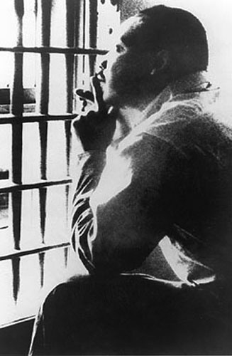
Creating Text-Dependent Questions for Informational Text
From Martin Luther King’s note “Letter from Birmingham Jail”
What words gave you some
meaning to this text?
Notes:
Linda
Instruct TLs to follow the same procedure as they did for Bats at the Beach…. Read the excerpt and write a TDQ

Slide 63
Creating Text-Dependent Questions for Informational Text
From Martin Luther King’s note to “Letter from Birmingham Jail”:
Begun on the margins of the newspaper in which the statement appeared while I was in jail, the letter was continued on scraps of writing paper supplied by a friendly Negro trusty, and concluded on a pad my attorneys were eventually permitted to leave me.
Notes:
Linda
Told me transition words…

Slide 64
Creating Text-Dependent Questions for Informational Text
From Martin Luther King’s note to “Letter from Birmingham Jail”:
Begun on the margins of the newspaper in which the statement appeared while I was in jail, the letter was continued on scraps of writing paper supplied by a friendly Negro trusty, and concluded on a pad my attorneys were eventually permitted to leave me.
Notes:
Linda
Told me that he only had little scraps of paper to write on and he made use of all of them
Lonely, but still communicating

Slide 65
Creating Text-Dependent Questions for Informational Text
From Martin Luther King’s note to “Letter from Birmingham Jail”:
Begun on the margins of the newspaper in which the statement appeared while I was in jail, the letter was continued on scraps of writing paper supplied by a friendly Negro trusty, and concluded on a pad my attorneys were eventually permitted to leave me.
Notes:
Linda
Trusty: A convict regarded as worthy of trust and therefore granted special privileges.

Slide 66
“Letter from Birmingham Jail” demonstrates that:
An effective text dependent question delves into a text to guide students in extracting the key meanings or ideas and events found there.
Text dependent questions begin by exploring specific words, details, explanations and arguments.
Teachers investigate the text through utilizing the Anchor and/or Grade-level Reading Standards to generate the question.
Notes:
Linda
The Letter from Birmingham Jail is found in Appendix B: Grade 9-10 Text Exemplar for ELA (NOT History/Soc. Studies)
A short text exemplar that demonstrates the effective use of words to

Slide 67


12:00 – 12:45 p.m.

Slide 68


Preparing to Write
Text-Dependent Questions
Materials Needed:
Creating a TDQ Handout
TDQ Draft Worksheet
Grade-Band Specific Literary and Informational Text
Text Complexity Analysis for Grade-Band Specific Text
These items will be used in the “Congruency in TDQs and Assessment” Breakout Session.
Notes:
Linda 12:45-1:15
You will be working with the whole group for 30 mins. (12:45 – 1:15) in order to get them started on writing TDQs
Creating a TDQ handout (introduced earlier by me when working with Bats and MLK), the text and placemats (we’ll have to give them out) and the
TDQ DRAFT template to begin writing a TDQ.
Thinking Critically TDQ handout (will be given out in Linda/Mary session)

Slide 69
Three 45 Minute Breakout Sessions
Session #1: Room 1
KCAS and the 3 Modes of Writing
Session #2: Room 2
Congruency in TDQs and Assessment
Session #3: Main Room
LDC :
Developing An Effective Module
K-5
1:20-2:05
6-8
2:10-2:55
3:00-3:45
9-12
Notes:
Carole/Linda
HANDOUT: Schedule
Participants will rotate through the 3 sessions. If your grade level begins in Session 3, you will then move to Session 1, etc

Slide 70

for January 31, 2013
Bring a completed LDC Module:
  Pre-Assessment
  Instructional Ladder
  2 Samples of Scored Student Work for each of the four performance levels:
    Bring copies, not originals. Remove any information that could identify the student (name, school, teacher’s name, personal information, etc.)
www.kvecelatln.weebly.com
Notes:
Carole

Slide 71

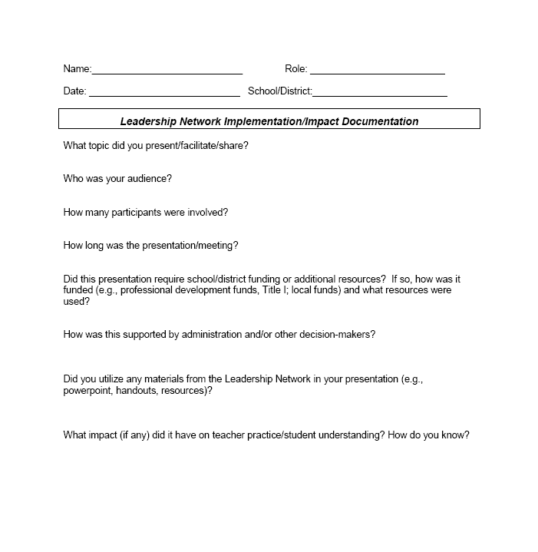
Impact Logs
Logs should be submitted to Carole Mullins in hard copy or via e-mail at the end of each month.
Notes:
Carole
Very important that your work is documented and submitted to KDE…
Complete a log for any work you have done in your district. This includes, but is not limited to, meetings attended/participated, trainings and informational sessions conducted, etc. In other words, anything you do that is related to the work of the network initiative. (If you don’t have documentation of specific dates, just include the month)
The documentation log asks very specific questions and some of them will NOT pertain to every activity you have done and/or will do in the future. The point is that you work is documented!
Logs should be submitted to me by the end of each month. Electronic version is available on Bb.

Slide 72

Remember…
Turn in your evaluations and Impact Logs before you leave!
Our next meeting is
31, 2013
www.kvecelatln.weebly.com
Notes:
EVALUATIONS!!!!!!!
Impact Logs
Certificate

