Slide 1


ELA Teacher Leader Network Meeting
Hazard Community & Technical College
October 27, 2011
Notes:
Carole (4 Slides) 10 min 9:00 – 9:10
Welcome
Sit in Grade Level Sections (Assign tables)
Parking Lot
T-Chart, etc.
Name Tags-return policy
New Cover for Notebook
Attendance: Notify your district administrator and me if you will be absent

Slide 2

Your Facilitators for Today
Carole Mullins
Regional Network Content Specialist, English/LA
Mary McCloud
KVEC Literacy Consultant
Linda Holbrook
KDE Literacy Consultant
Jennifer Carroll
Instructional Supervisor, Wolfe County Schools
Notes:
Carole
Introduce Facilitators

Slide 3
Today’s Agenda
Today’s Learning Targets
Essential Questions
Literacy Design Collaborative and CHETL
  Teaching Task 2: Can This Task Be Saved?
  A First Instructional Ladder
  Embedded connections to CHETL
Grade Level Groups:
Assessment Literacy: Formative Assessment
Leadership and Personal Goal Setting
Book Study: Mechanically Inclined (and other new resources!)
Making Connections: Standards-CHETL-Assessment-Leadership
Extended Learning
Closing
I and I Logs
Blackboard
Network Feedback Forms
Notes:
Carole
#1
#2 Addressing EQ in order to provide the needed support identified from the Sept. Feedback/Evaluation.
#3 Will learn how to identify strengths/weaknesses in tasks… Will use homework (task and text you brought)
Guidance on instructional ladder (will develop your own instructional ladder around task you created)
#4 Revisit homework: Research Brief Article and Active Learning Through Formative Assessment ACTIVITIES
#5 Come back together and “put it all together”
#6 Next steps for you as we continue development of the LDC Teaching Task
#7

Slide 4
Today’s Learning Targets
I can evaluate a teaching task and the resources used to create it.
I can design and sequence mini lessons that are congruent to a standards based culminating task and that also reflects the Characteristics of Highly Effective Teaching and Learning (CHETL).
I can explain how instructional activities can be used formatively.
I can set personal goals and make an action plan to advance the vision of 21st century learning.
Notes:
Carole End at 9:10

Slide 5



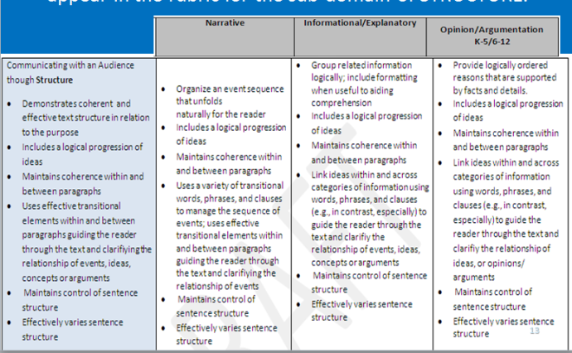

LEADERSHIP
STUDENT ACHIEVEMENT
KCAS
FORMATIVE ASSESSMENT
CHETL
Notes:
Jennifer 9:10 – 9:20
1 Slide

Slide 6
Essential Questions
½ of LDC template tasks use Essential Questions to set the context
Debate over Yes and No type questions
Since EQs, if they are strong, are an excellent instructional strategy used to engage students and they are critical to LDC work, let’s look at EQs….
Notes:
Jennifer 9:20 – 9:40 (20 min)
12 Slides

Slide 7

Essential Questions:
True or False
Essential questions may not be answerable with a one or two word response, but they do have a “right” answer. Students will be able to
answer the essential questions the
same way as their peers at the
conclusion of the unit.
FALSE
Notes:
Jennifer

Slide 8
Essential Questions:
True or False
Essential questions have no obvious right answer. They are not self-evident; even if there are “truths” and essential theories in a discipline, the students are forced to wonder and consider varied “answers” in studying the essential questions.
TRUE
Notes:
Jennifer

Slide 9
Essential Questions:
True or False
Essential questions should provoke and sustain student interest. Essential questions should be thought-provoking to students, they should value diversity within the classroom, and they should prompt student inquiry.
TRUE
Notes:
Jennifer

Slide 10
Essential Questions:
True or False
Essential questions list what students should know and be able to do at the conclusion of the unit. The teacher uses the essential questions primarily to reveal to students the content that will provide the focus of the unit.
FALSE
Notes:
Jennifer

Slide 11
Essential Questions:
True or False
Essential questions may provide some opportunities for deep, critical thinking, but generally, the questions are asked at a knowledge or comprehension level. They are similar to the types of questions that teachers most often ask in class.
FALSE
Notes:
Jennifer

Slide 12

Essential Questions:
Establishing Criteria
Directions:
Read the examples and non examples of Essential Questions found on 1st part of handout
Establish a short list of criteria for Essential Questions.
Identify the Essential Questions in the list on the 2nd half of the handout
Refine your criteria for Essential Questions based on those Essential Questions
Notes:
Jennifer
Concept of Attainment for Essential Questions HANDOUT

Slide 13

Characteristics of
Essential Questions
They require critical thinking and deep understanding.
They spark students’ questions, creativity, or inquiry.
They do not have obvious right answers.
They engage students in real-life problem-solving.
They encourage multiple perspectives.
They connect learning with personal experience.
They provide the “so what?” of a unit plan.
They are ARGUABLE!
Notes:
Jennifer

Slide 14

Characteristics of
Essential Questions
They are essential.
They require students to gather evidence, weigh conclusions, and justify responses.
“The question requires movement beyond understanding and studying - some kind of action or resolve – pointing toward the settlement of a challenge, the making of a choice or the forming of a decision.”
“The question probably endures, shifts and evolves with time and changing conditions - offering a moving target in some respects.”
They are derived from an attempt to understand the world and our place in it.
“An essential question is always poised at the boundary of the known and the unknown.” www.galileo.org.
Notes:
Jennifer

Slide 15

Essential Questions: Formative Assessment
True or False
How is a hero different from a celebrity?
Explain how history is or is not a history of progress.
What literary elements are utilized in Robert Frost’s poem “Mending Fences”?
How do natural resources affect nations and potential conflict among them?
What are the parts of a short story?
How is Holes like Hunger Games? How are they different?
What makes for a fair punishment?
Notes:
Jennifer
Index cards will be on table. Instruct participants to write T on one side and F on the other

Slide 16
Essential Questions: Formative Assessment
True or False
What makes one writer more powerful than another?
What are the steps in the writing process?
Why do you suppose some people break their promises?
What makes a good friend?
What are your five senses?
How can our nation best provide for security without undermining important civil liberties?
Find five examples of metaphor, simile, personification, and hyperbole in the collection of poems used throughout the unit.
Notes:
Jennifer End at 9:40
REMEMBER: Essential questions are not about Yes/No, but does the question allow for a strong counter-argument.

Slide 17

Task Weaknesses
Notes:
Linda and Mary 9:40 – 10:40 (60 min)
12 Slides

Slide 18

Can This Task be Saved?
Look at the sample tasks in your notebook. (Tab #10, pages 4-5)
Decide what, if anything, is wrong with the task.
After diagnosing all six, try drafting revisions to make each one more effective.
Notes:
Linda and Mary (Tab #10, pages 4-5)
Explain that we’re going to pause to give them a light way to learn some of the heavier lessons of the first year’s LDC work, using imaginary tasks.
Give directions and allow 20 minutes for crew work. Remind participants that THE TASKS ARE MIXED. NOT ALL ARE ARGUMENTATION. Intent of this activity is to see if this is a well-designed task.
Take comments and discuss each one using the appropriate slide.
Each slide below has notes on possible comments.
Note to Presenters:
Susan Weston made these tasks up. One of them uses real texts from a real teacher’s task, but that’s the strong part of the made-up task: the weak part is the part Susan rewrote.

Slide 19
Task 19
Can social climbers really move into a new social class? After reading The Great Gatsby, Vanity Fair, and Limbo: Blue-Collar Roots, White-Collar Dreams, write an essay that explains how a character succeeded or failed in efforts to move to a higher social class. What conclusions or implications can you draw? Cite at least two sources, pointing out key elements from each source.
English III
Notes:
Linda and Mary (Tab #10, pages 4-5)
MODEL THIS ONE: Intent is to see if this is a well-designed task
Vanity Fair is a 900-page novel, and Limbo is a complete non-fiction sociology book. This task won’t fit into two-to-four weeks at all! It’s important to choose manageable texts or sections of texts!
May need to look at template as doing this…

Slide 20
Task 18
After researching the War of 1812, write a report that explains the impact of the Battle of New Orleans on American presidential elections through 1836. What conclusions or implications can you draw? Cite at least 3 sources, pointing out key elements from each source.
Grade 7 U.S. History
Notes:
Linda and Mary (Tab #10, pages 4-5)
The Battle of New Orleans made Andrew Jackson a national hero.
Only, how many folks in the room remember that point, and how many think it’s a central issue in U.S. History?
This topic is too small to give it weeks of attention.

Slide 21
Task 11
After researching Romeo and Juliet and Westside Story, write a report that defines “star-crossed lovers.” Support your discussion with evidence from your research. If you had friends who were in love and whose families disapproved, what advice would you give them?
Grade 10 English
Notes:
Linda and Mary (Tab #10, pages 4-5)
This one breaks the template.
Template 11 wants students to define and explain something using the substance of the texts they read.
The first sentence leaves out the explanation part.
At the end, the question is completely outside the template, and it asks students for personal reflection rather than engagement with academic content.
GOOD CONVERSATION TASK because our teachers will have experience with this one…

Slide 22
Task 12
What is the most important challenge you have met? After reading several personal challenge essays on the Internet, write an essay that defines your challenge and explains how you met it. Support your discussion with evidence from your research.
Grade 6 Language Arts
Notes:
Linda and Mary (Tab #10, pages 4-5)
This one uses the template, but it makes weak use of what students read.
Mainly, the essays are being read as examples—which is a good technique for modeling a kind of writing, but not a good approach to demanding close reading of complex text.
The Internet is a source to be used with lots of care, because students need to be prepared to assess credibility.
Plus, to grade the student work, the teacher will need to read all the essays students find.

Slide 23
Task 2
Where have all the flowers gone? After reading selected anti-war poems and song lyrics, write an essay that addresses the question and support your position with evidence from the texts.
Grade 9 Government and Civics
Notes:
Linda and Mary (Tab #10, pages 4-5)
That question looks so classic, and it’s completely hopeless as the basis for an essay.
Sure, there’s one great folk song that says “Young girls have picked them, every one.” But can you use other poems and lyrics to support that answer, or argue for another answer about the flowers?
And, of course, it tilts to one side on issues of war participation, without much room for students to understand and maybe argue for other positions.

Slide 24
Task 3
After researching your textbook chapters on human anatomy, write an article for students your age that compares two major body systems and argues which one is the most exciting. Be sure to support your position with evidence from the texts.
Grade 8 Life Sciences
Notes:
Linda and Mary (Tab #10, pages 4-5)
Asking about excitement really undermines academic focus—and when talking with adolescents about anatomy, you (ahem) know what answers you’re going to get.
Is this worth two-to-four weeks of class time?
If you can use one task to engage students in thinking about circulation, respiration, digestion, the skeleton, muscles, tendons, and nerves, it could be—but you want them arguing about a more substantive competition.
Maybe “Which one is most important to individual well-being?”

Slide 25
Task 21
What will it take to raise voter participation? After reading "Where Have All the Voters Gone?” and “Many will mark this election by not voting,” write a legislative proposal that addresses the question and analyzes the best legal changes to increase participation, providing examples to clarify your analysis. What conclusions or implications can you draw?
A.P. U.S. Government
Notes:
Linda and Mary (Tab #10, pages 4-5)
This one is pretty good, and “a legislative proposal” is a pretty credible form of argument.
The problem here is that Task 21 is an information/explanation task, and the arguing doesn’t fit it well.
Remind participants: There is a grammatical error in notebook version… (voting”,) it is correct on slide
Address or bring in text complexity…
This is an AP class, but ALL kids should be reading this kind of text that addresses higher level, current and shorter text

Slide 26
Task 8
What will it take to raise voter participation? After reading "Where Have All the Voters Gone?” and “Many will mark this election by not voting,” write a legislative proposal that identifies a problem that keeps eligible citizens from voting and argues for a solution that can increase turnout by 10 percent or more.
A.P. U.S. Government
Notes:
Here’s the same concept, relocated to an argumentation template task.
Sometimes, the content should stay and the template task is what should be switched out..
SUGGESTION: After creating a argumentative task, write the introduction for both sides. If you can’t do this, the task is weak!

Slide 27
Table Task Analysis
At your table, brainstorm
characteristics that you
would expect to be included
in a Teaching Task.
Notes:
Linda and Mary Activity
In your table group, record a list of criteria that made these tasks weak (i.e. task didn’t match template requirements).
What were some of the things we identified that made these tasks weak?
Didn’t match template
Resources vague
Too much/too little directions on the text/resources
Too much time invested for the desired outcome…
Text Complexity
Rigor and relevance of the question
Use this criteria as a starting point to evaluate the Task and Text you completed and brought with you today.
Choose 1 person’s task and as a group begin to identify instruction that students will need in order to complete the task. (Seqway into the the instructional ladder);
(Reminder: You will submit a completed task 2 for inclusion in a bank of tasks… Will be posted to Bb and LDC)

Slide 28
Prepare for
“Critiquing a Teaching Task”
Number off at your table.
Place your number in the upper right hand corner of the “Critiquing a Teaching Task” handout.
Clip or staple your Teaching Task to the handout.
Notes:
Linda and Mary
“Critiquing a Teaching Task” HANDOUT

Slide 29
Critiquing a Teaching Task
INSTRUCTIONS
Begin with the person to your right.
Review their task. Place your comments in the box that corresponds to the appropriate TL# (top right corner).
When completed, pass the task packet to your left.
Continue reviewing and passing until have reviewed all tasks from your table.
Notes:
Linda and Mary

Slide 30
Critiquing Your Task
Read all comments made on your task.
Beginning with TL Task #1, discuss the comments with your colleagues for clarifications, suggestions, etc. Make notes on your handout as you go for future revisions/adjustments you want to make.
Continue this process until all TL Tasks from your group have been reviewed and discussed.
Notes:
Linda and Mary

Slide 31
Digging Deeper into a Task
Choose one of the tasks critiqued at your table. As a group identify and discuss what skills would be needed for a student to complete the task.
Notes:
Linda and Mary
This is a seqway into Instructional Ladder…

Slide 32
Self-Evaluation
Refer to Tab #10, Pages 9-10
Complete Slip
Notes:
Linda and Mary End at 10:40
Would you rather have a handout of this than having participants use their notebook page? It is to be turned in to us…

Slide 33
BREAK TIME!
10:40 – 10:50 a.m.
Notes:
10:40 – 10:50

Slide 34

A FIRST
INSTRUCTIONAL LADDER
Notes:
Jennifer 10:50 – 12:00

Slide 35
The Literacy Design Collaborative
An expanding set of classroom, district, state and service providers with the will to meet the challenge of expecting high levels of secondary literacy, head-on.
Notes:
Jennifer

Slide 36
Our Construction Calendar
Work Date | Project
September 2011 – March 2012 | Two teaching tasks
November - December2011 | Instructional ladder for first task followed by teaching time
January 2012 | Scoring student work from first task
January 2012 – March 2012 | Instructional ladder for second task followed by teaching time
March 2012 | Scoring student work from second task
TBA | Modules to share with other teachers
TBA | Ideas on expanding and sharing LDC work
Notes:
Jennifer
THIS IS A TENTATIVE CALENDAR!!!!!
Review the main work plan for the total project, including what’s already been done.

Slide 37
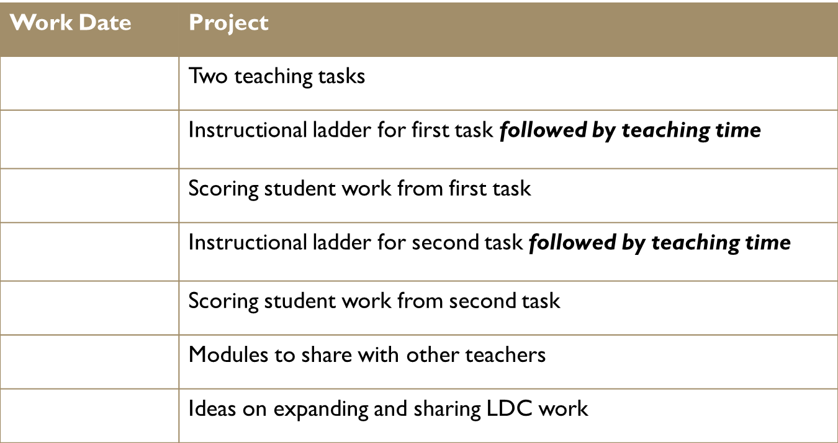
OUR CONSTRUCTION CALENDAR
September
January
October
January
February
March
Notes:
Judy

Slide 38
Our Previous Project
Product
Use template Task 2 to create a teaching task you can use during the calendar’s first “teaching time.”
Notes:
Jennifer

Slide 39
Module Basics
Notes:
Jennifer

Slide 40
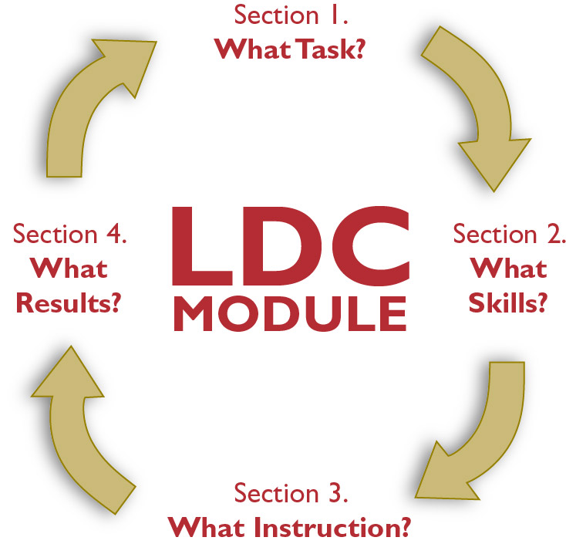
Building on Your Task 2
Notes:
Jennifer
Tab #11, Page 1 and ANATOMY OF AN LDC MODULE HANDOUT
Use this slide and the next 3 for a quick review what goes in each section of a module
Explain why Sections 2 and 3 are the focus for today. (Because participants have developed their tasks and now need to plan out skills and instruction on their way to teaching.
Work will turn to “What Results?” when they bring back student samples from that teaching effort.)

Slide 41
What Task?
A teaching task built from a template task
Background for students
Information on reading texts
State/local standards for task
Common Core State Standards from template task
Scoring rubric from template task
(What we produced earlier and will start from today)
Notes:
Jennifer
Use these slides to talk through the four main components of a module.
Notice that it’s actually a cycle, inviting teachers to move from what they see in the What Work? section on one task to thinking about What Task? for the next assignment.

Slide 42
What Skills?
Lists the skills students need to succeed on the teaching task (backward mapping)
Defines those skills as “the ability to …”
Clusters those skills in an order that makes sense for teaching
Notes:
Jennifer

Slide 43
What Instruction?
A mini-task to build each skill (prompt for student work, product for students to create, scoring guide)
Instructional strategies for mini-tasks
Pacing plan
Materials
Notes:
Jennifer

Slide 44
What Work?
Sample student responses to
your teaching task
(Pieces that you will develop and collect as you teach the task)
Notes:
Jennifer

Slide 45
A Sample Ladder in the LDC Guide
One way to complete the “What Skills?” and “What Instruction?” sections
A starting point for teachers to use, change, or replace elements to fit their teaching tasks.
Hint: Tab #8 Appendix D
(move pages 55-56 to Tab #8 with page 57)
Notes:
Jennifer
Use this slide and the next to call attention to the sample ladder in the Guidebook as a tool that participants will be exploring.
Explain that to give them time to figure out the overall ladder approach, today’s work will use the simplest version, leaving out the L2 and L3 Elements
Tab #8 Appendix D: Pages 55-57

Slide 46
Simplifications for Your First Ladder
Use the sample skills
Use most mini-tasks “as is” (modifying mainly to refer to specific resources students will use)
Work mainly on modifying instructional strategies to work smoothly for your teaching task and your students
Notes:
Jennifer

Slide 47
Today’s Project
Project
With your crew, plan your instruction, studying and revising each section of the sample instructional ladder in the LDC Guide for Teachers to work well with your first teaching task.
Supplies
Your teaching task and texts for your task.
Any note-taking and writing resources you have found helpful in other teaching.
Notes:
Jennifer
Introduce today’s project.
BLANK MODULE TEMPLATE HANDOUT

Slide 48
Pause to Consider
In your notebook for designers, please:
In a quick-write, share your first reaction to today’s project: Tab #11, Page 2
Then break your reaction down a bit, in terms of what you think may be easy and what you think may be hard.
After writing for 2-4 minutes, please:
Discuss your thoughts with your crew.
Notes:
Jennifer Tab #11, Page 2
Give instructions, and then allow 10 minutes to write and share.
Then take one thought from each table.
If possible, take all the thoughts and then respond to a few issues, rather than responding to each person.

Slide 49
Skills Cluster 1
Preparation for the Task
Notes:
Jennifer
Blank Template Module for Argumentation (Tab #8: Appendix D – Pages 55-63) SAMPLE MODULE???
50 minutes for this section
Participant products = Imagine Johnny notes, Skill Cluster 1 revisions

Slide 50
Skills Cluster 1
In the sample instructional ladder,
the first Skills Cluster
focuses on preparing students
for the teaching task.
Notes:
Jennifer
Blank Template Module for Argumentation
(If needed, also located in Tab #8: Appendix D – Pages 55-63)
Introduce Skill Cluster 1 (page 5 of blank template) and call their attention to that section of the sample ladder.

Slide 51
Break Down Our Version
(Tab #11: Pages 3-4)
To think concretely about the elements of
Skills Cluster 1, please:
Imagine Johnny as a fairly cooperative student in your class and as not weakest or strongest academically, but right in the middle of your range of students.
Individually, jot down answers to the questions in your notebook.
With your crew, talk through your answers
Be ready to share with the room.
Notes:
Jennifer (Tab #11 Pages 3-4)
Give instructions and allow 5 minutes for individual work, 10 for crew discussion.

Slide 52
What Did You See?
For the first mini-task, what are you asking Johnny to do? Part of the time he will be listening to you, but what else will he do as an active learner?
What can Johnny find out by doing the first mini-task?
What can he find out from the second mini-task?
How can that learning help him do better work?
What can you find out from Johnny’s work on the mini-tasks?
How can you use what you learn?
Notes:
Jennifer
Ask participants to share some answers to each question.

Slide 53
The Ladder Supports a Powerful Learning Cycle
“In a classroom that uses assessment to support learning, the divide between instruction and assessment blurs. Everything students do—such as conversing in groups, completing seatwork, answering and asking questions, working on projects, handing in homework assignments, even sitting silently and looking confused—is a potential source of information about how much they understand.”
Leahy, Lyon, Thompson and Wiliam, “Classroom Assessment: Minute by
Minute, Day by Day” (ascd.org)
Notes:
Jennifer
Connect this quote to key features of the ladder concept.
Notes to facilitators:
It emphasizes the value of information that can be used to see what’s being learned and what more needs learning—and Skill Cluster 1 provides lots of that information.
Notice that both the teacher and the students are finding out things about what’s going to be expected and about what may turn out to be a challenge.
The next slide changes the focus: when one teacher fills in a ladder, that’s a way of making the instruction “visible” to other teachers.
That allows a kind of dialogue essential to every profession and that needs to be much more common in education.)

Slide 54
Build Up Your Version
(Tab #8, Page 60)
With your crew, please:
Think through teaching the skills and mini-tasks of Skills Cluster 1 .
Decide on instructional strategies.
Feel free to use strategies from the sample ladder, revise those strategies, or use others that make sense for you.
Enter your choices in your ladder template.
Notes:
Jennifer
(Tab #8, Page 60) Must use notebook to do this activity because the mini-tasks are not included on the blank template…
Skill and Mini-Task Cards can be available, if you want…
Give instructions, and allow 15 minutes for crew work. Ask several crews to share examples of what they changed. Take a few questions.

Slide 55
Skills Clusters 2, 3, and 4
Reading Process
Transition to Writing
Writing Process
Notes:
Jennifer
(page 5 of blank template)
145 minutes for this section
Participant product = Common Core notes, Skills Cluster 2 revisions, Skills Clusters 3 & 4

Slide 56
Skills Clusters 2, 3, and 4
Skills Cluster 2 provides a reading process for students to tackle your selected reading texts.
Skills Cluster 3 offers a transition step where students connect what they learned in reading to what they’ll do in writing.
Skills Cluster 4 is a classic writing process, with the further note that the emphasis belongs on the quality of thought students put into their pieces.
Notes:
Jennifer
(page 5 of blank template) or (Tab #8, Appendix D: Page 59)
Quickly describe the other three Skill Clusters.

Slide 57
Argumentation Reading Standards
1. Read closely to determine what the text says explicitly and to make logical inferences from it; cite specific textual evidence when writing or speaking to support conclusions drawn from the text.
2. Determine central ideas or themes of a text and analyze their development; summarize the key supporting details and ideas.
corestandards.org
Notes:
Jennifer
Use this slide and next two to offer a quick reminder that LDC tasks and teaching are focused on a set of Common Core standards.

Slide 58
Argumentation Reading Standards
3. Analyze how and why individuals, events, and ideas develop and interact over the course of a text.
8. Delineate and evaluate the argument and specific claims in a text, including the validity of the reasoning as well as the relevance and sufficiency of the evidence.
10. Read and comprehend complex literary and informational texts independently and proficiently.
corestandards.org
Notes:
Jennifer

Slide 59
Argumentation Writing Standards
1. Write arguments to support claims in an analysis of substantive topics or texts, using valid reasoning and relevant and sufficient evidence.
4. Produce clear and coherent writing in which the development, organization, and style are appropriate to task, purpose, and audience.
9. Draw evidence from literary or informational texts to support analysis, reflection, and research.
10. Write routinely over extended time frames (time for research, reflection, and revision) and shorter time frames (a single sitting or a period or two) for a range of tasks, purposes, and audience.
corestandards.org
Notes:
Jennifer

Slide 60
Break Down Our Version
(Tab #11: Pages 6-7)
To explore the ladder more deeply, please:
Within your crew, assign each person two or three standards.
Individually, read through Skill Clusters 2, 3, and 4 of the sample ladder, looking for steps that build skill for each of your assigned standards, and making notes on what you find in your notebook.
Within your crew share each person’s findings.
Be ready to share with the larger group.
Notes:
Jennifer
(Tab #11: Pages 6-7)
Give instructions, and allow 20 minutes for individual and crew work. Then, for each standard, ask for examples of what they found.
Note that this activity has multiple answers: the standards are so closely related that one activity can contribute to developing several of them.

Slide 61
Build Up Your Version: Skills Cluster 2 (Tab #8, Pages 60-61)
With your crew, please:
Think through the skills and mini-tasks of Skills Cluster 2.
In your template, enter the instructional strategies you decide to use.
Consider making small revisions to the mini-tasks to make them fit more closely with your teaching task and instructional strategies.
Check your revisions to be sure they support each of the Argumentation Reading Standards.
Notes:
Jennifer
(Tab #8, Pages 60-61) Must use notebook to do this activity because the mini-tasks are not included on the blank template…
Skill and Mini-Task Cards can be available, if you want…
Give instructions and allow 40 minutes for those revisions to be made. Then ask for some people to share an example of what they changed.

Slide 62
Build Up Your Version: Skills Clusters 3 & 4
(Tab #8, Pages 61-63)
With your crew, please:
Work through the skills and mini-tasks of Skills Clusters 3 and 4.
In your template, enter the instructional strategies you will use.
Consider small revisions to the mini-tasks to make them fit your teaching task and instructional strategies.
Check your revisions to be sure they support each of the Argumentation Writing Standards.
Notes:
Jennifer
(Tab #8, Pages 61-63) Must use notebook to do this activity because the mini-tasks are not included on the blank template…
Skill and Mini-Task Cards can be available, if you want…
Give instructions and allow 40 minutes for those revisions to be made. Then ask for some examples of what people changed.

Slide 63
Pacing and Materials
Notes:
Jennifer
minutes for this section
Participant product = filled-in pacing and materials

Slide 64
Pacing Plans
How long will you spend on each step of your instructional ladder?
On the left side of the ladder template, there’s room to plan that out.
Notes:
Jennifer Page 7 of Blank Template
(Tab #11, Page 9) Information on Slide…
Use this slide and the next two to explain pacing, materials, and the option of a writer’s notebook

Slide 65
Materials
What books, handouts, and other supplies will you need to teach from this instructional ladder?
At the end of the ladder template, there’s space to list all of those items.
Notes:
Jennifer Page 7 of Blank Template
(Tab #11, Page 9) Information on slide…

Slide 66
The Option of a “Writer’s Notebook”
LDC work involves students producing multiple pieces of work, sometimes in response to a simple prompt and other times in response to a more complex handout you provide.
Some LDC teachers combine all of their assignments into a single “writer’s notebook” handout that students use during each class period and leave in the classroom the rest of the time.
Notes:
Jennifer
(Tab #11, Page 9) Information on slide…
Note to presenters:
The notebook is a really good, really efficient idea for organizing the handouts, so we offer it as a possibility.
It isn’t an LDC requirement, and the idea may overload some crews, so we don’t insist. We want people to make their own choice about whether to try this part.

Slide 67
Build Your Version
With your crew, please:
Take a look at the section in your Guide for Teachers that explains how to create a writer’s notebook (Tab #4 page 38).
Create a list of the materials you will use (including deciding whether to use separate handouts, a writer’s notebook, or some other approach to organizing students’ work) .
Work out how you plan to pace the work for each step of your instructional ladder (treating the design team sample as an example, but decide as a crew how your teaching task will work).
Notes:
Jennifer
(Tab #4 page 38)
Give instructions, and allow 25 minutes for crew work.

Slide 68
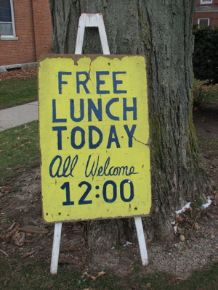
12:00 – 12:45 p.m.
Notes:
12:00 – 12:45

Slide 69
Project Status
Notes:
Jennifer (Tab #11, Page 10)
30 minutes for this section
Participant products = to-do notes and crew update

Slide 70
Time to Try it Out!
With any remaining changes your crew has planned, your next step is to teach your task, using your ladder, and find out how it works for your students.
Notes:
Jennifer (Tab #11, Page 10)
Explain what participants need to do before the next meeting.

Slide 71
Our Next Project: Due January 2012
Project
Reflect on the teaching experience
Score student work together, building deeper understanding of the LDC rubric
Choose sample student work to illustrate the results
Supplies
Four student responses to the teaching task from each teacher leader (or at least eight per crew)
Notes:
Jennifer (Tab #11, Page 10)
Introduce next project
You will have training on the scoring rubric during the November meeting.
NOTE THE REQUIRED # OF STUDENT RESPONSES TLs ARE TO BRING IN JANUARY!!

Slide 72
More on Bringing Student Work
Remove any information that could identify the student before you come: name, school, teacher’s name, etc.
If a student has included personal information in the body of the piece, choose a different piece.
Bring copies, not originals. You’ll be choosing some pieces as exemplars of each level of student work, and we’ll want to collect those from you at the end of the day.
Notes:
Jennifer (Tab #11, Page 10) information on slide…
Focus in on how to bring the work. Read the slide, ask for questions, and consciously wait a little bit for concerns to bubble up.

Slide 73
Organize for the Next Project
With your crew, please:
Discuss what work you need to do to be ready for teaching.
Discuss what work you need to do for our scoring project.
Make notes in your notebooks on how you divide up any needed work.
Complete your crew update and submit to your facilitator.
Notes:
Jennifer (Tab #11, Page 11) information on slide…
End at 1:30
Give instructions and allow 20 minutes for crew work. Then ask if there are any pressing questions to discuss.

Slide 74

Grade Level Groups
BREAK
1:30 – 1:40
K-5: Room 1
6-8: Room 2
9-12 : Main Room
Notes:
1:30 – 1:40
Break and Move to grade level groups

Slide 75
LDC RESOURCES
Reference Sheet
List of Possible Writing Forms
for LDC Tasks
Notes:
Share these 2 HANDOUTS as informational resources…

Slide 76

Formative Assessment Strategies
Use post-it notes and identify 4-5 formative assessment strategies, one strategy per post-it, that you currently use in your classroom or have seen used in your school.
Formative Assessment
Strategy
Notes:
Grade Level Facilitator 1:40 – 2:00 (20 min)
8 Slides

Slide 77

RESEARCH BRIEF, 2007
What Does Research Say the Benefits of Formative Assessment Are?
by Dylan Wiliam
Notes:
Grade Level Facilitator
You may recall that Rick Stiggins in his CASL( Classroom Assessment for Student Learning ) sets the purpose of our working toward balanced assessment by quoting the Dylan Wiliam research “ Inside the Black Box”.
This article is succinct and provides an overview of what all of the discussion around the role of formative assessment within a balanced assessment system is. You may find this very useful in communicating the discussion with teahcers, esepcially newer teacher who may have missed out on some of your earlier professional study.
1997 Inside the Black Box

Slide 78
Typology of Kinds of Formative Assessment
Type Focus Length
Long-cycle Across marking periods, 4 weeks to 1 year quarters, semesters, years
Medium-cycle Within and between 1 to 4 weeks instructional units
Short-cycle Within and between lessons day-by-day 24 to 48 hours minute-by-minute 5 seconds to 2 hours
Notes:
Grade Level Facilitator
Walkthrough Slide

Slide 79
Comprehensive Framework for Formative Assessment Processes:
Establishing where learners are in their learning
Establishing where they are going
Establishing how to get there
Notes:
Grade Level Facilitator
Walkthrough Slide
Yes, but how?????

Slide 80
Aspects of Assessment for Learning
 | Where the learner is going | Where the learner is right now | How to get there
TEACHER | Clarifying and sharing intentions and criteria for success | Engineering effective classroom discussions, questions, activities, and tasks that elicit evidence of learning | Providing feedback that moves learners forward
PEER | Understanding and sharing learning intentions and criteria for success | Activating students as instructional resources for one another
LEARNER |  | Activating students as owners of their own learning
Notes:
Grade Level Facilitator
A variety of research studies, including “Classroom Assessment Minute By Minute, ASCD” and many Wiliams studies, describe the main strategies for using formative assessment to increase optimal classroom learning.
Walkthrough Slide

Slide 81
Aspects of Assessment for Learning
 | Where the learner is going | Where the learner is right now | How to get there
TEACHER | Clarifying and sharing intentions and criteria for success | Engineering effective classroom discussions, questions, activities, and tasks that elicit evidence of learning | Providing feedback that moves learners forward
PEER | Understanding and sharing learning intentions and criteria for success | Activating students as instructional resources for one another
LEARNER |  | Activating students as owners of their own learning
Academic talk
Thoughtful questions
Meaningful Feedback
Student-friendly learning targets
Peer and self-assessment
Notes:
Grade Level Facilitator
A variety of research studies, including “Classroom Assessment Minute By Minute, ASCD” and many Wiliams studies, describe the main strategies for using formative assessment to increase optimal classroom learning.
Research Conclusion: Evidence that in addition to long-cycle formative assessment, minute-by-minute, day-by-day formative assessment can improve students’ engagement and produce substantial increases in students’ achievement.
Discuss Quotes

Slide 82
Formative Assessment Strategies
Long-Cycle
Medium-Cycle
Short-Cycle
Notes:
Grade Level Facilitator
Facilitators will place 3 Post-It Charts on the wall for each grade level group (Write the appropriate grade level on each chart along with the titles Short Cycle, Medium Cycle, or Long Cycle)
Having reviewed the research article, let’s go back to your post-it notes. With a learning partner, classify your formative assessment strategies as belonging to long-, medium, or short cycle and place them on the appropriate chart.
What did you notice?
Charts will be taken into the big room to share when return to whole group

Slide 83
Formative Assessment
Long-cycle
Medium-cycle
Short-cycle
Notes:
Grade Level Facilitator End at 2:00
Conclusion --- In order to create a truly balanced assessment system that will propel student learning forward, we need to use a formative assessments that are short, medium and long-cycle.

Slide 84
What did you learn?
Growth mindset…
Any strategies for engaging students at a higher level?
‘Dialogic” Talk
What about the link between formative and summative assessment?
Increasing motivation…
Maximize opportunities to think and question
Aha’s!?
Any connections to Characteristics of Highly Effective Teaching and Learning?
WHAT ELSE??
Notes:
Grade Level Facilitator 2:00 – 2:20 (20 min) 1 Slide
Review Book Study Guide completed as Sept. meeting homework and have table discussions

Slide 85
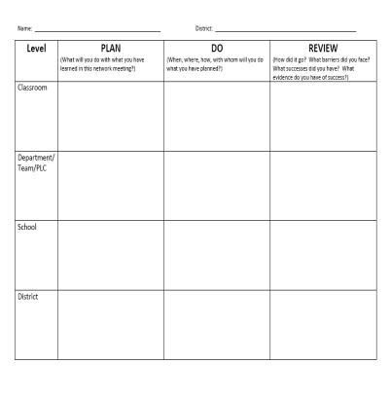
Goal Setting (Plan, Do, Review)
Notes:
Grade Level Facilitator 2:20 – 2:40 (20 min) 1 Slide
Conduct REVIEW section with a learning partner (This is what you planned at the Sept meeting and what you actually did since the last network meeting
Review
How did it go? What barriers did I face? What successes did I have?
What evidence do I have of my successes?
When finished sharing/discussing give your completed Sept. form to the room facilitator.
Use the blank PDR form to complete a your PLAN/DO for the next meeting. (Remember, you may need to change your planned P-D prior to next meeting because of real school issues and that’s OK!)
Plan
What will I do with what I have learned in this network meeting?
Do
When, where, how, with whom will I do what I have planned?

Slide 86

Book Study
Mechanically Inclined by Jeff Anderson
http://www.writeguy.net/
Notes:
Grade Level Facilitator 2:40 – 3:20 (40 min) 2 Slides
Each level facilitator will organize the 40 minute activity for reviewing this book OR use the MI activity shared by Ruthie. Below is some information from the author’s website
About the author:
Jeff has been sharing writing strategies with teachers and students for over 20 years. Whether presenting at national conferences like NCTE, ASCD, or in classrooms or writing his books, Jeff’s passion for writing and grammar inspires teachers and young writers to soar. He lives in San Antonio, Texas, and writes and consults fulltime.
Mechanically Inclined is the culmination of years of experimentation that merges the best of writer’s workshop elements with relevant theory about how and why skills should be taught. It connects theory about using grammar in context with practical instructional strategies, explains why kids often don’t understand or apply grammar and mechanics correctly, focuses on attending to the “high payoff,” or most common errors in student writing, and shows how to carefully construct a workshop environment that can best support grammar and mechanics concepts. Jeff emphasizes four key elements in his teaching:
• short daily instruction in grammar and mechanics within writer’s workshop;
• using high-quality mentor texts to teach grammar and mechanics in context;
• visual scaffolds, including wall charts, and visual cues that can be pasted into writer’s notebooks; regular, short routines, like “express-lane edits,” that help students spot and correct errors automatically.

Slide 87



Resources for You!!
Grades 6-12
Grades K-5
http://www.walloon.com/
http://www.thedailycafe.com/
Grades K-5
Complete the Subscription Form and
Return to Linda or Mary today!
Notes:
Grade Level Facilitator: Distribute Books and/or Subscription Forms
Texts and Lessons Review:
“This is a terrific resource. Not only do Daniels and Steinke provide us with very readable "one-page wonders", but we're also given lots of strategies to use with them. Those who've read Kyle Beers and Cris Tovani will recognize many of them. The fact that they're collected together here will make content are teachers much more likely to read them and then try them. Kudos.”
“Finally a way to teach the strategies in content areas and not have to spend hours looking for articles for students to read. I have been teaching reading strategies for several years now, but I always struggled to find the right article to go with the strategy being taught. NO LONGER! This book has a lesson and an article ready for you. The articles are engaging and the lessons are on target. I can't thank these authors enough for putting this book together for me and my students.”
Harvey Daniels website www.walloon.com for more information and resources.
The Daily 5
"I’ve never seen the concept so perfectly explained for the context of literacy routines... The procedures the book advocates for teaching children to be independent is applicable to whatever literacy tasks you have them regularly complete." website: http://www.thedailycafe.com/
***National Geographic for Kids (Remind 6-12 that we found more book resources for them than we did the K-5 so we have to “make it up”, HA!)
RETURN TO MAIN ROOM AT 3:20

Slide 88
Formative Assessment Strategies Classifications Results
Short, Medium and Long-Cycles
Before returning to your seat:
Conduct a Gallery Walk.
Have standing conversations with another Teacher Leader as you analyze the results from other grade levels.
Notes:
Carole 3:20 – 3:45 (25 min)
5 Slides

Slide 89

Extended Learning for November
Design an Instructional Ladder/plan
for Teaching Task 2.
Bring your completed Task 2 and
completed Instructional Ladder/Plan
to the November meeting.
Notes:
Carole
Reminder note for participants: You will teach the instructional plan and Task 2 between now and December so plan ahead!
Blank Instructional Plan Template sent electronically

Slide 90
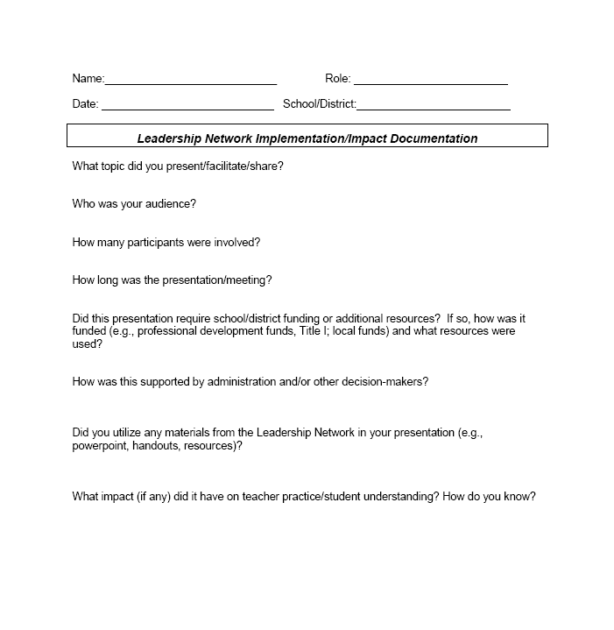
IMPACT LOGS
Logs should be submitted to Carole Mullins in hard copy or via e-mail at the end of each month.
Notes:
Carole
Very important that your work is documented and submitted to KDE…
Complete a log for any work you have done in your district. This includes, but is not limited to, meetings attended/participated, trainings and informational sessions conducted, etc. In other words, anything you do that is related to the work of the network initiative. (If you don’t have documentation of specific dates, just include the month)
The documentation log asks very specific questions and some of them will NOT pertain to every activity you have done and/or will do in the future. The point is that you work is documented!
Logs should be submitted to me by the end of each month. Electronic version is available on Bb.

Slide 91
Making Connections
CHETL
KCAS
Assessment
Literacy
Leadership
Notes:
Carole
Make connections between today’s work and each of the 4 pillars…Allow tables to discuss and make them… Share out?
Revisit Today’s Learning Targets, too:
I can evaluate a teaching task and the resources used to create it.
I can design and sequence mini lessons that are congruent to a standards based culminating task and that also reflects the characteristics of highly effective teaching and learning (CHETL).
I can explain how instructional activities can be used formatively.
I can set personal goals and make an action plan to advance the vision of 21st century learning.

Slide 92
Closing
Blackboard
2011-2012 Networks Year At A Glance
Evaluation
Certificates
Notes:
Carole

Slide 93

OUR NEXT MEETING
ELA Teacher Leader Network Meeting
Hazard Community & Technical College
November 29, 2011
9:00 a.m. – 4:00 p.m.
Notes:
Carole
End at 3:45 p.m.

