Slide 1
KVEC English/Language Arts
Teacher Leadership Network
September 14, 2010
“Preparing Students for College and Career”

Slide 2



Welcome!
KVEC ENG/LA LEADERSHIP TEAM:
Jeff Hawkins: KVEC Executive Director
jeff.hawkins@hazard.kyschools.us
Carole Mullins: KDE Network Content Specialist
carole.mullins@education.ky.gov
Dr. David Elias: EKU Professor of English
david.elias@eku.edu
Mary McCloud: KVEC Lit/Strategies Consultant
mary.mccloud@hazard.kyschools.us
Linda Holbrook: KDE Reading Consultant
linda.holbrook@education.ky.gov
Notes:
CAROLE (5 Min)
Intro and Welcome
Remind about T-Chart

Slide 3
AGENDA
Welcome
Revisit July Network Meeting Learning Targets
Network Happenings Update
Debrief CASL Chapter 1 and 2
Leadership: Keeping Learning on Track
Kentucky Core Academic Standards
Extended Learning

Slide 4
KENTUCKY’S VISION
The Commonwealth of Kentucky
Educational Vision:
Every child –
Proficient and prepared for success.
Dr. Terry Holliday, Kentucky Commission of Education
Karen Kidwell, Kentucky Leadership Network Program Manager
Notes:
CAROLE
Remind participants of Vision…

Slide 5
MAXIMIZING PRODUCTIVITY
Revisiting Group Norms:
Be present and be engaged in the work
We are all equal partners in this work
Seek first to understand, and then to be understood
Complete assignments before coming to next meeting
Be willing to negotiate and compromise
Use the law of “Two Feet”
Be courteous, respectful and positive
Keep side conversations to a minimum
Be mindful of time
No surprise expectations
Phones on Silent and No Text Messaging!
Notes:
CAROLE (5 Min)
Revisit Group Norms: Handout

Slide 6
Revisiting July Learning Targets
I can explain the Why, What, and How of the Kentucky Leadership Network (KLN).
I can identify the 4 major components that form the foundation of the KLN.
Notes:
CAROLE
REVIEW
Remind participants of July Learning Targets

Slide 7

Focus of Kentucky’s Plan: The Big Picture of Senate Bill 1
Leadership Networks
Kentucky Core Academic Standards
Characteristics of Highly Effective Teaching and Learning
Assessment Literacy
Notes:
CAROLE: 4 Major Components That Form the Foundation of Every Leadership Network in the State
Our work for the next year will focus around these items. We are leading you to proficiency in these areas in order for you to help lead your district…
Receiving Overview Today -- Quickly Mention each item…
LN - Coming together on a regular basis to learn, to share ideas, to act as “critical friends’ system of support, and share resources and tools
CCSS – Standards by themselves will not improve student achievement and motivation to learn so our work does not focus solely on them
CHETL - They are designed to provide guidance as to the kinds of activities/learning teachers should be honing and the type of feedback that might be given to improve practices – New Evaluation System currently being piloted used them in the development process.
Assessment Literacy – Ask: When you hear the term Balanced Assessment what comes to mind immediately? Formative and Summative
CASL developed by Rick Stiggins and others have been selected to be the primary framework for developing “Assessment Literacy” because they align so well with the Characteristics of HETL. Being assessment literate means you that are skilled both in gathering accurate information about student learning and in using it effectively to promote further learning (Stiggins)

Slide 8
Kentucky’s Leadership Network Updates
State
Central Office Instructional Supervision
Administrators
Teachers
Capacity Building vs Train-the-Trainer
Notes:
CAROLE
Refer participants to “Leadership Network System” Core Team Graphic given to them in July.
Remind participants that they have KLN “Scope of the Work” Handouts, etc. from 1st meeting for reference, if needed
CLARIFY and REINFORCE that we are implementing Capacity Building Strategies through our networks: Focusing on “people development” in order to sustain the learning within your district ---Districts will not receive a finished product to implement…
Explain more about their role as teacher leaders and what they will bring to the district level team…

Slide 9
On-Line Virtual PLC Updates
Virtual PLC is now open
Resources will be posted on the blackboard
For the first month I will send an e-mail informing you that I have posted a message for the network.
Notes:
CAROLE
Keeping up with how often we use the PLC…

Slide 10
Learning Targets
I can identify the Keys to Quality Classroom Assessment.
I can make a distinction between Classroom Assessment for and of Learning.
I can identify the differences in the Common Core Standards in Eng/LA compared to the current Program of Studies.
Notes:
CAROLE
The goal for today is that the information you receive will help you to meet the Learning Targets and leave here with the beginning or at least some thoughts of a plan to take back to your District Leadership Team

Slide 11

Classroom Assessment for Student Learning: Chapter 1
Homework Reading Guide Page 1:
  Discuss notes with your table
  group.
  As a group, develop a one
  sentence summary statement.
  Write the statement on a
  sentence strip and place
  on the wall.
  Group Discussion
Notes:
LINDA (25 Min)
Review CASL Chp 1: Share Homework page 1 (all 6 members at table);
Come up with one summary statement and write on sentence strip; Place on wall 10 min
Linda will read sentences out loud and conduct whole group synthesis (connect to Homework Reading Guide page 1) 10 min
“Walkthrough” Homework Reading Guide Page 2: 5 min
Page 13 has a diagram that illustrates the Keys to Quality Classroom Assessment
Page 27 summarizes that information in a table
You were asked to: tell what each of these keys means to you in terms of your current thinking and practices; challenges you see; and/or descriptions they include that confirm your current beliefs. Did anyone have a big “aha” or a comment you would like to share as a result of doing this?

Slide 12
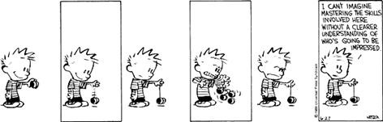
Assessment Literacy!
Notes:
LINDA:
Think of this cartoon in terms of our network, then think in terms of a student!!

Slide 13
MAKING CONNECTIONS
CHARACTERISTICS OF HIGHLY EFFECTIVE TEACHING AND LEARNING
CLASSROOM ASSESSMENT FOR STUDENT LEARNING: Doing It Right – Using It Well
Notes:
CAROLE (30 Min)
Refer participants to CHETL Document Handouts. Instruct them to look at Section Two and Highlight Key Ideas/Terms 5 min
Refer participants to CASL and CHETL Act 1 Handout – Refer to Instructions on Handout: 15 min
Whole Group Discussion: How could some of the (-) be turned into (+)? 5 min
Complete T-Chart 5 min

Slide 14
T-CHART TIME!

Slide 15
Be Back in 15!
Brain Break!

Slide 16
Classroom Assessment for Student Learning: Chapter 2
Where Am I Now?
Number 1-9 on small scrap of paper
Open CASL book to page 51
Rate yourself 1-5 according to the scale found on the Figure 2.3
Highlight or circle the 3 most important to you
Discuss the 3 most important to you with your school team members
Notes:
MARY (10 Min)
Have Participants Complete Activity on Slide

Slide 17

Rick Stiggins Explains:
Assessment OF/FOR Learning
VIDEO
Notes:
Mary (11 Min)
Chapter 2 DVD: Stiggin’s Explains Assessment of/for Learning
Turn to CASL Page 33 and use Table 2.2 for Summary Discussion-- FOCUS ON TEACHER’S ROLE SECTION (5 Min)

Slide 18

What Does Assessment for Learning Look Like?
Notes:
Mary (15 Min)
Refer participants to “7 Strategies Worksheet”
Instructions: Determine which of the 7 Strategies of Assessment for Learning are evident in each of the CASL Chapter 1 Scenarios. Use a (+) if evident and a (–) if not evident. When finished discuss results with table group.
Have participants share Homework Page 3 comments/ideas with table group while we set up for video…

Slide 19
Keeping Learning On Track…
“Meeting regularly in teacher learning communities is
one of the best ways for teachers to develop their skill
in using formative assessment.”
Changing Classroom Practice
Dylan Wiliam
Educational Leadership
December 2007/January 2008 | Volume 65 | Number 4
Informative Assessment Pages 36-42
Notes:
CAROLE/LINDA (18 Min)
Introduce Video Dylan Wiliam’s program – Keeping Learning on Track. “Formative Assessment and Teacher Learning Communities” Link: http://www.ets.org/Media/Campaign/12652/video.html
Notes from Karen’s Update E-Mail about the video--
This 5 min. video captures exactly what we are striving to do in our Content Leadership Networks.
It is also worth mentioning that all of these ‘formative assessment professional development’ programs insist on the same elements we’re
promoting: learning, practice/action, reflection, refinement…through on-going, job-embedded structures with support from colleagues and administrators.
No surprise, though, since all components are strongly supported by research on both formative assessment and best professional development practices.
After video read article “Changing Teacher Practice” by Dylan Wiliam (Will conduct 3-2-1 Activity at end of Day)

Slide 20

Time for Lunch !
Notes:
11:30 – 12:15 ??

Slide 21


“The Standards”
What Does It Mean to be a Literate Person in the 21st Century?
  Public School is an adventure.
  If you are going to use a map, make sure it’s correct!
Kentucky’s Core Academic Standards
for English Language Arts and
Literacy in History/Social Studies,
Science, and Technical Subjects
Notes:
Focused on critical demands of the global economy
Fewer, but more rigorous
Easily communicated to stakeholders
Based on research
Considered international benchmarks
Aligned from kindergarten through college entrance
Intended to be a living work: as new and better evidence emerges the standards will be revised accordingly
The Standards will begin as our Map for this adventure, but including knowledge of SB1, CASL, CHETL and the Deconstruction Process are the only ways to arrive at our destination of high level student learning.

Slide 22
The Key Design
  College and Career Readiness (CCR) Standards
    Overarching standards for each strand that are further defined by grade-specific standards
  Grade-Level Standards in English Language Arts
    K-8, grade-by-grade
    9-10 and 11-12 grade bands for high school
    Four strands: Reading, Writing, Speaking and Listening, and Language
  Standards for Literacy in History/Social Studies, Science, and Technical Subjects
    Standards are embedded at grades K-5
    Content-specific literacy standards are provided for grades 6-8, 9-10, and 11-12
Notes:
REMINDER INFORMATION
Walkthrough Slide by having participants view handouts Writing Standards for ELA 6-12 (pages 41, 42 and 45
Handout (Page 41):
CCR are know as ANCHOR STANDARDS. They define general, cross disciplinary literacy expectations for college/career readiness
Handout (Pages 42 and 45):
Grade-Level Stds – K-8 provide useful specificity; 9-10/11-12 bands allow flexibility in high school course design
Strands: 4 processes of communication are closely related and reflected throughout the document
Stds. insist that literacy instruction be a shared responsibility within the school.
Emphasis on informational and persuasive text

Slide 23
College and Career Readiness Standards
English Language Arts
Literacy in History/Social Studies, Science, and Technical Subjects
Reading (20)
1)Informational (10)
2)Literary (10)
Writing (10)
Speaking & Listening (6)
Language (6)
Reading (10)
Writing (10)
Notes:
REMINDER: Visual Chart of the key design…
Sally Hampton Chair, ELA College and Career Readiness Standards Work Group and Member, ELA K-12 Common Core Standards Committee stated “ most states have 120 standards in ELA. The CC has 42…”
Fewer and Broader… This means that teachers must design more rigorous tasks to help students achieve learning at a higher level… This is where CASL, Deconstruction and CHETL become the important pieces of the standards. By themselves, the standards WILL NOT improve student learning!!!
The overarching skill emphasized in the ELA standards is COMPREHENSION at its highest level: ANALYSIS, CLASSIFICATION, ABILITY TO COMPARE/CONTRAST, SYNTHESIZE
Reading has 20 standards that are sub-divided into informational and literary text and each has10 standards (each connects back to its corresponding CCR
anchor)
10 standards for writing
6 Standards for Speaking and Listening
6 Standards for Language
Content Specific Literacy standards include 10 standards for reading and 10 for writing:

Slide 24
Table of Contents
Page # | Strand/Topic | Grade Level
11 | Reading | K-5
19 | Writing | K-5
23 | Speaking/Listening | K-5
26 | Language | K-5
31 | Text Complexity | K-5
36 | Reading | 6-12
42 | Writing | 6-12
49 | Speaking/Listening | 6-12
52 | Language | 6-12
57 | Text Complexity | 6-12
61 | Literacy in History/Social Studies, Science and Technical Subjects | 6-12
Notes:
This is a slide you will want to access when you return to your school. These tabs will help to organize and locate just where things are in the document.

Slide 25
Standards do … | Standards do not …
Establish what students need to learn. | Dictate how teachers should teach. Instead, schools and teachers will decide how best to help students reach the standards.
Attempt to focus on what is most essential. | Describe all that can or should be taught. A great deal is left to the discretion of teachers and curriculum developers.
Set grade-level standards. | Define the intervention methods or materials necessary to support students who are below or above grade-level expectations.
Notes:
Everyone would like the standards to be a “magic wand” and solve our problems, but that is a Fantasy
You won’t see strategies or instructional advice. BUT— HIGHLY EFFECTIVE TEACHING AND LEARNING will guide teachers. Along with CHETL, the establishment of learning targets are beneficial in understanding if our students have met the standards.
The standards do not describe all that can or should be taught (only what is essential is included). A well-developed, content-rich curriculum must be developed by individual schools/districts/states…
G/T or Advanced Work: Advanced work in such areas as literature, composition, language, and journalism should be made available to students
Interventions: No grade-specific standard can fully reflect the great variety in abilities, but GREAT teachers and teaching can identify them and address their needs. Maybe mention RtI, CSIP, etc…

Slide 26
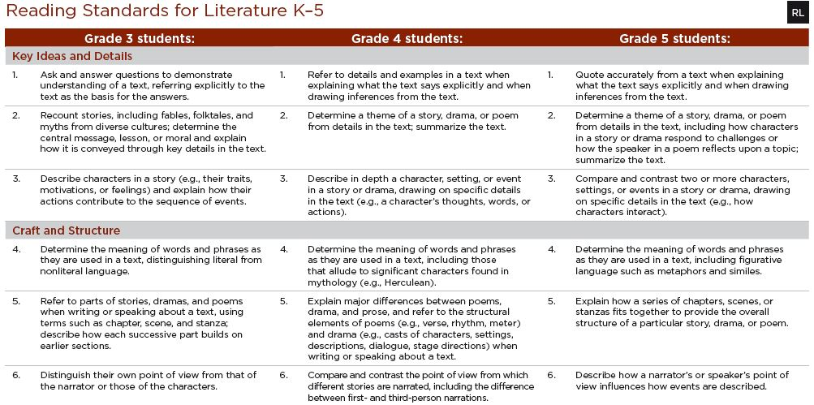
Format highlights progression of standards across grades
Notes:
Anchor Standard CCR Reading Standard 3: (remind about “number connections” to CCR Anchor Standard)
ELA Standards define what students should understand and be able to do by the end of each grade.
They correspond to the College and Career Readiness (CCR) anchor standards by number.
The CCR and grade-specific standards are necessary complements—the former providing broad standards, the latter providing additional specificity—that
together define the skills and understandings that all students must demonstrate.
CC Standards go in-depth earlier… CHETL, CASL (formative and summative assessment) are the guidance teachers need…

Slide 27
Example: W.CCR.6: Use technology, including the Internet, to produce and publish writing and to interact and collaborate with others.
W.K.6 | With guidance and support from adults, explore a variety of digital tools to produce and publish writing, including collaboration with peers.
W.2.6 | With guidance and support from adults, use a variety of digital tools to produce and publish writing, including in collaboration with peers.
W.4.6 | With some guidance and support from adults, use technology, including the Internet, to produce and publish writing as well as to interact and collaborate with others; demonstrate sufficient command of keyboarding skills to type a minimum of one page in a single sitting.
W.6.6 | Use technology, including the Internet, to produce and publish writing as well as to interact and collaborate with others; demonstrate sufficient command of keyboarding skills to type a minimum of three pages in a single sitting.
W.8.6 | Use technology, including the Internet, to produce and publish writing and present the relationships between information and ideas efficiently as well as to interact and collaborate with others.
W.9-10.6 | Use technology, including the internet, to produce, publish, and update individual or shared writing products, taking advantage of technology’s capacity to link to other information and to display information flexibly and dynamically.
W.11-12.6 | Use technology, including the Internet, to produce, publish, and update individual or shared writing products in response to ongoing feedback, including new arguments or information.
With no support
Notes:
Example from the writing strand of how the CCR Anchor Standards are reflected across the grade level standards. REFER TO HANDOUT
Top: CCR standard 6 for writing. It is coded as W.CCR.6 to show that it is a writing standard, from the CCR anchor section, and it is standard #6.
From that information we know that writing standard #6 from all grade levels and writing in the content areas and technical subjects will hook back to or progress toward proficiency in this CCR anchor standard.
Next line coded W.K.6, for writing, kindergarten, standard 6, you will see how it corresponds to the content in the CCR writing standard it supports.
Students use guidance and support from adults to explore digital tools to produce and publish writing.
Writing, grade 2, standard 6: students use guidance and support from adults to use a variety of digital tools to produce and publish writing…slight change in standard from Kindergarten to 2nd
Writing, grade 4 standard 6: student will use some guidance and support to use technology to demonstrate sufficient command of keyboarding skills to type a minimum of one page…
Writing, grade 6, standard 6: guidance and support for the students has been removed in this standard. “Quantum Leap” from 4th grade… The students are expected to have the skills necessary to use the technology independently as needed. Three pages
Writing, grade 8 standard 6: the focus has changed from using the technology to produce and publish to ensuring the relationships between the information and ideas are presented efficiently.
Writing, grade spans 9-10, standard 6: In this grade span, students are now expected to take advantage of the technology's capacity to other information and to display information flexibly and dynamically
Writing, grade spans 11-12, standard 6: revise individual or shared writing products in response to ongoing feedback
Refer back to top CCR: using technology to produce and publish writing and to interact and collaborate with others

Slide 28
Literary vs Informational
CCR Reading Standard 3: Analyze how and why individuals, events, and ideas develop and interact over the course of a text.
Reading Standards for Literature |  | Reading Standards for Informational Text
Grade 3: Describe characters in a story (e.g., their traits, motivations, or feelings) and explain how their actions contribute to the sequence of events. |  | Grade 3: Describe the relationships between a series of historical events, scientific ideas of concepts, or steps in technical procedures in a text, using language that pertains to time, sequence, and cause/effect.
Grade 7: Analyze how particular elements of a story or drama interact (e.g., how setting shapes the characters or plot) |  | Grade 7: Analyze the interactions between individuals, events, and ideas in a text (e.g., how ideas influence individuals or events, or how individuals influence ideas or events).
Grades 11-12: Evaluate various explanations for characters’ actions or for events and determine which explanation best accords with textual evidence, acknowledging where the text leaves matters uncertain. |  | Grades 11-12: Analyze a complex set of ideas or sequence of events and explain how specific individuals, ideas, or events interact and develop over the course of the text.
Notes:
This slide focuses on progression, but use it to emphasize the DIFFERENCES IN LITERATURE AND INFORMATIONAL TEXT.
Content teachers need the “clarification” (especially H.S. level) of how the standards define reading skills within their subject area.
Another important aspect is that ALL teachers should emphasize to their students that the SKILLS PROCESS of a standard are the same (i.e. describe, analyze, etc). It is the context, subject or topic that will be different!

Slide 29
Overview of the Reading Standards for History/Social Studies
  Key Ideas and Detail: Cite specific textual evidence to support analysis of primary and secondary sources
  Craft and Structure: Analyze, evaluate, and differentiate primary and secondary sources
  Integration of Knowledge and Ideas: Integrate information from diverse primary and secondary sources into a coherent understanding of an idea or event
Notes:
CCR Anchor Standards for Reading remain the same so I did not copy them
Handout Pg. 61: Reading Stds. in H/SS
Reminder: Only 10 standards for Reading and 10 for Writing
I think content area teachers, especially at H. S., will be more accepting once they have actually been exposed to the standards in a way that connects
them to their specific area!
Note terminology of Cite, primary/secondary, Analyze, Evaluate, Differentiate, Integrate --- DEPTH AND RIGOR implications for both teaching and learning.
Just becoming familiar with the standards will not get students to proficiency. In Kentucky we will use CHETL, CASL and Deconstruction to…

Slide 30
Overview of the Reading Standards for Science and Technical Subjects 6-12
  Key Ideas and Detail: Cite specific textual evidence to support analysis of scientific and technical texts
  Craft and Structure: Analyze the scope and purpose of an experiment or explanation and determine which issues remain unresolved or uncertain
  Integration of Knowledge and Ideas: Synthesize information in different formats by representing complex information in a text in graphical form (e.g., a table or chart) or translating a graphic or equation into words
Notes:
CCR Anchor Standards for Reading remain the same
Handout Pg. 62: Reading Stds in SC and Tech Subj.
Again, Remember only 10 standards for Reading and 10 for Writing
Note terminology of Cite, Analyze, Synthesize, Translating --- DEPTH AND RIGOR implications for both teaching and learning.

Slide 31



Appendices
Appendix C:
Annotated Writing Samples at Various Grade Levels
Appendix A:
Supplementary Materials and Glossary
Appendix B:
Text Exemplars and Sample Performance Tasks
Notes:
GIVE EACH DISTRICT AN ACCORDION FOLDER WITH COPY OF EACH APPENDICE
3 Appendices:
A: Supplementary materials and a glossary (43 pages)
B: Text exemplars illustrating complexity. text complexity is measured by 3 factors (DON’T KNOW IF I WILL GO INTO ALL THIS ABOUT APPENDIX B , BUT I WILL HAVE IT IF NEEDED)
qualitative evaluation (levels of meaning, structure, language conventionality, and clarity, and knowledge demands)
quantitative evaluation (readability, and other scores of text complexity), and matching reader to text and task (reader variables such as motivation, knowledge and experience, and task variables such as purpose and complexity generated by task assigned or question posed)
quality and range of reading for grade levels (includes text types for K-5 and 6-12 bands in these broad categories: stories, dramas, poetry and literary nonfiction/(historical, scientific and technical texts for K-5 only)
Accompanying Sample Performance Tasks (183 pages)
C: Annotated samples demonstrating at least adequate performance in writing at various grade levels (106 pages)

Slide 32

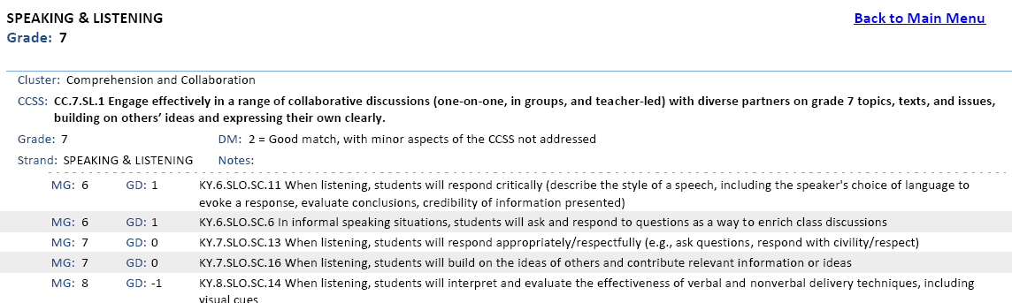
Kentucky Department of Education
ENGLISH LANGUAGE ARTS CROSSWALK
Notes:
Intent is to help in understanding of how the new Common Core Standards in ELA compares with current expectations for students AND to inform thinking about the implementation of Kentucky Core Academic Standards
Bookmarked Crosswalk Pg. 264 Handout and Basic Explanations Handout: Provide explanation for crosswalk document using example on the screen and the handout.
Activity: Have participants analyze the other 2 standards on the crosswalk handout using the explanations handout. Ask them to discuss any implications for curriculum alignment and or effective teaching/learning characteristics
Understanding the organization of this document and how to use it will help teachers organize and align current curriculum. It will allow them to identify “gaps” in the two standards and start planning/addressing standards before school is out…

Slide 33
Accessing and Using the
Bookmarked Crosswalk
Visit the KDE website: www.education.ky.gov
KDE Quick Links: Program of Studies
Access the link entitled: “English Language Arts Bookmarked Crosswalk (pdf)” (DO NOT access the “crosswalk” link listed first on the page)
Using the Bookmarked Crosswalk and Explanation Handout, instruct ALL teachers how to identify gaps/difference between the POS and CCSS.
Next Step: Work within school PLCs, common planning, etc. and develop an Action Plan for addressing curriculum alignment and instructional issues before the end of the 2010-2011 school year.
Notes:
SUGGESTION FOR BEGINNING THE STANDARDS WORK IN YOUR SCHOOL/DISTRICT.

Slide 34
Let’s take a 15” break!

Slide 35
Putting the Pieces Together for Deconstruction
Identify what you feel are important components/steps of the deconstruction process
Write them on a post-it note then share them with your team members
“I Do” Activity
Move into Grade Level Groups
“We Do, You Do” Activity
Notes:
CAROLE and LINDA take lead with support from Mary and David:
SEE SEPARATE PAGE OF INSTRUCTIONS FOR THIS PROCESS

Slide 36
T-CHART TIME!

Slide 37
3-2-1 ACTIVITY
Keeping SB1 in mind, use the 3-2-1 worksheet to think about how the three primary resources we will be using in our network (CHETL, KCAS and CASL) are connected and how we will help teachers learn about these connections.
Notes:
CAROLE and DAVID MS/HS:
LINDA and MARY EL:
Revisit the article “Changing Teacher Practice” by Dylan Wiliam 30 mins.
Finish reading article, if needed; Complete 3-2-1 Handout

Slide 38
Extended Learning
Prior to the October 5th Network Meeting:
Complete CASL Chapter 3 Anticipation Guide
Read Chapter 3
Implement one of the two Instructional Strategies identified in the 3-2-1 Activity in your classroom.
Be prepared to share successes/failures with your table group.
Notes:
CAROLE AND LINDA
Extended Learning Assignment: Distribute Chapter 3 Anticipation Guide to Participants and then explain assignment on slide

Slide 39

What Really Matters…
“What really matters, in terms of developing readers and writers, is the quality of classroom instruction.”
---Richard Allington
Notes:
REFLECTION COMMENTS FOR CLOSURE

Slide 40
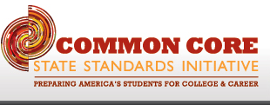
How Can I Support You?
Carole Mullins
Eng/LA Regional Content Specialist
606-854-2329
carole.mullins@education.ky.gov
Notes:
PLEASE CONTACT ME FOR SUPPORT!!

