Slide 1

Close Reading and Text-Dependent Questions
Carole Mullins, NBCT
KVEC Literacy Instructional Specialist
carole.mullins@hazard.kyschools.us
and
Kimberly Sergent
KVEC Social Studies Instructional Specialist
kimberly.sergent@letcher.kyschools.us
www.kvecelatln.weebly.com
Notes:
Before we begin, write down my website url. All the resources I will use today, along with others not included in today’s presentation are available on this website.

Slide 2

To identify the essential components of close reading (RL/RI 1) of complex texts
(RL/RI 10) which includes collaborative conversations (S & L 1) and writing from sources (W 1), fostering language development (L 6) and deeper thinking.
Notes:
D. Fisher (among many others) states: Every lesson should have a CLEAR learning target. “We’ve known this for 70 years, but are still not using it as we should”
The “purpose” for learning today is…
Must have relevance
So today, my PURPOSE for this session is:
To help you identify the essential components of Close Reading and the important connection to ELA/Literacy Standards while sharing some resources with you…

Slide 3
Common Core Standards
CC Themes | What students should be able to do…
Key ideas and details “What did the text say?” | Students should be able to determine what texts say explicitly and be able to summarize them (including central ideas/themes, how ideas and characters develop and interact), making logical inferences, and citing textual evidence.
Craft and Structure “How did the text say it?” | Students should be able to interpret the meanings of words and phrases and the structure of texts to determine how they affect meaning or tone, and how points of view and purpose shape content and style.
Integration of knowledge and ideas “What does the text mean? What is its value?” | Students should be able to synthesize and compare information from print and digital sources, and critically evaluate the reasoning and rhetoric of a text.
Range and level of text complexity | Students will be asked to read more challenging texts.
Notes:
Let’s begin with a quick look at what the Reading standards require…
Key ideas and details: In other words, “What did the text say?” (Do same for each of the other sections…)
REMEMBER: Read grade level text independently by end of 2nd grade

Slide 4

1. Read closely to determine what the text says explicitly and to make logical inferences from it; cite specific textual evidence when writing or speaking to support conclusions drawn from the text.
Notes:
Refer participants to Reading Anchor Standard #1 and 10 H/O

Slide 5
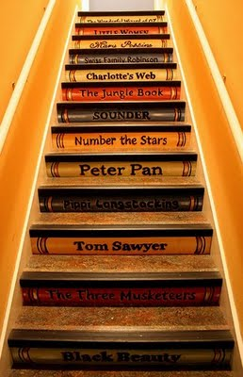
“Standard 10 defines a grade-by-grade
‘staircase’ of increasing text complexity that rises from beginning reading
to the college and career readiness level.” (CCSS, 2010, p. 80)
Notes:
Refer participants to Reading Anchor Standard #1 and 10 H/O

Slide 6
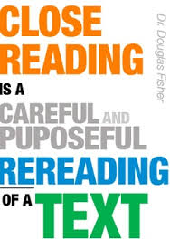
What is close reading?
It involves:
--analysis of a text
--at word, phrase level
--at sentence, paragraph level
--identify author’s central idea
--identify key details
Doug Fisher: Close Reading Explanation Videos
Part 1: 2:47 mins
https://www.youtube.com/watch?v=5w9v6-zUg3Y
Part 2: 3:00 mins
https://www.youtube.com/watch?v=JhGI5zdjpvc
Notes:
Douglas Fisher
Close reading is the instructional practice of having students critically examine a text, especially through multiple readings.
It has been utilized most commonly at the secondary and college levels, usually within the context of rhetorical reading and writing courses.
2 Short Videos are available and are great PLCs or Common Planning

Slide 7



Why Depth through
“Close Reading” Matters
Close reading instruction:
Requires careful attention to how the text unfolds through asking text-dependent questions.
Focuses on building knowledge through the strategic use of text-dependent questions.
Can prepare students for the kinds of reading tasks they will encounter after graduation.
Despite its name, close reading has a lot more to do with writing than reading!
Notes:
Doug Fisher “quotes”
Go over slide information

Slide 8
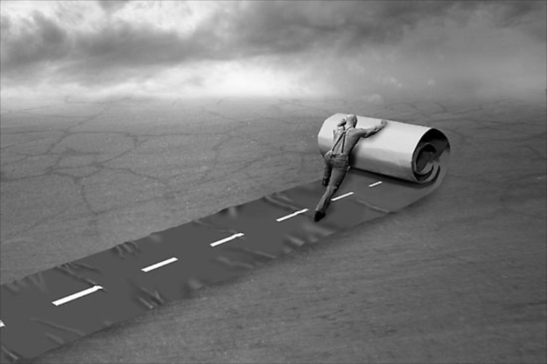
The Role of Pre-reading
Multiple readings often make this unnecessary
Notes:
Let’s address a skill we all were taught to use with students: the role of pre-reading in reference to the requirements of the CCSS…
PR is still a part of the scaffolding process, but the intent is to move toward independence… “Cold reads”, assessment, etc…

Slide 9
The Role of Pre-reading
Too often provides information students can glean from careful reading of the text
Hard to wean students from this
Similarly challenging to move teachers away from providing this “smoothing of the road”
Multiple readings often make this unnecessary
Notes:
“COLD READ” model what happens during assessments…
This is another reason why the CR instructional strategy is so important! Regular practice with academic text at their grade level!!
Prep for assessment!

Slide 10

“X-ray the book”
Notes:
The teacher MUST carefully select text for use in a CR… WHY?
From the article provided today:
Adler and Van Doren (1940/1972) explain in their seminal text How to Read a Book that readers should “x-ray the text ” in order to find “the skeleton hidden between its covers”(p. 75).
The intent in analytic reading is to identify these deep structures in order to plumb the explicit and implicit meanings of the text.
“Leveled Texts Lead to Leveled Lives” D. Fisher

Slide 11
Not every reading is a close one!
“X-ray the book”
Notes:
ELA Shift: Regular practice with COMPLEX text”…
Teachers MUST read text in advance of a CR in order to KNOW what makes it complex and to ensure it is taught
Text Complexity “lives” inside the text
Teachers must scaffold the learning to lead students to rigorous texts

Slide 12

Use a short passage
Creating a Close Reading
Notes:
Let’s discuss the steps that Doug Fisher has identified to create a CR.
Be strategic about the text you choose:
How short is short? There is no research on this, but D. Fisher utilizes this “rule of thumb” IF IT HAS TO BE STAPLED, IT’S TOO LONG! The longest short passage is front/back of 1 page.
Excerpts from a longer text are great
Choose excerpts that contains information students “really need to get”.

Slide 13
Use a short passage
Re-reading
Creating a Close Reading

Slide 14

Why We Re-Read A Text
Initial reads of the text
What does the text say?
After at least one reading
How does the text work?
Later readings of the text or related texts
What does the text mean?
Notes:
Different Readings Have Different Foci so I’m going to stop here and clarify why we re-read…
Notes on slide
D. Fisher notes:
Re-reading improves Comprehension and Fluency, but kids don’t appreciate the need to re-read so we must trick them into doing it.
Ask worthy TDQs that force them back into the text
Change up the tasks
Press for evidence from the task
Remember, students DO NOT have to re-read the ENTIRE text

Slide 15
Use a short passage
Re-reading
“Read with a pencil”
Creating a Close Reading

Slide 16

Annotation slows down the reader in order to deepen understanding.
Notes:
Reading with a pencil: Annotation is a note of any form made while reading text. Some of you already have established procedures you use with students (graphic organizers, etc.)
When you annotate it means you are noticing the DIFFERENCE in DETAILS and the MAIN IDEA. It forces kids to monitor their understanding and is a great FORMATIVE assessment. Be sure to collect student annotations because it is EVIDENCE for their thinking while reading
The driver for annotation is TDQ (We will look at the progress of TDQ in a few minutes)
Be sure not to go into overkill with annotation.
Foundational Annotation Skills: (Mortimer Adler’s 1940 work on google, still pertinent today)
Underline the major points.
Circle keywords or phrases that are confusing or unknown to you.
Write margin notes restating the author’s ideas.

Slide 17
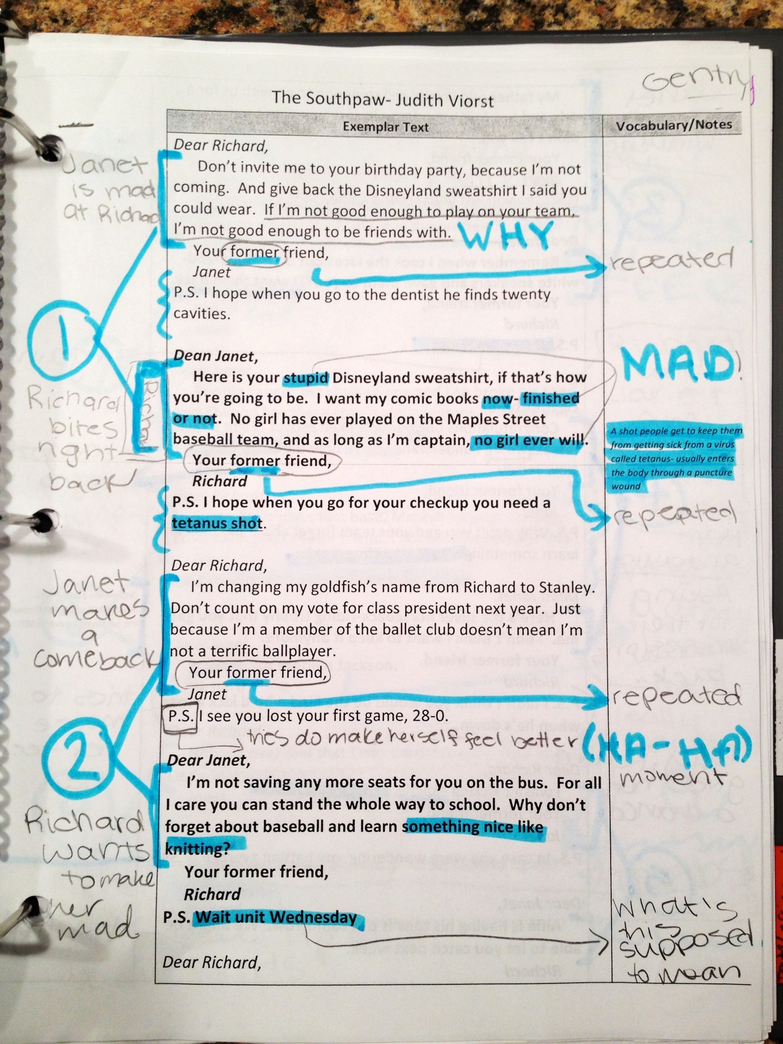
Student annotation in 6th grade
Student sample from Leigh McEwen, AEA 9, Iowa
Notes:
Intermediate

Slide 18
Use a short passage
Re-reading
“Read with a pencil”
Text-dependent questions
Creating a Close Reading

Slide 19
Close Reading Requires a Good Progression of Text-Dependent Questions
Opinions/Arguments,
Intertextual Connections
Inferences
Author’s Craft and Purpose
Key Details
General Understandings
Vocab & Text Structure
What does the text mean?
TDQs are designed to cause students to return to the text.
How does the text work?
What does the text say?

Slide 20
Text-dependent Questions and the Standards
Opinions, Arguments,
Intertextual Connections
Inferences
Author’s Purpose
Vocab & Text Structure
Key Details
General Understandings
Standards
8 & 9
3 & 7
6
4 & 5
2
1
Notes:
K-5 Reading: Anchor Standards (Page 10, CCSS)
Each type of TDQ in the Progression Process can be directly linked to a Reading Standard…

Slide 21
Use a short passage
Re-reading
“Read with a pencil”
Text-dependent questions
Give students the chance to struggle a bit
Creating a Close Reading
Notes:
One important outcome that should come from a CR is to give students the chance to struggle a bit!
Four Steps for Introducing…Close Reading H/O

Slide 22
What are Text-Dependent Questions?
Text-dependent questions:
Draw the reader back to the text to discover what it says.
Have concrete and explicit answers rooted in the text.
Frame inquiries in ways that do not rely on a mix of personal opinion, background information, and imaginative speculation.
Guide to Creating Text Dependent Questions
www.achievethecore.org
Notes:
College- and career-ready standards, including the Common Core, expect students to use evidence from texts to present careful analyses, well-defended claims, and clear information.
A key method to help students develop these skills is the use of text-dependent questions: questions that can only be answered by referring back to the text.
Go over slide Tell participants we will come back to Guide to Creating TDQ in a minute

Slide 23

Characteristics of Text-dependent questions

Slide 24
Characteristics of Text-dependent questions
Questions that can only be answered with evidence from the text
Can be literal but can also involve analysis, synthesis, evaluation
Focus on word, sentence and paragraph as well as larger ideas, themes or events
Focus on difficult portions of text in order to enhance reading proficiency

Slide 25

Close reading should invite struggle
Notes:
Now let’s transition to a middle school lesson that will cause students to think critically in order to identify evidence to answer TDQs.
REMEMBER: As students progress through this process the ultimate goal is to be able to do this: INDEPENDENTLY (the “A” word, assessment)

Slide 26

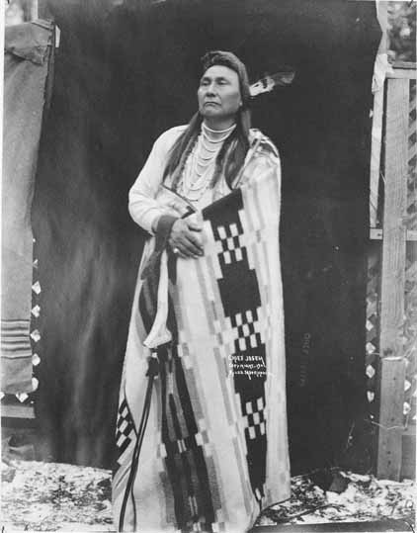
1877
Notes:
Doug Fisher: Close Reading Procedure H/Outs:
Middle Grades U. S. History: Chief Joseph’s Surrender Speech (This is the last two sentences)

Slide 27
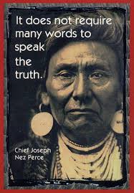
I WILL FIGHT NO MORE FOREVER
Chief Joseph of the Nez Perce, 1877
I am tired of fighting.
Our chiefs are killed.
Looking Glass is dead.
Toohulhulsote is dead.
The old men are all dead.
It is the young men who say no and yes.
He who led the young men is dead.
It is cold and we have no blankets.
The little children are freezing to death.
My people, some of them, have run away to the hills and have no blankets, no food.
No one knows where they are.
Perhaps they are freezing to death.
I want to have time to look for my children and see how many of them I can find.
Maybe I shall find them among the dead.
Hear me, my chiefs, I am tired.
My heart is sad and sick.
From where the sun now stands,
I will fight no more forever.
Notes:
Kim:
Close Reading Procedure H/O
Quickly review/introduce the handout
For the sake of time, we are going to “pretend” that you have already completed the 1st/2nd discussions and the 2nd readings and are now ready for TDQs
Formal Surrender of Chief Joseph H/O: Use this as a COLD READ!!
An audio version will be available in my resources… (1:28 minutes long)
BACKGROUND INFORMATION FOR TEACHERS, NOT STUDENTS:
Canyon Creek Battlefield, Bear Paw Mountains, Montana: site of Chief Joseph’s speech.
Background info: In 1863, some Nez Perce chiefs signed a treaty with the US agreeing to surrender their ancestral lands and be moved instead to a reservation in Idaho. Chief Joseph the Elder (Chief Joseph’s father), Chief Looking Glass and Chief Toohulhulsote, as well as others, refused to do so. This lead to an uneasy standoff for 14 years, during which time the non-treaty Nez Perce were allowed to remain. In 1877, the US Army decided to take action to end the standoff. The Nez Perce War was the name given to the U.S. Army's pursuit of the over 800 Nez Perce and an allied band of the Palouse tribe who had fled toward freedom. Initially they had hoped to take refuge with the Crow nation in the Montana Territory, but when the Crow refused to grant them aid, the Nez Perce went north in an attempt to reach asylum with Sioux Chief Sitting Bull and his followers who had fled to Canada in 1876.
For over three months, the Nez Perce outmaneuvered and battled their pursuers traveling 1,170 miles across Oregon, Washington, Idaho, Wyoming, and Montana.
General Howard, leading the opposing cavalry, was impressed with the skill with which the Nez Perce fought, using advance and rear guards, skirmish lines, and field fortifications. Finally, after a devastating five-day battle during freezing weather conditions with no food or blankets, with the major war leaders dead, Joseph formally surrendered to General on October 5, 1877 in the Bear Paw Mountains of the Montana Territory, less than 40 miles south of Canada. (Source: Wikipedia)
The battle is remembered in popular history by the words attributed to Chief Joseph at the formal surrender.

Slide 28
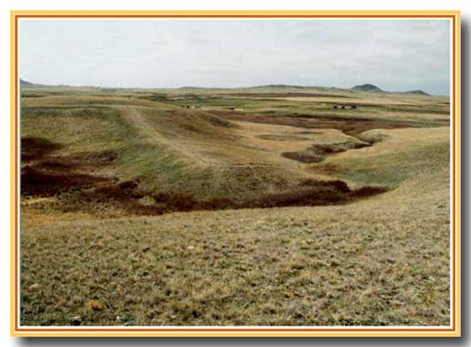
What does the text say? General Understanding
Who is delivering the speech?
What happened?
Who is the author?
Who is the audience?
(Sourcing)
Notes:
Kim
We are going to quickly go through the PROGRESSION OF TDQs that are aligned with the demands of KAS

Slide 29
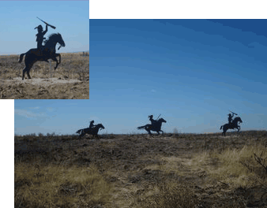
What does the text say? General Understanding
Without yet knowing who Looking Glass and Toohulhulsote are, what can we say about their roles in this decision?
When was it written? Why was it written?
(Sourcing)
Notes:
Kim
Pronunciation: Too hool hool zo the

Slide 30
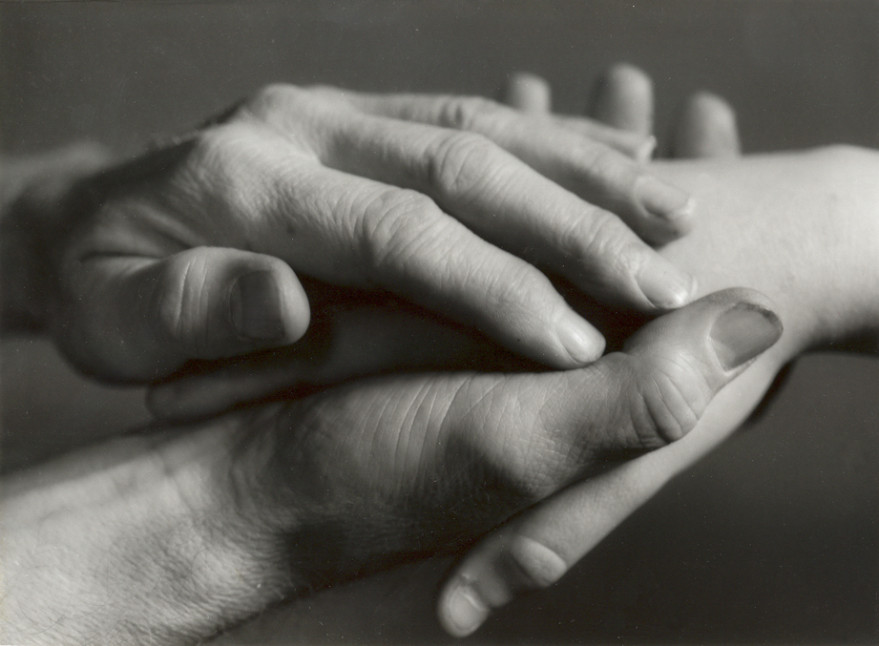
What does the text say? Key Details
What concerns does Chief Joseph have about the health and welfare of his people? How do you know?
Is Chief Joseph a reliable source? What evidence supports your answer?
Notes:
Kim

Slide 31

How does the text work? Vocabulary
What does Chief Joseph mean when he says, “From where the sun now stands?”
How does the language Chief Joseph use indicate his perspective? (Close reading)
Notes:
Kim

Slide 32

How does the text work? Structure
How does the text structure convey Chief Joseph’s mood?
What language does Chief Joseph use to persuade his audience? (Close reading)
Notes:
Kim

Slide 33

What does the text mean? Inferences
Who is Chief Joseph referring to when he says, “I want to have time to look for my children”? What other parts of the speech support your claim?
How might the circumstances in which this speech was written affect how Chief Joseph wrote this? (Contextualization)
Notes:
Kim

Slide 34

How does the text work? Vocabulary
What is the tone of this speech? What words and phrases support your claim?
Notes:
Kim

Slide 35

How does the text work? Structure
What is it about the use of the word forever in the last line, “I will fight no more forever” that makes this statement so memorable?
Notes:
Kim

Slide 36
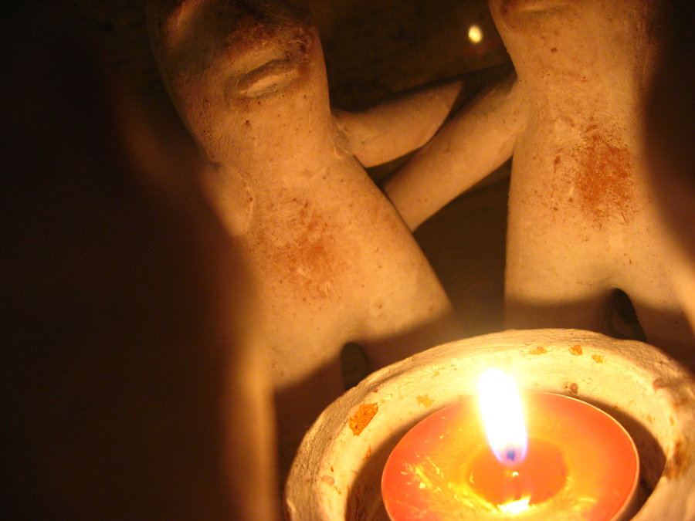
What does the text mean? Intertextual connections
Chief Joseph succeeded his father as leader of the Wallowa band in 1871. Before his death, the father said to his son:
Notes:
Kim

Slide 37
“My son, my body is returning to my mother earth, and my spirit is going very soon to see the Great Spirit Chief. When I am gone, think of your country. You are the chief of these people. They look to you to guide them. Always remember that your father never sold his country. You must stop your ears whenever you are asked to sign a treaty selling your home. A few years more and white men will be all around you. They have their eyes on this land. My son, never forget my dying words. This country holds your father's body. Never sell the bones of your father and your mother.”
Joseph commented "I clasped my father's hand and promised to do as he asked. A man who would not defend his father's grave is worse than a wild beast."
Notes:
Kim
Chief Joseph’s father (2nd Text) handout

Slide 38
“My son, my body is returning to my mother earth, and my spirit is going very soon to see the Great Spirit Chief. When I am gone, think of your country. You are the chief of these people. They look to you to guide them. Always remember that your father never sold his country. You must stop your ears whenever you are asked to sign a treaty selling your home. A few years more and white men will be all around you. They have their eyes on this land. My son, never forget my dying words. This country holds your father's body. Never sell the bones of your father and your mother.”
Is this source reliable? How might we confirm or deny that Chief Joseph responded to his father? How did the Nez Perce maintain historical records…or would they have done that? (Corraboration)
Joseph commented "I clasped my father's hand and promised to do as he asked. A man who would not defend his father's grave is worse than a wild beast."
Notes:
Kim
Chief Joseph’s father (2nd Text) handout

Slide 39
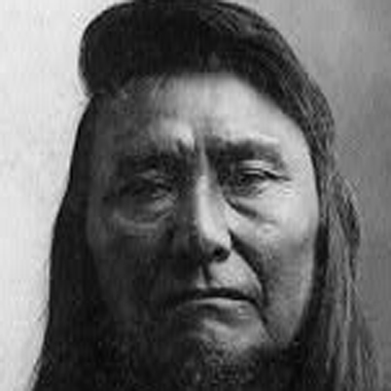
What does the text mean? Intertextual connections
How does this second passage help you to understand the speech?
What inner conflict would Chief Joseph have experienced?
Where do you see
evidence of this conflict in the speech?
Does this document help to support or explain
Chief Joseph’s actions during the Indian Wars?
(Corroboration)

Slide 40

What does the text inspire you to do?
Presentation
Debate
Writing
Socratic Seminar
Investigation and research
Test
https://sheg.stanford.edu/sourcing-poster
Notes:
Lots of options! How about student choice?
Most students want to do research in order to learn more about Chief Joseph’s life

Slide 41
Writing From Sources
What is the role of courage in surrender? After reading and discussing Chief Joseph’s speech “I Will Fight No More Forever,” write an essay that defines courage and explains the courageousness of Chief Joseph’s decision. Support your discussion with evidence from the texts. What conclusions can you draw?
Constructed using Task Template 12: www.literacydesigncollaborative.org
Notes:
Connection to LDC Task…

Slide 42

Additionally…
Teachers often pose a question to the whole class but then calls on only a few hands…
Ask- is the question you are asking one that you want the whole class to consider?
Yes? Then why call on volunteers to answer?
Pose the question to the whole class and indicate how you want students to answer (Think, Write, Share; etc.)
Notes:
Carole: Examples of TDQs for Close Reading H/Out (Uncommon Impact)
If we ask students a question that everyone can and wants to answer: “Have you ever felt scared before you face a challenge?” or “Does anyone have a pet?” or “What kind of advice would you give a friend in this situation?” Why not let them all answer?
WRITE is so important!!!

Slide 43

Comprehension and Collaboration
1. Prepare for and participate in collaborations with diverse partners, building on each others’ ideas and expressing their own clearly and persuasively.
SL.CCR.1
Notes:
It’s not enough to have complex text in the room. Students need to read and discuss complex text.
Speaking/Listening Standard #1—Important part of Close Reading

Slide 44

Talk is essential to writing

Slide 45
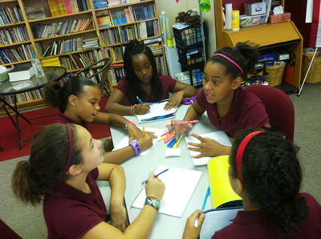
Students compose orally
in the company of their peers.
What forces can
change Earth?
Notes:
Lapp, Flood, & Tinajero, 1994
Use Collaborative Learning to Foster Discussion and Production of Complex Texts

Slide 46

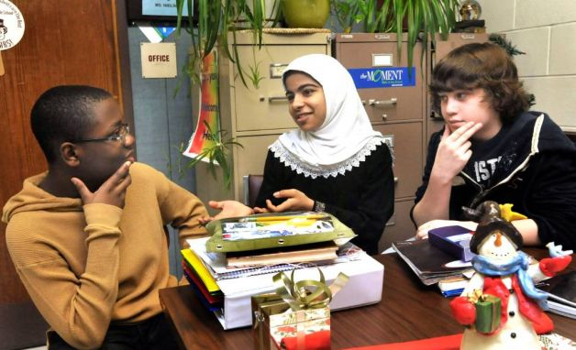
6-8 Features
Using evidence to probe and reflect
Collegial discussions include goals and deadlines
Questions connect ideas from several speakers
Acknowledge new information

Slide 47

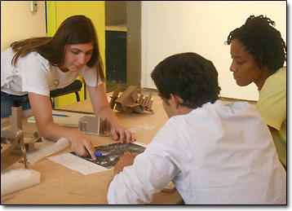
9-10 Features
Use prepared research in discussion
Voting, consensus, and decision making
Ensure hearing full range of opinions or options
Summarize and synthesize points of disagreement

Slide 48
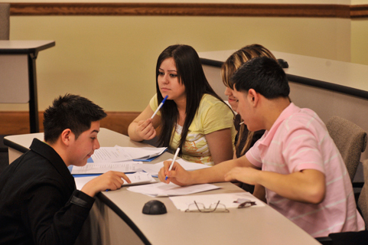
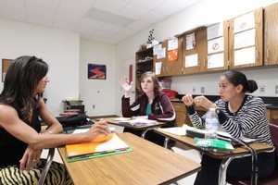
11-12 Features
Civil, democratic discussions
Questions probe reasoning and evidence
Resolving contradictions
Determine what additional info is needed

Slide 49
History circles
Engaging in multiple texts and multiple perspectives

Slide 50
History circles
Design
Format
Inspired by Non-fiction Literature circle design by Harvey Daniels (2002)
Each team member has a role specific to literacy skills
5 Rounds of play
Grades 6-12
Groups of 4 (Or 5)
Multiple text set
Multiple perspectives

Slide 51
Why use multiple texts?
Students will:
Grasp more information being exposed to more sources.
Think more critically.
Learn to synthesize when they read many texts on one topic.
Contribute on a richer, deeper level in class discussions.
Source: The Case for Multiple Texts by Sunday Cummins, ASCD Educational Leadership, Feb. 2017

Slide 52
Rounds of play
Round One: Reading the source (Sourcing leader or student of your choosing)
Round Two: Entire team sources the document with “Sourcing” student leading the discussion
Round Three: Work is specific to to role.
Round Four: Share within the team
Round Five: Share with larger group

Slide 53
Here we go…
Round One: Reading the source
Round Two: Source the document (Everyone annotates!)
Round Three: Know your role!
Round Four: Share as a team with each other.

Slide 54
Let’s share!
Source A group and Source C
Source B with Source D, Source E

Slide 55
Round Five
Pair groups together by:
a. Opposing viewpoints – this strategy prepares students to engage in argumentation.
b. Shared viewpoints – this format strengthens the team’s position before they go into argumentation.
You can also do 2 quick share outs, using both formats, to better prepare students for the thinking/writing phase.

Slide 56
Reflecting on History Circles
What do you understand differently about using disciplinary texts in the classroom?
How can you apply multiple texts, multiple perspectives approach to your classroom?

Slide 57

“Every piece of text/book has a skeleton hidden between its covers. Your job as an analytic reader is to find it.”
Adler and Van Doren, 1940/1972
Notes:
Carole
D. Fisher suggests setting a goal that 50% of your instruction is STUDENT INTERACTION.
He also states that there should be a 71% increase in the use of conversation and collaboration in reading.
The performance levels of the KY Framework for Teaching (TPGES) supports this suggestion!

Slide 58
In Closing…
Claims Driving Design: ELA/Literacy
Students are on-track or ready for college and careers
Students build and present knowledge through research and the integration, comparison, and synthesis of ideas.
Reading Literature
Students read and comprehend a range of sufficiently complex texts independently
Students write effectively when using and/or analyzing sources.
Reading Informational Text
Vocabulary Interpretation and Use
Written Expression
Conventions and Knowledge of Language
Notes:
Carole
REMINDER: Text Complexity, Close Reading using Text-Dependent Questions and a Written Response assist in teaching standards at the highest level!
Go over slide information again, if necessary… Intent of the Standards, therefore, these are the areas that will be emphasized through assessment.

