Slide 1
Novice Reduction Strategies That Impact Student Learning
Novice Reduction for Gap Closure
2017
Notes:
1 min. - Welcome participants. Introduce yourself and others quickly. Set purpose for today…overview, quick introduction, just enough time to plant seeds and have your thoughts focused on Novice Reduction.

Slide 2
Ethical Imperative
Reading 2015-16
Grade Levels | Number of Novice Students
Elementary School (3rd-5th) | 31,690
Middle School (6th-8th) | 31,473
High School (English II EOC) | 16,863
Total | 80,026
Math 2015-16
Grade Levels | Number of Novice Students
Elementary School (3rd-5th) | 25,229
Middle School (6th-8th) | 24,462
High School (Algebra 2 EOC) | 9,838
Total | 59,529
Notes:
2 min.- Reading is up about 800 students and Math is down 3000 Novice!!! Total number of students are for Reading 153,836 (elem), 149,164 (middle) and 50,187 (high). For mathematics total number of students-elem and middle same as above, but for high school the total number was 46,627.
Regardless of what YOUR definition is of NOVICE, or how many students you currently have as “novice” performers, that fact that to have under performing students is an ethical and morale imperative. This data is the most recent data for all students in KY. After looking at the chart together and seeing the shear numbers of novice students…the description of “Novice” and being a “novice” learner, is representative of very low performance that is several levels below college and career readiness benchmarks. When understanding the description of novice performance, it is not where we would want our students, our neighbors, or community members to be.
these students are the students who will struggle to finish HS, who will not likely reach CCR, who have a higher likelihood of incarceration, who will also be more apt to need social services and support. Our state must not ignore this and set a plan in place to provide interventions before it is too late for these students.
Schools and districts MUST not ignore the students who are represented here- schools and districts must know WHO these students are, their faces, what they are thinking and feeling- we as educators must provide them a stream of support; support that is founded on results so that we leave these young humans, better than we found them.

Slide 3
Conditions of the AS-IS-STATE What is your current state?
Notes:
2 min. - For many folks, this document creates urgency. WE believe that schools and district must be keenly aware of their current conditions (As-IS- State) and this is one avenue to look at a current condition.
How do schools determine their current conditions? Often schools and district review KPREP data or other end of the year data and determine the path of the improvement efforts for their school and district. Although student performance data is a piece of the story- it is only a piece…what is the root causes of these particular data points? WE don’t want to underplay the importance of this data, but there are many other pieces of work and information that must be considered before a diagnosis for improvement can be made.
The SRC does NOT contain prescribed next steps as we already know. We need to dive deeper into the processes that are embedded within our schools and dictate our practices in our schools and districts.

Slide 4
Key Core Work Processes
Varied Data Points
K-Prep Data
Screeners
Common Assessments
Classroom Data
CCR Data
Brigance
Non-academic Data
Notes:
3 min. - Novice Reduction suggest that the practice of only reviewing or even analyzing SRC data is NOT enough for NR and sound school improvements, this is NOT a full picture of your AS-Is-State and that the analysis goes much deeper than this. There must be a balanced approach with data results and the evaluation of Key Work Processes. Work Processes are the work of the school and district that impact student learning the most. These are nothing new. These are the processes that are already in place, but varying from school to school in quality and level of efficacy. These KCWP and the strategies that support these processes also need to be weighed out in determination of the AS-IS-State of the current KCWP.
The data is the measure of the success of the KCWP and the strategies/interventions that support them. The As-IS-State must consist of the evaluation of the work systems. Not only the data collected upon them.
There is much more to examine and analyze in order to put the right plan in place than looking at antiquated student data or even the most recent, we know we must be data into the context of the work where we are.

Slide 5
Evaluation of the Key Core Work Processes
Design and Deploy Standards
Design and Deliver Instruction
Design and Align Support Processes
Establish Learning Culture and Environment
Design and Deliver Assessment Literacy
Review, Analyze, and Apply Data Results
Notes:
2 min. - The message of NR is that schools must determine what are we doing very well (known as a leverage) and what do we NOT do well at all (known as a concern). The important thing- is to be keenly aware and create a plan.
There are 6 KCWP that we have schools and districts to evaluate, which become a piece of their needs assessment to determine needed next steps for reducing novice in their schools and districts. The approach differs from school to school and district to district.

Slide 6
Evaluation of the Key Core Work Processes
Design and Deploy Standards
Design and Deliver Instruction
Design and Align Support Processes
Establish Learning Culture and Environment
Design and Deliver Assessment Literacy
Review, Analyze, and Apply Data Results
Notes:
1 min. – Our work today will focus around two of the six KCWPs –Standards and Instruction

Slide 7
Learning Target and Measure of Success:
Today, we will reflect on current practices in the classroom and investigate strategies that positively impact novice performance
So that we can move from skill to implementation and continuously monitor for effectiveness
We will know we are successful when we have identified and planned next steps for our own improvement
Notes:
3 min
(Disclaimer about time– an actual plan on paper WILL NOT happen right here today, but you will have information that can become part of your plan for next year.)
We will give you time throughout the day to reflect and that is an important part of planning. You will be planning throughout the day– when we are asking you to reflect, those are pieces of your planning. THIS IS THE BEGINNING OF THE PLANNING PROCESS! When we are asking you to do these reflective activities, they become pieces of the plan.
May cite research– Effective teams spend 80% of the time planning, and 20% of the time is spent on action

Slide 8
Learning Target and Measure of Success:
Today, we will reflect on current practices in the classroom and investigate strategies that positively impact novice performance
So that we can move from skill to implementation and continuously monitor for effectiveness
We will know we are successful when we have identified and planned next steps for our own improvement
Notes:
1 min. – we will start with the first part of the learning target– the part now highlighted in red– reflection on our current practices in the classroom

Slide 9
Design and Deploy Standards
Kentucky Academic Standards and Career Technical Education curriculum are being implemented with efficacy.
Quality Practice and Evidence:
Valid Curriculum
Taught with high level of fidelity
System(s) in place for continuous improvement
KAS ensures that all districts and schools have access to the same outline of expectations. It is imperative that schools continually assess, review and revise school curricula to support the assurance that all students have the knowledge, skills and dispositions for success.
Notes:
3 min. - This is in your packet
The reflection on current practices begins with reflecting on what your AS-IS-State is within the key core work processes. The first KCWP you will examine is Design and Deploy Standards. The corner stone of any and all school success is a valid curriculum derived and congruent with standards. The question is, is that valid curriculum begin taught in your classrooms with a high level of fidelity? Remember the CCSS standards for ELA and math are performance standards, is the intention of that standard being reached and then appropriately assessed?
Valid Curriculum WHO MONITORS and EVALUATES THIS? HOW? WHO NEEDS THIS INFORMATION?
Taught with Fidelity
Measured appropriately – based on performance standards

Slide 10
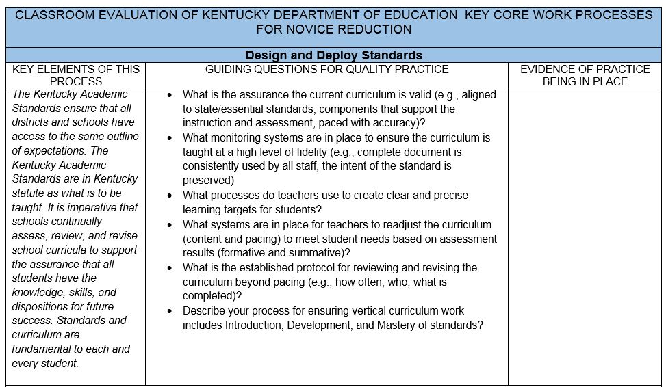
Notes:
1 min. – In your packet on the back of the KCWP
explain layout of document – We will use this document to reflect on and evaluate the current state of curriculum – questions should be used to guide your thinking and discussion. Transparency is key. You may choose to jot down specific evidence for each question, but this is for you, so don’t have to write anything down if you don’t want to– or maybe one person writes for the group– up to you because this is for you.

Slide 11
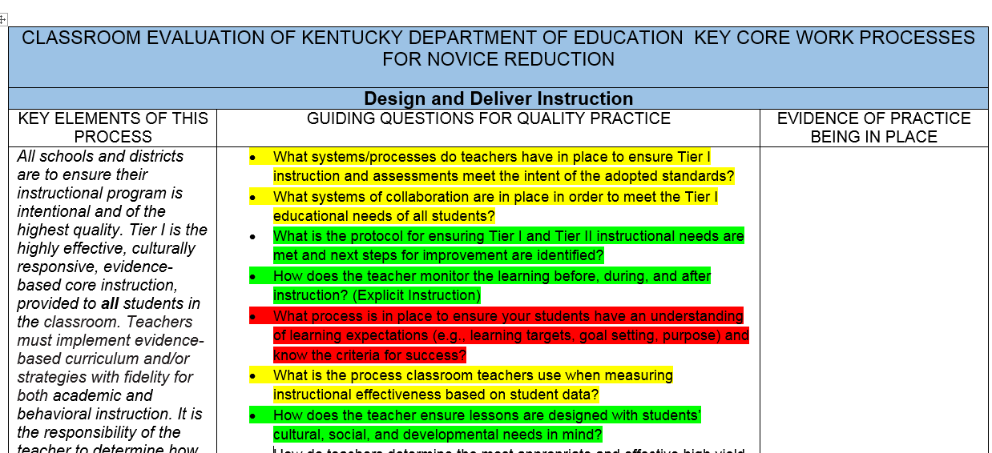
Determining the AS-IS STATE
Green- working well, monitored and evaluated for effectiveness, impacting ALL students in EVERY classroom
Yellow- not in place systematically throughout, implementation is spotty, more conversations needed
Red- not on the radar as of right now due to will levels, skill levels, or not a priority
Notes:
15 min.- As you note evidence and discuss the guiding questions, you will also use highlighting to help you really key in on your as-is state. Each question will be highlighted either green, yellow, or red (pink)
WHAT is highly effective at our schools and districts…what is working well, it is monitored and evaluated for effectiveness and we know this practice is impacting ALL students in EVERY classroom? (highlight this in GREEN).
If there are practices that are not in place systematically through out the building, spotty, we are in conversation and implementation (highlight this yellow),
There are items that are NOT on the radar as of right now either because of will levels, skill levels, or not on the front burner, then highlight this red (pink)

Slide 12
Design and Deliver Instruction
Instruction is congruent to the intent of the standard and is measured for student success. Teachers ensure high yield strategies are appropriately used in the instructional process.
Quality Practice and Evidence:
Systems are in place to ensure Tier I Instruction
All learning is intentional and measured daily for success by students and teachers
Teachers are reflective of practices aligned with TPGES and CHETL
Schools and districts are to ensure their instructional program is intentional and of the utmost quality. Tier I is the highly effective, evidence-based core provided to ALL students in the classroom.
Notes:
3 min. – This is the next page in your packet
The next KCWP we will reflect on is Design and Deliver Instruction….How does the design of instruction look in your buildings? Is instruction congruent to the intention of the standard? How do you currently monitor that work? Do teachers understand how to grow instructionally through the use of the Framework for Teaching and Learning? Do principals lead that work? Are PLCs intentional with a protocol that allows teachers to reflect continuously on improvement of core instruction?
What interventions are taking place in your classrooms for Tier I ? Who monitors Tier I for success? How do you evaluate the success of the instructional core, is it sound? Does every teacher know and does every student know? Is all student learning intentional?
How do you monitor the effectiveness of teaching and learning? How does TPGES and CHETL align in your work?

Slide 13
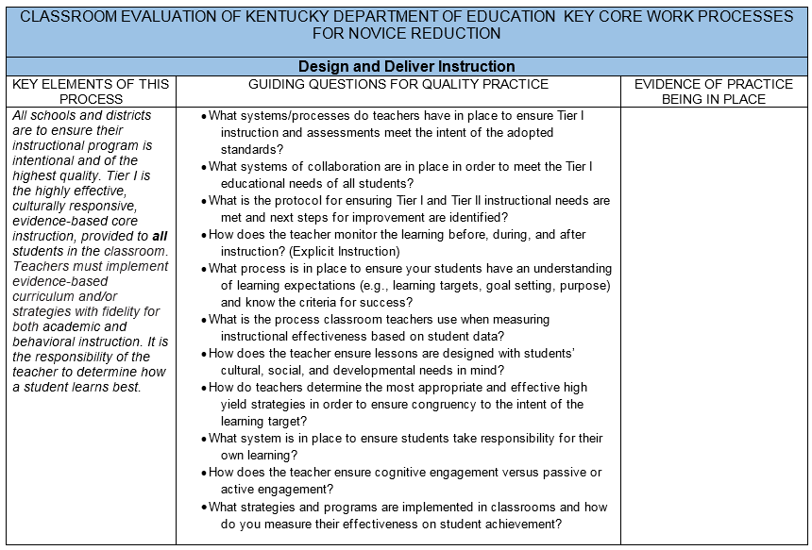
Notes:
1 min. – In your packet- on the back of the KCWP
We will use the same guiding question document to think about the current state of instruction in our schools

Slide 14
Determining the AS-IS STATE
Green- working well, monitored and evaluated for effectiveness, impacting ALL students in EVERY classroom
Yellow- not in place systematically throughout, implementation is spotty, more conversations needed
Red- not on the radar as of right now due to will levels, skill levels, or not a priority
Notes:
15 min.- Again, as you note evidence and discuss the guiding questions, you will also use highlighting to help you really key in on your as-is state.
WHAT is highly effective at our schools and districts…what is working well, it is monitored and evaluated for effectiveness and we know this practice is impacting ALL students in EVERY classroom (highlight this in GREEN).
If there are practices that are not in place systematically through out the building, spotty, we are in conversation and implementation (highlight this yellow)
There are items that are NOT on the radar as of right now either because of will levels, skill levels, or not on the front burner, then highlight this red (pink)

Slide 15
Learning Target and Measure of Success:
Today, we will reflect on current practices in the classroom and investigate strategies that positively impact novice performance
So that we can move from skill to implementation and continuously monitor for effectiveness
We will know we are successful when we have identified and planned next steps for our own improvement
Notes:
1 min. – Now that we have completed the first part of the learning target and reflected on current practices, we will move into investigating actual strategies that we can implement in the classroom that will positively impact novice performance

Slide 16
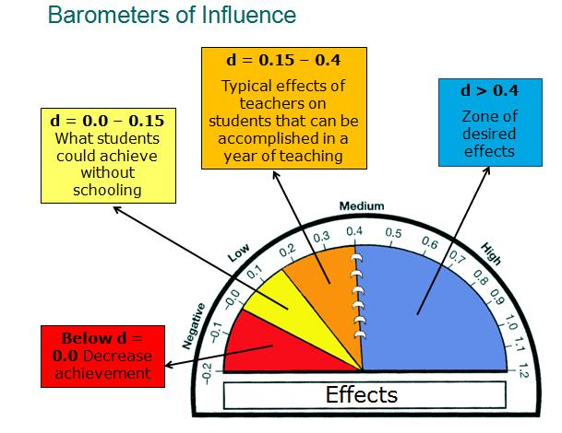
Notes:
5 min.
If you have attended any NR workshops in the past, you know that we embrace the work of John Hattie-- his research on influences that impact NR the most is extensive and valuable. Hattie recently (2016) released an updated list of influences and effect sizes. So some of the numbers you may remember seeing in the past may have changed slightly.
Here is an illustration of the Hattie’s effect sizes and his barometer of influence. (the measure of growth or decline that strategies have on the classroom and student learning) . There are strategies that we know impact student learning at greater levels than other strategies….ALL strategies do not impact learning equally. Hattie says ALMOST anything works, “all that is needed to enhance achievement is a pulse”- we need to identify a level of evidence that might be considered the minimum level for ensuring the “hinge point and strategies that are really working to increase student learning.. These strategies, in order to be most effective, will NOT only have to be implemented, but implemented with high levels of fidelity.
Orange: up to .40 This illustrates the typical year of growth- The classroom is giving students the required minimum growth. An effect size of .40 represents one year’s growth over the course of one school year. Schools that use effect sizes to measure student progress can maximize their impact on student outcomes.
Yellow: zero -.15 Progress that a student can make without proper strategy instruction, guidance…students learning on their own through natural inquisitiveness and strategies done ineffectively and inconsistently.
Red: below zero There are strategies and actions that students may be exposed to that have reverse consequences on their learning.
BLUE: greater than .40 The blue represents the zone of desired effects. An effect of .40 represents one year’s growth over the course of 1 school year. Hattie refers to this as the “hinge point”. Hattie’s work promotes every child deserves at LEAST one year’s progress over one year’s time. His research shows that there are many influences done with fidelity that will give students an opportunity to grow and have one, two and sometime three years of progress.
Schools that use effect sizes to measure student progress can maximize their impact on student outcomes.

Slide 17
Phase 1
Phase 2
Phase 5
Phase 3/4
Crafting
Composing
Reflection
Notes:
7 min.
Before we talk about specific instructional strategies, it is important to realize that in order for ANY instructional strategy to be highly effective and positive impact novice performance, it should not happen randomly or in isolation. Instructional strategies must be very intentionally planned as part of a quality instructional process. This chart illustrates the Gradual Release Model. Notice that there is a progression of learning, with a clear Before, During, and After. Any high quality instructional framework will follow this general model. Two examples of quality instructional processes that you are probably familiar with, or that you maybe have used are the Direct Explicit Instruction Model and Workshop Model.
The Direct Explicit Instruction Framework for Instruction divides instructional time into phases– you can see how the phases are represented here-
(click to bring in phase 1) Phase 1 happens Before Learning
(click to bring in phase 2) Phase 2 transition from Before to During
(click to bring in phase 3/4) Phases 3 and 4 occur During Learning, and
(click to bring in phase 5) Phase 5 represents the “After Learning”
The Workshop Model divides instruction into three distinct phases:
(click to bring in crafting) Crafting, in which the teacher introduces a mini-lesson – so BEFORE LEARNING
(click to bring in composing) Composing, in which the students work together to practice and apply the skills modeled in the mini-lesson in different contexts – this is the DURING LEARNING
(click to bring in reflection) Reflection, in which students reflect on their thinking and learning- AFTER LEARNING

Slide 18
“In a growth mindset, people believe that their most basic abilities can be developed through dedication and hard work—brains and talent are just the starting point. This view creates a love of learning and a resilience that is essential for great accomplishment.” ~ Carol Dweck
GROWTH MINDSET
Notes:
2 min.-
The first “strategy” we are going to send some time investigating isn’t really a strategy, per say– it is more of an “influence” that can greatly impact learning. However, in order for the other strategies to work effectively in reaching novice learners, we MUST be aware of perceived mindsets in the classroom and intentionally foster a growth mindset in our students.
(click to bring in quote) Over 30 years ago, Carol Dweck and her colleagues became interested in students' attitudes about failure. They noticed that some students rebounded while other students seemed devastated by even the smallest setbacks. After studying the behavior of thousands of children, Dr. Dweck coined the terms fixed mindset and growth mindset to describe the underlying beliefs that people have about learning and intelligence.
We can see here how Dweck defines GROWTH MINDSET– (Read the quote aloud)

Slide 19
Growth vs. Fixed Mindset Effect Size - .19
Teacher Growth Mindset is critical for Student Growth Mindset
Collective Teacher Efficacy (Effect Size – 1.57)
Student Self-Regulation (Effect Size – 1.33)
Does mindset REALLY make a difference?
Notes:
10 min. – Now, here is something that you might find interesting-- According to Hattie, the influence of Growth vs. Fixed Mindset actually has a relatively low effect size of .19 – still in the orange on the barometer (yielding a typical years growth), but not as high as one may think. This may lead one to ask (click) “Does mindset really make a difference?”
Peter DeWIitt is an educator who works with John Hattie as a Visible Learning Trainer. In a recent article titled “Why a Growth Mindset Won’t Work”, he poses the question “what if our actions in school contribute to the reason why a growth mindset has a low effect size?” In the article, he concludes that the reason why growth vs. fixed mindset has a low effect size is due to the fact that adults in schools have a fixed mindset, and they keep treating students accordingly, so right now the effect size is low, and will continue to stay low unless we change our practices in the classroom. Students are conditioned to have a fixed mindset, and it's due to us. Thus, WE have to get away from having a fixed mindset because it has terrible implications for how WE treat students.
SO, (CLICK) DeWitt (and by extension Hattie) concludes that teacher growth mindset is critical to students having a growth mindset!! When teachers actually do embrace the idea that they and their students are truly life-long learners, it contributes to teacher efficacy (click) and student self regulation (also referred to as self-reporting) (click), which both have massive effect sizes and in Hattie’s latest research are classified as “SUPER FACTORS”– within the top six influences on student achievement.
SO, although the effect size can be misleading, mindset really does matter and can hugely impact student achievement– especially with Novice learners and students in the gap– because these students especially often struggle with mindset and self-confidence

Slide 20
ACTIVITY: Mindset Check-Up
Do you have a growth mindset?
Notes:
10 min.- We have just discovered the importance of teachers having a growth mindset, and truly believing that not only can all students learn at high levels, but also see themselves as lifelong learners. So, lets take a few minutes and check ourselves.
(click) Do we REALLY have a growth mindset?
If you will flip to the next page in your packet, you will find the Mindset check-up – These questions can help determine the state of your mindset. This is an independent activity- be transparent- You won’t be required too share this info with anyone if you choose not to.
Answer the questions on the front, then you will total your score and flip too the back to see what your score says about your mindset.

Slide 21
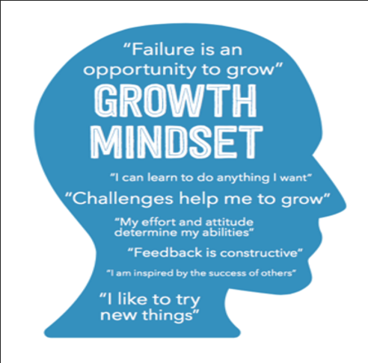
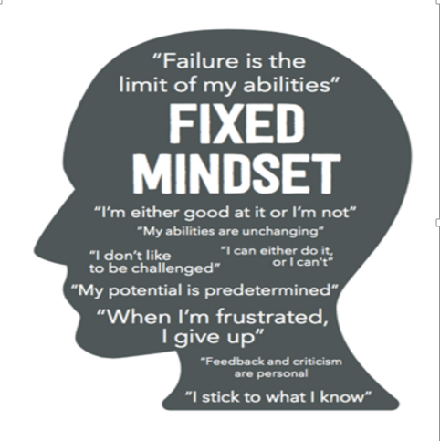
Mindset Comparison
Notes:
5 min – Hopefully, you learned a little something about yourself and your mindset from the check-up
Let’s quickly review the difference between the two mindsets, so that we are all on the same page-
(click) A “fixed mindset” assumes that our character, intelligence, and creative ability are static givens which we can’t change in any meaningful way, and success is the affirmation of that inherent intelligence, an assessment of how those givens measure up against an equally fixed standard; striving for success and avoiding failure at all costs become a way of maintaining the sense of being smart or skilled. You see on this image some of the thoughts a student with a fixed mindset might tell themselves (read a few aloud)
(click) A “growth mindset,” on the other hand, thrives on challenge and sees failure not as evidence of unintelligence but as a springboard for growth and for stretching our existing abilities. You see on this image some of the thoughts a student with a growth mindset might tell themselves (read a few aloud)

Slide 22
Does your learning environment foster a GROWTH MINDSET?
Use mixed ability grouping
Emphasize high expectations for ALL students
Avoid use of “person labels” such as “smart,” or being a “math person”
Teach students that our brains get stronger when we’re challenged
Emphasize the goals of learning and problem-solving
Create environments where intellectual struggle is embraced
Create opportunities to celebrate and publicly discuss mistakes
Provide praise that focuses on the process
When students are struggling, affirm high standards and provide reassurance that you believe in their ability to succeed
Encourage help-seeking and collaboration
Notes:
5 min. – Sometimes, as parents, as teachers, just as people, we say lots of things that we “believe”, but our actions don’t always support our words. It is easy to SAY that we have a growth mindset, and that our students should, too. But do our actions really support that belief? Are we intentionally fostering this belief within our learning environments?
There are some very intentional ways that we, as teachers can make sure that we are promoting a growth mindset in our classrooms. As each one of these indicators come in, think about whether or not you are fostering growth mindset in your classroom. (click to bring in each bullet- read each one as they come in)
*Feel free to say anything else you want about each indicator

Slide 23
ACTIVITY: Matching Game
Struggle and failure are an important part of success. We learn from every mistake we make. Many highly successful individuals did not gain success easily.
Locate the “Matching Game” cards
Read each scenario
As a group, work together to match the scenarios to the highly successful individuals that each scenario describes
Notes:
2 min. – (click to bring in quote) In order to promote growth mindset, it is important for students to view struggle and failure as necessary steps on the road to success. This is great activity that you can have students do to help them see that even the most successful people didn’t get there without struggling and failing along the way. They had to have a growth mindset, persevere, and keep pushing forward.
(click to bring in directions and explain activity)
You will have about 5 minutes to match your cards. GO! - 5 min

Slide 24
ACTIVITY: Matching Game
Check Yourself!
1. JK Rowling
2. Abraham Lincoln
3. Steve Jobs
4. Walt Disney
5. Albert Einstein
6. Oprah Winfrey
7. Michael Jordan
8. The Beatles
9. Henry Ford
10. Thomas Edison
Notes:
5 min. (click) Time to check your answers! You will notice that there are numbers in the bottom right corner of each scenario card.
(click to bring in answers)

Slide 25
Testimonial from Kentucky Teacher of the Year
Notes:
4 min. – In this video (which can be found on our NR website), KY Teacher of the Year Joanna Stevens talks about how growth mindset has benefitted her students.
SHOW VIDEO

Slide 26
So What? Now What?
Independently
Use a sticky note
Considering what we’ve learned
about Growth Mindset…
What could be the “NOW WHAT” for your school/team?
Notes:
3 min. – So What… Now What? – We have looked closely at what the research has to say about growth mindset– so what are your takeaways? Now what are you going to do with this information? Take a couple of minutes and think about growth mindset and what your current state is in this area. What may be an implication or next step?
Throughout the day, we will be using sticky notes for reflection. Designate a spot on your table to serve as the “parking lot” for all of your sticky notes. You will use them at the end of the day as you determine next steps.

Slide 27
Metacognitive Strategies
Effect Size
.53
Notes:
2 min – The next strategy we are going to spend some time investigating is actually a group of strategies – Metacognitive Strategies., to be exact! If you attended aby of our workshops last fall, you may recall that we spent a good amount of time talking about metacognition. But today, we are going to examine Metacognitive strategies specifically through the lens of instruction– how we can intentionally TEACH our students how to be metacognitive and use metacognitive strategies to regulate themselves as learners.
(click twice) Hattie assigns the use of Metacognitive Strategies an effect size of .53 – so it is above the hinge point of .40 in that blue area of the barometer- proven to have a strong impact on learning

Slide 28
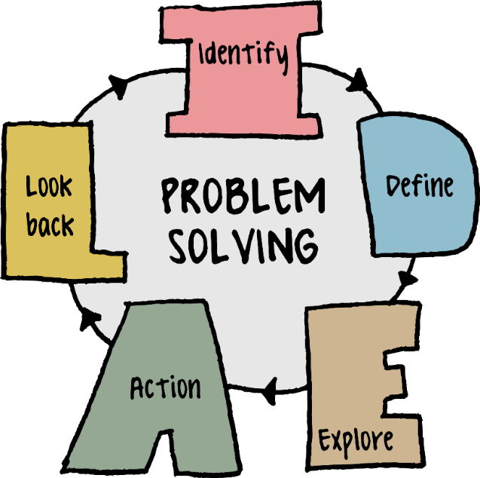
What is Metacognition?
“Metacognition is one’s ability to use prior knowledge to plan a strategy for approaching a learning task, take necessary steps to problem solve, reflect on and evaluate results, and modify one’s approach as needed.”
Notes:
2 min- Before we start talking about metacognitive strategies, let’s review what the word “metacognition” really means– it is more than just “thinking about thinking”. (click)
“Metacognition is one’s ability to use prior knowledge to plan a strategy (click) for approaching a learning task, take necessary steps to problem solve, (click) reflect on and evaluate results, and modify one’s approach as needed.”
SO, when students are being metacognitive, they are truly regulating their own thinking and learning. Remember, self-regulation has a very high effect size– 1.33

Slide 29
Metacognition…
Enhances a learner’s self-regulation
Develops over time
Impacts learning in all domains
CAN BE LEARNED!
Notes:
2 min – So, why is it so important that we intentionally teach students to be metacognitive?
Well, first of all, as we just said- metacognition (click) enhances a learners self-regulation. If learners are able to reflect on their learning strategies, they can determine which strategies were most helpful, or plan to change strategies on future tasks and/or assignments if needed
Additionally, metacognition (click) develops over time. For example, most teenagers have better metacognitive skills than children. As children grow, metacognition develops and becomes more complex. Humans are able to think more strategically as they develop and mature
Metacognition (click) impacts learners in all domains and
Most importantly, METACOGNITION (click) CAN BE LEARNE! It can be taught, mastered, and applied by all learners. It can be developed and practiced by anyone and most educational psychologists believe it should be taught from a very young age.
Metacognition is a vital part of being a successful student!

Slide 30
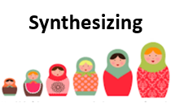
Comprehension (Thinking) Strategies
“Thinking Strategies” lead to deeper understanding!
Notes:
3 min – (click twice) There are seven “Comprehension Strategies” that lead to deeper understanding and help students to be more metacognitive. We are going to call them “Thinking Strategies” since comprehension implies that these thinking processes only happen when we are reading, when actually, Thinking Strategies can be applied in a variety of contexts.
(click to bring in each strategy and read the strategy)
In your packets, you will find these strategies, along with thinking stems for each one– these stems provide scaffolds for students to use when talking or writing about their thinking.
Let’s talk a little bit about each of these.

Slide 31
Monitoring for Meaning
Knowing when you fully understand
Knowing when you don’t understand
Knowing how to help yourself understand
Knowing how to use a wide range of “fix-up” strategies
Notes:
5 min
It’s important for students to be able to monitor their own understanding. Monitoring for meaning involves the learner’s ability to:
(click) -know when they fully understand
(click) –know when they do not fully understand
(click) –know how to help themselves understand and
(click) –know how and when to use a wide range of “fix up” strategies
You can see that the picture represents that monitoring for meaning is an ongoing process– the learner is constantly asking themselves, “Am I understanding”

Slide 32
Using Schema (Prior Knowledge)
Relating new to known (activating prior knowledge to help understand new information)
Making connections to self, text, and world
Creating new schema in order to understand new information
Notes:
5 min
Notice first the picture-- Think about a lint brush– everything it touches changes it in some way-- something sticks to it! We are much the same as learners- every experience we have adds our knowledge, and shapes our understanding and perceptions.
The word schema refers to all of our past experiences, combined with our current and prior knowledge. Thus, the thinking strategy of using schema requires students to use all that they know and have experienced to help them understand and create meaning.
(click) Students can often relate new information to known information, which helps them to understand new information.
(click) When students are making connections to self, to text, or to the world, they are activating their schema!
Finally, (click) it is important to remember that schema is always evolving, (remember the lint brush? – we learn new things and have new experiences every day) so this creation of new schema is essential to understanding new information.

Slide 33
Inferring
Making predictions
Forming opinions based on evidence
Drawing conclusions based on evidence
Creating meaning to fill in gaps
Developing interpretations
Making decisions about inexplicit meanings based on evidence
Notes:
5 min
When we think of making an inference, we usually think of (click) making predictions, or (click) forming an opinion based on evidence. Yes, both of these are examples of inferring. But inferring may also be characterized as (click) drawing conclusions, (click) creating meaning in order to fill gaps, (click) developing interpretations, and (click) making decisions about inexplicit meanings.
Inferring is a critical thinking skill. Learners have to be able to “read between the lines” and create meaning, based on clues or evidence. So, you can see this process represented in the picture EVIDENCE + KNOWLEDGE = INFERRING

Slide 34
Asking Questions
Generating questions before, during, and after
Using questions to:
-focus on various aspects understanding
-delve more deeply into meaning
-extrapolate insights and inferences
Notes:
5 min
Asking Questions is the thinking strategy that often comes most easily to students. As learners, we are naturally inquisitive and tend to “WONDER” about everything. Even so, it is still important for teachers to intentionally teach questioning techniques.
(click) Students should be generating questions throughout the learning process- before, during, and after.
(click) Students may use questions to focus on various aspect of understanding, to delve more deeply into meaning, or to extrapolate insights and inferences
There are many MANY different types of questions that students use in order to develop understanding, as represented by the various colors in the picture

Slide 35
Creating Mental Images
Using images that emanate from all five senses to understand more vividly and deeply
Using images that emanate from emotions to understand more vividly and deeply
Notes:
5 min
Being able to create mental images is critical for students. Sometimes, when we talk to students about this thinking strategy, they make the mistake of thinking that it is only about “visualizing” or “getting pictures in their heads” BUT (click)
It’s important to help students learn to use images that emanate from all five senses to understand more vividly and deeply, (click) as well as using images that emanate from emotions to understand more vividly and deeply
Students should be able to talk about not only what they imagine seeing, hearing, smelling, etc, but also what emotions and feelings are evoked that help them understand. You will notice that all of these are represented in the picture.

Slide 36
Determining Importance
Deciding which information is most important
Justifying why information is relevant
Articulating what influenced your opinion regarding importance of information
Identifying key themes and big ideas
Notes:
5 min – The next thinking strategy is Determining Importance. Throughout the course of a day, students may encounter a lot of new information. Take a look at the picture -- It is important for students to filter new information and decide what the KEY take-aways are.
In order to effectively determine importance, students need to be able to:
(click) decide which information is most important
(click) justify why information is relevant
(click) articulate what influenced their opinions AND
(click) identify key themes and big ideas
The ability to determine importance is key to metacognition!

Slide 37
Synthesizing
Creating meaning and understanding by combining multiple strategies
Changing thinking and evolving understanding based on new information
Notes:
5 min – The last thinking strategy is synthesizing. The word “synthesize” means to form a whole by combining parts or elements. As learners and thinkers, our thinking is constantly evolving. When we learn more about a topic, our knowledge of that topic changes and grows. And so we can relate the picture of the nesting dolls to synthesis – with each doll representing thinking growing and changing.
When students synthesize, they are able to:
(click) combine multiple strategies to create meaning and understanding,
as well as (click) change their thinking and evolve their understanding based on new information
In order to be metacognitive, it is critical that students are aware of and can describe how their thinking and understanding is changing and evolving. That is synthesizing!
*You may want to point out that another good picture that could represent synthesizing is a target, with each new ring representing a new level of understanding.*

Slide 38
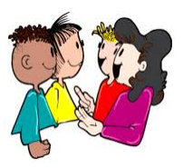
Mix – Freeze – Pair
MIX – Walk around the room
FREEZE – At the signal, stop walking
PAIR – “Pair up” with someone standing nearby (This will be your discussion partner)
Notes:
3 min. – Now you are going to get a chance to practice using metacognitive strategies! We are going to do an activity called “Mix Freeze Pair” Here is how it works--
First, (click) you will MIX yourselves up by walking around the room for 15 seconds ;
Then, (click) we will give you a signal to stop by saying the word “FREEZE;”
Finally, (click) you will PAIR up with someone nearby
We will give you specific directions for which metacognitive strategy you will practice with your partner. As you talk to each other, be intentional about using the stems provided in your packet to talk about your thinking. For example, if you are practicing synthesizing, you might say, “At first, I thought ___, but now, I think __”.

Slide 39
Mix – Freeze – Pair
Notes:
5 min. -show words only until they pair up
After you say freeze, and they pair up:
The first thinking strategy we will practice is QUESTIONING – locate the questioning stems in your packet- try to use these in your discussion
A picture is going to come up on the screen. Take a few minutes to generate questions– what do you wonder about the picture?? Share your questions with your partner!
(click to bring in picture) – GO! (allow 2-3 min)

Slide 40
Mix – Freeze – Pair
Notes:
5 min. -show words only until they pair up
After you say freeze, and they pair up:
This time, the thinking strategy we will practice is INFERRING – locate the inferring stems in your packet- try to use these in your discussion
A group of pictures is going to come up on the screen. Imagine that all of these items were taken from the same house. Based on these pieces of evidence, what might you infer about the family? What conclusions might you draw? Share your inferences with your partner! Be sure to tell WHY your inferences are valid– what evidence did you use?
(click to bring in picture) – GO! (allow 2-3 min)

Slide 41
Mix – Freeze – Pair
Notes:
5 min. -show words only until they pair up
After you say freeze, and they pair up:
This time, the thinking strategy we will practice is USING SCHEMA – locate the using schema stems in your packet- try to use these in your discussion
This time, when the picture comes up on the screen, we want you to connect to your schema. What does this picture remind you of? What prior knowledge or past experiences come to mind that help you draw meaning from this picture? Share with your partner!
(click to bring in picture) – GO! (allow 2-3 min)

Slide 42
Mix – Freeze – Pair
Notes:
5 min. -show words only until they pair up
After you say freeze, and they pair up:
This is the last one, and it is a little bit different. This time, the thinking strategy we will practice is CREATING MENTAL IMAGES– locate the creating mental images stems in your packet- try to use these in your discussion
We are going to play some music for you. (About a minute long clip) As you listen, we would like for you to close your eyes and create mental images. What types of images and/or emotions does the music evoke? What do you imagine seeing, hearing, smelling, tasting or touching? How does it make you feel? When the music stops, you can open your eyes and talk with your partner about the mental images you created!
(click to play music) – when music stops, allow 2-3 min for partners to share
When sharing is over, have participants return to their seats.

Slide 43
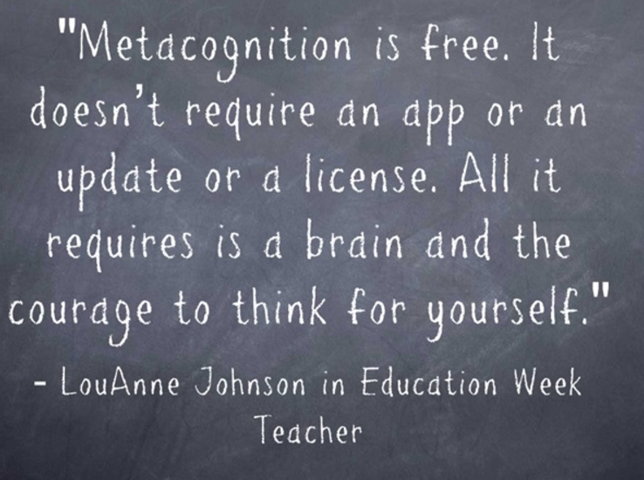
Notes:
2 min.- So, to wrap up our time learning about metacognition, we want to share this quote– (read quote)
We love this, because so often, teachers think that to impact student achievement, they have to have the latest and greatest technology, or expensive resources and programs, but that simply is not the case. Metacognition can make a huge difference for all learners, especially novice learners and students “in the gap”– and it requires exactly ZERO TECHNOLOGY, and costs exactly ZERO DOLLARS.

Slide 44
So What? Now What?
Independently
Use a sticky note
Considering Metacognitive Strategies…
What could be the “NOW WHAT” for your school/team?
Notes:
3 min. – So What… Now What? – We have looked closely at what the research has to say about teaching students to be metacognitive– so what are your takeaways? Now what are you going to do with this information? Take a couple of minutes and think about intentional instruction in the area of metacognition and what your current state is in this area. What may be an implication or next step?
Don’t forget to put all of your sticky notes in the “parking lot”... You will use them at the end of the day as you determine next steps.

Slide 45
Cooperative Learning
Effect Size .55
Notes:
2 min. - Cooperative learning is a highly successful and POPULAR instructional strategy in which small teams, each with students of different levels of ability, use a variety of learning activities to improve their understanding of a subject.
(click) Hattie assign cooperative learning with an effect size of .55 – which falls into the zone of desired effects and is above the hinge point of .40

Slide 46
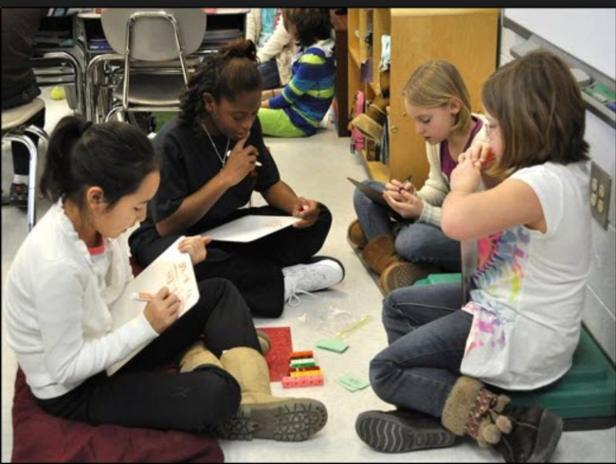
Why Cooperative Learning?
Improves Academic Achievement (an average 28 percentile gain in cooperative learning classrooms)
Helps to build interpersonal skills
Highly engaging for students
Provides opportunity to support students within the Achievement Gap
Allows novice learners to interact with proficient peer models
Notes:
2 min – There are MANY benefits of cooperative learning, but some of the BIGGEST benefits are:
(click to bring in each bullet– read each bullet as it comes in)

Slide 47
We’ve Known This…
Lecture 5 %
Reading 10 %
Audiovisual 20%
Demonstration 30%
Discussion Group 50%
Practice By Doing 75%
Teaching Others/ Immediate Use of Learning 90%
Verbal Processing
“I hear, and I forget.
I see, and I remember.
I do, and I understand.”
- Chinese Proverb
Verbal & Visual Processing
Doing
Average % of material retained after 24 hours
Notes:
3 min – How many people have seen this proverb before? (read it off the screen) – We all know that when students are actively engaged in learning, they will retain information better.
But statistically, does active engagement REALLY matter?
(click once) Lets take a look at a graphic representation of the average percent of material retained by learners after 24 hours
(click to bring in the parts of the triangle– read each part as it comes in)
So, we can see that research solidly supports the idea that active engagement through cooperative learning activities really does make a difference!

Slide 48
Notes:
2 min – There are a multitude of cooperative learning activities and structures out there. Dr. Spencer Kagan is a world renowned author and keynote speaker in the field of education. He is very well known for his work surrounding cooperative learning structures. In this video, two Kentucky teachers discuss how they use Kagan structures to reach all of their students.
**show video- 3 min
To see the full video, visit our website!

Slide 49
Cooperative Learning Examples
3-Step Interview
Round Table
Think-Pair-Share
Expert Groups
Jigsaw
Three Stay, One Stray
Notes:
2 min – As we said before the video, in addition to Kagan structures, there are a multitude of cooperative learning structures and activities out there. Here a few examples that you may be familiar with.
(click to bring in examples and read them)
In your packet, you will find a list of ten additional cooperative learning activities!

Slide 50
Cooperative Learning is More Than Working in Groups!
There are five key elements that differentiate cooperative learning from simply putting students into groups to learn
1
5
2
4
3
Notes:
2 min – In the video, we heard Ms. Copley and Ms. Adams talking about how a common misconception is that ALL group work is “cooperative learning”. This simply is not true.(click to bring in words and pie chart– read words on screen) - Lets take a closer look at each of these elements

Slide 51
1. Positive Interdependence
Mutual goals
Division of labor (roles)
Sharing of materials
Each student's grade is dependent on the performance of the group
Group members believe that each person's efforts benefit all
1
Notes:
2 min – The first element is POSITIVE INTERDEPENDENCE– (click in number)
(click) The group has mutual goals
(click) There is division of the work– sometimes through the assignment of roles
(click) Material are shared
(click) Each student’s grade is dependent on the performance of the group AND
(click) There is a belief among the group members that each person’s efforts will benefit all

Slide 52
2. Individual Accountability
Students learn together, but are responsible for individual contributions
Measures are established for both group success and individual success toward goals
2
Notes:
2 min – The second element is INDIVIDUAL ACCOUNTABILITY– (click in number)
(click) Students are learning together, but each student is responsible for individual contributions
AND
(click) Measures are established for both group success and individual success toward goals

Slide 53
3. Face-to-Face Interaction
Oral explanations of how to solve problems
Discussing the nature of the concepts being learned
Connecting present learning with past knowledge
Members become personally committed to each other
as well as to their mutual goals.
3
Notes:
2 min – The third element is FACE-TO-FACE INTERACTION– (click in number)
Students are required to
(click) Explain problem solving through discourse,
(click) Discuss the nature of concepts being learned
(click) Connect present learning with past knowledge
AND through this face-to-face interaction,
(click) Group members become personally committed to each other

Slide 54
4. Interpersonal and Small
Group Social Skills
Effective leadership
Decision-making
Trust-building
Communication
Conflict management
4
Notes:
2 min – The fourth element is INTERPERSONAL AND SMALL GROUP SOCIAL SKILLS– (click in number)
TRUE professional learning builds important interpersonal and social skills like:
(click) Effective leadership
(click) Decision-making
(click) Trust-building
(click) Communication
AND (click) Conflict management
These skills are especially critical for novice learners and students in some gap groups, as interpersonal and social skills are often barriers to learning for them.

Slide 55
5. Group Processing
Students are given time and procedures for analyzing success of learning groups
Involves both task work and teamwork
Reflection on how to improve as a group
5
Notes:
2 min – The fifth element is GROUP PROCESSING– (click in number)
(click) Students are given time and procedures for analyzing success of learning groups
(click) Activities involve both task work and teamwork
AND
(click) Time is provided for intentional reflection on how to improve as a group

Slide 56
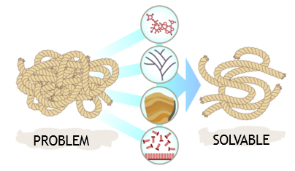
KNOTTY PROBLEMS
What is it?
Individual students get feedback from peers on resolving obstacles to complex problems
Good for:
Identifying obstacles or roadblocks to solving complex problems or assignments; giving students opportunities to learn from one another
Notes:
2 min- We are going to practice cooperative learning by engaging in an activity called “Knotty Problems” (click to bring in picture)
Whether it's wood or problems, sometimes the word knotty can apply to both. ... The word can be used figuratively to describe something that is intricate and difficult to solve. But just because a problem seems insurmountable, does not mean it is not solvable. Sometimes, it just takes a diverse group of learners working together to overcome the challenge!
So, that is where the name of the activity comes from- and here are the basics of “Knotty Problems”
(click to bring in information and read info from slide as it comes in)

Slide 57
KNOTTY PROBLEMS
Divide into small groups
One group member has two minutes to explain the problem or obstacle that he/she has encountered
Other group members actively listen without interruption
Each group member takes turns sharing ideas about possible solutions
Notes:
3 min – Let’s take a look at the procedure for Knotty Problems:
(click) In just a moment, we will ask you to arrange yourself into small groups. This may be your table group, or you may choose to do triads or groups of four, but don’t let your group get too large.
(click) Once you have established your groups, choose one person to share a “knotty problem” -we will help you out with this in a few minutes by giving you scenario to frame your thinking– so don’t be shy about volunteering! ☺ You will have two minutes to share.
(click) While their peer is sharing, the other group members remain silent and demonstrate active listening… NO INTERUPTING! (Students could jot their thinking down on paper during this time, especially if they have an idea and are worried that they will forget it)
(click) Finally, once the two minute share tie is up, each group member will take turns sharing ideas about possible solutions
OK- go ahead and find your group now– you may want to also go ahead and determine which group member will share (or if you want to wait until after you see the scenario to decide, that is ok, too)

Slide 58
KNOTTY PROBLEMS
SCENARIO:
Think of a time when you experienced challenges with a student, parent/guardian, or colleague that seemed insurmountable. Describe the situation and explain the obstacles you faced.
Notes:
1 min – Here is the scenario (click and read scenario) now we realize that any situation you think of has most likely already been resolved – but for the purposes of practicing the activity, let’s pretend that your situation has not been resolved yet, and that you are currently in the midst of it
Take a minute of for think time if you need to then make the final determination of who will share (if you have not already done so)
OK- remember that you will have 2 minutes uninterrupted to share with your peers everything they need to know about you knotty problem – fully describe the situation, the challenges, and the obstacles that you are facing.
GO! (let them know when 2 minutes is up – then give them about 5 minutes for group members to discuss their thinking about possible solutions)
After 5 minutes, wrap up the activity by having the group member who shared thank the other group members for their input. Have them return to their seats if needed.
SO, that was Knotty Problems! There are many ways that teacher could use this activity in the classroom. We hope you enjoyed getting to practice with it!

Slide 59
So What? Now What?
Independently
Use sticky notes
Considering what we’ve learned
about Cooperative Learning…
What could be the “NOW WHAT” for your school/team?
Notes:
3 min. – So What… Now What? – We have spent some time focusing on cooperative learning and how it positively impacts student achievement– so what are your takeaways? Now what are you going to do with this information? Take a couple of minutes and think about cooperative learning and what your current state is in this area. What may be an implication or next step?
Don’t forget to put all of your sticky notes in the “parking lot”... You will use them at the end of the day as you determine next steps.

Slide 60
Notes:
TIME FOR LUNCH!
Lunch break– we will start back promptly at 12:30

Slide 61
CLASSROOM DISCUSSION
EFFECT SIZE .82
Notes:
2 min – The next strategy we are going to spend some time talking about is classroom discussion. (click) Classroom Discussion had a very high effect size- .82-- more than double the average hinge point of .40 – but we must be careful to not have a misconception here. When we talk about effective classroom discussion that will yield an effect size of .82, we are talking about just allowing your students to engage in random, unstructured conversations. HIGHLY EFFECTIVE classroom discussion must be intentionally taught with clear expectations and procedures in place – it must be monitored closely and students must be held accountable at all times

Slide 62
Connection to Cooperative Learning
Lecture 5 %
Reading 10 %
Audiovisual 20%
Demonstration 30%
Discussion Group 50%
Practice By Doing 75%
Teaching Others/ Immediate Use of Learning 90%
Effective oral communication enhances cooperative learning experiences in the classroom
Effective oral communication is an important part of 21st Century Learning - critical to success in the “real world”
Effective Oracy and Student Discourse is a learned behavior that must be intentionally taught
Average % of material retained after 24 hours
Notes:
5 min – We have already had some practice using classroom discussion today. Do you recognize this triangle? This is the same graphic we looked at a little while ago when we talked about cooperative learning. Notice on the triangle (click) that “discussion groups” yield a 50% retention rate and (click) “Teaching Others” yields a 90% retention rate.
So, (click) we can clearly see that effective oral communication– or kids’ ability to talk to one another effectively definitely enhances cooperative learning experiences in the classroom.
In addition, effective oral communication is an important part of 21st century learning – it is critical to success in the real world. As a matter of fact, one of the most important workforce skills sought out by employers is effective communication skills.
Here’s the BEST NEWS! Effective Oracy and Student Discourse can be learned and developed!!! So, we MUST intentionally teach kids how to talk to each other!

Slide 63
Purposes of Discourse
Sharing Thinking
Building On
Agreeing/Disagreeing
Clarifying
Notes:
1 min-There are many reasons that we speak up in discussion groups. (click to bring in each bullet) These are just a few. Teaching students to be aware of the PURPOSES of discourse in the classroom helps them to be more effective in classroom communication. It brings intentionality to classroom discussions.

Slide 64
Talking Stems
Sharing Thinking
I believe ____ because _____
It says _______, so I think _______
I noticed that ______
I am wondering ______
Building on
Let me add to what we have been discussing
To add to what ______ said, I think ______
Building on that, _______
In response to _______, I think ______
Agreeing/Disagreeing
I agree with ______ because ______
I respectfully disagree with ______ because _______
I can see that ______; however, _______
I like what _____ said because _____
I’m not sure I agree with what _____ said because _______
Clarifying
Could you please clarify what you mean by ____?
I understood that you said _____. Is that correct?
Could you please repeat that for me?
So, what I hear you saying is ______
I am confused about _____
Notes:
5 min. –
One very intentional way to teach students to be effective oral communicators is through the use of talking stems. (click to bring in all talking stems) These stems provide scaffolding for students as they speak for various purposes.
Having anchor charts posted where students can see the talking stems at all times- making them very visible and easily accessible- makes it very easy to hold students accountable for using appropriate talking stems. So, for example, if you are having a classroom discussion, and a student wants to add on to the thinking of another student, he can quickly reference the “building on” stems.
YOU MAY HAVE ALREADY NOTICED, BUT THESE TALKING STEMS ARE IN YOUR PACKET. This is just a small sampling of talking stems that you may use to get started, but these lists can definitely be added to throughout the school year as your students come up with others. The more they use talking stems, the more they will recognize new purposes for speaking and new stems that could be added to the charts. Additionally, using stems will become more and more natural for them, and they will rely on the charts less and less! ☺

Slide 65
Procedures and Expectations
Robert Marzano says…
Set procedures and expectations for classroom discussion
Involve students in development of procedures and expectations
Harry Wong says…
“The most successful classes are those where the teacher has a clear idea of what is expected from the students and the students clearly understand what the teacher expects from them.”
Notes:
3 min- Just like with anything we want our students to learn, if we are to be very intentional about holding our students accountable for effective discourse, it is critical that we have clear procedures and expectations in place. They need to know the “do’s and don’ts”.
We are all familiar with the research of Marzano (click to bring in the Marzano box and bullets) and Wong (click to bring in Wong box)-- both highly highly respected in the world of education!
In his books, Classroom Management that Works and The Highly Engaged Classroom, Marzano not only discusses the importance of setting procedures and expectations for classroom discussion, but also the importance of involving students in the process. This brings authenticity and ownership to the process.
And I am sure we are all familiar with Harry Wong’s very famous book, The First Days of School, where he reminds us that “The most successful classes are those where the teacher has a clear idea of what is expected from the students and the students clearly understand what the teacher expects from them.”

Slide 66
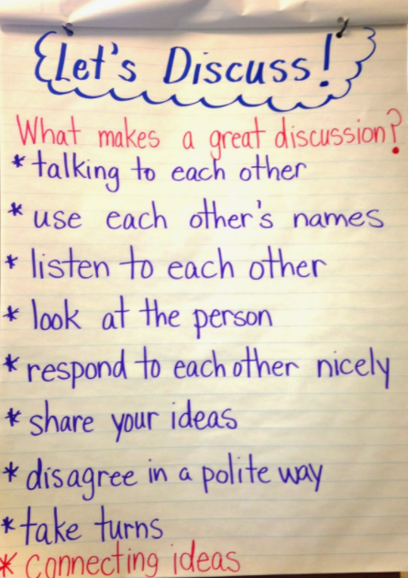
Procedures and Expectations- Examples
Notes:
3 min- Let’s look at a couple of examples from real classrooms. (click to bring in both examples) The first example is from a math classroom, as you see reflected in the questions at the bottom. The anchor chart on the right is from an elementary classroom, Notice that the bullet at the bottom “connecting ideas” was added later as kids discovered something new they wanted to add to their chart.
Providing guidelines, procedures, and/or expectations helps students learn the “do’s and don’ts” of effective communication!

Slide 67
Using Discussion for Assessment
“Getting Students Thinking at Higher Levels”
Susan M. Brookhart
Use open-ended questions that require students to explain their thinking
Listen as students respond to one another
Provide tasks that require metacognitive conversations, not just recalling facts or re-telling stories
Have students self-assess verbally by describing their current progress toward learning goals (i.e. Where I am, Why I think so, What I plan to do next)
Notes:
5 min.- Another benefit of intentional classroom discussion is that classroom discussion can provide teachers with another way to assess students. (click to bring in article title) You may be familiar with Brookhart’s research and work surrounding learning targets and formative assessment. In a recent article, titled “Getting Students Thinking at Higher Levels”, Brookhart discusses how classroom discussion can be used to assess student learning. Some ways that teachers can use discussion for assessment are:
(click) Using open-ended questions that require students to explain their thinking
(click) Listening and taking anecdotal notes as students respond to one another
(click) Providing tasks that require metacognitive conversations… asking questions, inferring, synthesizing, etc. – rather than just recalling facts or re-telling stories
AND
(click) Having students assess their own progress toward learning goals by explaining where they are in their own progression of learning. This is an important part of self-regulation, and remember that self-regulation is one of Hattie’s super factors, with an effect size of 1.33!
So you can see that classroom discussion can be a great way to assess student learning!

Slide 68
Effective Talk in the Classroom
Notes:
2 min- BEFORE VIDEO– We are going to watch a video titled “Effective Talk in the Classroom”. The school featured in the video is actually in England, but we know that kids are kids, no matter where they live, and solid instructional strategies are universal!
In your packet, you will find a note-taking sheet that you can use to capture your thinking as you watch. The “three column notes” template provides a place for you to jot down notes about things you notice (general thinking), things you wonder about (questions), and connections you make as you watch. After the video, you will use the notes you take to engage in discussion with your peers.
VIDEO– 6 min.

Slide 69
“Popcorn Share”
Choose one person in your table group to start the discussion – this person should stand up
10 minutes
When this person finishes sharing and sits, others quickly and voluntarily “pop up” from their chairs (one at a time) to add to the discussion
Seated group members may choose to write responses or add to their notes as new thinking is shared
Don’t forget to use your TALKING STEMS!
Notes:
3 min.- We are now going to give you some time to engage in an effective classroom discussion. At your table you will discuss your take-aways from the video – What was your thinking? What did you notice? What questions did you have? What were you wondering? What did you connect to?
For our discussion, we will use a structure called “Popcorn Share”. Here is the procedure: (click to bring in bullets and reads each one – clarify if needed)
Remember to use your talking stems– they are in your packet.
You have 10 minutes to discuss your take-aways from the video! GO!
Allow 10 min for discussion.

Slide 70
So What? Now What?
Independently
Use sticky notes
Considering what we’ve learned about Classroom Discussion…
What could be the “NOW WHAT” for your school/team?
Notes:
3 min. – So What… Now What? – We have discovered that there is tremendous power in teaching our students how to engage in meaningful classroom discussion– remember, .82 effect size– HUGE!-- so what are your takeaways? Now what are you going to do with this information? Take a couple of minutes and think about classroom discussion and what your current state is in this area. What may be an implication or next step?
Don’t forget to put all of your sticky notes in the “parking lot”... You will use them at the end of the day as you determine next steps.

Slide 71
Reciprocal TEACHING
Effect Size .74
An innovative and powerful strategy that engages students and promotes enhanced comprehension and interactive learning
Notes:
2 min. – The last strategy that we are going to learn about today is Reciprocal Teaching. The word “reciprocal” means “bilateral commitment” or “done in return” , so as the name implies, “reciprocal teaching” is a high impact instructional strategy that requires students to teach each other. It is most often used as a type of guided reading, but can also be modified for use in math as students work together to interpret word problems.
(click) Reciprocal teaching is an innovative and powerful strategy that engages students and promotes enhanced comprehension and interactive learning.
And it has a very high effect size (click) of .74 - which is well into that blue zone of desired effects on the barometer

Slide 72
Benefits of Reciprocal Teaching
Enables students to take on a more active role in discussing text
Improves both comprehension and in-class interaction
Incorporates elements of: student self-regulation (1.33), cooperative learning (.55), metacognition (.53), and classroom discussion (.82)
Notes:
2 min. – Research supports the MANY benefits associated with Reciprocal Teaching, some of which include:
(click) Enabling students to take a more active role in discussing text AND (click) improving both comprehension and in-class interaction.
In addition, (click) Reciprocal Teaching incorporates elements of self-regulation, cooperative learning, metacognition and classroom discussion., all of which we have mentioned at other times today, and all of which have high effect sizes themselves.
So, Reciprocal Teaching is one strategy that can give you a huge “bang for your buck”!

Slide 73
Notes:
1 min.- We are going to watch a short video that gives an overview of the processes involved in reciprocal teaching- including the roles that students assume. You will also find these roles in your packet.

Slide 74
SUMMARIZING
Helps students connect to what they read
Allows students to develop and display their understanding of the material
Students are required to determine importance
Students explain key ideas in their own words
Notes:
2 min. – Let’s take a few minutes to review the four responsibilities of students when they are engaged in Reciprocal Teaching. The first is summarizing.
Summarizing is an important part of the process because it (click) helps students connect to what they read and (click) allows students to develop and display their understanding of the material
Students who assume the role of “Summarizer” (click) are required to determine importance AND (click) explain key ideas in their own words

Slide 75
QUESTIONING
Allows students to identify portions of text that are thought provoking
Allows students to share their need for clarification
Leads students to make inferences or draw conclusions
Enables students to think critically
Notes:
2 min. - The next responsibility in the Reciprocal Teaching process is questioning.
Questioning is an important part of the process because it (click) allows students to identify portions of text that are thought provoking
(click) share their need for clarification
AND (click) make inferences or draw conclusions
(click) Questioning enables students to think critically!

Slide 76
CLARIFYING
Allows students to answer posed questions
Students point out areas the group may see as confusing and provides insight
Students provide an explanation of their own thought processes (think aloud)
Notes:
2 min. - The third responsibility in the Reciprocal Teaching process is clarifying.
Clarifying is an important part of the process because it (click) allows students to answer posed questions
AND (click) point out areas the group may see as confusing and provide insight
Students playing the role of “Clarifier” are also able to (click) provide an explanation of their own thought processes

Slide 77
PREDICTING
Students generate ideas about upcoming text
Students consider what has already taken place and use their imagination to think ahead
Prediction connects students with the thinking and intentions of the author
Notes:
2 min. - The final responsibility in the Reciprocal Teaching process is predicting
Predicting is an important part of the process because it allows students to (click) generate ideas about upcoming text
Students in this role also (click) consider what has already taken place and use their imagination to think ahead
(click) Prediction connects students with the thinking and intentions of the author, so it is vitally important!

Slide 78
LET’S PRACTICE!
Assign roles: Summarizer, Questioner, Clarifier, Predictor (Distribute role cards)
Locate the article “Culturally Responsive Teaching” (in your packet)
Read and annotate/highlight the article, keeping your role in mind as you read
STOP after the first section:
- Summarizer- Summarize the section read
- Questioner- Share questions generated from the section
- Clarifier- Clarify confusing parts and/or words
- Predictor- Predict what the next section will be about
Notes:
2 min.- (explaining the activity) – Now that we have reviewed the roles and the process, you are going to get to practice!
(click) Assign roles at your table- Decide who will be The Summarizer, The Questioner, The Clarifier, and The Predictor. (Just a side note-- When you do this with students, it is fun to let them choose their own names, like “Sam the Summarizer”, “Quincy the Questioner”, etc.) Each of you will need a Role Card. Each card contains your assigned role, questions to guide your thinking as you read, and sentence starters that you can use when sharing your thinking with the group.
(click) In your packet, please locate the article titled “Culturally Responsive Teaching”. We are going to ask you to divide the article into two sections, by drawing a line after the fourth paragraphs
As you read, it is important to keep your role in mind– REMEMBER THAT YOUR ROLE SETS YOUR PURPOSE FOR READING- to determine important parts that would be included in a summary, to ask meaningful questions, to identify unknown words or parts of the text that may be unclear an need clarification, or to look for clues hat may help you predict what the next section may be about. Keeping this in mind, (click) you will probably want to annotate or highlight the article as you read
(click) After reading the first section (at the end of paragraph four- where you drew the line), STOP, and have a discussion about your understanding of the text thus far. Start with the Summarizer, then the Questioner, the Clarifier, and finally, the Predictor
We will take about 10 minutes for this activity– You may only get through the first section, but if time permits, you may choose to switch roles before moving on to the next section.
GIVE 10 minutes for activity

Slide 79
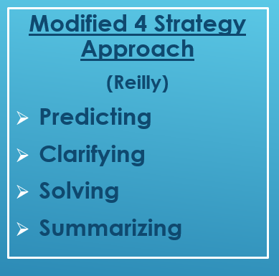
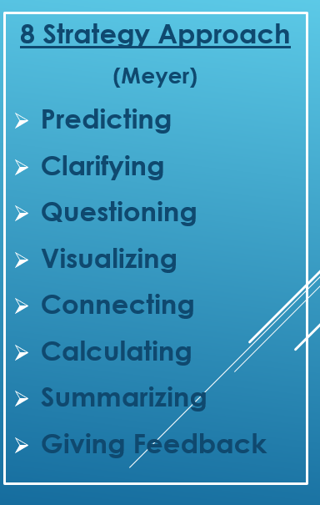
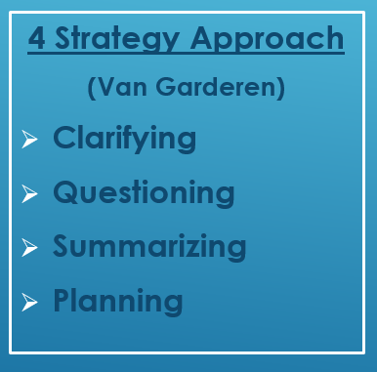
RECIPROCAL TEACHING IN MATH
Notes:
3 min. – Now that we have practiced Reciprocal Teaching, you can see how it lends itself to being used most often as a type of guided reading, in an ELA setting, but it can really be used in any content area that involves reading and interpreting texts– scientific texts, historical texts, etc. Also, because it is a cyclical process, you don’t always have to start with summarizing.
We mentioned earlier that Reciprocal Teaching can also be modified for use in math as students work together to interpret word problems. Here are three approached to Reciprocal teaching in MATH that have been developed:
(click to bring in first box) You will see that in Van Garderen’s 4 strategy approach, the order of the processes is slightly different, and instead of predicting, students must construct a plan for problem-solving
(click to bring in next box) Reilly’s Modified 4 Strategy Approach involves predicting what the problem will require you to do, clarifying math vocabulary and concepts, solving the problem, then summarizing the process.
(click to bring in last box) Meyer’s approach actually has 8 steps – including visualizing, which requires students to create a picture, diagram, or visual representation of the problem.
So you see that Reciprocal Teaching can be modified and used in a variety of ways and in all content areas.

Slide 80
So What? Now What?
Independently
Use a sticky note
Considering Reciprocal Teaching…
What could be the “NOW WHAT” for your school/team
Notes:
3 min. – So What… Now What? – We have spent some time focusing on reciprocal teaching and how it positively impacts student achievement– so what are your takeaways? Now what are you going to do with this information? Take a couple of minutes and think about reciprocal teaching and what your current state is in this area. What may be an implication or next step?
Don’t forget to put all of your sticky notes in the “parking lot”... You will use them in a few minutes as you determine next steps.

Slide 81
Learning Target and Measure of Success:
Today, we will reflect on current practices in the classroom and investigate strategies that positively impact novice performance
So that we can move from skill to implementation and continuously monitor for effectiveness
We will know we are successful when we have identified and planned next steps for our own improvement
Notes:
2 min – Alright, we are getting ready to wrap up our time talking to you and move you into your time to talk as a team - Let’s review our learning target for the day!
(READ SLIDE)

Slide 82
Learning Target and Measure of Success:
Today, we will reflect on current practices in the classroom and investigate strategies that positively impact novice performance
So that we can move from skill to implementation and continuously monitor for effectiveness
We will know we are successful when we have identified and planned next steps for our own improvement
Notes:
2 min – We have reflected on current practices, we have investigated strategies that positively impact novice performance. Hopefully, you feel confident that you can move from skill to implementation, and monitor these strategies for effectiveness. So, YOU as a team will spend the rest of our time together planning very intentional next steps based on the reflection and thinking you have done today.

Slide 83
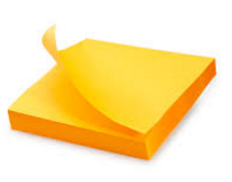
Planning: Next Steps for Improvement
Locate your highlighted guiding questions
Transfer to sticky notes anything that is highlighted in red or yellow (paraphrase if needed)
Compile ALL sticky notes
Notes:
5 min – (explain directions- read from slide)

Slide 84
Planning: Next Steps for Improvement
**THE PRINCIPAL WILL BE A SILENT OBSERVER AT THIS TIME**
Each sticky note represents a possible next step for improvement. Work together as a team (excluding the principal) to sort your group’s sticky notes into THREE categories:
Category 1
Category 2
Category 3
**HIGHEST PRIORITY**
Notes:
10 min. – (Explain sorting-- read directions from slide)
(Groups may sort on the table or wall)

Slide 85
Planning: Next Steps for Improvement
Once the team has sorted the sticky notes, explain and justify the categories to the principal
If principal disagrees with any sticky note’s placement, he/she may re-sort as needed
Category 1
Category 2
Category 3
**HIGHEST PRIORITY**
Notes:
10 min. – (Read directions from slide)
The principal has the big picture of how everything works together for whole school improvement– he/she is the one that is ultimately responsible for carrying out the school improvement plan, and may know of something that teachers don’t that needs to cause movement of sticky notes. This is why the principal can choose to move any sticky notes.

Slide 86
Planning: Next Steps for Improvement
As a team, come to consensus on final categories
Work together to identify 3-5 next steps for improvement that will become a part of your improvement planning process (i.e. 30-60-90 Day plans, CSIP, PLC work, etc.) for the upcoming school year
Notes:
5 min. – (read slide)- Make sure someone records your next steps. Feel free to take all of your sticky notes with you today when you leave.

Slide 87
Novice Reduction Strategies That Impact Student Learning
For Additional Resources and Support:
Visit the Novice Reduction for Gap Closure webpages at www.education.ky.gov
Contact Novice Reduction Team for follow-up:
Susan Greer, Coordinator – susan.greer@education.ky.gov
J’Nora Anderson – jnora.anderson@education.ky.gov
Wanetta Morrow – wanetta.morrow@education.ky.gov
Kelli Prater – kelli.prater@education.ky.gov
Jennifer Steidel-Jones – jennifer.steidel-jones@education.ky.gov
Juett Wells – juett.wells@education.ky.gov
Novice Reduction for Gap Closure 2017
Notes:
2 min. – share additional resources and support
May choose to show webpages if time permits and interest is there
**PLUS/DELTA**

