Slide 1

Summer Institute
“Staking Our Claim on Innovation”
Teaching Students to Ask Their Own Questions
One small change can yield big results!
July 29, 2015
www.kvecelatln.weebly.com
Notes:
9:00 –Carole
WELCOME

Slide 2

Carole Mullins, NBCT
KVEC Literacy Instructional Specialist
carole.mullins@hazard.kyschools.us
Kimberly Sergent
KDE Social Studies Instructional
Specialist
kimberly.sergent@education.ky.gov
Notes:
Carole - Introductions

Slide 3

Our Target Focus:
Exploring Student Questioning
Recognize the importance of teaching students to ask their own questions.
Explore the relevance between students asking their own questions and increasing inquiry and rigor in the classroom. (Kentucky Academic Standards and TPGES).
Introduction to the Right Question Institute and the Question Formulation Technique.
Notes:
Carole

Slide 4
Traditional Classroom
Teachers ask
Students answer
Teachers explain
Students take notes
Teachers create
Students complete
Instruction and inquiry flow almost entirely in one direction…
From the teacher to the student
Notes:
Carole
In a traditional classroom, the teacher is the center of attention, the owner of knowledge and information. Teachers often ask questions of their students to gauge comprehension, but it’s a passive model that relies on students to absorb information they need to reproduce on tests.
What do you think? Is the basic flow of education? Discuss with a partner…
We need to strive for a more balanced questioning diet, one that welcomes more questions from students

Slide 5

What would happen if students asked their own questions in your classroom?
Notes:
Carole Chart(s) posted for participants to write their responses on walls
Chalk Talk Process:
The facilitator explains VERY BRIEFLY that chalk talk is a silent activity.
No one may talk at all and anyone may add to the chalk talk as they please. You can comment on other people’s ideas simply by drawing a connecting line to the comment.
It can also be very effective to say nothing at all except to put finger to lips in a gesture of silence and simply begin with #2.
Actively interacting invites participants to do the same kinds of expansions. A Chalk Talk can be an uncomplicated silent reflection or a spirited, but silent, exchange of ideas. It has been known to solve vexing problems, surprise everyone with how much is collectively known about something, get an
entire project planned, or give a committee everything it needs to know without any verbal sparring.

Slide 6
Relevance to New Demands
Inquiry and Rigor
      Kentucky Framework for Teaching
      Kentucky Academic Standards (KAS)
      in ALL Content Areas
Notes:
Carole
Let’s think about student questioning in terms of… Standards and TPGES

Slide 7
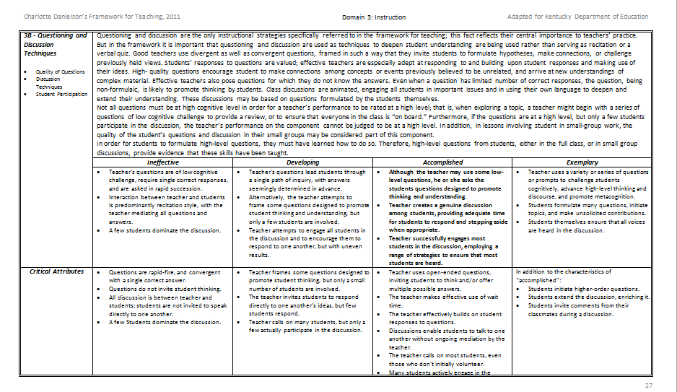
Domain 3: Instruction
3b – Questioning & Discussion Techniques
Notes:
Carole: Framework 3b: (Page 32 in the 8.5 format and Page 27 in the 8.5 by 14 format)
Instruct participants to find this handout. We are going to talk specifically about KfT 3b…
Instructions for Activity on next slide

Slide 8

Making Comparisons
Read the 3b summary AND the descriptors for both the Accomplished and Exemplary category.
Summarize the difference between them.
With a discussion partner, share your summarizations.
With your partner, synthesize into a superior summarization and write it on the chart.
Instructional Strategy: FSLC (Formulate, Share, Listen, Create)
Notes:
Carole
Look at the critical attributes below that. See the distinguishing characteristics among the 4 categories.

Slide 9

Critical Attributes
In addition to the characteristics of accomplished:
  Students initiate higher-order questions.
  Students extend the discussion, enriching it.
  Students invite comments from their classmates during discussion.
Notes:
Carole
Clearly critical attributes of best practice have students initiating and leading the classroom.
High-quality questions encourage students to make connections among concepts or events previously believed to be unrelated, and arrive at new understandings of complex material. Effective teachers also pose questions for which they do not know the answers. Even when a question has limited number of correct responses, the question, being non-formulaic, is likely to promote thinking by students. Class discussions are animated, engaging all students in important issues and in using their own language to deepen and extend their understanding. These discussions may be based on questions formulated by the students themselves.
Not all questions must be at high cognitive level in order for a teacher’s performance to be rated at a high level; that is, when exploring a topic, a teacher might begin with a series of questions of low cognitive challenge to provide a review, or to ensure that everyone in the class is “on board.” Furthermore, if the questions are at a high level, but only a few students participate in the discussion, the teacher’s performance on the component cannot be judged to be at a high level. In addition, in lessons involving student in small-group work, the quality of the student’s questions and discussion in their small groups may be considered part of this component.
In order for students to formulate high-level questions, they must have learned how to do so. Therefore, high-level questions from students, either in the full class, or in small group discussions, provide evidence that these skills have been taught.

Slide 10

1
The teacher is usually the person who asks the questions during a discussion. In a longitudinal study of elementary and secondary school classes, Dillon (1990) found that each student asks only one question(s) per month on average. Teachers must take deliberate steps to get their students to ask questions.
Notes:
Carole
Ask participants to guess how often students ask questions.

Slide 11
Why is it worth the time and effort to encourage more student questioning?
The average preschool child asks 100 questions per day, but that number declines sharply when kids enter grade school.
By middle school, the number of questions the average child asks in a day approaches zero.
Why is there such a drastic decrease in the frequency of a behavior that seems to come naturally to most kids when they are very young?
Because like most adults, kids will do what they are rewarded for doing, and in school you are rewarded for having correct answers, not asking good questions.
Notes:
Carole
Being college and career ready is being able to ask good questions

Slide 12


For Students, Why the Question is More
Important Than the Answer
By Katrina Schwartz October 26, 2012
http://ww2.kqed.org/mindshift/2012/10/26/for-students-why-the-question-is-more-important-than-the-answer/
Notes:
Carole
In preparation for your introduction to QFT and build some background knowledge read the teacher written article until the section that begins “Rule 1”

Slide 13

Students' Questions as a Catalyst for:
Deeper Learning, Joy in Teaching and a Healthier Democracy
The Right Question Institute
www.rightquestion.org
Notes:
Carole
Introduction to Make Just One Change book and the Right Question Institute
Intended for all grade levels and all content areas!!

Slide 14

Students are more successful when they learn to ask their own questions.
Notes:
Carole
What makes this “big idea” so relevant to you as a KY teacher?
Relevant to new requirements and 21s century/global skills
Process of learning

Slide 15

Question Formulation Technique as a FOUNDATIONAL SKILL
From a Big Idea to a Practical Resource
Designed to address the burdens on you to ensure that your students can get to more of the right answers.
This resource leads to changes in your classroom when students ‘own’ the questions and the learning agenda.
Notes:
Carole 3 Important Changes from using QFT:
Increases student participation in group and peer learning processes.
Improves classroom management
Enhances their efforts to address inequities in education

Slide 16
Engagement!
The QFT:
A rigorous step-by-step process that helps students (across grades, subject areas and levels of academic readiness) to consistently:
    Produce their own questions
    Improve their questions
    Strategize on how to use their questions
Notes:
Carole
KYfT 3c Engaging Students in Learning

Slide 17
Components of the
Question Formulation TechniqueTM
Question Focus (Q-Focus)
Produce Your Questions
Improve Your Questions
Prioritize Your Questions
Discuss Next Steps
Reflect
Notes:
Carole
QFT 101 Handout

Slide 18
Question Focus (Q-Focus)
A Question Focus IS a simple statement, a visual or aural aid to help students generate questions
  Created from curriculum content
  Brief
  Stimulates a new line of thinking
A Q-Focus is NOT
  A question
A Question Focus IS a simple statement, a visual or aural aid to help students generate questions
  Created from curriculum content
  Brief
  Stimulates a new line of thinking
A Q-Focus is NOT
  A question
Notes:
Carole
Handout on website to guide you through process of developing a Q-Focus
The Question Focus (QFocus) is a prompt presented in the form of a statement, visual/audio aid, short text, etc. The QFocus attracts students’ attention and stimulates the formation of questions.

Slide 19
Question Focus Example
Some students are not
asking questions in my classroom.
Notes:
Carole

Slide 20
Four Rules for
Producing Questions
Ask as many questions as you can.
Do not stop to answer, judge, or discuss. (silence)
Write down every question exactly as it was stated.
Change any statements into questions.
Notes:
Carole
Reference the QFT 101 Handout

Slide 21

Experiencing the Question Formulation Technique^{TM (QFT)}
Notes:
Carole

Slide 22
Producing Questions – 5 min.
Some students are not asking questions in my classroom.
Ask Questions
Follow the 4 Rules
Number the Questions
Notes:
Carole
Participants will write take turns asking questions independently or the whole group on chart paper (Produce Your Questions section of QFT handout)
No discussion about questions and write them down exactly as stated
Go through questions and change any statement into a question
Number the questions
Sample Questions:
How are the students who are not asking questions performing in your class
What kind of questions do I want students
Have I created an environment conducive to student questions
Why are they not asking questions
How can I model High Level questions for students
Does the classroom environment create a clrm of trust.
Do students feel comfortable asking questions
Do the students that are not asking questions know how to ask them
How can I teach students to ask effective questions

Slide 23
Categorizing Questions:
Closed/Open
Definitions:
  Closed-ended questions can be answered with a “yes” or “no” or with a one-word answer.
  Open-ended questions require
  more explanation.
Directions: Identify your questions as closed-ended or open-ended by marking them with a “C” or an “O”.
Notes:
Carole
Follow directions on slide and “Improve Your Questions” on QFT handout

Slide 24
Change Closed to Open -Ended Questions (Divergent Thinking)
Directions: Take one closed-ended question and change it into an open-ended question
CLOSED-ENDED
OPEN-ENDED
Notes:
Carole
Follow directions on slide and “Improve Your Questions” on QFT handout

Slide 25
Change Open to Closed -Ended Questions (Convergent Thinking)
Directions: Take one open-ended question and change it into an closed-ended question
OPEN-ENDED
CLOSED-ENDED
Notes:
Carole
Follow directions on slide and “Improve Your Questions” on QFT handout

Slide 26
Prioritizing Questions
Review your list of questions
Choose the three questions you consider most important
While prioritizing, think about your Q-Focus:
Some students are not asking
questions in my classroom.
Notes:
Carole
Follow directions on slide and “Prioritize Your Questions” on QFT handout

Slide 27
REFLECTION
Why did you choose those three questions as the most important?
Where are your priority questions in the sequence of your entire list of questions?
Notes:
Carole
Follow directions on slide and “Prioritize Your Questions” on QFT 101 handout
Kim will share how she used QFT with her students and how student generated questions were organized and implemented
Reflections can be focused on what the students learned, how the students felt about the process, or how the students' behavior might change as a result of this process.

Slide 28

Classroom Example:
Middle School
Teacher: Megan Harvell, Boston, MA
Topic: American History –The Civil War
Purpose: Pre-reading activity to engage students
Notes:
Carole

Slide 29
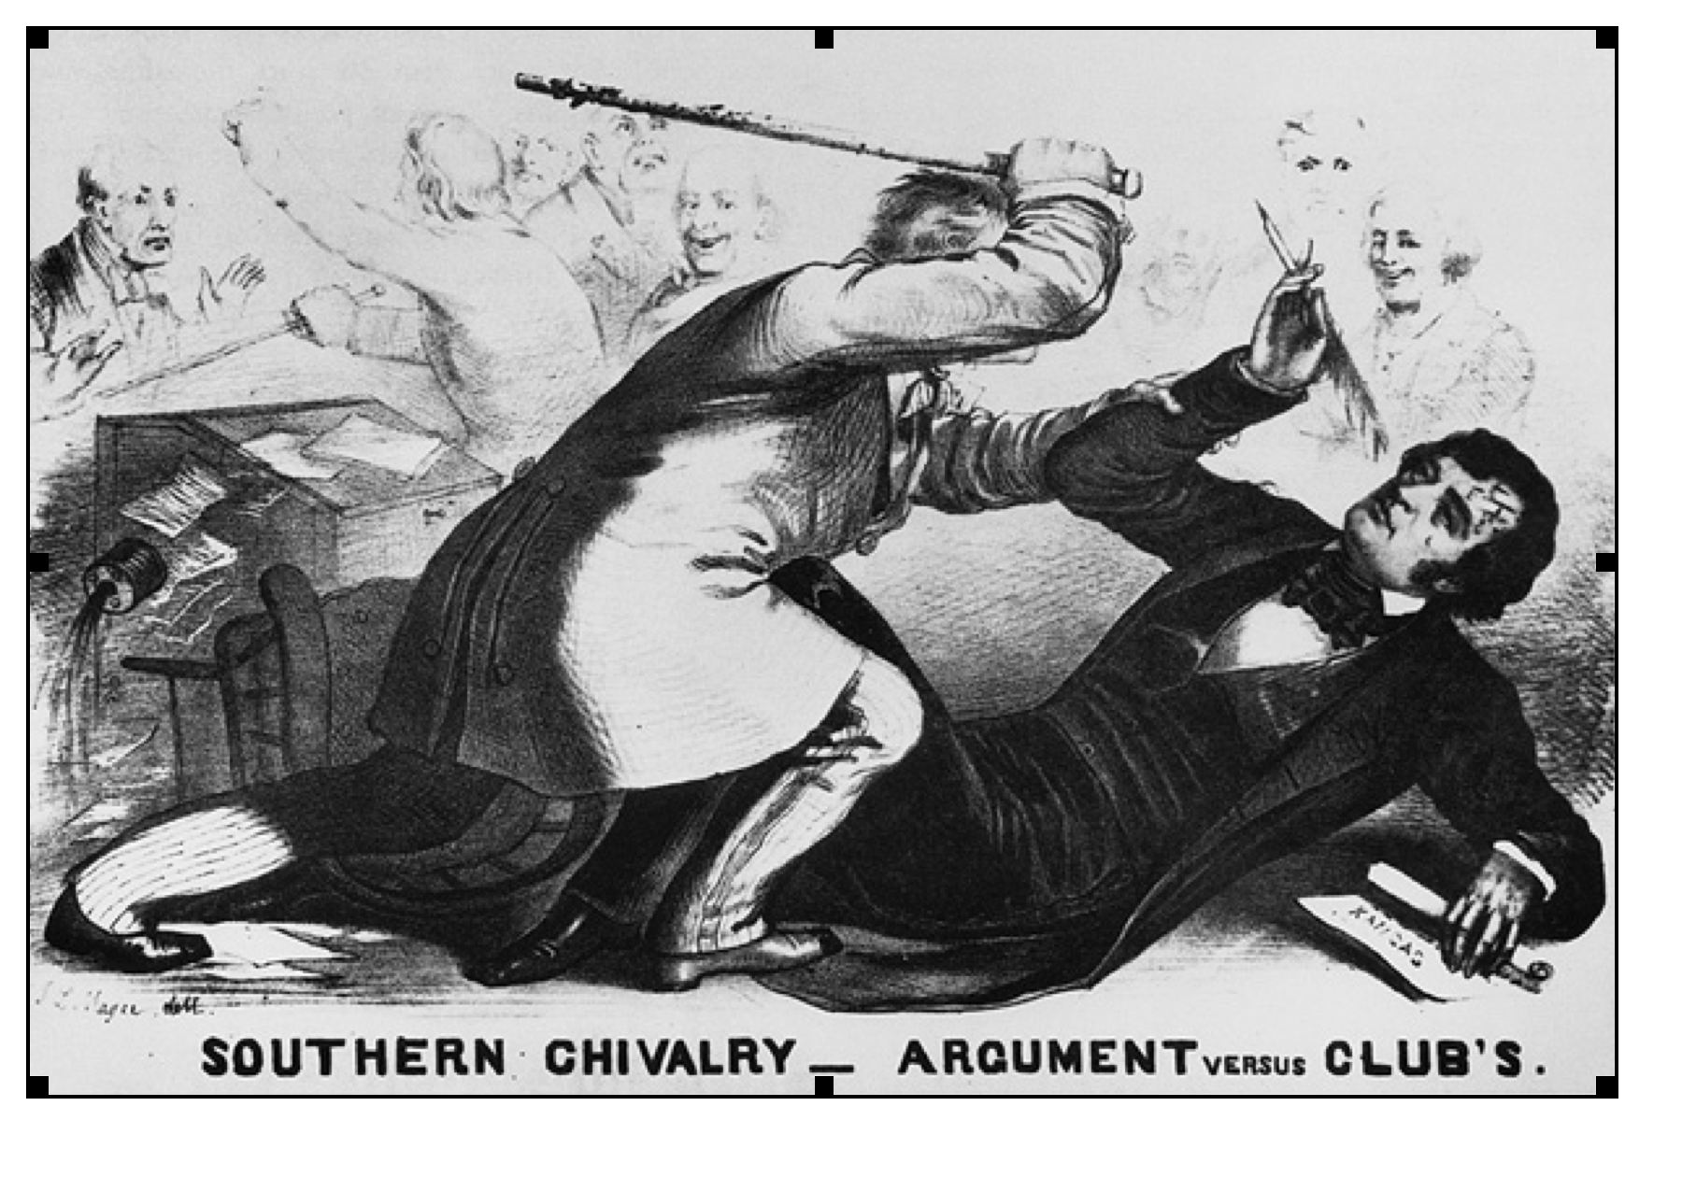
Question Focus
Notes:
Carole
Using a visual only

Slide 30
Student Questions
Why are they fighting?
Are they fighting?
Are they part of the government?
Where were they?
Who are they?
Were they signing anything?
Who else was there?
Why are you hitting him?
Why didn’t they call 911?
Was this related to slavery?
Why is he hitting him with a bat?
Why are you taking a pen?
Why are they in court?
Who hit who first?
Who died?
Why are they smiling?
Notes:
Carole

Slide 31
Rigor in the Question Formulation Technique
  Three Thinking Abilities
  in One Process
  Divergent
  Convergent
  Metacognitive
Notes:
Carole

Slide 32
Thinking in many different directions: Moving from CLOSED to OPEN QUESTIONS
DIVERGENT
THINKING
Notes:
Carole

Slide 33
Narrowing Down, Focusing
Moving from OPEN to CLOSED
CONVERGENT
THINKING
Notes:
Carole

Slide 34

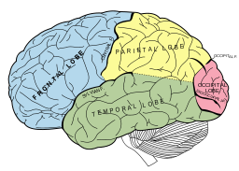
Thinking about Thinking
METACOGNITIVE
THINKING:
“Why did
you pick those as
your priority
questions?”
Notes:
Carole

Slide 35

The Research Confirms the Importance of Student Questioning
Self-Questioning (metacognitive strategy):
Students formulating their own questions proved to be one of the most effective metacognitive strategies
Engaging in pre-lesson self-questioning improved students rate of learning by nearly 50% (Hattie, p.193)
Visible Learning: A Synthesis of Over 800 meta-Analyses Relating to Achievement by John Hattie. 1st Edition, December 26, 2008.
Notes:
Carole HANDOUT: Recommendations on facilitating the QFT in your classroom

Slide 36
Experience a Social Studies Lesson Using the Question Formulation Technique^{TM (QFT)}
Notes:
Kim

Slide 37


Remembering Pearl Harbor
(Franklin D. Roosevelt Library, NLR-PHOCO-A-8150(29))
Notes:
Kim

Slide 38
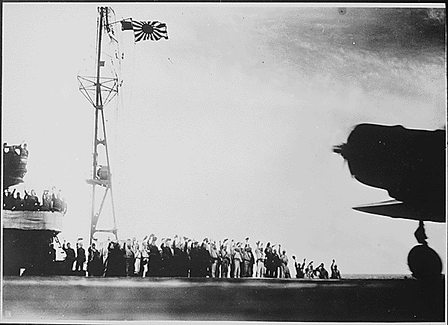
Notes:
Kim

Slide 39
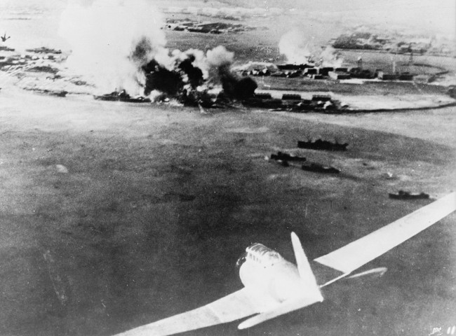
Notes:
Kim

Slide 40
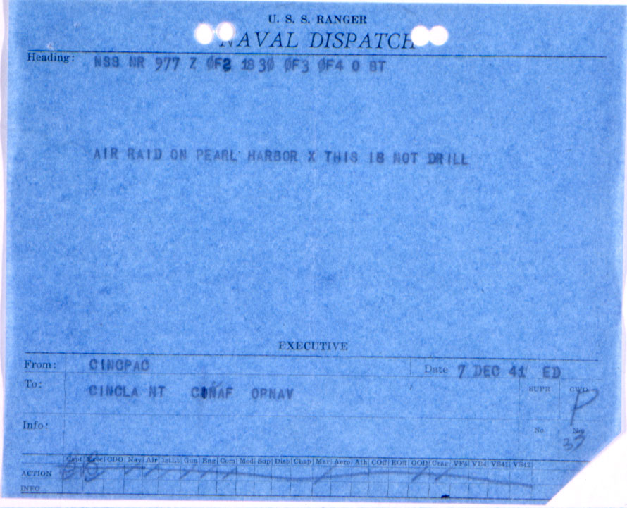
Notes:
Kim

Slide 41
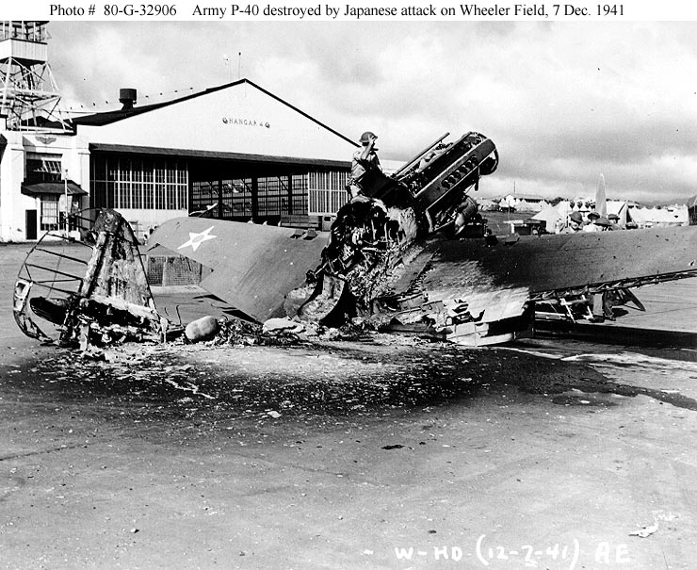
Notes:
Kim

Slide 42

Notes:
Kim

Slide 43

Notes:
Kim

Slide 44

Notes:
Kim

Slide 45

Notes:
Kim

Slide 46
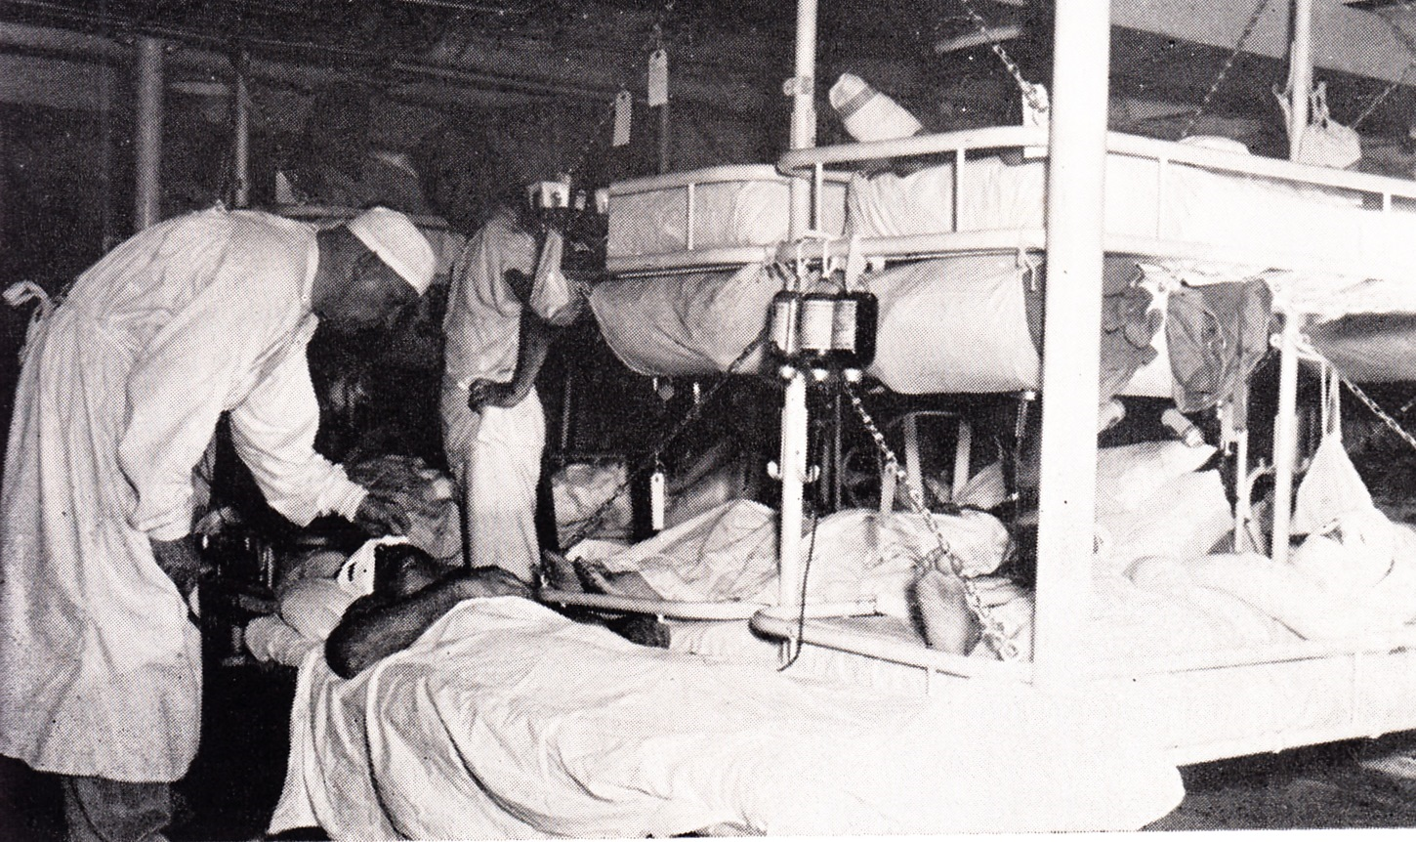
Notes:
Kim

Slide 47


QFT can be used effectively before, during and after instruction.
Beginning of Instruction
Middle of Instruction
End of Instruction
Students ask questions about previous instruction to guide a class discussion or Socratic Seminar
Teacher uses student questions as an assessment to guide future instruction
The teacher references student questions from the beginning of a unit to see how questions are being answered
Students use questions to design final projects
Students use questions to design final products
The teacher uses the QFT to review learning that occurred during a unit
Notes:
Kim
At this point students and teachers can work together to determine how to use the questions they selected.

Slide 48

Applications Across the Disciplines
Develop science experiences
Create their own research projects (NHD)
Begin research on teacher-assigned topic
Prepare to write an essay
Analyze a word problem
Think more deeply about a challenging reading assignment
Prepare an interview
Get “unstuck” in a topic
Notes:
Kim

Slide 49

Remember…
Have a Great School Year!
Notes:
Carole

