Slide 1

Text Complexity, Close Reading and Text Dependent Questions
Carole Mullins, NBCT
KDE Eng/LA Content Specialist
carole.mullins@education.ky.gov
www.kvecelatln.weebly.com

Slide 2

Today’s Targets
I can recognize important instructional shifts demanded by the KCAS Eng/LA and Literacy Standards.
I can implement strategies that address instruction for comprehending and writing about complex text.
Notes:
Everything we do today focuses on ways to plan for effective instruction that meets the criteria of the ELA/Literacy KCAS

Slide 3

The CCSS Requires Three Shifts in ELA/Literacy
Building knowledge through content-rich nonfiction
Reading, writing and speaking grounded in evidence from text, both literary and informational
Regular practice with complex text and its academic language
Notes:
The shifts are a high-level summary of the biggest changes signified by the adoption of the CCSS.
They represent the most significant shifts for curriculum materials, instruction, student learning, and thinking about assessment. Taken all together, they should lead to desired student outcomes.
They are meant to be succinct and easy to remember.

Slide 4

Do my students spend more class time in text or out of text?
Notes:
Talk with the person sitting next to you about this.

Slide 5


Time – In and Out of the Text
The shifts require experience within the text – building knowledge primarily through reading, using evidence that can only be found in text, and exposure to academic vocabulary found in text.
By grounding the discussion in the text itself, all students are given an equal opportunity to engage. The text becomes a shared experience in learning about any topic.
Notes:
4 Important Points!
1st bullet – The shifts require experience within the text – building knowledge primarily through reading, using evidence that can only be found in text, and exposure to academic vocabulary found in those very texts.
2nd bullet – For example, reading about tornadoes, then asking students to talk about a time when they were in a tornado only allows the students who have had this experience to engage. The expectations outlined by the CCSS are requirements for ALL students. By grounding the discussion in the text itself, all students are given an equal opportunity to engage. The text becomes a shared experience in learning about any topic.

Slide 6
Time – In and Out of the Text
(con’t)
Requiring students to persevere through difficult text builds critical reading muscles.
Those reading muscles are what students will need to be successful in college and career – reading difficult subject matter or technical job related information without anybody to support them is the critical skill necessary for success.
Notes:
3rd bullet – As texts and reading becomes challenging – it’s easier for students to disengage with the text and go to what they know (or think they know based on their experience.) Requiring students to persevere through difficult text builds critical reading muscles.
4th bullet – Those reading muscles are what students will need to be successful in college and career – reading difficult subject matter or technical job related information without anybody to support them is the critical skill necessary for success.

Slide 7

Text Complexity
and The KY Core Academic Standards for ELA and Literacy in History/Social Studies, Science & Technical Subjects

Slide 8
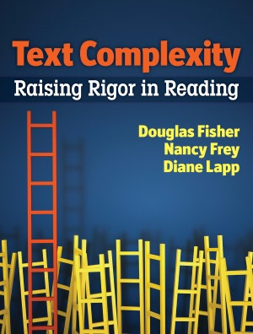
Text Complexity:
Raising Rigor in Reading
By Douglas Fisher, Nancy Frey, Diane Lapp
ISBN: 978-0-87207-478-1
Notes:
Handout: Page 8 from book…
TLs read and share one important point they learned with others at their table

Slide 9
The Crisis of Text Complexity
  Complexity of texts students are expected to read is way below what is required to achieve college and career readiness:
    High school textbooks have declined in all subject areas over several decades
    Average length of sentences in K-8 textbooks has declined from 20 to 14 words
    Vocabulary demands have declined, e.g., 8th grade textbooks = former 5th grade texts; 12th grade anthologies = former 7th grade texts
  Complexity of college and careers texts has remained steady or increased, resulting in a huge gap (350L)
Notes:
Too many students are reading at too low a level (Less than 50% of graduates can read sufficiently complex texts) Look at an old McGuffey Reader… Text is more difficult than our text now.

Slide 10

Shift in Instruction
“. . . it is important to recognize that scaffolding often is entirely appropriate. The expectation that scaffolding will occur with particularly challenging texts is built into the Standards’ grade-by-grade text complexity expectations, for example. The general movement, however, should be toward decreasing scaffolding and increasing independence both within and across the text complexity bands defined in the standards.”
CCSS Appendix A
Notes:
Text Complexity Page 8 HANDOUT
Read first two paragraphs then discuss your summarization of the information with an elbow partner

Slide 11

Text Complexity: What does it mean to you?
Anchor Standard
  R.CCR.10
  Read and comprehend complex literary and
  informational texts independently and proficiently.
Notes:
Specifically, reading standard #10:

Slide 12
R.L.6.10 | By the end of the year, read and comprehend literature, including stories, dramas, and poems, in the grades 6–8 text complexity band proficiently, with scaffolding as needed at the high end of the range.
R.L.7.10 | By the end of the year, read and comprehend literature, including stories, dramas, and poems, in the grades 6–8 text complexity band proficiently, with scaffolding as needed at the high end of the range.
R.L.8.10 | By the end of the year, read and comprehend literature, including stories, dramas, and poems, at the high end of grades 6–8 text complexity band independently and proficiently.
R.L.9-10.10 | By the end of grade 9, read and comprehend literature, including stories, dramas, and poems, in the grades 9–10 text complexity band proficiently, with scaffolding as needed at the high end of the range. By the end of grade 10, read and comprehend literature, including stories, dramas, and poems, at the high end of the grades 9-10 text complexity band independently and proficiently.
R.L.11-12.10 | By the end of grade 11, read and comprehend literature, including stories, dramas, and poems, in the grades 11–CCR text complexity band proficiently, with scaffolding as needed at the high end of the range. By the end of grade 12, read and comprehend literature, including stories, dramas, and poems, at the high end of the grades 11–CCR text complexity band independently and proficiently.
Notes:
Specifically, reading standard #10:

Slide 13

What Makes Text Complex?
Educational Leadership, March 2012
The Challenge of Challenging Text
Timothy Shanahan, Douglas Fisher and Nancy Frey
Vocabulary: Knowledge of word meaning
Sentence Structure: How the words operate together
Coherence: How particular words, ideas, and sentences in text connect with one another
Organization: The patterns authors use to communicate complex information
Background Knowledge: The reader’s prior knowledge
Notes:
ACTIVITY:
Number Off 1-5: Read Section and chart info to share with rest of groups
1. Vocabulary:
Studies show that higher-order thinking in reading depends heavily on knowledge of word meanings… Students' ability to comprehend a piece of text depends on the number of unfamiliar domain-specific words and new general academic terms they encounter.
2. Sentence Structure:
Words are not the whole picture. Sentence structure matters, too, because it determines how the words operate together. In some cases, complex sentence structures are necessary to communicate the complexity of the information itself—thus the long noun phrases common in science.
3. Coherence:
How particular words, ideas, and sentences in text connect with one another, a feature referred to as coherence.
4. Organization:
The patterns authors use to communicate complex information… Ideas can be arranged across text in many ways, some more straightforward than others.
5. Background:
Vocabulary, sentence structure, coherence, and organization can all be determined by closely analyzing the text itself. A final determinant of text difficulty, however, depends on the reader's prior knowledge. Students' background knowledge, including developmental, experiential, and cognitive factors, influences their ability to understand the explicit and inferential qualities of a text.

Slide 14

Assessing Texts
Text Complexity
Quantitative measures
Qualitative values
Task and Reader considerations
Notes:
Three Legs of the TC process

Slide 15
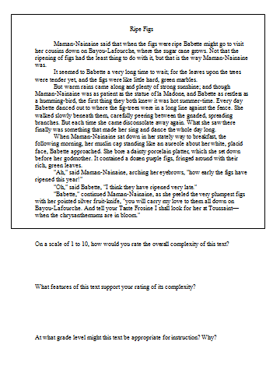
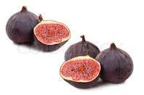
Ripe Figs by Kate Chopin
  As a small group, read “Ripe Figs” and answer the three questions provided….
Notes:
Carole
Follow directions on screen…

Slide 16
Discussion
  On a scale of 1 to 10, how would you rate the overall complexity of this text?
  What features of this text support your rating of its complexity?
  At what grade level might this text be appropriate for instruction? Why?
Notes:
Will Give Answer after we have worked through all three steps of the Text Complexity process using Ripe Figs

Slide 17
Determining Text Complexity
Page 31, Elementary
Page 57, Secondary
Determine the quantitative measures of the text.
Analyze the qualitative measures of the text.
Reflect upon the reader and task considerations.
Recommend placement in the appropriate text complexity band.
Qualitative
Quantitative
Reader and Task
Notes:
Overview of the Protocol
Measuring Text Complexity: Three Factors found in standards
Page 31 - Standard 10: Range, Quality, and Complexity of Student Reading K–5
Page 57 - Standard 10: Range, Quality, and Complexity of Student Reading 6-12

Slide 18
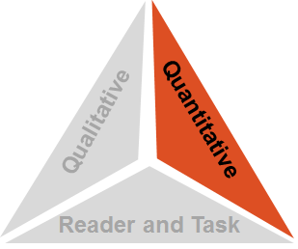
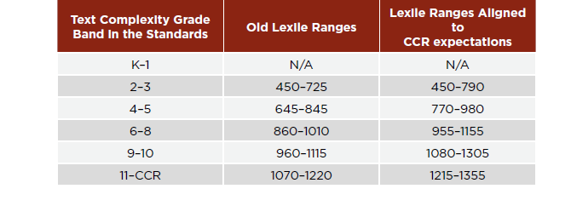
Quantitative Measures Ranges for
Text Complexity Grade Bands
Stretch Texts are needed
Notes:
Reminder From the standards…
Lexile measures and the Lexile ranges above help to determine what text is appropriate for each grade band and what should be considered "stretch" text.
The Common Core Standards devote as much attention to the text complexity of what students are reading as it does to how students read.
As students advance through the grades, they must both develop their comprehension skills and apply them to increasingly complex texts. The proportion of texts that students read each year should come from a particular text complexity grade band.

Slide 19
Step 1: Quantitative Measures
  Measures such as:
  Word length
  Word frequency
  Word difficulty
  Sentence length
  Text length
  Text cohesion
Qualitative
Quantitative
Reader and Task
Notes:
(Share Ben/Benjamin story)
Quantitative measures stand as proxies for semantic and syntactic complexity:
Word difficulty (frequency, length)
Sentence length and syntax
Some newer measures also measure text cohesion and other features of vocabulary

Slide 20
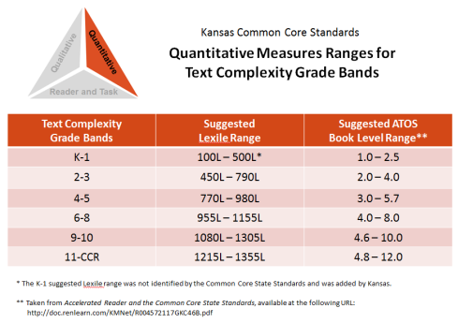


Step 1: Quantitative Measures
The Quantitative Measures Ranges for Text Complexity:
This document outlines the suggested ranges for each of the text complexity bands using:
Lexile Text Measures
Accelerated Reader (ATOS Book Levels)
Frye
DRA
Other readability measures
Notes:
In past year CCSSO and Kansas have research other readability measures/analyzer tools other than Lexile
Remember, however, that the quantitative measures aspect is only the first of three “legs” of the text complexity triangle.
Our final recommendation may be validated, influenced, or even over-ruled by our examination of qualitative measures and the reader and task considerations.

Slide 21
Step 2: Qualitative Measures
  Measures such as:
  Levels of meaning
  Levels of purpose
  Structure
  Organization
  Language conventionality
  Language clarity
  Prior knowledge demands
Qualitative
Quantitative
Reader and Task
Notes:
Qualitative measures are on a continuum (not grade/band specific) and most useful working in conjunction with quantitative measures.

Slide 22
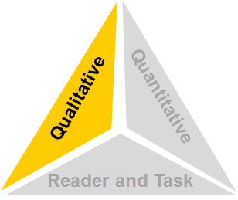
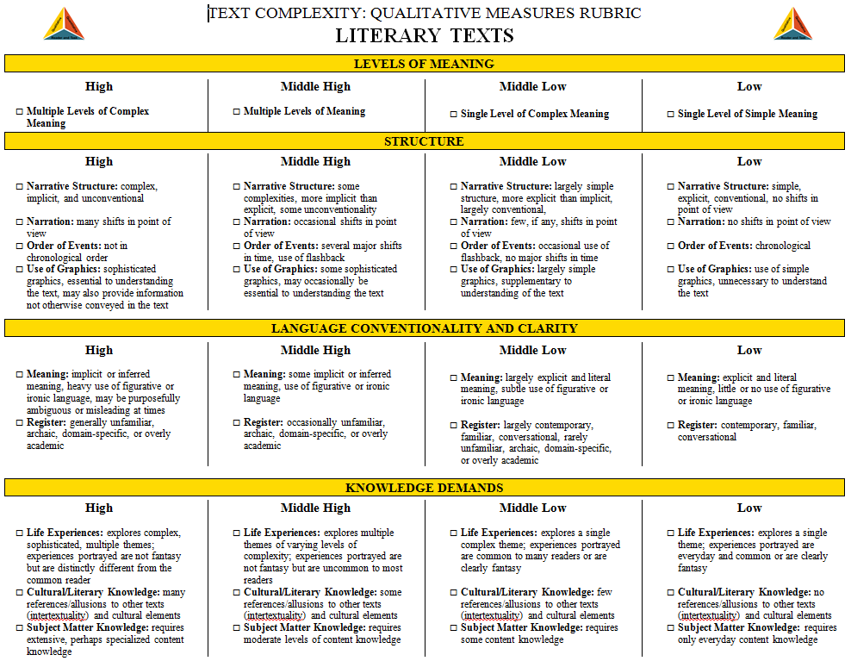
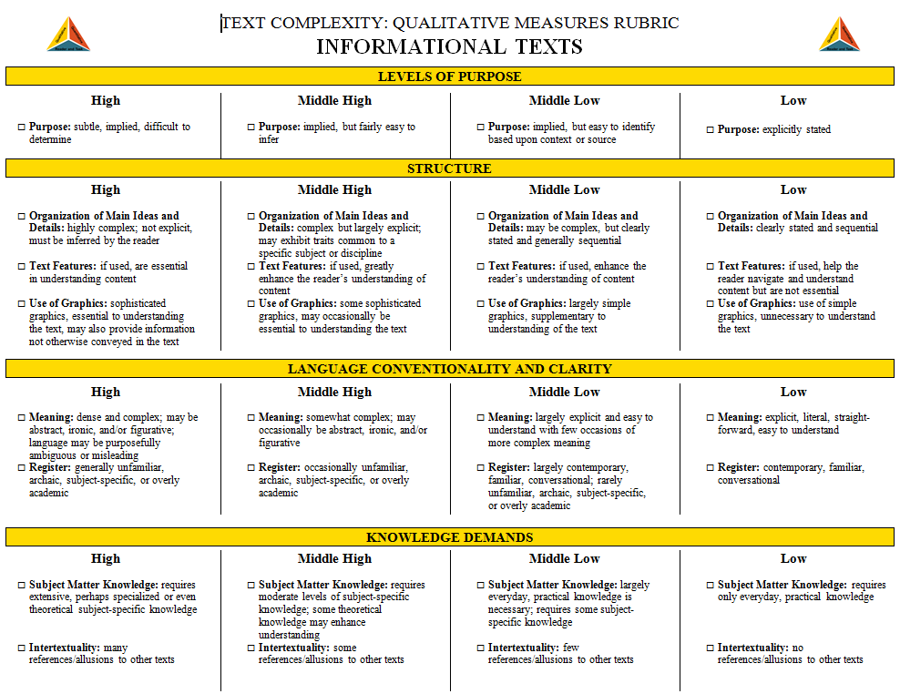
Qualitative Measures Resources
The Qualitative Measures Rubrics
for Literary and Informational Text: http://www.ksde.org/Default.aspx?tabid=4778#TextRes
The rubric for literary text and the rubric for informational text allow educators to evaluate the important elements of text that are often missed by computer software that tends to focus on more easily measured factors.
Notes:
Resources for determining QM
Handouts: Literary and Informational Rubric for Qualitative measuring…
Because the factors for literary texts are different from information texts, these two rubrics contain different content. However, the formatting of each document is exactly the same.
Quickly Review the Rubric for Literary – Think about Ripe Figs

Slide 23
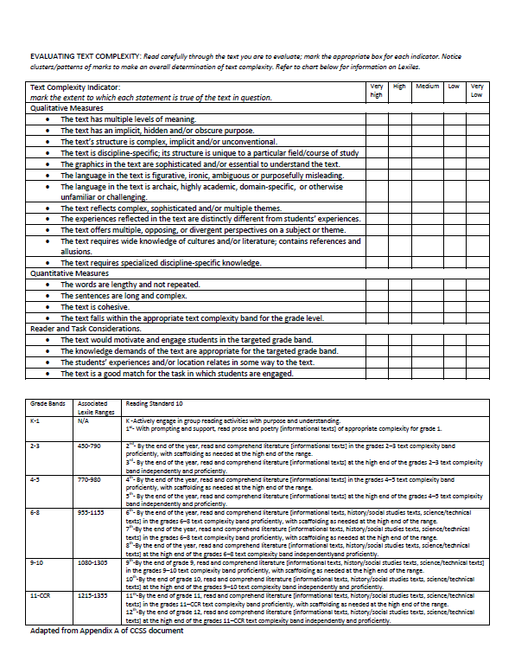
Another Qualitative Measures Resource
Notes:
Another resource: 1 Page adapted from CCSS Appendix A by Robin Hebert. Also includes the Lexiles…
CHOOSE THE KANSAS OR APPENDIX A OR BOTH TO DO THE QUALITATIVE MEASURE OF RIPE FIGS
Does having a specific resource to guide you help? Are you still focused in the same grade band as the Lexile level?

Slide 24
Step 3: Reader and Task Considerations
  Considerations such as:
  Motivation
  Knowledge and experience
  Purpose for reading
  Complexity of task assigned regarding text
  Complexity of questions asked regarding text
Qualitative
Quantitative
Reader and Task
Notes:
HANDOUT

Slide 25
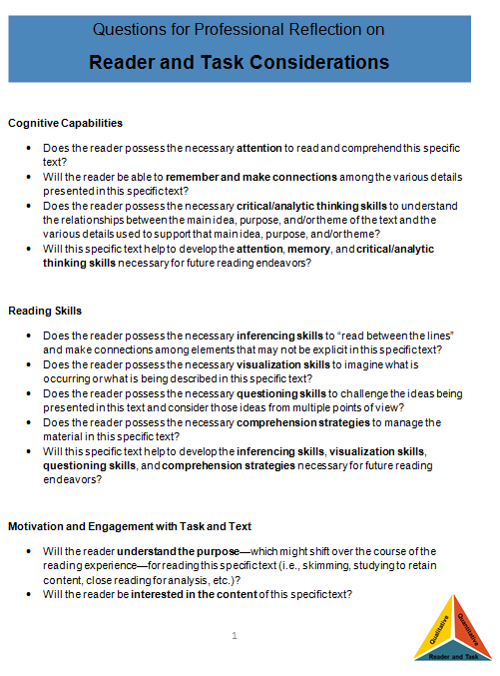
Step 3: Reader and Task Considerations
Questions for Professional Reflection on Reader and Task Considerations:
The questions provided in this resource are meant to spur teacher thought and reflection upon the text, students, and any tasks associated with the text.
Notes:
Handouts: Reader and Task Considerations
The questions included here are largely open-ended questions without single, correct answers, but help educators to think through the implications of using a particular text in the classroom.
Take a few minutes and work though the step for Ripe Figs…

Slide 26
Step 4: Recommended Placement
After reflecting upon all three legs of the text complexity model we can make a final recommendation of placement within a text and begin to document our thinking for future reference.
Qualitative
Quantitative
Reader and Task
Notes:
RIPE FIGS: What’s your decision for recommended placement?
ANSWER: “Ripe Figs” – Kate Chopin – 286 words – Lexile 1030 – upper end of Grade 6-8 band

Slide 27
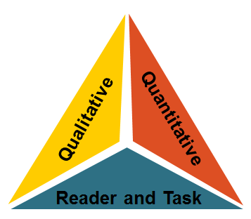
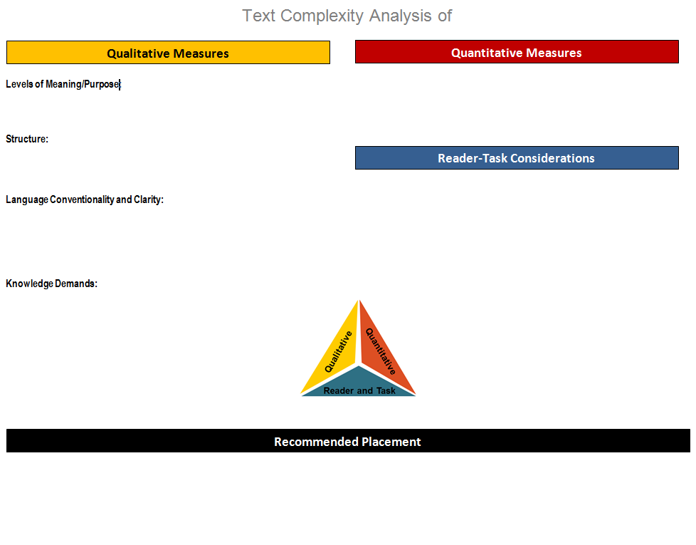
Additional Resource:
Recommended Placement Form
Template for Text Complexity Analysis and Recommended Placement Form:
http://www.ksde.org/Default.aspx?tabid=4778#TextRes
The one-page template provides an opportunity to record the thinking involved in recommending the placement of a specific text into a text complexity band.
Keeping a record of such analysis and thinking might be useful documentation in the case that any questions arise in the future.
Notes:
Optional Step and a resource
Once the recommended placement has been decided upon, educators might also find it useful to document some the thinking that led them to their conclusion.
Handouts: Share examples of placement at varying grade levels:
K-1: Engaging in group activity example
2-3: Otis and the Tornado
4-5: Coral Reefs
6-8: Extraordinary Mark Twain
7-12: Hunger Games
Refer to WEBSITE for ALL KINDS OF resources (also a blank template…)

Slide 28

Teaching with
Complex Texts

Slide 29




A Focus on “Close Reading”
“One of the key requirements of the Common Core State Standards for Reading is that all students… must be able to read and comprehend independently and proficiently the kinds of complex texts commonly found in college and careers.”
--CCSS Appendix A, pg. 2

Slide 30

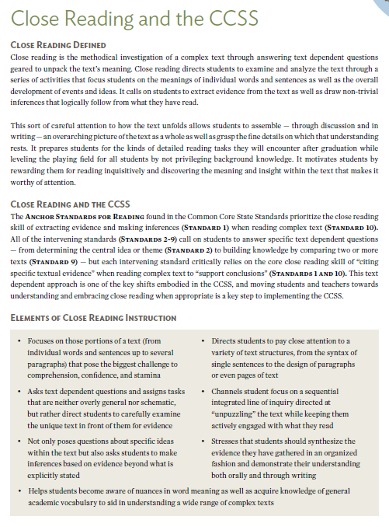
Why Depth through
“Close Reading” Matters
Close reading instruction:
Requires careful attention to how the text unfolds through asking text-dependent questions.
Focuses on building knowledge through the strategic use of text-dependent questions.
Can prepare students for the kinds of reading tasks they will encounter after graduation.
Despite its name, close reading has a lot more to do with writing than reading!
Notes:
HANDOUT: Read first two paragraphs of article
Go over slide and refer TLs to the article posted on our website for additional information: Close Reading and the CCSS

Slide 31

Close Reading
Dr. Douglas Fisher
Close Reading and the CCSS, Part 1
http://www.youtube.com/watch?v=5w9v6-zUg3Y&feature=relmfu
Notes:
2:30 min video and VIDEO VIEWING GUIDE HANDOUT LOCATED ON MY WEBSITE..
"Close reading is an instructional approach that requires readers to re-read a text several times and really develop a deep understanding of the content contained in the text. The purpose is to build the habits of readers as they engage with the complex texts and to build their stamina and skills for being able to do so independently. However, close reading doesn’t mean that you simply distribute a complex reading and then exhort them to read it again and again until they understand it. As part of a close reading, students "read with a pencil" and learn to annotate as they go. In addition, they are asked text-dependent questions that require that they produce evidence from the text as part of their responses. - Dr. Douglas Fisher

Slide 32
Close Reading
Dr. Douglas Fisher
Close Reading and the CCSS, Part 2
http://www.youtube.com/watch?NR=1&v=JhGI5zdjpvc&feature=endscreen
Notes:
Carole
2:37 min video

Slide 33

Use a short passage
“Read with a pencil”
Note what’s confusing
Pay attention to patterns
Give your students the chance to
struggle a bit
Creating a Close Reading
Notes:
Follow-up to video
Suggested process from Fisher and Frey

Slide 34

“Every book has a skeleton hidden between its covers. Your job as an analytic reader is to find it.”
Adler and Van Doren, 1940/1972

Slide 35
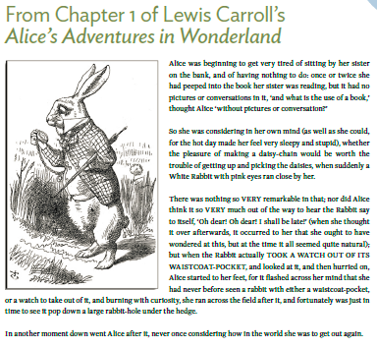
Close Reading of a Sample Text
Notes:
Carole
Read the AAIW excerpt using Close Reading strategies…

Slide 36

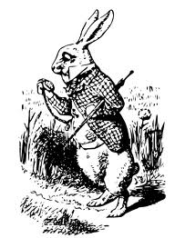
What did you do as a “Close Reader” when you read the excerpt from
?
Reflect on this question then explain it to someone at another table how you could teach this skill to your students.
Notes:
Carole
End at 11:00

Slide 37

Moves from literal to interpretive
Requires students to return to the text to formulate responses
Text-dependent Questioning

Slide 38

Why Ask Text Dependent Questions
80 to 90% of the ELA Reading Standards in each grade level require text dependent analysis
One of the first and most important steps to implementing the ELA Common Core Standards is to focus on identifying, evaluating, and creating text-dependent questions
Close/Deep Reading, the kind encouraged by the common core standards, asks students to “read like a detective”, looking closely for details to help students “write like a reporter” in one of the Three Modes of Writing.
Rather than asking students questions about their prior knowledge or experiences, the standards expect students to struggle with text-dependent questions
www.achievethecore.org/steal-these-tools/text-dependent-questions
Notes:
Connection to Writing!!!!!!!

Slide 39

80-90% of (CCSS) reading standards require text-dependent analysis yet over 30% of questions in major textbooks do not.
Sue Pimentel, Lead Author of Common Core State Standards for ELA/Literacy
Notes:
Carole

Slide 40
The Problem With
Classroom Texts
Existing questions in many reading programs were designed for a different set of standards.
Therefore, we must align our reading series with KCAS and create or modify existing questions when possible to text dependent questions.

Slide 41
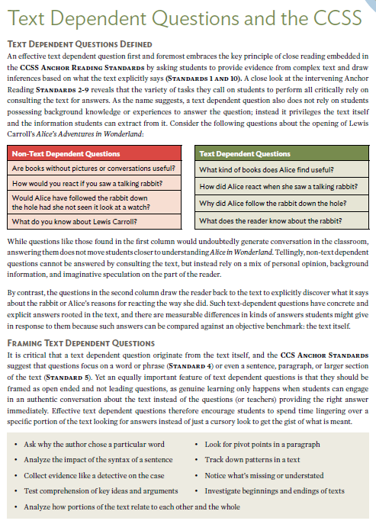
What are Text-Dependent Questions?
Text-dependent questions:
Draw the reader back to the text to discover what it says.
Have concrete and explicit answers rooted in the text.
Frame inquiries in ways that do not rely on a mix of personal opinion, background information, and imaginative speculation.
Notes:
Go over slide and refer TLs to the article posted on the website

Slide 42

Inferences
Probe each argument in persuasive text, each idea in informational text, each key detail in literary text, and observe how these build to a whole.
Notes:
Fisher and Frey sum up TDQs this way…

Slide 43

Consider this…
The teacher is usually the person who asks the questions during a discussion. In a longitudinal study of elementary and secondary school classes, Dillon (1990) found that each student asks only one question per month on average. Teachers must take deliberate steps to get their students to ask questions.
Notes:
Carole
Ask participants to guess how often students ask questions.

Slide 44

Additionally…
Teachers often pose a question to the whole class but then call on only a few hands…
Is the question you are asking one that you want the whole class to consider?
Yes? Then why call on volunteers to answer?
Pose the question to the whole class and indicate how you want students to answer:
  Think, Pair, Share
  Think , Write, Share
  Think, Write, Show
Notes:
If we ask students a question that everyone can and wants to answer:
“Have you ever felt scared before you face a challenge?” or
“Does anyone have a pet?” or
“What kind of advice would you give a friend in this situation?”
Why not let them all answer?

Slide 45
Differences in Depth:
Text versus Non-Text-Dependent Questions
Non-Text-Dependent Questions | Text-Dependent Questions
Are books without pictures or conversations useful? | What kind of books does Alice find useful?
How would you react if you saw a talking rabbit? | How did Alice react when she saw a talking rabbit?
Would Alice have followed the rabbit down the hole had she not seen it look at a watch? | Why did Alice follow the rabbit down the rabbit-hole?
What do you know about Lewis Carroll? | What does the reader know about the rabbit?
A Guide to Creating Text-Dependent Questions for Close Analytic Reading
Notes:
Carole
Let’s go back to Alice…
Selecting: there’s work to be done beyond identifying lexile scores and grade bands
Sorting: almost all schools are way out of balance with respect to literary and informational text
Share: the equity issues for Els are complex
AFTER REVIEWING QUESTIONS…
Refer TLs to “A Guide to Creating Text Dependent Questions for Close Analytic Reading” HANDOUT

Slide 46
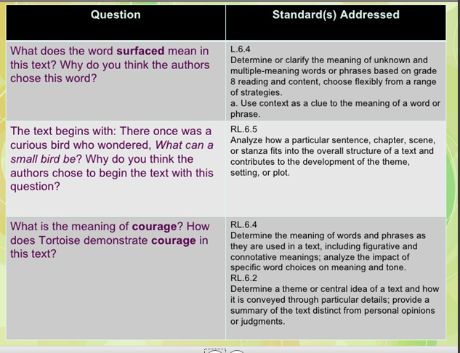

Slide 47

“Close Reading” of a Stand-Alone Text
Notes:
Carole
BATS AT THE BEACH HANDOUT

Slide 48

Activity
Read the opening of Brian Lies’ Bats at the Beach
With a partner write one Text-Dependent Question
Share your question with others at your table
Evaluate your TDQ based on the samples provided
Notes:
Carole
After TLs have written their TDQs and shared out, distribute the TDQ for BATB excerpt handout and have them evaluate their question based on the samples and discuss with your colleagues

Slide 49
Progression of
Text-dependent Questions
Opinions, Arguments,
Intertextual Connections
Inferences
Author’s Purpose
Vocab & Text Structure
Key Details
General Understandings
Whole
Across texts
Entire text
Segments
Paragraph
Sentence
Word
Part
Notes:
IRA Publication: Text Dependent Questions Article posted on the website that explains this graphic in detail. I will provide an overview of it today…
Types of Text-Dependent Questions:
there are a number of different topics for which text-dependent questions can be developed. There are questions that focus on parts of texts, and there are questions that focus on whole texts.
Have one thing in common: They require that readers have read and understood the text. Some TDQs will require that they return to the text and reread to find evidence.
Figure 1 also suggests something about the frequency of types of text dependent questions.
For example, general understanding and key detail questions occur more frequently than inferences and opinions.
This should not be seen as a rigid hierarchy or that the questions must be asked in this order.
However, it is essential to understand that different types of knowledge are utilized when deeply understanding a text.
Fisher and Frey provide this graphic and explanation of each type of question so that teachers can plan lessons that include TDQs.
General understandings.
Ensure that students grasp the overall view of the text. Often they are global questions, but questions that require that students demonstrate an understanding of what the author really said
Key details.
These TDQs require that readers pay attention to the details.
Vocabulary and text structure.
These TDQs focus on the specific words and phrases the author uses as well as the structure of the text. This requires that the reader bridge literal and inferential meanings,
Author’s purpose.
Although often not specifically stated, there is a purpose for each text.
Inferences.
Inferences are more than guesses or simply telling students to “read between the lines.” Readers should know how to probe each argument in persuasive text, each idea in informational text, each key detail in literary text, and observe how these build to a whole.
TDQs should allow students to consider the information that is provided and then make informed extrapolations from the information provided.
Opinions, arguments, and intertextual connections.
The final category of TDQs are often the questions that teachers like to ask because these questions tend to generate a lot of discussion and personal connections. When they follow a discussion built on text dependent questions, they work well for this purpose.
If they are used in place of text-dependent questions, the risk is that students will answer and not need to read the text.
As such, teachers can unintentionally telegraph a message to students suggesting that reading and understanding are not necessary. When these questions are used, they can analyze claims, evidence, and counterclaims.

Slide 50
Inferences
Probe each argument in persuasive text, each idea in informational text, each key detail in literary text, and observe how these build to a whole.

Slide 51

Focus on Instruction – Close Reading and Text-Dependent Questions
Attributes of Close Reading lessons:
Selection of a (brief), high quality, complex text
Individual reading of the text
Rereading the text
Text-based questions and discussion that focus on discrete elements of the text
Discussion among students
Writing about the text

Slide 52


Excerpt (1963)
By Martin Luther King, Jr.
Close Reading Activity
Notes:
Modeling and Guided Practice
HANDOUTS:
I Have A Dream Text
Close Reading Graphic Organizer
Read the text and complete GO
Stress CR is NOT something you do with students every time they read!

Slide 53
Answering the Dilemma of Increasing Writing Scores!
Close Reading
Text Dependent Questions
Congruent Assessments
Text Complexity:
Regular practice with complex text and its academic language.
Close Reading:
Despite its name, close reading has a lot more to do with writing than reading!
Why is it important?
“Close reading” is an essential college skill, regardless of a writer’s discipline.
Text-dependent questions:
Draw the reader back to the text to discover what it says.
Teachers frame questions in ways that do not rely on a mix of personal opinion, background information, and imaginative speculation.

Slide 54

Text-Dependent Questions
Write your own Text-Dependent Question for a familiar piece of text.

Slide 55

Notes:
When we return from break we are going to continue with the 3 Modes of Writing

