Slide 1

Domain 3: Instruction
Component 3C
Engaging Students in Learning
KVEC ELA Teacher Leader Network
Breakout Session
March13
Stacy Noah, Effectiveness Coach
Kentucky Department of Education
Abbie Combs, KVEC Director of Innovations

Slide 2

Today’s Targets
I can recognize aspects of the Teacher Professional Growth and Effectiveness System.
I can apply the Framework for Teaching to identify and support effective teaching practices. (3C: Student Engagement)

Slide 3
“…teacher quality matters – and… it matters a great deal. If we are committed to this premise, then we must be committed to populating our schools with the highest quality teachers possible.”
Stronge, Gareis, & Little (2006)

Slide 4
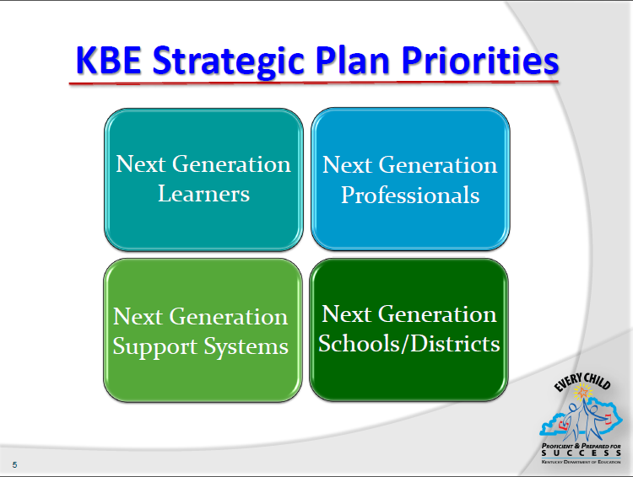
Notes:
In 2010, the commissioner outlined the KBE strategic plan for Kentucky schools.
The Strategic Plan is organized by Strategic Priorities, Objectives and Goals--goals are defined by a unique Delivery Plan, which will include various projects, or strategies.
The Five Strategic Priorities Are:
· Next-Generation Learners
· Next-Generation Professionals
· Next-Generation Schools and Districts
· Next-Generation Support Systems
We will briefly address each of these priorities.

Slide 5
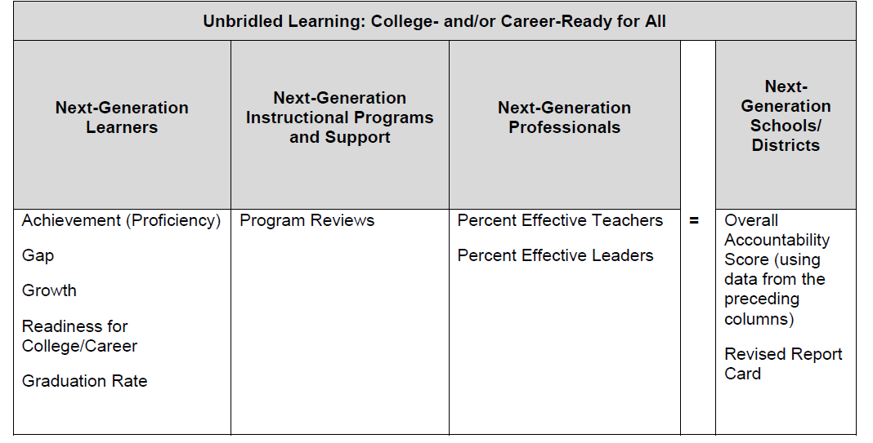
KY Accountability System
Notes:
You may be familiar with this format for the accountability system. Under each area, you see the components that make up that accountability area.

Slide 6

Notes:
Briefly share the objectives – read or paraphrase these.
This is KDE’s VISION for today’s teachers.

Slide 7
Teacher Professional Growth & Effectiveness System
TPGES

Slide 8
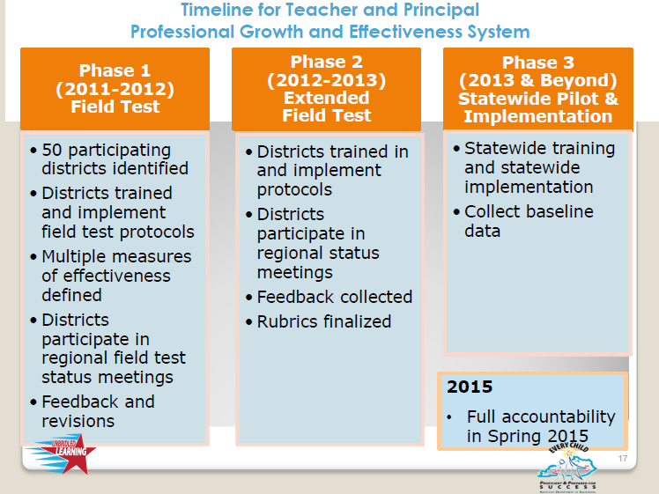

Slide 9
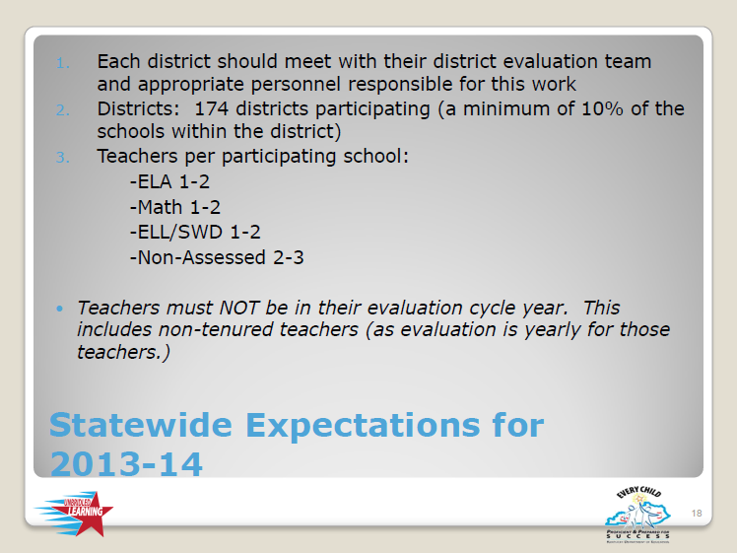

Slide 10
Without Teachers, the Classroom is Just a Room
What do teachers need?
Connections to TPGES?
Notes:
As you watch the short video, think about what teachers need to be successful? What do teachers need to support student success? How do these attributes connect to the new TPGES?

Slide 11
Without Teachers, the Classroom is Just a Room
Better Feedback on Performance
Tailored Professional Development
Opportunities to become LEADERS
Teacher Collaboration
Teacher as Expert
Notes:
*Better Feedback: Same language is used, common understanding of expectations, teachers and principals work collaboratively- teachers take the lead in the pre and post observation conference.
*PD: use of PD 360, PD Reflection Instrument allows teachers to analyze individually and collaboratively come up with a plan of professional learning. Unique and specific.
*PEER Observer role encourages teachers to take leadership roles in the school. Professional repsonisbility portion of evaluation encourages leadership roles for teachers.
*Teacher Collaboration: between peer observer, creation of assessments for student growth goals
*Teacher Expert: teacher is viewed as expert in knowing what he/she needs for improvement. Collegial conversations and collaboration support teacher knowledge base of need.

Slide 12
Professional Growth
Student Voice
Peer Observation
Student Growth
Reflective Practice
Observation
Domain 1: Planning & Preparation
Domain 2: Classroom Environment
Domain 3: Instruction
Domain 4: Professional Responsibilities
Domain 5: Student Growth
Notes:
Reminder that the circles represent the multiple measures of the PGES. The data from these multiple measures is amalgamated and filtered through the domains of the Kentucky Framework For Teaching (an adaptation of the original research-based work of Charlotte Danielson). Those domains are: Planning & Preparation, Classroom Environment, Instruction, Professional Responsibilities, and Student Growth.
The Framework provides common language for teachers and principals to use when working toward effective teaching.
The measures provide supports for effective teaching.

Slide 13

What is good teaching?
Notes:
So… what is good teaching? Optionally, you can share Charlotte’s story: I’m reminded of the story of a young teacher who was doing a science unit on buoyancy and density. To have them engage in the learning she had the students push their desks together in groups of four. Each group had a pan of water in the middle of the table, and they were using clay to construct clay boats. Their goal was to construct the boat that could carry the most cargo (in the form of paper clips) before it would sink. So, the students were all up on the knees and leaning in and having conversations about the (what I call “butts up learning”) the principal comes to the door-looks in and says, “I’ll come back when you’re teaching.” Clearly this principal and this teacher didn’t even agree on what teaching was let alone what good teaching was---and that teacher, by the way, was Charlotte Danielson, whose Framework for Teaching we are here to discuss today.

Slide 14

Framework Video
Qualities & Characteristics of The Framework:
How do you think it will help you improve your teaching practice to receive feedback that is tied to a framework?
Notes:
As you watch, take notes on the qualities and characteristics of the framework discussed. What is it? Why use it?

Slide 15

Charlotte Danielson Video
Notes:
After viewing the video, invite the participants to answer the question, “In this classroom, what did you see or hear (from the students as well as the teacher) that would cause you to think you were in the presence of an expert. First reflecting by themselves, writing one idea per post-it and then as a table group. Share out with whole gropu.

Slide 16
Framework Video
Qualities & Characteristics of The Framework:
How do you think it will help you improve your teaching practice to receive feedback that is tied to a framework?
Notes:
As you watch, take notes on the qualities and characteristics of the framework discussed. What is it? Why use it?

Slide 17
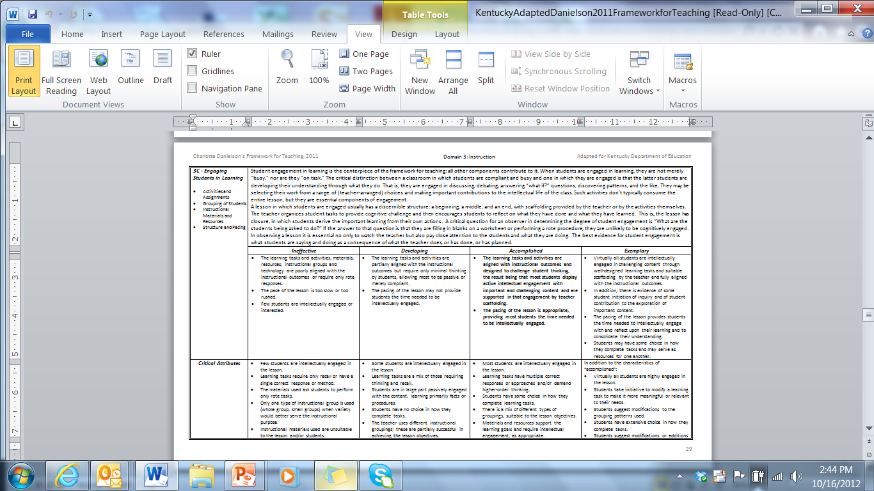
Zeroing in on 3C
Page 29
Notes:
Ask participants to refer to page 29 of the Framework in your materials (or a copy of that page provided in their ISLN packet). Student engagement in learning is the centerpiece for effective instruction. All other components contribute to it.
Component 3C - Engaging students in learning - is one way to identify effective practice.

Slide 18

Engaging Students in Learning
Domain Instruction
Component:3C
Notes:
Student engagement in learning is the centerpiece of the framework for teaching; all other components contribute to it. Improving student engagement requires that teachers actively seek to create the conditions that foster student engagement in the classroom. Betsy Layne’s Staff has taken the first step to whole-school improvement in the area of student engagement. Let’s take a few minutes to discuss in table groups. Please share your current definition of student engagement and discuss why you think student engagement is vital to the learning process.

Slide 19

What Does Research Say?
Engagement has been shown to decline as students progress through the upper elementary grades and middle school, reaching its lowest levels in high school
(Marks 2000; National Research Council
and Institute of Medicine 2004).
Notes:
Not surprisingly, increasing student engagement has been an explicit goal of many school and district improvement efforts, especially at the secondary level (National Research Council and Institute of Medicine 2004).

Slide 20

This decline can be even
more dramatic as students move through feeder patterns of low-performing, high-poverty schools
(Yazzie-Mintz 2007).

Slide 21

Some studies estimate that by high school as many as 40–60 percent of youth are disengaged (Marks 2000).
Notes:
Share at your tables what this means in light of recent test release data.

Slide 22

What is Student Engagement?
True student engagement is when students are intellectually active in learning important and challenging content.
Not Compliant
Not simply busy
Students are developing and understanding through what they do.
Notes:
The critical distinction between a classroom in which students are compliant and busy and one in which they are engaged is that in the latter students are developing their understanding through what they do. Such activities don't typically consume an entire lesson, but they are essential components of engagement.

Slide 23

Elements of Student Engagement
Student engagement may be broken down into four distinct and important elements. As we review these elements, think about what they might look like in practice in the classroom
Activities and Assignments
Grouping of Students
Instructional Materials and Resources
Structure and Pacing
Notes:
As you discovered from your table conversations, we don’t all have the same definition of student engagement. An important characteristic of the work of Charlotte Danielson is that components of teaching are broken down into elements. Student engagement is broken down into 4 elements. It is critical that teachers and supervisors know and understand how each element contributes to student engagement.

Slide 24

Activities and Assignments
Activities and assignments that promote learning are those that require student thinking, that emphasize depth over breadth, and that may allow students to exercise some choice.
Notes:
The activities and assignments are the centerpiece of student engagement, since they determine what it is that students are asked to do.

Slide 25

Grouping of Students
students of similar background and skill may be clustered together
the more advanced students may be spread around into the different groups.
a teacher might permit students to select their own groups, or
they could be formed randomly
Notes:
How students are grouped for instruction is one of the many decisions teachers make every day. There are many options; Whatever the arrangement, skilled teachers decide it purposefully.

Slide 26

Instructional Materials and Resources
While some teachers are obliged to use a school or district's officially sanctioned materials, many teachers use these selectively or supplement them with others of their choosing that are better suited to engaging students in deep learning; for example, the use of primary source materials in social studies.
Notes:
The instructional materials a teacher selects to use in the classroom can have an enormous impact on student experience.

Slide 27

Structure and Pacing
Keeping things moving, within a well-defined structure, is one of the marks of an experienced teacher. And since much of student learning results from their reflection on what they have done, a well-designed lesson includes time for reflection and closure.
Notes:
Neither adults nor students like to be either bored or rushed in completing a task.

Slide 28

How Might it Look?
Students engaged in discussion or debate
Students answering "what if?" questions
Student discovering patterns,
Students may be selecting their work from a range of (teacher arranged) choices, and making important contributions to the intellectual life of the class
Notes:
You have now examined the 4 Elements of Student Engagement. Let’s take a minute to translate how this might look in the in the classroom. The critical distinction between a classroom in which students are compliant and busy and one in which they are engaged is that the latter students are developing their understanding through what they do. That is, they are engaged in discussing, debating, answering “what if?” questions, discovering patterns, and the like. They may be selecting their work from a range of (teacher-arranged) choices and making important contributions to the intellectual life of the class. Such activities don’t typically consume the entire lesson, but they are essential components of engagement.

Slide 29

What Does the Lesson Look Like?
A lesson in which students are engaged usually has a discernible structure: a beginning, a middle, and an end, with scaffolding provided by the teacher or by the activities themselves
Notes:
In the beginning the teacher organizes student tasks to provide cognitive challenge and then encourages students to reflect on what they have done and what they have learned. Students engage in the activity or lesson and then lesson has closure, in which students derive the important learning from their own actions. A critical question for an observer in determining the degree of student engagement is “What are the students being asked to do?” If the answer to that question is that they are filling in blanks on a worksheet or performing a rote procedure, they are unlikely to be cognitively engaged.
In observing a lesson it is essential no only to watch the teacher but also pay close attention to the students and what they are doing.

Slide 30

Are They Really Engaged?
When determining
the student engagement in a lesson it is essential not only to watch the teacher, but also to pay close attention to the students and what they are doing

Slide 31

Student Engagement?
The best evidence for student engagement is what students are saying and doing as a consequence of what the teacher does, or has done, or has planned.

Slide 32
Indicators of Student Involvement
Activities aligned with the goals of the lesson
Student enthusiasm, interest, thinking, problem-solving, etc.
Learning tasks that require high-level student thinking and are aligned with lesson objectives
Students are highly motivated to work on all tasks and are persistent even when the tasks are challenging
Students actively "working," rather than watching while the teacher "works"
Suitable pacing of the lesson: neither dragging nor rushed, with time for closure and student reflection
Notes:
Determining a level of performance for a component must be grounded in evidence found during an observation of a lesson. The indicators below may be used as a guide for looking for evidence of this component in a classroom. (We discuss specific examples of evidence when we talk about the levels of performance for this component.)

Slide 33

Critical Attributes
Most students are intellectually engaged in the lesson.
Learning tasks have multiple correct responses or approaches and/or demand higher-order thinking.
Students have some choice in how they complete learning tasks.
There is a mix of different types of groupings, suitable to the lesson objectives.
Materials and resources support the learning goals and require intellectual engagement, as appropriate.
The pacing of the lesson provides students the time needed to be intellectually engaged.
Notes:
Possible Examples:
Students are asked to formulate a hypothesis about what might happen if the American voting system allowed for the direct election of presidents.
Students are given a task to do independently, then to discuss with a table group, and then to report out from each table.
There is a clear beginning, middle and end to the lesson.
The lesson neither rushes or drags.

Slide 34

Engaging Students in Learning
What is Accomplished?
1. Read the 3C component description and rubric.
2. Highlight the “look fors” for this component.
3. Discuss with your table group.
Notes:
Look at your Framework page for 3b. Read directions on the slide.

Slide 35
Accomplished
The learning tasks and activities are aligned with the instructional outcomes and are designed to challenge student thinking, resulting in active intellectual engagement by most students with important and challenging content, and with teacher scaffolding to support that engagement. The lesson has a clearly defined structure and the pacing of the lesson is appropriate, providing most students the time needed to be intellectually engaged
Notes:
Review what has been highlighted in the slide (no right /Wrong answers.

Slide 36
Exemplary
Virtually all students are intellectually engaged in challenging content, through well-designed learning tasks and suitable scaffolding by the teacher. Learning tasks and activities are fully aligned with the instructional outcomes. In addition, there is evidence of some student initiation of inquiry and student contributions to the exploration of important content. The lesson has a clearly defined structure, and the pacing of the lesson provides students the time needed to intellectually engage with and reflect upon their learning, and to consolidate their understanding. Students may have some choice in how they complete tasks and may serve as resources for one another.

Slide 37
Developing
The learning tasks and activities are partially aligned with the instructional outcomes but require only minimal thinking by students, allowing most students to be passive or merely compliant. The lesson has a recognizable structure; however, the pacing of the lesson may not provide students the time needed to be intellectually engaged.

Slide 38
Ineffective
The learning tasks and activities, materials, resources, instructional groups, and technology are poorly aligned with the instructional outcomes, or require only rote responses. The lesson has no clearly defined structure, or the pace of the lesson is too slow or rushed. Few students are intellectually engaged or interested.

Slide 39
Zeroing in on 3C
Page 29
Performance Level Indicators
Notes:
Refer to page 29 of the Framework again.
Look at the performance levels and indicators.
What did you highlight here the most critical language in each set of indicators. What are the “look fors”?

Slide 40
Accomplished | Exemplary
The learning tasks and activities are aligned with instructional outcomes and designed to challenge student thinking, the result being that most students display active intellectual engagement with important and challenging content and are supported in that engagement by teacher scaffolding. The pacing of the lesson is appropriate, providing most students the time needed to be intellectually engaged. | Virtually all students are intellectually engaged in challenging content through well-designed learning tasks and suitable scaffolding by the teacher and fully aligned with the instructional outcomes. In addition, there is evidence of some student initiation of inquiry and of student contribution to the exploration of important content. The pacing of the lesson provides students the time needed to intellectually engage with and reflect upon their learning and to consolidate their understanding. Students may have some choice in how they complete tasks and may serve as resources for one another.
Notes:
Notice what moves engagement to exemplary is the level of student ownership and student initiation. Teacher practice fosters this level of engagement that allows students to take responsibility for their own learning.

Slide 41

Framework for Teaching
3C: Engaging Students in Learning
ACTIVITY
Notes:
As the Field Test Districts and Integration Sites have had the opportunity to see the Framework in action, all of you will now have an opprot

Slide 42
DIRECTIONS: At your table, determine the appropriate level for the four scenarios. As a table, come to consensus with your answer and be prepared to share.
Use the provided paper to share your answer.
ORANGE: Level 1: Ineffective
YELLOW: Level 2: Developing
GREEN: Level 3: Accomplished
PINK: Level 4: Exemplary
Notes:
Orange- level 1, ineffective
Yellow- level 2, developing
Green- level 3, accomplished
Pink- level 4, exemplary

Slide 43
Level 3: Accomplished
Critical Attribute: Learning tasks have multiple correct responses or approaches and/or demand higher-order thinking. The lesson asks students to choose a character in Hamlet, and describe him or her in their own way. Students are asked to share their answers out to the class, which reinforces the notion that there are multiple approaches to this learning task. There is some choice in how students answer these questions, but there is no evidence that students initiated the inquiry, which would be required for a level of performance 4.
Critical Attribute: The pacing of the lesson provides students the time needed to be intellectually engaged. Students only have a limited amount of time to work alone on the task. However, they have additional time to share their answers with one another before they are brought back together as a class. This staggered pacing provides students the time needed to be intellectually engaged.

Slide 44
2. Level 2: Developing
Critical Attribute: Student engagement with the content is largely passive, learning primarily facts or procedures. Students are asked merely to copy board problems into their notebooks and perform rote multiplication in order to solve them. This activity does not intellectually engage most students in a rigorous way or demand higher-order thinking- all critical attributes of a level of performance 3.
Critical Attribute: The pacing of the lesson is uneven; it is suitable in parts, but rushed or dragging in others. The pacing is suitable for most students during the first part of the lesson; however, the lesson builds in too much time to solve the assigned problems and there are no follow-up activities for students who finish early. As a result, many students just sit around waiting. The lesson is a level of performance 2 and not 1 because the lesson has a recognizable structure.

Slide 45
3. Level 4: Exemplary
Critical Attribute: Virtually all students are highly engaged in the lesson. The observation notes indicate that all students are on task when completing their learning assignment.
Critical Attribute: Students have extensive choice in how they complete tasks. Students have extensive choice in what tasks are completed and how; this is indicative of a level of performance 4 and not 3. Through the ability to choose their task, students are more motivated to engage deeply with the material.
Critical Attribute: Students have an opportunity for reflection and closure on the lesson to consolidate their understanding. Students are able to reflect on the lesson by hearing one student group present their findings to the whole class.

Slide 46
4. Level 1: Ineffective
Critical Attribute: Few students are intellectually engaged in the lesson. These observation notes indicate a lack of engagement. Most students do not understand why they are completing the assignment and cannot or do not want to contribute to a class discussion about the activity.
Critical Attribute: The materials used ask students only to perform rote tasks. The lesson requires students to merely fill in a worksheet by looking at the overhead. They are not asked to do anything with the material or use any higher-order thinking skills. If the lesson incorporated a mix of learning tasks, it would have been indicative of a level of performance 2 and not 1.
Critical Attribute: The lesson drags or is rushed. Students seem to be given too much time to complete the rote task. Most are able to finish it with time to spare and do not have an additional assignment to work on.

Slide 47
Video Activity
Refer to your rubric as we view two short videos that depict accomplished and ineffective strategies for engaging students in learning.
Be prepared to discuss the key descriptors from each Video.

Slide 48

Session Reflection
An insight I had as a result of today’s session is….
Concepts from this session that are most applicable to my teaching practice are…
A question I have related to today’s session is…

Slide 49
Questions & Comments
stacy.noah@education.ky.gov
abbie.combs@hazard.kyschools.us

