Slide 1
WORLD LANGUAGE/ GLOBAL COMPETENCY QFT
“Water, Water everywhere”

Slide 2
Question formulation technique
Rules for QFT:
Ask as many questions as you possibly can.
Do NOT stop to judge, answer, or discuss a question.
Write it down exactly as it is stated.
Change any statements into questions.

Slide 3
Reflecting on the rules
Which rule will be the hardest for you to follow?
Why?
How will you address this problem now, during the QFT?

Slide 4
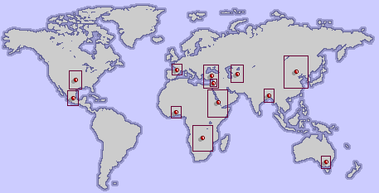
Worldwide, 1 out of every 5 deaths of children under 5
is due to a water-related disease.

Slide 5
Worldwide, 1 out of every 5 deaths of children under 5
is due to a water-related disease.
Developing questions – 4 min.
With the Qfocus in mind – AND THE RULES FOR QFT –
Create questions as a group.
The Recorder will write the questions on your group’s sheet.

Slide 6
categorizing your questions
Definitions:
Closed-ended questions can be answered with a “yes” or “no” or with a one-word answer.
Open-ended questions require more explanation.
Directions: Identify your questions as closed-ended or open-ended by marking them with a “C” or an “O”.

Slide 7
Improving your questions
Take one closed-ended question and change it into an open-ended question.
Take one open-ended question and change it into a closed-ended question.

Slide 8
Prioritizing your questions
Review your list of questions
Choose the three questions that need to be addressed in dealing with the World Water Crisis.
After prioritizing, reflect on these questions:
Why did you choose those three questions?
Where are your priority questions in the sequence of your entire list of questions?

Slide 9
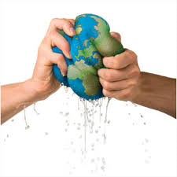
Sharing your questions
With another group, share:
Your priority questions
The two questions you changed/improved
Your group reflection
Now, plan together:
How could you use this Qfocus in your classroom?

Slide 10
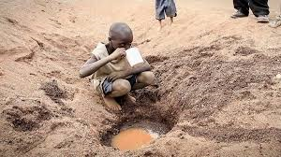
Individual reflection
What did you learn today?
How did asking your own questions affect your learning?
What do you understand differently about allowing your students to direct the learning in your classroom?

