Slide 1

English/Language Arts
Common Core Standards
Learning Targets:
How different are the Common Core Eng/LA standards compared to the current Program of Studies?
What should teachers be doing right now with the standards?
How should I support them?
Notes:
1. In terms of content and instructional implications
2. Making Meaning, Comparing Old to New in terms of grades/courses is a great place to begin
3. Begin with an “introduction” to the organization, etc. and then build in time for identifying “gaps”, time for horizontal and vertical
review of the new standards and MAKE SURE sure that Science and SS teachers are participating in all the ELA Standards work, too!
Wouldn’t it be great if we had a Staples “Easy Button” to get us through our work in assisting schools…
The goal for today is that the information you receive will help you to answer the questions and leave here with the beginning or at least some thoughts of a plan to address the needs of the educators you are working with…
WHY NOW?
Along with the National Governors Association Center for Best Practices (NGA Center) in partnership with Achieve, Inc., ACT, and the College Board initiated a state-led process of developing and adopting a common core of state standards, the Common Core State Standards Initiative.
Focused on critical demands of the global economy
Fewer, but more rigorous
Easily communicated to stakeholders
Based on research
Considered international benchmarks
Aligned from kindergarten through college entrance:
Intended to be a living work: as new and better evidence emerges the standards will be revised accordingly
The Standards ARE JUST THE BEGINNING! knowledge of CASL, CHETL and the Deconstruction Process are the only ways to arrive at our destination of high level student learning.

Slide 2
The Key Design
  College and Career Readiness (CCR) Standards
    Overarching standards for each strand that are further defined by grade-specific standards
  Grade-Level Standards in English Language Arts
    K-8, grade-by-grade
    9-10 and 11-12 grade bands for high school
    Four strands: Reading, Writing, Speaking and Listening, and Language
  Standards for Literacy in History/Social Studies, Science, and Technical Subjects
    Standards are embedded at grades K-5
    Content-specific literacy standards are provided for grades 6-8, 9-10, and 11-12
Notes:
Handout PG. 1 (Page 41 of Standards):
CCR are know as ANCHOR STANDARDS. They define general, cross disciplinary literacy expectations for college/career readiness
Handout PGS. 2-3 (Pages 42 and 45 of Standards):
Grade-Level Stds – K-8 provide useful specificity; 9-10/11-12 bands allow flexibility in high school course design
Strands: 4 processes of communication are closely related and reflected throughout the document
Stds. insist that literacy instruction be a shared responsibility within the school.
Emphasis on informational and persuasive text
BACK-MAPPED

Slide 3
College and Career Readiness Standards
English Language Arts
Literacy in History/Social Studies, Science, and Technical Subjects
Reading (20)
1)Informational (10)
2)Literary (10)
Writing (10)
Speaking & Listening (6)
Language (6)
Reading (10)
Writing (10)
Notes:
Visual Chart of the key design…
Sally Hampton Chair, ELA College and Career Readiness Standards Work Group and Member, ELA K-12 Common Core Standards Committee stated “ most states have 120 standards in ELA. The CC has 42…”
Fewer and Broader… This means that teachers must design more rigorous tasks to help students achieve learning at a higher level… This is where CASL, Deconstruction and CHETL become the important pieces of the standards. By themselves, the standards WILL NOT improve student learning!!!
The overarching skill emphasized in the ELA standards is COMPREHENSION at its highest level: ANALYSIS, CLASSIFICATION, ABILITY TO COMPARE/CONTRAST, SYNTHESIZE
Reading has 20 standards that are sub-divided into informational and literary text and each has10 standards (each connects back to its corresponding CCR
anchor)
10 standards for writing
6 Standards for Speaking and Listening
6 Standards for Language
Content Specific Literacy standards include 10 standards for reading and 10 for writing:

Slide 4
Standards do … | Standards do not …
Establish what students need to learn. | Dictate how teachers should teach. Instead, schools and teachers will decide how best to help students reach the standards.
Attempt to focus on what is most essential. | Describe all that can or should be taught. A great deal is left to the discretion of teachers and curriculum developers.
Set grade-level standards. | Define the intervention methods or materials necessary to support students who are below or above grade-level expectations.
Notes:
Everyone would like the standards to be a “magic wand” and solve our problems, but that is a Fantasy
You won’t see strategies or instructional advice. BUT— HIGHLY EFFECTIVE TEACHING AND LEARNING will guide teachers. Along with CHETL, the establishment of learning targets are beneficial in understanding if our students have met the standards.
The standards do not describe all that can or should be taught (only what is essential is included). A well-developed, content-rich curriculum must be developed by individual schools/districts/states…
G/T or Advanced Work: Advanced work in such areas as literature, composition, language, and journalism should be made available to students
Interventions: No grade-specific standard can fully reflect the great variety in abilities, but GREAT teachers and teaching can identify them and address their needs. Maybe mention RtI, CSIP, etc…

Slide 5
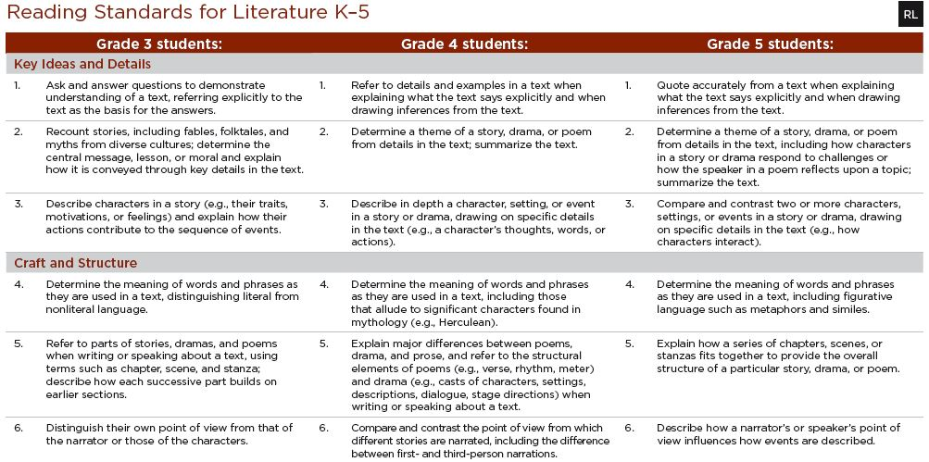
Standards Format
Standards format highlights progression of standards across grades
Notes:
Use HANDOUT PG. 4 that is same as the slide to conduct short walkthrough of progression across grade levels of one of the standards
Anchor Standard CCR Reading Standard 3: (remind about “number connections” to CCR Anchor Standard)
ELA Standards define what students should understand and be able to do by the end of each grade.
They correspond to the College and Career Readiness (CCR) anchor standards by number.
The CCR and grade-specific standards are necessary complements—the former providing broad standards, the latter providing additional specificity—that
together define the skills and understandings that all students must demonstrate.
CC Standards go in-depth earlier… CHETL, CASL (formative and summative assessment) are the guidance teachers need…

Slide 6
Example: W.CCR.6: Use technology, including the Internet, to produce and publish writing and to interact and collaborate with others.
W.K.6 | With guidance and support from adults, explore a variety of digital tools to produce and publish writing, including collaboration with peers.
W.2.6 | With guidance and support from adults, use a variety of digital tools to produce and publish writing, including in collaboration with peers.
W.4.6 | With some guidance and support from adults, use technology, including the Internet, to produce and publish writing as well as to interact and collaborate with others; demonstrate sufficient command of keyboarding skills to type a minimum of one page in a single sitting.
W.6.6 | Use technology, including the Internet, to produce and publish writing as well as to interact and collaborate with others; demonstrate sufficient command of keyboarding skills to type a minimum of three pages in a single sitting.
W.8.6 | Use technology, including the Internet, to produce and publish writing and present the relationships between information and ideas efficiently as well as to interact and collaborate with others.
W.9-10.6 | Use technology, including the internet, to produce, publish, and update individual or shared writing products, taking advantage of technology’s capacity to link to other information and to display information flexibly and dynamically.
W.11-12.6 | Use technology, including the Internet, to produce, publish, and update individual or shared writing products in response to ongoing feedback, including new arguments or information.
With no support
Notes:
Example from the writing strand of how the CCR Anchor Standards are reflected across the grade level standards. REFER TO HANDOUT PG. 5
Top: CCR standard 6 for writing. It is coded as W.CCR.6 to show that it is a writing standard, from the CCR anchor section, and it is standard #6.
From that information we know that writing standard #6 from all grade levels and writing in the content areas and technical subjects will hook back to or progress toward proficiency in this CCR anchor standard.
Next line coded W.K.6, for writing, kindergarten, standard 6, you will see how it corresponds to the content in the CCR writing standard it supports.
Students use guidance and support from adults to explore digital tools to produce and publish writing.
Writing, grade 2, standard 6: students use guidance and support from adults to use a variety of digital tools to produce and publish writing…slight change in standard from Kindergarten to 2nd
Writing, grade 4 standard 6: student will use some guidance and support to use technology to demonstrate sufficient command of keyboarding skills to type a minimum of one page…
Writing, grade 6, standard 6: guidance and support for the students has been removed in this standard. “Quantum Leap” from 4th grade… The students are expected to have the skills necessary to use the technology independently as needed. Three pages
Writing, grade 8 standard 6: the focus has changed from using the technology to produce and publish to ensuring the relationships between the information and ideas are presented efficiently.
Writing, grade spans 9-10, standard 6: In this grade span, students are now expected to take advantage of the technology's capacity to other information and to display information flexibly and dynamically
Writing, grade spans 11-12, standard 6: revise individual or shared writing products in response to ongoing feedback
Refer back to top CCR: using technology to produce and publish writing and to interact and collaborate with others

Slide 7
Eng/LA vs Content
CCR Reading Standard 3: Analyze how and why individuals, events, and ideas develop and interact over the course of a text.
Reading Standards for Literature |  | Reading Standards for Informational Text
Grade 3: Describe characters in a story (e.g., their traits, motivations, or feelings) and explain how their actions contribute to the sequence of events. |  | Grade 3: Describe the relationships between a series of historical events, scientific ideas of concepts, or steps in technical procedures in a text, using language that pertains to time, sequence, and cause/effect.
Grade 7: Analyze how particular elements of a story or drama interact (e.g., how setting shapes the characters or plot) |  | Grade 7: Analyze the interactions between individuals, events, and ideas in a text (e.g., how ideas influence individuals or events, or how individuals influence ideas or events).
Grades 11-12: Evaluate various explanations for characters’ actions or for events and determine which explanation best accords with textual evidence, acknowledging where the text leaves matters uncertain. |  | Grades 11-12: Analyze a complex set of ideas or sequence of events and explain how specific individuals, ideas, or events interact and develop over the course of the text.
Notes:
This slide focuses on progression, but use it to emphasize the DIFFERENCES IN LITERATURE AND INFORMATIONAL TEXT.
Content teachers need the “clarification” (especially H.S. level) of how the standards define reading skills within their subject area.
Another important aspect is that ALL teachers should emphasize to their students that the SKILLS PROCESS of a standard are the same (i.e. describe, analyze, etc). It is the context, subject or topic that will be different!

Slide 8
Overview of Reading Standards in History/Soc. Stu., Sci. & Tech. Subjs.
Grades 6-12
  Key Ideas and Detail: Cite specific textual evidence related to the content area
  Craft and Structure: Analyze, evaluate, and differentiate primary and secondary sources in content specific language
  Integration of Knowledge and Ideas: Integrate/synthesize information into a coherent understanding of an idea, event, graphical terms, etc.
Notes:
Handouts #7 and #8 (Pg. 61-62 of Standards)
Reminder: Only 10 standards for Reading and 10 for Writing
History/Soc. Stud.: Note terminology of Cite, primary/secondary, Analyze, Evaluate, Differentiate, Integrate --- DEPTH AND RIGOR implications for both teaching and learning.
Science/Tech.Subj.: Note terminology of Cite, Analyze, Synthesize, Translating --- DEPTH AND RIGOR implications for both teaching and learning.
Just becoming familiar with the standards will not get students to proficiency. In Kentucky we will use CHETL, CASL and Deconstruction to…

Slide 9



Appendices
Appendix C:
Annotated Writing Samples at Various Grade Levels
Appendix A:
Supplementary Materials and Glossary
Appendix B:
Text Exemplars and Sample Performance Tasks
Notes:
3 Appendices:
A: Supplementary materials and a glossary (43 pages)
B: Text exemplars illustrating complexity. text complexity is measured by 3 factors (DON’T KNOW IF I WILL GO INTO ALL THIS ABOUT APPENDIX B , BUT I WILL HAVE IT IF NEEDED)
qualitative evaluation (levels of meaning, structure, language conventionality, and clarity, and knowledge demands)
quantitative evaluation (readability, and other scores of text complexity), and matching reader to text and task (reader variables such as motivation, knowledge and experience, and task variables such as purpose and complexity generated by task assigned or question posed)
quality and range of reading for grade levels (includes text types for K-5 and 6-12 bands in these broad categories: stories, dramas, poetry and literary nonfiction/(historical, scientific and technical texts for K-5 only)
Accompanying Sample Performance Tasks (183 pages)
C: Annotated samples demonstrating at least adequate performance in writing at various grade levels (106 pages)

Slide 10

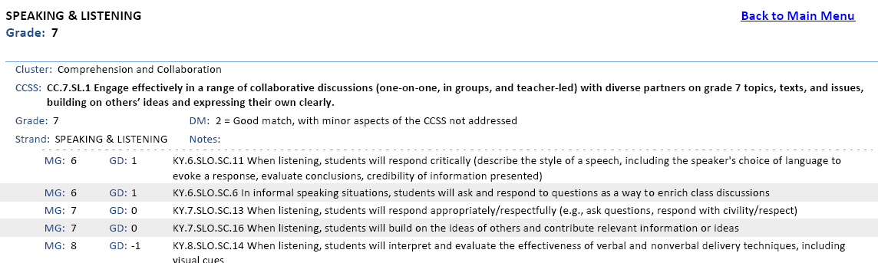
Kentucky Department of Education
ENGLISH LANGUAGE ARTS CROSSWALK
Notes:
Intent is to help in understanding of how the new Common Core Standards in ELA compares with current expectations for students AND to inform thinking about the implementation of Kentucky Core Academic Standards
Crosswalk Handout (Page 264) and Basic Explanations Handout: Provide explanation for crosswalk document using example on the screen and the handout.
Activity: Have participants analyze the other 2 standards on the crosswalk handout using the explanations handout. Ask them to discuss any implications for curriculum alignment and or effective teaching/learning characteristics
Understanding the organization of this document and how to use it will help teachers organize and align current curriculum. It will allow them to identify “gaps” in the two standards and start planning/addressing standards before school is out…

Slide 11
Accessing and Using the
Bookmarked Crosswalk
Visit the KDE website: www.education.ky.gov
KDE Quick Links: Program of Studies
Access the link entitled: “English Language Arts Bookmarked Crosswalk (pdf)” (DO NOT access the “crosswalk” link listed first on the page)
Using the Bookmarked Crosswalk and Explanation Handout, instruct ALL teachers how to identify gaps/difference between the POS and CCSS.
Next Step: Work within school PLCs, common planning, etc. and develop an Action Plan for addressing curriculum alignment and instructional issues before the end of the 2010-2011 school year.
Notes:
SUGGESTION FOR BEGINNING THE STANDARDS WORK AT YOUR SCHOOL/DISTRICT.

Slide 12
What have you learned in this training that will help you begin work on the ELA standards…
How different are the Common Core Eng/LA standards compared to the current Program of Studies?
What should teachers be doing right now with the standards?
How should I support them?
PLANNING FOR ACTION
Work in small groups and brainstorm ideas/strategies that could help you to develop a plan for assisting your teachers as they begin their initial work with the English/LA Standards.
Chart and Post 3 – 5 Ideas/Strategies From Your Group’s Work.
Notes:
Refer back to the Guiding Questions and Goal:
The goal for today is that the information you received will help you to answer the questions and leave here with the beginning or at least some thoughts of a plan to address the needs of the school you are working within…
Now let’s take some time for discussion and get on paper the GREAT IDEAS I know have crossed your mind as you’ve participated in yesterday and today’s sessions about Standards, CASL, CHETL, etc.
Use Reflection Page HANDOUT

Slide 13
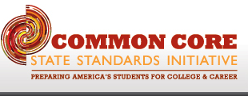
How Can I Support You?
Carole Mullins
Eng/LA Regional Content Specialist
606-854-2329
carole.mullins@education.ky.gov

