Slide 1
Just Write
Presenter:
Renee’ Buchanan
Mullins School: Pike County Schools
renee.buchanan@pike.kyschools.us

Slide 2
Intentional Focus of Session
NOTE:
To change images on this slide, select a picture and delete it. Then click the Insert Picture icon
in the placeholder to insert your own image.
This session will involve teachers actively unpacking the KCAS /ELA Standards to support a comprehensive writing plan/curriculum within their school. Intentional focus will be directed towards:
The reading/writing connection Grades K-5
Writing skills that are appropriate in each grades K-1, 2-3, 4-5
Writing genres that need to be taught at each specific grade level K-1,
2-3, 4-5
Identifying and understanding the elements of writing genres to ensure exposure, development, and mastery of the writing standards K-5
Activities that develop writing proficiency in grades K-1, 2-3, 4-5

Slide 3
NOTE:
To change images on this slide, select a picture and delete it. Then click the Insert Picture icon
in the placeholder to insert your own image.
I can….
Identify grade appropriate KCAS writing skills
Determine grade appropriate writing genres based on KCAS
Differentiate between the elements of writing genres
Select activities that meet their specific curriculum needs
Grades K-5:
Reading Teachers
ELA Teachers
Content Area Teachers
Learning Objectives /
I Can Statements
Intended Audience

Slide 4
The Question Formulation Technique™ (QFT™) Rules for Producing Questions -Ask as many questions as you can. -Do not stop to discuss, judge, or answer any question. -Write down every question EXACTLY as it is stated. -Proof: Change any statement into a question ©2001 The Right Question Institute www.rightquestion.org

Slide 5
QFT Statement:
Students should be creating appropriate writings in grades K-5.

Slide 6
NOTE:
To change images on this slide, select a picture and delete it. Then click the Insert Picture icon
in the placeholder to insert your own image.
W R I T E
some letters and make a word
W R I T E
some paragraphs and create a piece
W R I T E
some words and make a sentence
Just write
W R I T E
some sentences and make a paragraph

Slide 7
NOTE:
To change images on this slide, select a picture and delete it. Then click the Insert Picture icon
in the placeholder to insert your own image.
Activities:
Vocabulary Development
Sentence Development
Paragraph Development
Genre Development
Curriculum :
Is your Reading/Writing curriculum aligned to KCAS standards?
Does your school have a schoolwide Writing Plan aligned to the Reading series?
Does your school have “Touchstones”?
Are all grade levels and teachers required to implement and produce writings?
Is there a system of accountability for writing at each grade?
Resources:
KDE Resources
Achieve the Core
LDC
Websites
Vetted Publications
HOW ?????

Slide 8
KDE Resources:
http://education.ky.gov/AA/items/Pages/K-PREPItems.aspx http://www.corestandards.org/assets/Appendix_A.pdf
Appendix A: Research Supporting Key Elements of the Standards Glossary of Key Terms
http://www.corestandards.org/assets/Appendix_B.pdf
Appendix B: Text Exemplars and Sample Performance Tasks
http://www.corestandards.org/assets/Appendix_C.pdf
Appendix C: Samples of Student Writing
http://education.ky.gov/curriculum/conpro/engla/Documents/Literacy%20PERKS%20Planning%20Booklet.pdf
Literacy PERKS Professional Development Moduleshttp://education.ky.gov/curriculum/conpro/engla/Documents/standard 4-facilitator guide.pdfLiteracy PERKS Professional Development Modules Literacy PERKS (Program Effectiveness Review for Kentucky Schools) was designed for use by school and district
https://coretools.ldc.org/login
Join a community of passionate educators.
Tens of thousands of K-12 teachers use the LDC framework.
Exemplary curricular items across all disciplines are added all the time.
LDC CoreTools improves your instruction and your students' literacy skills.
http://achievethecore.org/
An ELA/Literacy instructional module to help build understanding
and experience with standards

Slide 9
KVEC Resources: ENGLISH/LANGUAGE ARTS PROGRESSION DOCUMENT (Standards) www.kvecelatln.weebly.com Open the Kentucky Academic Standards for English/LA tab. It is the first document. CONTENT LITERACY PROGRESSION DOCUMENT (Standards) www.kvecelatln.weebly.com Open the Kentucky Academic Standards for English/LA tab. It is the second document. http://kvecelatln.weebly.com/ http://www.theholler.org/

Slide 10
WRITING WEBSITES
http://www.readworks.org/books/passages
ReadWorks is a leading national non-profit organization that provides FREE, research-based, and Common Core-aligned reading comprehension curriculum. The ReadWorks curriculum is based on the most highly regarded, proven research on reading instruction, and includes:
Informational and literary passages and question sets for grades K-12
Skill and Strategy lesson units for grades K-4
Comprehension units for grades K-5
Novel study units for grades 5-6
Please click here to take our two-minute site tour for a quick introduction to ReadWorks.
http://writinglesson.ning.com/?xg_source=msg_mes_network
http://corbettharrison.com/

Slide 11
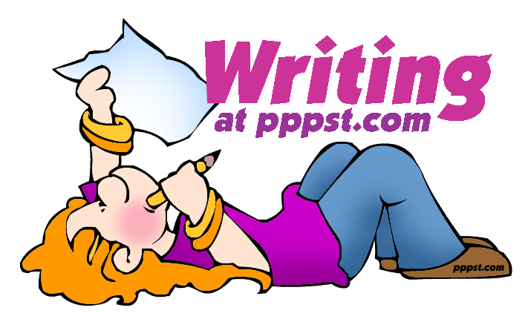
http://readingandwritingproject.org/
https://owl.english.purdue.edu/
http://www.ttms.org/
http://writing.pppst.com/

Slide 12
Resources: - 26 years of Personal Observation - Write Source: Great Source Education Group - 6 +1 Trait Writing Program: Ruth Culham- Scholastic - Jeff Anderson: Mechanically Inclined - Katie Wood Ray: Wondrous Words - Jessica Ivey: Mentor Sentences and Mentor Text
THANK YOU for attending this session.

