Slide 1


Understanding K-5 Kentucky Academic Standards in Reading/Writing: Effective Strategies for Classroom Instruction Across the Curriculum
August 28, 2018
Notes:
Carole and Dionne
Welcome and Introductions: Take count of teachers by grade level
Post this slide as participants have breakfast, meet and greet

Slide 2
“He who dares to teach, must never cease to learn. ”
~John Cotton Dana
Notes:
Carole
We owe this to the students we teach and future generations!

Slide 3
What Does It Mean to be College & Career Ready?
The larger goal of college and career readiness requires schools to enable all students to:
  master core content
  develop key cognitive strategies
  take ownership of their learning and become proficient with a range of learning strategies
  acquire the privileged knowledge necessary to make a successful transition from secondary to postsecondary education
David T Conley, PhD
CEO, Educational Policy Improvement Center (EPIC)
Professor, University of Oregon
Notes:
Carole

Slide 4
Important Factors Related to the Design of K-5 Reading/Writing Standards:
Studies revealed that students are required to read very little informational text in elementary and middle school.
Non-fiction makes up the vast majority of required reading in college/workplace.
Because informational text is harder for students to comprehend than narrative text, they need additional support when learning how to read different types of informational text.
Notes:
Carole
Before we look a little closer at the standards, let’s review a few important factors related to the design that impact K-5 teaching and learning…
Scaffolded Instruction K-12

Slide 5
College and Career Readiness Standards
English Language Arts
Literacy in History/Social Studies, Science, and Technical Subjects
Reading (20)
1)Informational (10)
2)Literary (10)
Writing (10)
Speaking & Listening (6)
Language (6)
Reading (10)
Writing (10)
K-5 Reading Foundational Skills (4) (Encompass the 5 Essential Components of Reading)
Same Skills, Different Approach !
Notes:
Carole
Visual Chart of the key design…
Fewer and Broader… This means that teachers must design more rigorous tasks to help students achieve learning at a higher level… By themselves, the standards WILL NOT improve student learning!!!
The overarching skill emphasized in the ELA standards is COMPREHENSION at its highest level: ANALYSIS, CLASSIFICATION, ABILITY TO COMPARE/CONTRAST, SYNTHESIZE
Reading has 20 standards that are sub-divided into informational and literary text and each has10 standards (each connects back to its corresponding CCR anchor)
10 standards for writing
6 Standards for Speaking and Listening
6 Standards for Language
4 Reading Foundational Skills
10 standards for reading and 10 for writing: Content Specific Literacy Standards

Slide 6
Standards do … | Standards do not …
Establish what students need to learn. | Dictate how teachers should teach. Instead, schools and teachers will decide how best to help students reach the standards.
Attempt to focus on what is most essential. | Describe all that can or should be taught. A great deal is left to the discretion of teachers and curriculum developers.
Set grade-level standards. | Define the intervention methods or materials necessary to support students who are below or above grade-level expectations.
Notes:
Carole: STANDARDS ARE THE FLOOR, NOT THE CEILING FOR INSTRUCTION
The standards do not describe all that can or should be taught (only what is essential is included). A well-developed, content-rich curriculum must be developed by individual schools/districts/states…
You won’t see strategies or instructional advice. BUT— HIGHLY EFFECTIVE TEACHING AND LEARNING will guide teachers. Along with this, the establishment of learning targets are beneficial in understanding if our students have met the standards.
No grade-specific standard can fully reflect the great variety in abilities, but GREAT teachers and teaching can identify them and address their needs. Maybe mention RtI, CSIP, etc…

Slide 7
Summary of the “Biggest” Instructional Shifts
Regular practice with complex text and its academic language
Reading, writing and speaking grounded in evidence from text, both literary and informational
Building knowledge through content-rich nonfiction
Notes:
Carole: 6 Major Shifts…
This is a high-level summary of the biggest changes signified by the adoption of the CCSS.
They represent the most significant shifts for curriculum materials, instruction, student learning, and thinking about assessment. Taken all together, they should lead to desired student outcomes.
SHIFT #2:
Most college and workplace writing requires evidence.
Evidence is a major emphasis of the ELA Standards: Reading Standard 1, Writing Standard 9, Speaking and Listening standards 2, 3 and 4, all focus on the gathering, evaluating and presenting of evidence from text.
SHIFT #3:
Literary/Informational Reading: 50/50 balance K-5
ASSESSMENTS will require a high and increasing proportion of informational text as students advance through the grades.
Students learning to read should exercise their ability to comprehend complex text through read-aloud texts
Reading aloud texts that are well-above grade level should be done throughout K-5 and beyond!
In grades 2+, students begin reading more complex texts, consolidating the foundational skills with reading comprehension

Slide 8
Distribution of Literary and Informational Passages by Grade in the NAEP Reading Framework
GRADE | LITERARY | INFORMATION
4 | 50% | 50%
8 | 45% | 55%
12 | 30% | 70%
The Standards aim to align instruction with this framework so that many more students than at present can meet the requirements of college and career readiness.
ELA CCSS Page 5
Notes:
Carole
Students who were successful on NAEP were found to spend a high percentage of time reading informational passages.
The percentages on the table reflect the sum of student reading, not just reading in ELA settings.
At the HS level: Because the ELA classroom must focus on literature (stories, drama, and poetry) as well as literary nonfiction, a great deal of informational reading in grades 6–12 must take place in other classes if the NAEP assessment framework is to be matched instructionally.
It is a shared responsibility!!

Slide 9
Reading Standard #2
CCR ANCHOR STANDARD
Determine central ideas or themes of a text and analyze their development; summarize the key supporting details and ideas.
K-12 Progressions
Notes:
Carole: Going to focus today’s work around Informational Reading and Informational/Explanatory Writing
Reading Standard #2 HANDOUT
“Transition” for R/W skills in all content areas actually takes place at 5th grade!
Full ELA Progressions Document available on my website and will be posted to the HOLLER along with today’s handouts.

Slide 10
Reading Informational Standard #10
R.CCR.10: Read and comprehend complex literary and informational texts
independently and proficiently.
K
Actively engage in group reading activities with purpose and understanding.
1
With prompting and support, read informational texts appropriately complex for grade 1.
2
By the end of the year, read and comprehend informational texts, including history/social studies, science, and technical texts, in the grades 2–3 text complexity band proficiently, with scaffolding as needed at the high end of the range.
Notes:
Carole: Refer participants to Standard #10
KINDERGARTEN:
Here’s what the Kindergarten standard looks like for the same anchor standard: Actively engage in group reading activities with purpose and understanding.
Kindergarteners have not yet learned to: READ on their own
TEACHERS MUST REALIZE THAT READING ALOUD IS AN IMPORTANT PART OF THE KINDERGARTEN DAY.
1st GRADE:
Continue to watch and notice how skills build throughout the grades. The blue text represents what the Grade 1 standard is for the same anchor.
You see the beginning of independent reading, which occurs with “prompting and support.”
2nd GRADE:
Grade 2 brings more details about the types of informational text and some independent reading, but second graders may still require “scaffolding as needed” at the high end of the range.
In grades K-1 children should be taught to read (or decode) with the skills strand with no expectation that they are reading information texts, independently.
The earliest readers in K-1 just don’t have the vocabulary or skills to read about those topics.
The expectation that they are reading informational texts, independently, is at the end of Grade 2.
IMPORTANT:
BY 2ND GRADE, CHILDREN WILL HAVE BEEN INTRODUCED TO THE 44 SOUNDS OF THE ENGLISH LANGUAGE AND MOST OF THE SOUND-SPELLINGS THEY NEED TO BEGIN TO READ INFORMATIONAL TEXTS ON THEIR OWN.

Slide 11
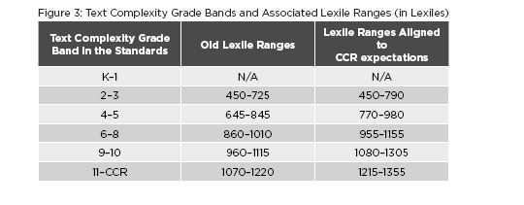
This Chart Demonstrates the Lexile Ranges for
Text Complexity Grade Bands
CCSS Appendix Pg. 8
Notes:
Carole
Shift 2 states: Regular practice with complex text and its academic language
Realigned Upward from earlier levels
A Quantitative Measure (Step 2 of 3 Step Process)
To Kill A Mockingbird:
Lexile is 870 – Grade Band Level 4-5
Qualitative Measures such as: VERY IMPORTANT
Levels of meaning
Levels of purpose
Structure
Organization
Language conventionality
Language clarity
Prior knowledge demands
Task and Reader Considerations: THE TEACHER
RECOMMENDED PLACEMENT IS GRADES 9-10
Text Complexity for Grades K-2
No complexity requirement for independent reading
Complexity band begins at 2nd grade and students need to be reading texts in the lower part of the grades two-three band (does not mean all texts!)
K-1-2 instruction should include LOTS of Read Aloud Texts and these texts should be at least 2 years above the grade level of the students (e.g., read aloud texts to students in the first grade should be of third grade complexity).

Slide 12
Distribution of Communicative Purposes by Grade in the NAEP Writing Framework
GRADE | TO PERSUADE Opinion/Argumentation | TO EXPLAIN Info./Exp. | TO CONVEY EXPERIENCE Narrative
4 | 30% | 35% | 35%
8 | 35% | 35% | 30%
12 | 40% | 40% | 20%
It follows that writing assessments aligned with the Standards should adhere to the distribution of writing purposes across grades outlined by NAEP.
ELA CCSS Page 5
Notes:
Carole Let’s now look at Writing
As with reading, the percentages in the table reflect the sum of student writing, not just writing in ELA settings.
ONE REASON FOR THIS SHIFT IN THE ORGANIZATION OF WRITING STANDARDS IS TO BETTER PREPARE STUDENTS COLLEGE AND CAREER WRITING
Notice the decreasing emphasis on narrative writing that students do in school. THOSE PERCENTAGES DO NOT REPRESENT AN ELA CLASSROOM IN ISOLATION.

Slide 13

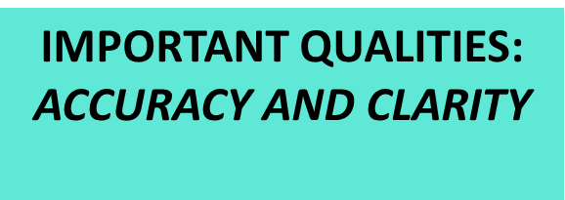
Writing Standard #2
CCR ANCHOR STANDARD
Write informative/explanatory texts to examine and convey complex ideas and information clearly and accurately through the effective selection, organization, and analysis of content.
K-12 Progressions
Notes:
Carole
Writing Standard #2 HANDOUT
3 main skills identified in Writing Standard 2: SELECTING, ORGANIZING, AND ANALYZING
2 important qualities identified ACCURACY AND CLARITY

Slide 14

Informative/Explanatory writing seeks to accurately convey information
Purposes are:
  to increase readers’ knowledge of a subject
  to help readers better understand a procedure or process
  to provide readers with an enhanced comprehension of a concept
Notes:
Carole

Slide 15
Shift #2 Requires a Good Progression of
Text-Dependent Questions & Answers
Opinions/Arguments,
Intertextual Connections
Inferences
Author’s Craft and Purpose
Key Details
General Understandings
Vocab & Text Structure
What does the text mean?
TDQs are designed to cause students to return to the text.
How does the text work?
What does the text say?
Notes:
Carole
Shift 2 states: Reading, writing and speaking grounded in evidence from text, both literary and informational

Slide 16

Text-dependent Questions and the Standards
Opinions, Arguments,
Intertextual Connections
Inferences
Author’s Purpose
Vocab & Text Structure
Key Details
General Understandings
Standards
8 & 9
3 & 7
6
4 & 5
2
1
Notes:
Carole
Each type of TDQ in the Progression Process can be directly linked to a Reading Standard…

Slide 17




Characteristics/Intent of Text-Dependent Questions
Questions that can only be answered with evidence from the text.
Focus on difficult portions of text in order to enhance reading proficiency.
Frame inquiries in ways that do not rely on a mix of personal opinion, background information, and imaginative speculation.
Notes:
Carole

Slide 18

“Read like a detective, write like a reporter.”
Notes:
Carole
Mantra—we need students that “read like detectives and write like reporters” (Coleman)

Slide 19
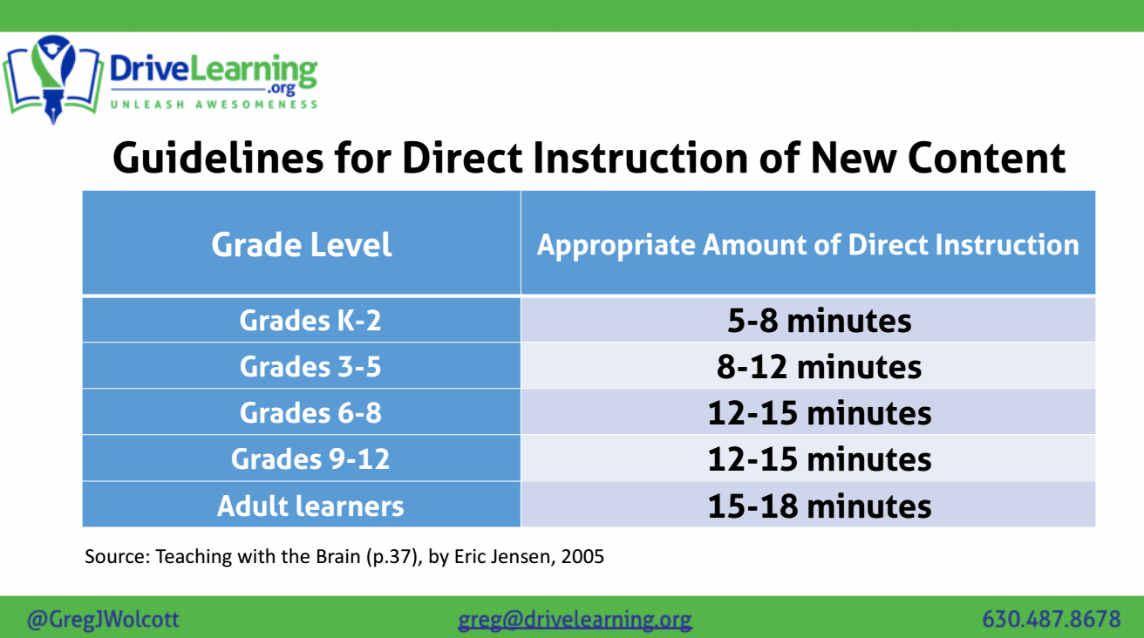

Slide 20
Notes:
Carole: One quick message about Opinion/Argument Writing in K-5
K-5 Writing building block to argumentation: HANDOUT
Read and Discuss at Your Table
Write Steps Handout!
Thinking about O/A Writing…
Teach opinion pieces in the early grades (as the CCSS suggest), but help students make the transition by showing, early on, the difference between opinion (or reasons) and true evidence.
We do not need to demand evidence in their writing at this stage, but I think we do need to show them what evidence is, and indicate that beginning in middle school, they will be doing more independent research.
It is never too early to teach research and the documentation of that research.
Even with primary students, it is possible to model the borrowing of a fact, and show how that fact strengthens personal writing.
Too many college students flounder because they have no idea how to track down information, incorporate it into their writing, or cite the sources from which they took it.

Slide 21



Appendices
Appendix C:
Annotated Writing Samples at Various Grade Levels
Appendix A:
Supplementary Materials and Glossary
Appendix B:
Text Exemplars and Sample Performance Tasks
www.corestandards.org
Notes:
Carole
3 Appendices:
A: Supplementary materials and a glossary (43 pages)
B: Text exemplars illustrating complexity. text complexity is measured by 3 factors
qualitative evaluation (levels of meaning, structure, language conventionality, and clarity, and knowledge demands)
quantitative evaluation (readability, and other scores of text complexity), and matching reader to text and task (reader variables such as motivation, knowledge and experience, and task variables such as purpose and complexity generated by task assigned or question posed)
quality and range of reading for grade levels (includes text types for K-5 and 6-12 bands in these broad categories: stories, dramas, poetry and literary nonfiction/(historical, scientific and technical texts for K-5 only)
Accompanying Sample Performance Tasks (183 pages)
C: Annotated samples demonstrating at least adequate performance in writing at various grade levels (106 pages)

Slide 22
Literacy Design Collaborative (LDC) Rubrics
Create a Free Account!
www.ldc.org
Join Core Tools
Notes:
Carole
Share LDC rubrics as a resource

Slide 23
Kentucky Academic Standards:
Reading Foundational Skills (K-5)
These standards are directed toward fostering students’ understanding and working knowledge of concepts of print, the alphabetic principle, and other basic conventions of the English writing system. These foundational skills are not an end in and of themselves; rather, they are necessary and important components of an effective, comprehensive reading program designed to develop proficient readers with the capacity to comprehend texts across a range of types and disciplines. Instruction should be differentiated: good readers will need much less practice with these concepts than struggling readers will. The point is to teach students what they need to learn and not what they already know—to discern when particular children or activities warrant more or less attention. Note: In KINDERGARTEN, children are expected to demonstrate increasing awareness and competence in ALL the areas, too!
Notes:
Dionne
Choral Reading Activity

Slide 24
Kentucky Academic Standards:
Reading Foundational Skills (K-5)
Using the Reading Foundational Skills document, silently read the standards for your grade level.
Identify the SKILLS that must be mastered by students at that particular grade level. Write them on a post-it note.
Move to the appropriate grade-level chart with your completed post-it note.
Through “round-robin” sharing, discuss your findings and chart SKILLS that must be taught in your grade level.
Identified SKILLS will be revisited throughout the next segment of today’s session.
Notes:
Dionne
6 mins to identify skills
15 to discuss/post

Slide 25
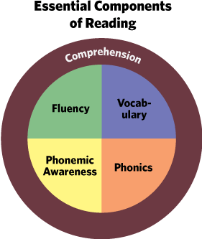
K-5: The Five Essential Components of Reading
Phonemic Awareness
Phonics
Fluency
Vocabulary
Comprehension
“WORD ATTACK SKILLS”
Notes:
Dionne: Note Taking Tool HANDOUT
Students cannot meet the requirements of the 2nd grade text complexity band (read level text independently by the end of grade 2) if not enough time is spent in K-1 teaching the 5 essential components of reading. WORD ATTACK SKILLS. They must learn the skills in order to break down difficult words.
MAP TESTING: VOCABULARY ACQUISITION scores low? This verifies the problem…(Found in the Reading Foundational Skills of the ELA Standards)
We have moved from Ungraded primary to specific reading skills taught at specific grade levels…
Some teachers/administrators may need a “recalibration” of the 5 essential components of reading.
Phonemic awareness
is the ability to notice, think about, and work with the individual sounds in spoken words. ... can be taught in the dark because it is all about the sounds in words. 20 hours of phonemic awareness should be enough instruction for the average reader, but research shows that 1 out of every 5 children in a typical classroom will have phonemic awareness deficits
Phonics
National Reading Panel findings conclude that all beginning readers regardless of their age can benefit from instruction in systematic phonics.
Systematic and explicit phonics instruction is particularly beneficial for children who are having difficulty learning to read and who are at risk for developing future reading problems.
Systematic and explicit phonics instruction is most effective when introduced early. Phonics instruction is not an entire reading program for beginning readers.
Fluency
Repeated and monitored oral reading improves reading fluency and overall reading achievement.
Increasing “eyes on text” should be an intentional focus in creating fluent readers, as well as building the endurance of text necessary for comprehension.
Vocabulary
Tier 1-2-3 Words
Children learn the meanings of most words indirectly, through everyday experiences with oral and written language.
Although a great deal of vocabulary is learned indirectly, some vocabulary should be taught directly.
Vocabulary is found in the Language Standards under Vocabulary Acquisition and Use.
Language Standards/Vocabulary Acquisition and Use is found are found in grades K – 11/12.
Comprehension
Comprehension monitoring, a critical part of metacognition, has received a great deal of attention in the reading research.
Need comprehension strategies: Direct explanation, Modeling, Guided Practice, Application
Text structure: Cause and effect, Compare and Contrast, Sequence, Problem and Solution and Description.

Slide 26
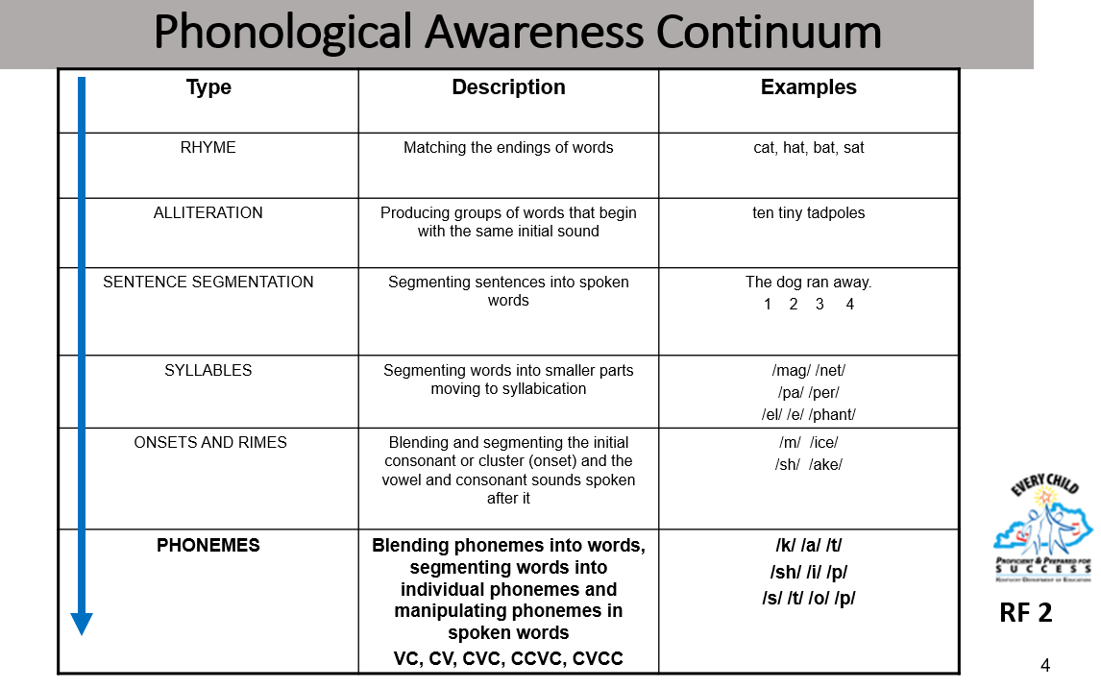
Phonemic Awareness
Notes:
Dionne - HANDOUT
Phoneme isolation - Tell me the first sound /b/ bed
Phoneme identity – commons sound in different words – alliteration
Phoneme categorization –which word doesn’t belong?
Phoneme blending – sk, br, bl
Phoneme segmentation – ship
Phoneme deletion – recognize words when one phoneme is taken away – plate, late

Slide 27
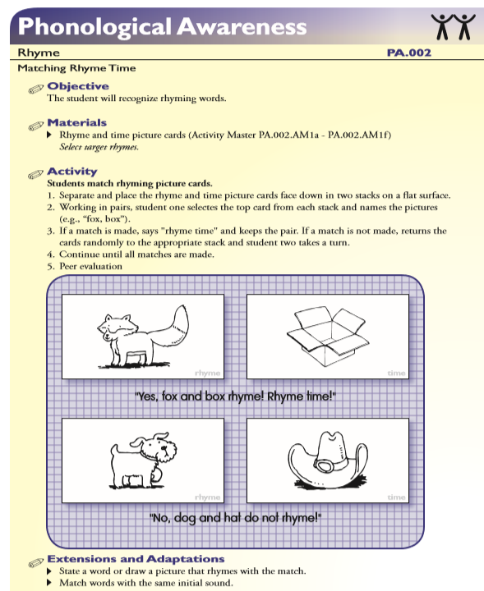
http://www.fcrr.org/documents/sca/GK-1/PA_Final_Part1_Rhyme.pdf
Notes:
Dionne

Slide 28

Phonics
Phonics is the relationship between the letters, (graphemes) of written language and the individual sounds (phonemes) of spoken language.
It is important because it leads to an understanding of the alphabetic principle--the systematic and predictable relationship between written letters and spoken sounds.
Notes:
Dionne The 2nd component is Phonics.
Read slide.
Phonics
National Reading Panel findings conclude that all beginning readers regardless of their age can benefit from instruction in systematic phonics.
Systematic and explicit phonics instruction is particularly beneficial for children who are having difficulty learning to read and who are at risk for developing future reading problems.
Systematic and explicit phonics instruction is most effective when introduced early. Phonics instruction is not an entire reading program for beginning readers.

Slide 29
Sight Word vs. Decoding
If a student is taught ten words from sight word recognition—all he really knows are those ten sight words.
If a student is taught 10 sounds and blending—they can read 350 (3-sound words), 4,320 (4-sound words), and over 21,000 (5-sound words).
Notes:
Dionne

Slide 30
Phonics
Students Who Struggle With Decoding: | Students With Strong Decoding Skills:
Rely heavily on context & guessing. Read slowly and with great effort. Focus on decoding rather than comprehending. Skip challenging words and sections of text. Do not monitor their reading to make sure it makes sense. | Read a word letter by letter & eventually syllable by syllable. Process words automatically and rapidly. Look for known word parts in unfamiliar words. Use context to confirm pronunciation and meaning.
Notes:
Dionne

Slide 31
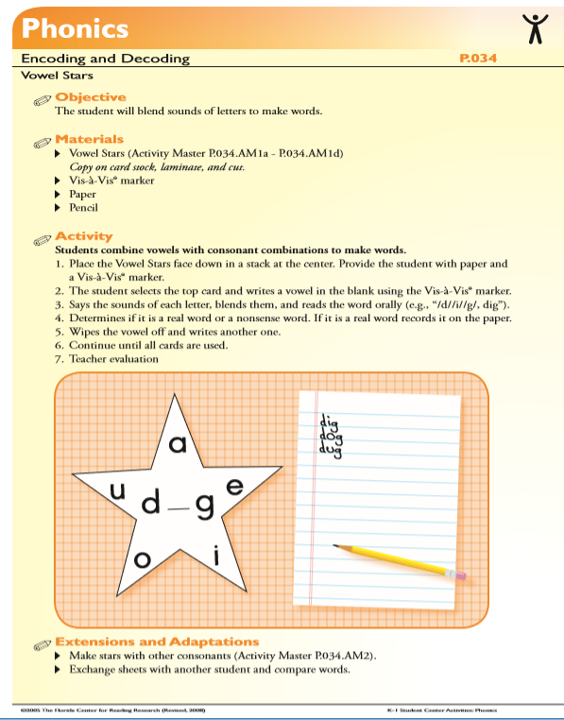
http://www.fcrr.org/documents/sca/GK-1/P_Final_Part4.pdf
Notes:
Dionne – Table Groups ACTIVITY

Slide 32
Fluency
Fluency is the ability to read a text accurately and quickly.
It is important because it frees students to understand what they read.
Notes:
Dionne The 3rd component which we will review is Fluency.
Read slide.
Fluency
Repeated and monitored oral reading improves reading fluency and overall reading achievement.
Increasing “eyes on text” should be an intentional focus in creating fluent readers, as well as building the endurance of text necessary for comprehension.

Slide 33
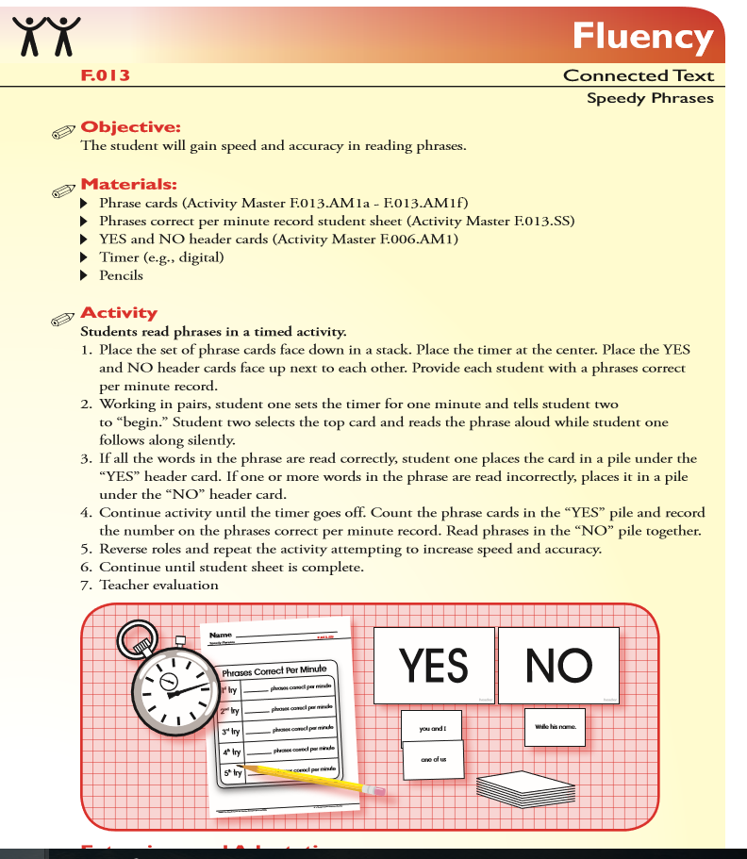
http://www.fcrr.org/documents/sca/GK-1/F_Final_Oral_Reading.pdf
Notes:
Dionne

Slide 34
Vocabulary
Vocabulary refers to the words we must know to communicate effectively.
It is important because beginning readers use their oral vocabulary to make sense of the words they see in print.
It is important because readers must know what most of the words mean before they can understand what they are reading.
Notes:
Dionne: Our 4th component is Vocabulary.
Read slide.
Vocabulary
Tier 1-2-3 Words
Children learn the meanings of most words indirectly, through everyday experiences with oral and written language.
Although a great deal of vocabulary is learned indirectly, some vocabulary should be taught directly.
Vocabulary is found in the Language Standards under Vocabulary Acquistion and Use.
Language Standards/Vocabulary Acquisition and Use is found are found in grades K – 11/12.

Slide 35
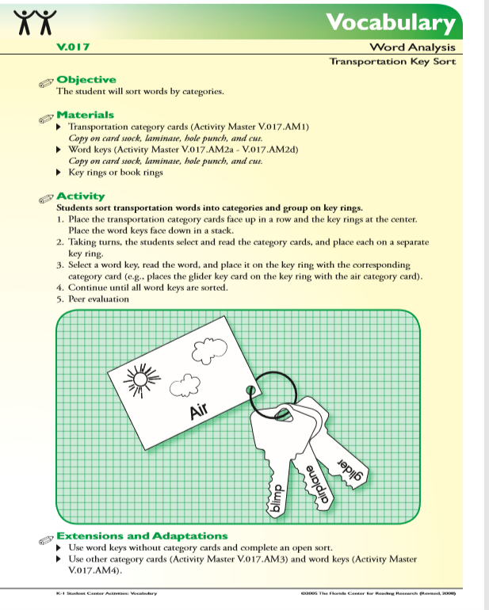
http://www.fcrr.org/documents/sca/GK-1/V_Final_Word_Analysis.pdf
Notes:
Dionne

Slide 36
Comprehension
Comprehension is the active process of constructing meaning from text.
It is important because it is the reason for reading.
Notes:
Dionne
And the last component described in the National Reading Panel Report as a necessary part of a successful reading program is Comprehension.
Read slide.
Comprehension
Comprehension monitoring, a critical part of metacognition, has received a great deal of attention in the reading research.
Need comprehension strategies: Direct explanation, Modeling, Guided Practice, Application
Text structure: Cause and effect, Compare and Contrast, Sequence, Problem and Solution and Description.

Slide 37
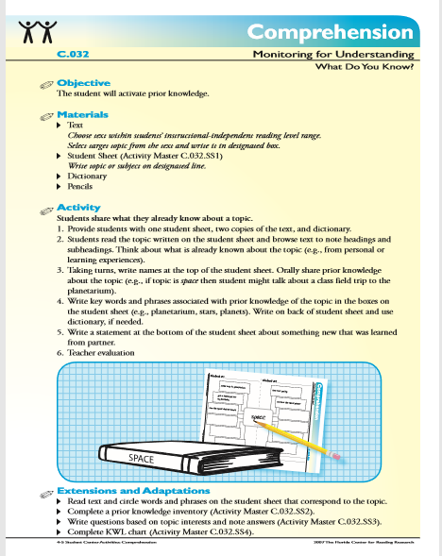
http://www.fcrr.org/documents/sca/G4-5/45CPartFour_Monitoring_for_Understanding.pdf
Notes:
Dionne

Slide 38
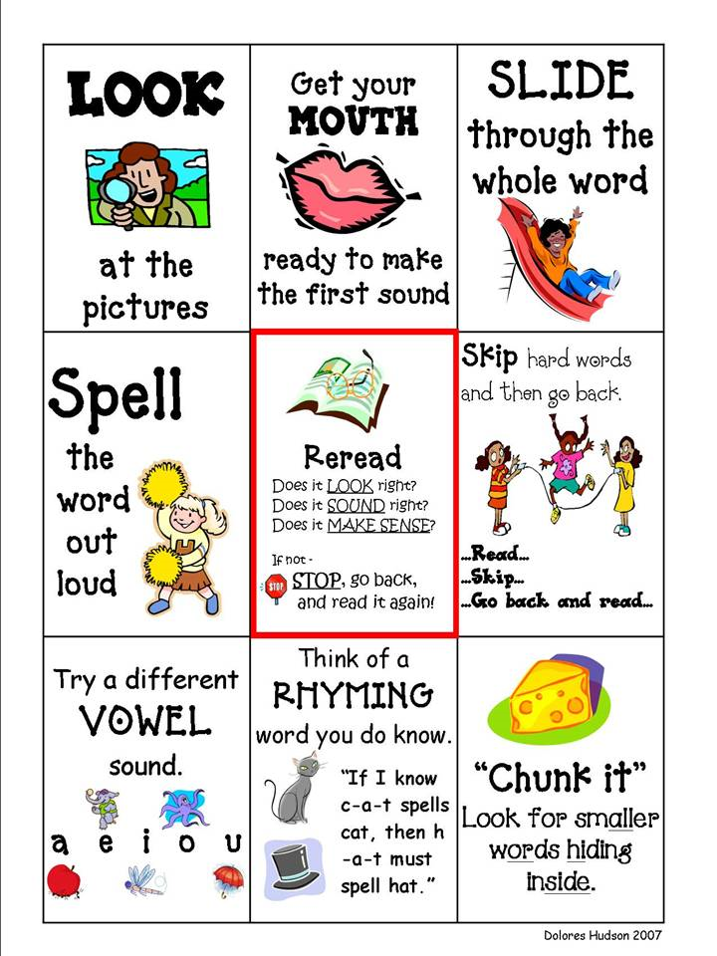
Importance of the 5 Essential Components of Reading for K-1 Students
Prior to the end of Grade 2, students will be building their decoding skills, while listening to rich informational texts to build their background knowledge and vocabularies.
Read Alouds should be at least 2 grade levels above reading abilities.
Notes:
Dionne
Intent of the Standards Scaffolding…
Students cannot meet the requirements of the 2nd grade text complexity band (read level text independently by the end of grade 2) if not enough time is spent in K-1 teaching the 5 essential components of reading. WORD ATTACK SKILLS
When you look closely at the standards, The foundation of learning to read occurs in these 3 grades!
“I Can” statements H/O (Shared with Administrators for K-1)

Slide 39

What Really Matters…
“What really matters, in terms of developing readers and writers, is the quality of classroom instruction.”
---Richard Allington
Notes:
Carole
You won’t see strategies or instructional advice in the standards. But, the establishment of learning targets are beneficial in understanding if your students have met the standards.
No grade-specific standard can fully reflect the great variety in abilities, but GREAT teachers and teaching can identify them and address their needs.

Slide 40

S. T. R. A. P
What essential WRITING SKILLS do students need in order to effectively respond to a timed/untimed writing task?
Notes:
Rebecca

Slide 41


Determine the exact/specific question you need to answer.
S=
Notes:
Rebecca

Slide 42

Writing Task
Recent studies show that plastic straws are the 11th most found ocean trash and have a significant negative impact on marine life. Our city council is considering a measure to ban the use of straws in restaurants within the city limits. The local newspaper invites members of the community to agree or disagree with this measure in letters to the editor which will be printed in next week’s issue.
A. Straws
B. Plastic Straws
C. The city should or should not ban
plastic straws from restaurants
within the city limits.
Notes:
Rebecca
After explaining to students that they must determine the specific question which is being asked in the task. Read the task aloud and have students choose the correct answer from the multiple choice answers provided. Do this on individual cards or paper to help all students make a decision.

Slide 43

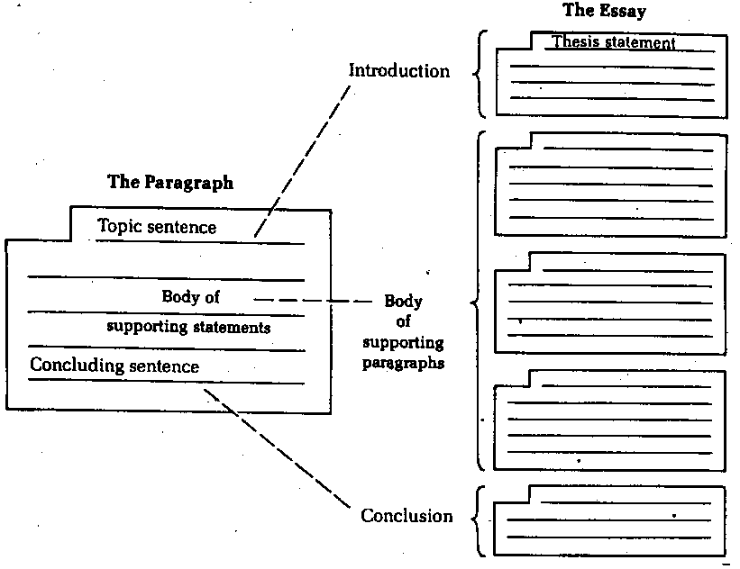
T=
Notes:
Rebecca
While there are many types or forms which writing may take, they all share the structure of an essay: Introduction, Body, Conclusion. These parts may be longer or shorter in various types of writing, but close analysis will show that letters, emails, blogs, articles, and editorials all contain these basic parts.
Because of this, helping students to master essay writing is the key to success in writing in a timed or untimed situation.
The next step is to help them recognize and apply the characteristics of different genres of writing. At each grade level, this work is different--but the goal is the same. For example, if K-1 students can learn to write a topic sentence the foundation is laid for 2-3 teachers to help them master a paragraph structure. In 4-5, students will have the skills needed to develop 3 paragraph essays and recognize and apply the characteristics of different genres of writing.

Slide 44
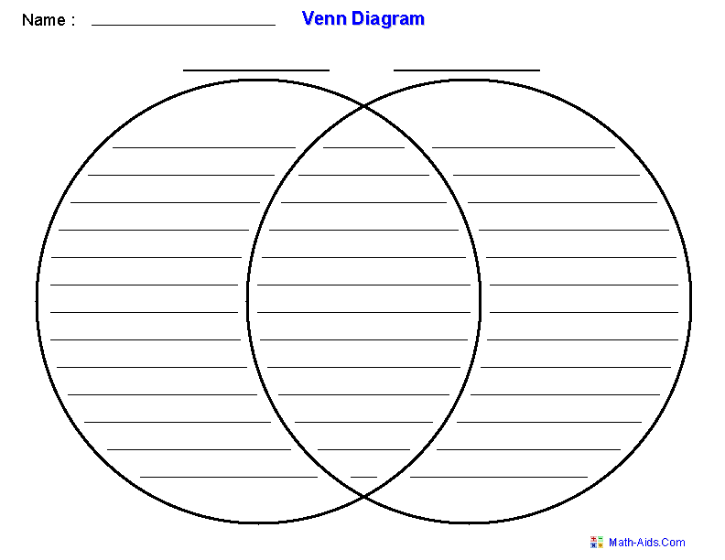
Type=Characteristics of a Genre
Letter
Both
Article
Notes:
Rebecca
Type: Lesson 1
Give students three different color highlighters and ask them to read both a letter and an article from National Geographic for kids. With the pink, ask them to highlight the introduction (or topic sentence) depending on the grade level. With the yellow, ask them to highlight the body paragraphs (or support/reasons) depending on level and objective. With the orange, ask them to highlight the conclusion. (For K-1, you can have them use one color and highlight the topic sentence in each paragraph.)
**Discuss with students how the two texts look different on the page, but share a common structure--intro, body, and conclusion. Then, shift to Lesson 2:
Ask students to work together to generate a venn diagram which illustrates the similarities and differences between the two texts.

Slide 45

R=
The different roles
we play.
Notes:
Rebecca

Slide 46

Working with peers seated at your table, look at each of the 6 photos.
Focus on the children in each photograph and decide what role the child is playing in the situation depicted in the photograph.
As you make your decision, attach the labels provided to the photograph it describes most accurately.
Nominate one person at your table to defend your group’s decision.
Notes:
Rebecca
Lead group through this activity. As you have groups share and defend answers move through the photographs in the slide show.

Slide 47

#1
Notes:
Rebecca

Slide 48
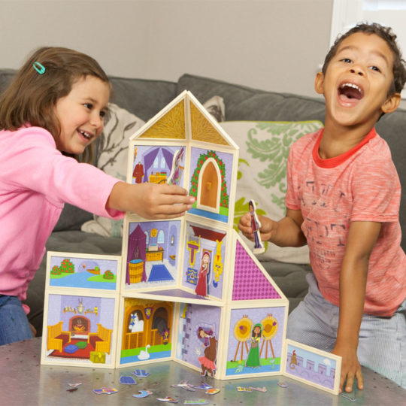
#2
Notes:
Rebecca

Slide 49
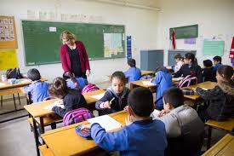
#3
Notes:
Rebecca

Slide 50
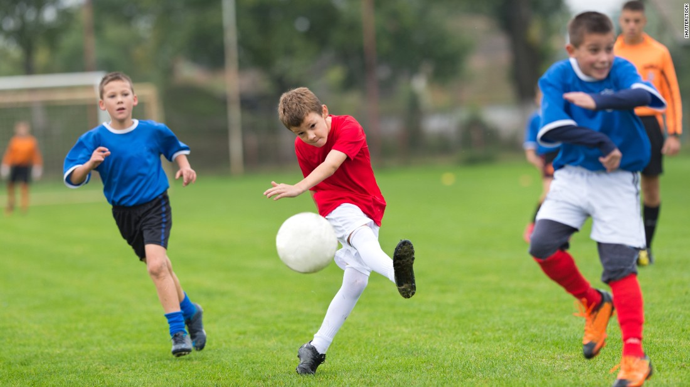
#4
Notes:
Rebecca

Slide 51
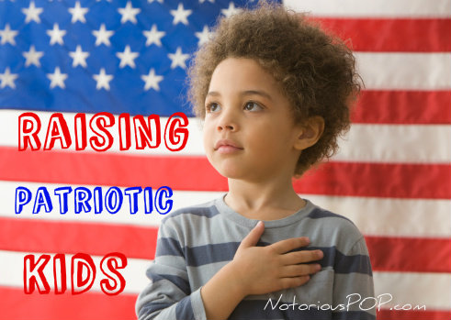
#5
Notes:
Rebecca

Slide 52
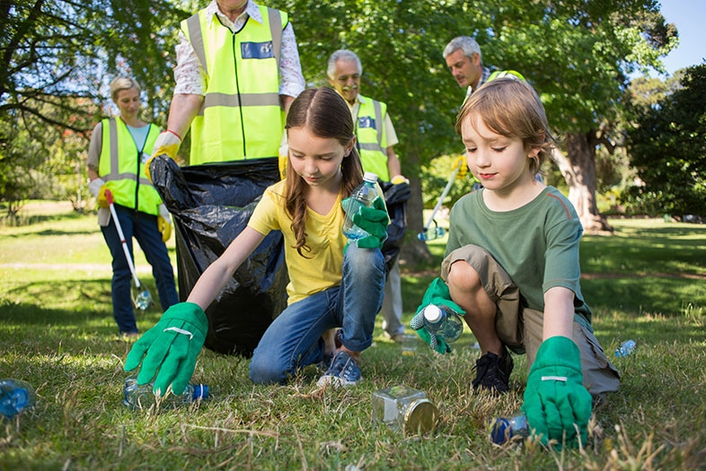
#6
Notes:
Rebecca

Slide 53


A=
A specific audience is one composed of people who share a common background or who have a common knowledge level.
A general audience is one composed of people from different backgrounds and with different knowledge levels.
Notes:
Rebecca
After defining each type of audience ask participants to work together to label each of the audiences on the yellow page as specific or general and be prepared to discuss answers.

Slide 54

General Specific Audience
Answers
A conference of English professors.
The listeners of a Top 40 radio show.
The attendees at a 4th of July fireworks display.
The developers for a particular website.
The readers of a newspaper.
SPECIFIC
GENERAL
GENERAL
SPECIFIC
GENERAL
Notes:
Rebecca
Discuss answers as whole group.

Slide 55

P=
To inform or explain
To support a point of view
https://www.youtube.com/watch?v=JKFu-2gjjo0
https://www.youtube.com/watch?v=ThIrw_LpuRA
Notes:
Rebecca
Strategy: Give participants a two column index card and ask them to decide which video is primarily informative/explanatory writing and which is persuasive---they should cite evidence from the video to support their choice.

Slide 56
STRAP | When considering a Writing Situation and Task, determine each of the following:
SUBJECT | What topic are you to address?
TYPE | What format should your writing take?--- essay, email, letter, article, etc.
ROLE | From what role will you write? student, son, daughter, volunteer, citizen, athlete, etc.
AUDIENCE | To whom are you writing? HINT: The writing situation will GIVE you this information.
PURPOSE | For what purpose do you write? To inform or explain or to support a point of view.
STRAP adapted from The Write Source. 2007
Notes:
Rebecca

Slide 57
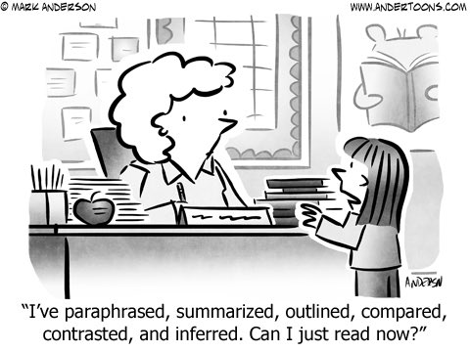

12:00 – 12:45 pm.
Notes:
Carole

Slide 58

Alexander Who Used to Be Rich Last Sunday
Lexile Level: 570
Grade 2-3 Text Complexity Grade Band: 450-790
Standards Complexity Level Range: Middle
Book Recommendation: Ages 4-8

Slide 59
Reading Standards
Literary and Informational
R.I.3.1 - Ask and answer questions to demonstrate understanding of a text, referring explicitly to the text as the basis for the answers.
R.I.3.7- Use information gained from illustrations (e.g., maps, photographs) and the words in a text to demonstrate understanding of the text (e.g., where, when, why, and how key events occur).
R.L.3.3 - Describe characters in a story (e.g., their traits, motivations, or feelings) and explain how their actions contribute to the sequence of events.
R.L.3.4 - Determine the meaning of words and phrases as they are used in a text, distinguishing literal from nonliteral language.

Slide 60
Alexander Who Used to Be Rich Last Sunday
View Read-Aloud Video
Several versions of this read-aloud are available on
YouTube and other internet sites.

Slide 61
Text Dependent Questions
1. What language tells us that Alexander is the narrator? Use evidence from the text to
support your answer.
2. Alexander uses the word fair to express his thoughts. What does the word fair mean to
Alexander in this story? How do you know?
3. Why did Alexander repeat the phrase “good-bye _____ cents”?
4. Alexander tells us that this father fined him for saying certain words to his
brothers. Using evidence from the text, what does fine (fined) mean in this story?
5. In the book, Alexander stays, “Good-bye eight cents, and the butter knife, and the
scissors.” What did he mean by this?

Slide 62
MATH Skills/Standards
2.MD.8 - Solve word problems involving dollar bills, quarters, dimes, nickels, and pennies, using $ and cents symbols appropriately.
3.MD.3: Draw a scaled picture graph and a scaled bar graph to represent a data set with several categories. Solve one- and two-step “how many more” and “how many less” problems using information presented in scaled bar graphs. For example, draw a bar graph in which each square in the bar graph might represent 5 pets.
4.MD.2 - Use the four operations to solve word problems involving distances, intervals of time, liquid volumes, masses of objects, and money, including problems involving simple fractions or decimals, and problems that require expressing measurements given in a larger unit in terms of a smaller unit. Represent measurement quantities using diagrams such as number line diagrams that feature of a measurement cycle.

Slide 63
Mathematical Practices

Slide 64

Math Talk
According to Hattie, Mathematical Talk that guides deep learning has an effect size for classroom discussion is equal to 0.82.
John Hattie, Douglas Fisher and Nancy Frey, Visible Learning for Mathematics, What Works Best to Optimize Student Learning, P142

Slide 65
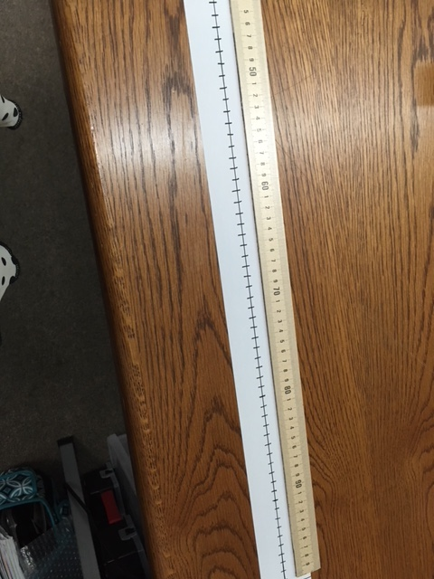

Number line Representation

Slide 66
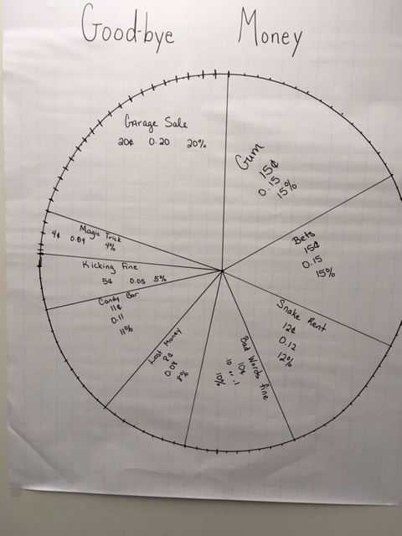
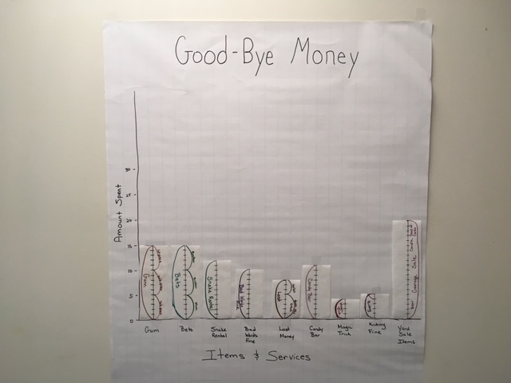
Different Representations

Slide 67
Writing Task for Math
Why was it so difficult for Alexander to save his money?
Writing Standard 3.2
Write informative/explanatory texts to examine a topic and convey ideas and information clearly.
  a. Introduce a topic and group related information together; include illustrations when useful to aiding comprehension.
  b. Develop the topic with facts, definitions, and details.
  c. Use linking words and phrases (e.g., also, another, and, more, but) to connect ideas within categories of information.
  d. Provide a concluding statement or section.

Slide 68

Resource: KVEC ELA Website
Carole Mullins, NBCT
KVEC Literacy Instructional Specialist
carole.mullins2@hazard.kyschools.ky.us
www.kvecelatln.weebly.com
Notes:
Carole

Slide 69

Carole Mullins, NBCT
KVEC Literacy Instructional Specialist
carole.mullins2@hazard.kyschools.us
Dionne Bates, Ed. S.
KVEC Achievement Gap Specialist, Literacy
dionne.bates@hazard.kyschools.us
Vonda Adams
KVEC Achievement Gap Specialist, Math
vonda.adams@perry.kyschools.us
Stephanie Kidd
KVEC Achievement Gap Specialist, Math
stephanie.kidd@floyd.kyschools.us
Rebecca King
Teacher, Pikeville Independent Schools
rebecca.king@pikeville.kyschools.us
www,kvecelatln.weebly.com
Notes:
Carole

