Slide 1

January 2013 ELA Network
Welcome!
www.kvecelatln.weebly.com
Notes:
Carole
Names for Prizes

Slide 2

Your Facilitators for Today
Carole Mullins
KDE/KVEC English/LA Content Specialist
Mary McCloud
KVEC Literacy Consultant
Linda Holbrook
KDE Literacy Consultant
Jennifer Carroll
Intervention Specialist, Wolfe County Schools
Stacy Noah
KDE, Effectiveness Coach
Notes:
Carole

Slide 3



AGENDA
BREAKOUT SESSIONS
LUNCH
RESOURCES and
LITERACY DESIGN TOOLBOX
GRADE LEVEL GROUP WORK TIME
Notes:
Carole
Review Today’s Agenda

Slide 4

Inclement Weather Procedure
If Perry County Schools are closed for inclement weather, the KVEC ELA Network will not meet.
Please check WYMT or the Lexington TV stations and/or websites for school closing information.
Meetings will be rescheduled ASAP and you will be contacted via email with the new meeting date.
Notes:
Carole
Hopefully we won’t have to worry about this in March, but here is a reminder!!
If Perry County is not closed, but your district is please contact your central office person and then make your own best judgment as to whether you should attend the meeting. We don’t want anyone risking their life on treacherous roads!
Next meeting date is January 31, 2013

Slide 5

Maximizing Productivity
Revisiting Group Norms:
Be present and be engaged in the work
We are all equal partners in this work
Complete assignments before coming to next meeting
Use the law of “Two Feet”
Be courteous, respectful and positive
Keep side conversations to a minimum
Phones on Silent and No Text Messaging!
Notes:
CAROLE
Value the work – It’s a Professional Obligation

Slide 6

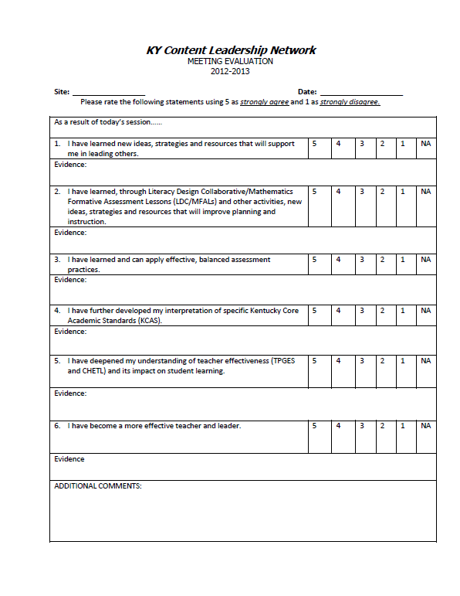
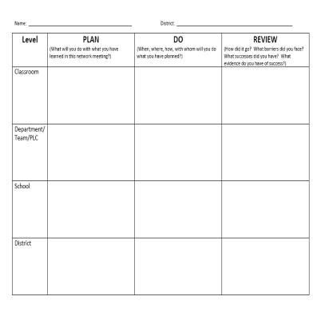
Through-out the Day, please complete the:
Evaluation
Plan/Do/Review
Gather evidence about what you are learning today.
Plan how you could share what you learned today:
in your school
in your district

Slide 7


2012-13 Teacher Leader Network Target
I can use careful planning to improve instruction in order
to become an effective
teacher and leader.
Notes:
Carole
Everything we do today focuses on ways to plan for effective instruction that meets the criteria of the ELA/Literacy KCAS

Slide 8

Small Group Sessions
TOPICS
TPGES
Student Engagement
Component 3c
A Closer Look at
Text-Dependent Questions
Sharing and Submitting
LDC Modules
Notes:
Carole – REFER TO BREAKOUT SESSION SCHEDULE HANDOUT (Sessions begin at 9:20)
Quick Explanation about morning breakout sessions 55 minutes each
TPGES – Stacy
TDQ – Linda and Mary
LDC – Jennifer

Slide 9



12:15 – 1:00 p.m.

Slide 10

Plan-Do-Review
Take a moment and add notes to your P-D-R
Guiding Questions
  What information will you share?
  How will you share the information?
  What concerns do you still have?
Notes:
Carole
Ask TLs to take a few minutes and add information to their PDR as we “gather back together” after lunch…
We understand that the time allowed to do this on a large scale is not determined by you; however, share in a PLC, with a colleague, a department, principal, etc…

Slide 11


“Strategies That Work”
Teaching Comprehension for
Understanding and Engagement
(2nd Edition)
By Stephanie Harvey and Anne Goudvis
…an indispensable resource for teachers who want to explicitly teach thinking strategies so that students become engaged, thoughtful, independent readers.
Notes:
Carole
Strategies That Work: Teaching Comprehension for Understanding and Engagement
Teachers will be introduced and given this book. Their assignment will be to choose one of the strategies and implement in their upcoming LDC or… They should be prepared to share with others in their grade levels in March.
Make connection to TPGES Student Engagement 3c

Slide 12

Strategies That Work
March Meeting Sharathon
Choose one strategy from “Strategies That Work”
Implement the strategy with students (if possible include it within your upcoming LDC Module)
Come to the March 28th meeting prepared to share the strategy and your results with a small group of teachers in your grade level.
If you want, feel free to bring handouts, etc. to share with your small group!
Notes:
Carole
We want to continue the “Give One-Get One” activity in March…
NOT MANDATORY TO BRING HANDOUTS, ETC.

Slide 13


A Collaborative Learning Space to share instructional expertise and practices or receive coaching
R-Coaches
  act as “think partners”
  offer collegial support in best practices, designing LDC modules and implementing instruction to meet the CCSS
  are available virtually 24/7
To Join R-Group Space
  Complete and sign the release form inside your folder
  Submit completed, signed form to Carole Mullins
  You will receive an invitation via email with instructions to access the site and set up a user name and password
Notes:
Carole HANDOUT – Release Form
An OPTIONAL Professional Learning Community for LDC. Allow Integration School TLs that are already members to share input about R-GroupSpace

Slide 14

LDC TOOLBOX
Notes:
Jennifer

Slide 15

LDC Module Checklist
LDC Module Checklist is used to ensure that all required elements of a LDC module are present.
Perfect for use by authors of LDC modules during the development process OR to ensure a module is ready to move forward for feedback and jurying.
Notes:
Jennifer

Slide 16
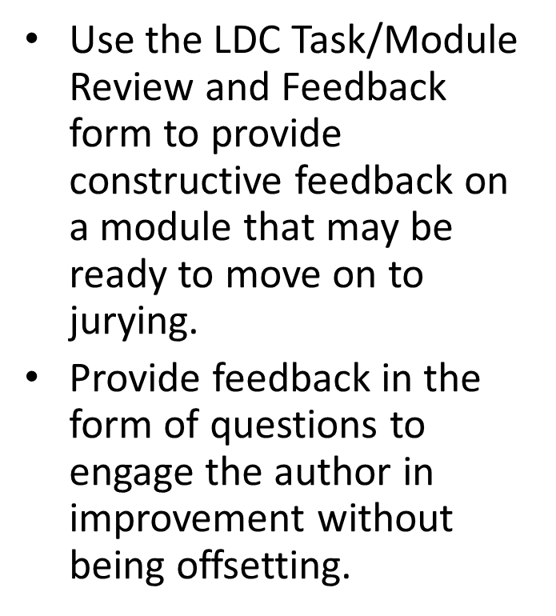
LDC Task/Module Review and Feedback Form
Notes:
Jennifer

Slide 17
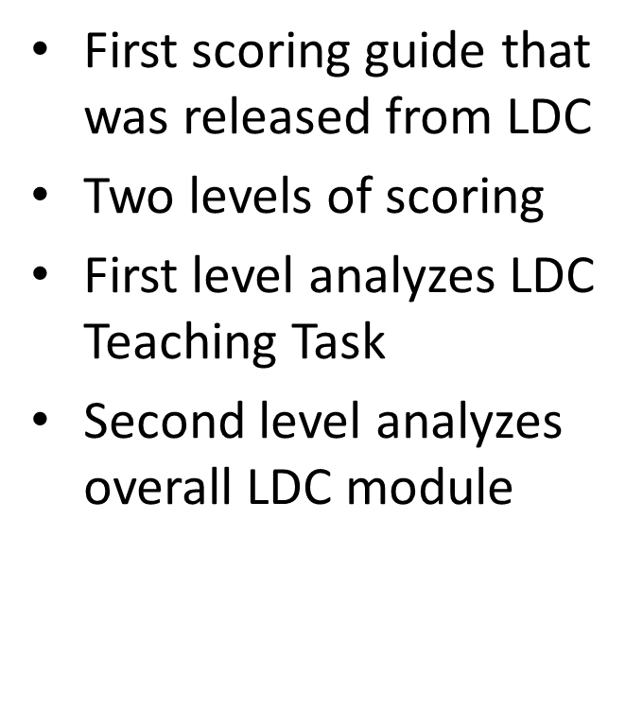
LDC “Good to Go” Scoring Guide
Notes:
Jennifer

Slide 18
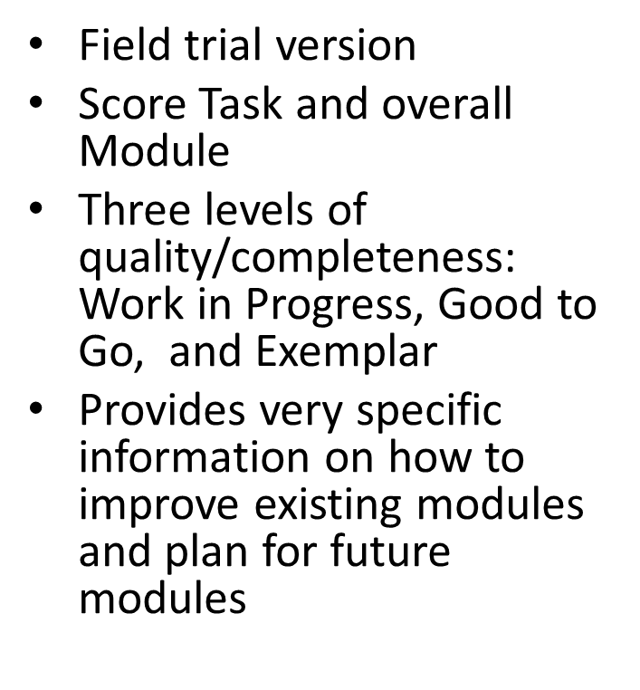
LDC Task/Module Scoring Guide: Field Trial Version
Notes:
Jennifer

Slide 19
Using LDC Tools
We will be using the LDC module checklist, the LDC Module Review and Feedback Form, and your own module that you are submitting today.
You will be working with a partner.

Slide 20
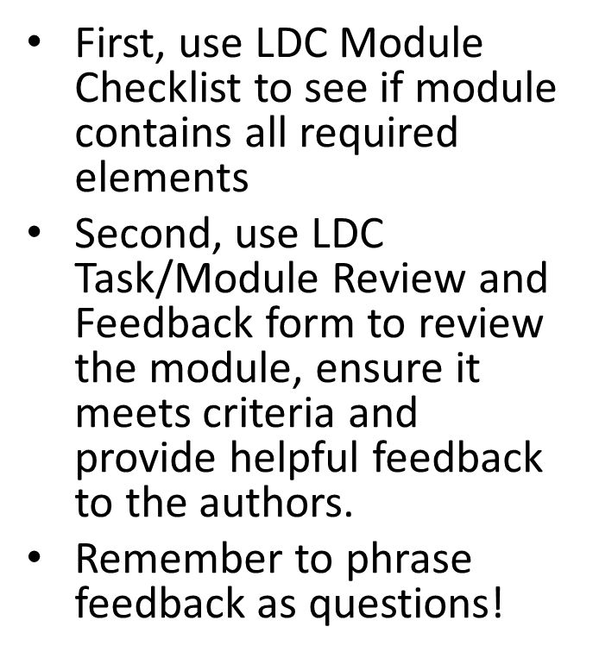

Using LDC Tools
Notes:
Jennifer

Slide 21

An Instructional Tool
Notes:
Jennifer

Slide 22

Engaging Students in the Module
Students need to see the connection between the final task and the mini-tasks/Skills Clusters included in the Instructional Ladder that lead to successful completion.
In Skill Cluster 1 students must understand the task.
One strategy to help build this understanding is to ask students to rewrite the task and annotate it in order to get the “big picture” of what the module will entail.
Notes:
Jennifer

Slide 23

Trying it Out!
Using the handout, rewrite and annotate the following
Teaching Task:
How are a culture’s values reflected in literature?
After reading a version of Cinderella from a different
culture(s) write an essay that discusses the similarities
and differences between each story and evaluates how
they reflect which values are most important in that
culture(s). Be sure to support your position with
evidence from the texts.
Notes:
Jennifer

Slide 24

I Will…
In engaging in an LDC Module, students also need to analyze the task to see what work and learning it entails.
Using the same task, fill in the “I will” chart to identify what student will be doing to successfully complete the module.
How are a culture’s values reflected in literature?
After reading a version of Cinderella from a different
culture(s) write an essay that discusses the similarities
and differences between each story and evaluates how
they reflect which values are most important in that
culture(s). Be sure to support your position with
evidence from the texts.
Notes:
Jennifer

Slide 25

Rubric Translation
What does work that meets standards “look like”?
Students will break down the rubric into “look fors”…what are the key features of each scoring criteria?
What do I already know how to do? What do I need support in completing? How can I plan for success?
Notes:
Jennifer

Slide 26

Pacing
Time management and study skills are key skills for College and Career Readiness and we struggle to teach them to our students.
Providing students the opportunity to plan their path to successful completion of a task is a way to engage them in these skills.
Students will identify the date that the final task is due, then back-map to identify key dates that work must be completed.
Notes:
Jennifer

Slide 27

Don’t Forget the Tools that Help to Plan and Develop successful LDC Modules!
KCAS ELA Standards/Quality Core Standards (HS)
LDC Module Checklist
LDC Jurying Tool
Sample Modules
Argumentative or Informational/Explanatory LDC Module Templates
Instructional Strategies you learned in today’s Breakout Session!!
Notes:
Jennifer

Slide 28

for March 28, 2013
Bring a completed LDC Module:
  Pre-Assessment
  Instructional Ladder
  2 Samples of Scored Student Work for each of the four performance levels:
    Bring copies, not originals. Remove any information that could identify the student (name, school, teacher’s name, personal information, etc.)
  “Strategies That Work” Lesson Results
www.kvecelatln.weebly.com
Notes:
Carole
Right before break and group work time, a few reminders…

Slide 29


Remember to…
Turn in your Evaluation
and Impact Log
before you leave!
Notes:
Carole
Give these items to your room facilitator

Slide 30



Grade Level Groups
(Sessions begin at 2:30 p.m.)
K-5: Room 1
6-8: Room 2
9-12: Main Room
2:15-2:25 p.m.
Notes:
Carole
Take a break then report to your grade level group workroom for LDC Development Work Time with Facilitator Assistance

Slide 31


Our next meeting is March 28, 2013
www.kvecelatln.weebly.com
Notes:
Carole
March Meeting Reminder

