Slide 1
6-12 English/LA and Disciplinary Literacy
Floyd County Literacy Leaders
November 27, 2017
Carole Mullins, NBCT
KVEC Literacy Instructional Specialist
carole.mullins@hazard.kyschools.ky.us
www.kvecelatln.weebly.com
Kimberly Sergent
KVEC Social Studies Instructional Specialist
Kimberly.sergent@letcher.kyschools.us

Slide 2
“He who dares to teach, must never cease to learn. ”
~John Cotton Dana

Slide 3


October 24, 2017
Step 1: Read the article and identify 2-3 “AHAs”.
Step 2: Record your thoughts/comments about each aha on the
paper covering your table. Sign your name.
Step 3: Walk around the table(s) and read your colleague’s
thoughts/comments.
Step 4: Respond to the thoughts/comment when appropriate.
Step 5: Return to your seat for discussion.
Notes:
Carole
Utilize “The Tablecloth Write-Around” strategy. Can be used with students, too.
Intent is to use a timely message “to set stage for the day’s learning” by revealing the writing results from a large number of 6-12 students that were challenged on different skills from a set of facts and vague language. Results are NOT good…
Making connections among the standards, required teacher instruction and student academic and social achievement.`

Slide 4

What is meant by College and Career Readiness (CCR)
Anchor Standards?
…the acquisition of the knowledge and skills a student needs to enroll and succeed in credit-bearing, first-year courses at a postsecondary institution (such as a two- or four-year college, trade school, or technical school) without the need for remediation. (ACT)
The standards were built on this vision for every single student who graduates from high school.
Notes:
Carole
Let’s begin with the “end in mind”…
Our goal is to graduate students that are prepared to continue their education without the need for remediation!
“While the English language arts classroom has often been seen as the proper site for literacy instruction, the standards acknowledge that the responsibility for teaching such skills must also extend to other content areas.”

Slide 5
A Few Major Problems Identified…
Significant numbers of students read so poorly that they are unlikely to have access to full participation in American society
Significant numbers of students who are deemed literate are not sufficiently literate to succeed in college or career
According to NAEP, there have been clear reading improvements among fourth-graders since 1992. And yet, middle school students are reading no better than then and high school students appear to have fallen
Teachers have found ways of getting info to students without texts (e.g., Powerpoint, video) and omitting reading of text
But, ACT research has found that the amount of text reading between 7th and 12th grades was the best preparation of later success
Notes:
Carole
Prior to and during development of the CCSS…
Avoiding Text

Slide 6
Elevating Literacy And Literacy Instruction
Up Through The Grade Levels
ACT found that state standards did not take specific
Reading standards through high school.
The Kentucky Academic Standards (KAS) for English/LA changed this…
  Reading Foundational Skills for K-5
  Literacy Skills for K-5 content area classes embedded
  Grades 6-12: 10 Reading/Writing Standards specific
  to History/Social Studies; Science and Technical
  Subjects
Notes:
Carole
Review Quickly:
Reading Foundational Skills: Phonemic Awareness, Phonics, Vocabulary, Fluency and Comprehension
…now let’s take a closer look at the standards… Because this is a Train-the-Trainer Session, we will go as slowly or as fast as you want…

Slide 7


“The Standards”
What Does It Mean to be a Literate Person in the 21st Century?
  Public School is an adventure.
  If you are going to use a map, make sure it’s correct!
Kentucky’s Academic Standards
for English Language Arts and
Literacy in History/Social Studies,
Science, and Technical Subjects
Notes:
Carole
Standards were developed to be:
Focused on critical demands of the global economy
Fewer, but more rigorous
Easily communicated to stakeholders
Based on research
Considered international benchmarks
Aligned from kindergarten through college entrance
Intended to be a living work: as new and better evidence emerges the standards will be revised accordingly
The Standards are our Map for the destination of high level student learning.

Slide 8
College and Career Readiness Standards
English Language Arts
Literacy in History/Social Studies, Science, and Technical Subjects
Reading (20)
1)Informational (10)
2)Literary (10)
Writing (10)
Speaking & Listening (6)
Language (6)
Reading (10)
Writing (10)
Same Skills, Different Approach !
Notes:
Carole
Visual Chart of the key design… The Standards Work Group for the ELA K-12 Common Core Standards Committee stated “ most states have 120 standards in ELA. The CC has 42…”
Fewer and Broader… This means that teachers must design more rigorous tasks to help students achieve learning at a higher level…
This is where Formative Assessment (CASL), Deconstruction of the Standards and Characteristics of Highly Effective Teaching and Learning (CHETL) become the important pieces of the standards.
By themselves, the standards WILL NOT improve student learning!!!
The overarching skill emphasized in the ELA standards is COMPREHENSION at its highest level: ANALYSIS, CLASSIFICATION, ABILITY TO COMPARE/CONTRAST, SYNTHESIZE
Reading has 20 standards that are sub-divided into informational and literary text and each has10 standards (each connects back to its corresponding CCR
anchor)
10 standards for writing
6 Standards for Speaking and Listening
6 Standards for Language
Content Specific Literacy standards include 10 standards for reading and 10 for writing:

Slide 9

“Read like a detective, write like a reporter.”
Notes:
Carole
Mantra—we need students that “read like detectives and write like reporters” (Coleman)

Slide 10
Reading Standard #1
CCR Anchor Standard #1
(Literature and Informational)
Read closely to determine what the
text says explicitly and to make
logical inferences from it; cite
specific textual evidence when
writing or speaking to support
conclusions drawn from the text.
K-12 Progressions
Notes:
Carole
Expectations for Literature and Informational Reading and Content Literacy: Standard #1 H/O
ELA Reading Standard #1 – Have participants to:
Skim/Scan grade level’s standard in both literature and informational reading.
Compare/Contrast (Reading St 1 Skills are the same for both L and I.
Now highlight the first word in each grade level K-12
Discuss observations you made with others at your table
“Transition” for R/W skills in all content areas actually takes place at 5th grade!
Great for planning and communication for vertical alignment. Development of units, etc…
Full Document available on my website and will be posted to the HOLLER along with today’s handouts. I will also be posting additional resources that I have researched, used, etc.

Slide 11

Deconstructed Reading Informational Standard 1: 7th Grade

Slide 12
Distribution of Literary and Informational Passages by Grade in the NAEP Reading Framework
GRADE | LITERARY | INFORMATION
4 | 50% | 50%
8 | 45% | 55%
12 | 30% | 70%
The Standards aim to align instruction with this framework so that many more students than at present can meet the requirements of college and career readiness.
ELA CCSS Page 5
Notes:
WORK ON THESE NOTES The Standards are not alone in calling for a special emphasis on disciplinary literacy and informational text. The 2009 reading framework of the National Assessment of Educational Progress (NAEP) requires a high and increasing proportion of informational text on its assessment as students advance through the grades.
Percentages do not imply that high school ELA teachers must teach 70% informational text; they demand instead that a great deal of reading should occur in other disciplines. It is a shared responsibility!!
Students who were successful on NAEP were found to spend a high percentage of time reading informational passages
The percentages on the table reflect the sum of student reading, not just reading in ELA settings.
Teachers of senior English classes, for example, are not required to devote 70 percent of reading to informational texts. Rather, 70 percent of student reading across the grade should be informational.
Because the ELA classroom must focus on literature (stories, drama, and poetry) as well as literary nonfiction, a great deal of informational reading in grades 6–12 must take place in other classes if the NAEP assessment framework is to be matched instructionally.

Slide 13
Literary vs Informational
CCR Reading Standard 3: Analyze how and why individuals, events, and ideas develop and interact over the course of a text.
Reading Standards for Literature |  | Reading Standards for Informational Text
Grade 7: Analyze how particular elements of a story or drama interact (e.g., how setting shapes the characters or plot) |  | Grade 7: Analyze the interactions between individuals, events, and ideas in a text (e.g., how ideas influence individuals or events, or how individuals influence ideas or events).
Grades 11-12: Evaluate various explanations for characters’ actions or for events and determine which explanation best accords with textual evidence, acknowledging where the text leaves matters uncertain. |  | Grades 11-12: Analyze a complex set of ideas or sequence of events and explain how specific individuals, ideas, or events interact and develop over the course of the text.
Notes:
Carole
Emphasize the DIFFERENCES IN LITERATURE AND INFORMATIONAL TEXT… SAME SKILL, DIFFERENT APPROACH
Content teachers need the “clarification” (especially H.S. level) of how the standards define reading skills within their subject area.
Another important aspect is that ALL teachers should emphasize to their students that the SKILLS PROCESS of a standard are the same (i.e. describe, analyze, etc). It is the context, subject or topic that will be different!

Slide 14
Specific Elementary Reading Issues…
“Sounding the Alarm on Kentucky’s Academic Test Scores”
Hal Heiner, Secretary
KY Education & Workforce Development Cabinet
http://kentuckytoday.com/stories/sounding-the-alarm-on-kentuckys-academic-test-scores,9455
“The Prichard Statement on 2017 Academic Test Scores”
http://prichblog.blogspot.com/2017/09/prichard-statement-on-2017-results.html
Notes:
Carole:
I want to discuss some KY specific issues that are directly connected to the teaching of Reading K-2.
Share information from these two reports that focuses, especially on 3rd grade reading…
Not spending enough time with instruction around the 5 components of reading at K-2

Slide 15
Writing Standard #1
CCR Anchor Standard #1
Write arguments to support claims in an analysis of substantive topics or texts, using valid reasoning and relevant and sufficient evidence.
K-12 Progressions
Notes:
Carole
Review Writing Standard #1-2-3 Progression Handout
The Standards place an important emphasis on argumentation across all disciplines and grade levels.
ELA Writing Standard #1 – Argumentation
Have participants to:
Read the introductory paragraph on page 2
Read the Anchor Standard for Standard 1
Read a specific grade level standard (understand that this a teacher’s part of helping a student reach the Anchor Std. by the time they graduate HS
Beginning in kindergarten, students are asked to communicate their opinions – a building block to writing effective argument
Shift occurs in 6th grade from opinion to argumentation. What does this mean for grades 4-5?
DISCUSSION

Slide 16
Deconstructed Writing Standard 1: 7th Grade
Kentucky Academic Standards with Targets

Slide 17
Distribution of Communicative Purposes by Grade in the NAEP Writing Framework
GRADE | TO PERSUADE Opinion/Argumentation | TO EXPLAIN Info./Exp. | TO CONVEY EXPERIENCE Narrative
4 | 30% | 35% | 35%
8 | 35% | 35% | 30%
12 | 40% | 40% | 20%
It follows that writing assessments aligned with the Standards should adhere to the distribution of writing purposes across grades outlined by NAEP.
ELA CCSS Page 5
Notes:
As with reading, the percentages in the table reflect the sum of student writing, not just writing in ELA settings.
One reason for this shift in the organization of writing standards is to better prepare students college and career writing
Notice the decreasing emphasis on narrative writing that students do in school. THOSE PERCENTAGES DO NOT REPRESENT AN ELA CLASSROOM IN ISOLATION.

Slide 18
Disciplinary Literacy:
KAS Literacy Standards
Each content or subject discipline has:
its own unique knowledge core and …
its own ways of inquiring, investigating, reasoning, representing, and questioning.
Literary Fiction
Mathematics
Bio Science
Phy Science
History
Social Studies
Technical
Health Fitness
Humanities
Intermediate Literacy
Basic Literacy
Doug Buehl, Developing Readers in the Academic Disciplines, 2011, p.13
Notes:
Disciplinary literacy refers to the specialized skills that someone must master to be able to read and write in the various disciplines (science, math, literature, history, geography, economics, politics, government, law, sociology, psychology, etc. ) and technical fields.
Learn to read – read to learn – need the next step.
Types of reading required by CCSS: The best teachers have always known this…formalize and systematize the process.
Basic Literacy: Literacy skills such as decoding and knowledge of high-frequency words that
underlie virtually all reading tasks.
Intermediate Literacy: Literacy skills common to many tasks, including generic comprehension
strategies, common word meanings, and basic fluency. Streamlining and multi-tasking phase
Disciplinary Literacy: Literacy skills specialized to history, science, mathematics, literature, or
other subject matter.

Slide 19
Overview of the Reading Standards for History/Social Studies
  Key Ideas and Detail: Cite specific textual evidence to support analysis of primary and secondary sources
  Craft and Structure: Analyze, evaluate, and differentiate primary and secondary sources
  Integration of Knowledge and Ideas: Integrate information from diverse primary and secondary sources into a coherent understanding of an idea or event
Notes:
Kim
Carole
6-12 Literacy in the Content Area Standards and emphasis (again) SAME SKILL, DIFFERENT APPROACH!
Refer participants back to the “Expectations for Literature and Informational Reading and Content Literacy: Standard #1 H/O”
CCR Anchor Standards for Reading remain the same
Again, Remember only 10 standards for Reading and 10 for Writing
Note terminology of Cite, primary/secondary, Analyze, Evaluate, Differentiate, Integrate --- DEPTH AND RIGOR implications for both teaching and learning.
Remember: Just becoming familiar with the standards will not get students to proficiency

Slide 20
Overview of the Reading Standards for
Science & Technical Subjects 6-12
  Key Ideas and Detail: Cite specific textual evidence to support analysis of scientific and technical texts
  Craft and Structure: Analyze the scope and purpose of an experiment or explanation and determine which issues remain unresolved or uncertain
  Integration of Knowledge and Ideas: Synthesize information in different formats by representing complex information in a text in graphical form (e.g., a table or chart) or translating a graphic or equation into words
Notes:
Kim
6-12 Literacy in the Content Area Standards and emphasis (again) SAME SKILL, DIFFERENT APPROACH!
Refer participants back to the “Expectations for Literature and Informational Reading and Content Literacy: Standard #1 H/O”
CCR Anchor Standards for Reading remain the same
Again, Remember only 10 standards for Reading and 10 for Writing
Note terminology of Cite, Analyze, Synthesize, Translating --- DEPTH AND RIGOR implications for both teaching and learning.

Slide 21
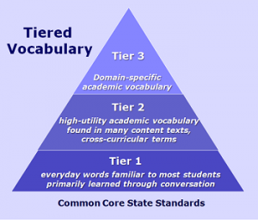
Including Tier Words in Instruction
The standards suggest that it's important to target specific instruction on Tier 2 and Tier 3 vocabulary words to help students develop deep understanding that cannot be acquired through independent reading.
Since Tier 3 words are typically targeted in content specific instruction, it's particularly important and challenging to identify and target Tier 2 words, since they appear across all disciplines.
The task at hand, then, appears to be identifying the Tier 2 words and finding effective instructional strategies to support acquisition of those words.
Notes:
Tier 1:
Words acquired through every day speech, usually learned in the early grades
Tier 2:
Academic words that appear across all types of text. These are often precise words that are used by the author in place of common words. (i.e. gallop instead of run). They change meaning with use.
Tier 2 High frequency words used by mature language users across several content areas. Because of their lack of redundancy in oral language, Tier 2 words present challenges to students who primarily meet them in print. Examples of Tier 2 words are obvious, complex, establish and verify.
Tier 3:
Domain specific words" that are specifically tied to content. (i.e. Constitution, lava) These are typically the types of vocabulary words that are included in glossaries, highlighted in textbooks and address by teachers. They are considered difficult words important to understanding content.

Slide 22
What About Disciplinary Writing?
Using writing to learn provides students with frequent opportunities to write expressively in order to wrestle with classroom content.
Writing is a method of demonstrating understanding of content area knowledge.
Writing should be utilized in all content areas, not just English language arts classrooms.
Notes:
Kim

Slide 23

Discipline-specific Considerations
History
Primary source documents
Sourcing
CTE
Technical manuals
Fostering collaboration
Contextualizing
Resolving problems
Notes:
Carole

Slide 24

Discipline-specific Considerations
Math
Language-rich, multi-step problems
Concepts represented in multiple ways
Science
Unique text features
Information conveyed through visual representations
Use of language to defend, explain, or provide evidence of reasonableness
Acquisition of technical vocabulary
Notes:
Carole

Slide 25
Common Core You Tube Videos
Videos Produced by
James B. Hunt, Jr. Institute for Educational
Leadership and Policy
And the Council of Chief State School Officers (CCSSO)
Example:
Writing to Inform and Make Arguments (3:36)
http://www.youtube.com/watch?v=Jt_2jI010WU&feature=related
Notes:
12 You Tube Videos – explaining intent of standards, etc. – longest one is about 10 minutes. Presenters worked on standards development
Located on my website
Common Core State Standards: A New Foundation for Student Success (2:55 mins)
http://www.youtube.com/watch?v=9IGD9oLofks
Common Core State Standards: Principles of Development (8:01 mins)
http://www.youtube.com/watch?v=d1MVErnOD7c
The Crucial Role of Higher Education and Business in Developing the Standards (1:42 mins)
http://www.youtube.com/watch?v=_VqzWyjSlk4
The English Language Arts Standards: Key Changes and their Evidence (6:25 mins.)
http://www.youtube.com/watch?v=JDzTOyxRGLI&feature=related
Literacy in Other Disciplines: (3:61 Mins)
http://www.youtube.com/watch?v=1zHWMfg_8r0&feature=related
The Balance of Informational and Literary Texts in K-5 (2:15 mins)
http://www.youtube.com/watch?v=k7yQk6a501s&feature=related
Literary Non-Fiction in Grades 6-12: Opening New Worlds for Teachers and Students (1:33 mins)
http://www.youtube.com/watch?v=KC5lgdf0-W8
Literary Non-Fiction in the Classroom: Opening New Worlds for Students (2:27 mins)
http://www.youtube.com/watch?v=I0uvIAqZbNI&feature=related
Writing to Inform and Make Arguments (3:36)
http://www.youtube.com/watch?v=Jt_2jI010WU&feature=related
Speaking and Listening: The Key Role of Evidence (2:25 mins)
http://www.youtube.com/watch?v=FZXwEaHrdbo&feature=related
Conventions of Standard English Writing and Speaking (1:44)
http://www.youtube.com/watch?v=zoeh0r1Qe_k&feature=related
Text-Dependent Analysis in Action: Examples From Dr. MLK, Jr.'s Letter from a Birmingham Jail: From ELA Appendix B (10:20 mins) http://www.youtube.com/watch?v=Ho_ntaYbL7o

Slide 26
Standards do … | Standards do not …
Establish what students need to learn. | Dictate how teachers should teach. Instead, schools and teachers will decide how best to help students reach the standards.
Attempt to focus on what is most essential. | Describe all that can or should be taught. A great deal is left to the discretion of teachers and curriculum developers.
Set grade-level standards. | Define the intervention methods or materials necessary to support students who are below or above grade-level expectations.
Notes:
Kim: Let’s…
Standards are the floor, not the ceiling for instruction
The standards do not describe all that can or should be taught (only what is essential is included). A well-developed, content-rich curriculum must be developed by individual schools/districts/states…
Everyone would like the standards to be a “magic wand” and solve our problems, but that is a Fantasy
You won’t see strategies or instructional advice. BUT— HIGHLY EFFECTIVE TEACHING AND LEARNING will guide teachers. Along with this, the establishment of learning targets are beneficial in understanding if our students have met the standards.
No grade-specific standard can fully reflect the great variety in abilities, but GREAT teachers and teaching can identify them and address their needs. Maybe mention RtI, CSIP, etc…

Slide 27

What Really Matters…
“What really matters, in terms of developing readers and writers, is the quality of classroom instruction.”
---Richard Allington
Notes:
Carole
You won’t see strategies or instructional advice in the standards. But, the establishment of learning targets are beneficial in understanding if your students have met the standards.
No grade-specific standard can fully reflect the great variety in abilities, but GREAT teachers and teaching can identify them and address their needs.

Slide 28
Common Core Shifts
Increase Reading of Informational Text
Text Complexity
Academic Vocabulary
Text-based Answers
Increase Writing from Sources
Literacy Instruction in all Content Areas
Notes:
Carole “Oregon” Shifts in ELA/Literacy H/O
I like this document because it focuses on Actions, not just statements about the shifts. It also contains links to ELA Appendix A-B-C (we will discuss these later…)
All Teachers Must Support Literacy: WHY?
This interdisciplinary approach to literacy stems from extensive research establishing the need for college and career ready students to be proficient in reading complex informational texts, independently, in a variety of content areas.
Most of the required reading in college and workforce training programs is informational in structure and challenging in content
Postsecondary education programs typically provide students with both a higher volume of such reading than is generally required in K–12 schools and comparatively little scaffolding.
Assessments will require a high and increasing proportion of informational text as students advance through the grades.

Slide 29
Shifts Mean a Change in Practice!
From…
Content knowledge primarily from teacher-led lecture
To…
Content knowledge comes from a balance of reading, writing lecture, and hands-on experience
Quick Explanation of the Shifts by Kate Gerson, Senior Regent Research Fellow for Common Core with the Regents Research Fund
(And, Former Secondary Teacher)
https://www.engageny.org/resource/quick-explanation-of-the-shifts-by-kate-gerson
Notes:
Carole:
Presentation by Kate Gerson, a Senior Regents Research Fellow for Common Core with the Regents Research Fund, gives a quick explanation of the Common Core Shifts. November 2012

Slide 30
High Level Summary of the “Biggest” Shifts
Building knowledge through content-rich nonfiction and informational texts
Reading, writing and speaking grounded in evidence from text
Regular practice with complex text and its academic vocabulary
Notes:
Carole: Key Instructional Shifts H/Out
The shifts are a high-level summary of the biggest changes signified by the adoption of the CCSS. They are a great starting point for learning about and understanding the CCSS. They are meant to be succinct and easy to remember.
Shift 1: WHY?
Students are required to read very little informational text in elementary and middle school.
Non-fiction makes up the vast majority of required reading in college/workplace.
Informational text is harder for students to comprehend than narrative text.
Supports students learning how to read different types of informational text
Shift 2: WHY?
Most college and workplace writing requires evidence.
Evidence is a major emphasis of the ELA Standards: Reading Standard 1, Writing Standard 9, Speaking and Listening standards 2, 3 and 4, all focus on the gathering, evaluating and presenting of evidence from text.
Being able to locate and deploy evidence are hallmarks of strong readers and writers.
Shift 2 requires TEXT DEPENDENT QUESTIONS and ANSWERS.
Shift 3: WHY?
Gap between complexity of college and high school texts is huge.
What students can read, in terms of complexity, is greatest predictor of success in college ( 2006 ACT study).
Too many students are reading at too low a level.
Standards include a staircase of increasing text complexity from elementary through high school.
Standards also focus on building general academic vocabulary so critical to comprehension.

Slide 31


Comprehension and Collaboration
SL.CCR.1
the
Notes:
Carole: Processing the Shifts H/Out and Activity
SL.CCR.1
Prepare for and participate in collaborations with diverse partners, building on each others’ ideas and expressing their own clearly and persuasively.

Slide 32

10. Read and comprehend complex literary and informational texts independently and proficiently.
Notes:
Carole: Transitioning to TEXT COMPLEXITY
Refer back to Reading Standard 1 and 10 H/O
“Standard 10 defines a grade-by-grade ‘staircase’ of increasing text complexity that rises from beginning reading to the college and career readiness level.” (CCSS, 2010, p. 80)

Slide 33
The Crisis of Text Complexity
  Complexity of texts students are expected to read is way below what is required to achieve college and career readiness:
    High school textbooks have declined in all subject areas over several decades
    Average length of sentences in K-8 textbooks has declined from 20 to 14 words
    Vocabulary demands have declined, e.g., 8th grade textbooks = former 5th grade texts; 12th grade anthologies = former 7th grade texts
  Complexity of college and careers texts has remained steady or increased, resulting in a huge gap (350L)
Notes:
Carole
Too many students are reading at too low a level (Less than 50% of graduates can read sufficiently complex texts) Look at an old McGuffey Reader… Text is more difficult than our text now.

Slide 34

What does it mean to you?
Anchor Standard
  R.CCR.10
  Read and comprehend complex literary and
  informational texts independently and proficiently.
Notes:
Carole
Refer participants to Reading Standard #10 H/out

Slide 35
What Makes Text Complex?
Educational Leadership, March 2012
The Challenge of Challenging Text
Timothy Shanahan, Douglas Fisher and Nancy Frey
Vocabulary: Knowledge of word meaning
Sentence Structure: How the words operate together
Coherence: How particular words, ideas, and sentences in text connect with one another
Organization: The patterns authors use to communicate complex information
Background Knowledge: The reader’s prior knowledge
Notes:
ACTIVITY:
Number Off 1-5: Read Section and chart info to share with rest of groups
1. Vocabulary:
Studies show that higher-order thinking in reading depends heavily on knowledge of word meanings… Students' ability to comprehend a piece of text depends on the number of unfamiliar domain-specific words and new general academic terms they encounter.
2. Sentence Structure:
Words are not the whole picture. Sentence structure matters, too, because it determines how the words operate together. In some cases, complex sentence structures are necessary to communicate the complexity of the information itself—thus the long noun phrases common in science.
3. Coherence:
How particular words, ideas, and sentences in text connect with one another, a feature referred to as coherence.
4. Organization:
The patterns authors use to communicate complex information… Ideas can be arranged across text in many ways, some more straightforward than others.
5. Background:
Vocabulary, sentence structure, coherence, and organization can all be determined by closely analyzing the text itself. A final determinant of text difficulty, however, depends on the reader's prior knowledge. Students' background knowledge, including developmental, experiential, and cognitive factors, influences their ability to understand the explicit and inferential qualities of a text.

Slide 36
Text Complexity is Defined in the Standards by:
1. Qualitative measures – levels of meaning, structure, language conventionality and clarity, and knowledge demands often best measured by an attentive human reader.
2. Quantitative measures – readability and other scores of text complexity often best measured by computer software.
Qualitative
Quantitative
3. Reader and Task considerations – background knowledge of reader, motivation, interests, and complexity generated by tasks assigned often best made by educators employing their professional judgment.
Reader and Task
Notes:
Carole
Let’s take a look at Text Complexity so you will have some background and a way to help other teachers understand it’s important for student achievement.
Specific information is located in Appendix A of the CCSS

Slide 37
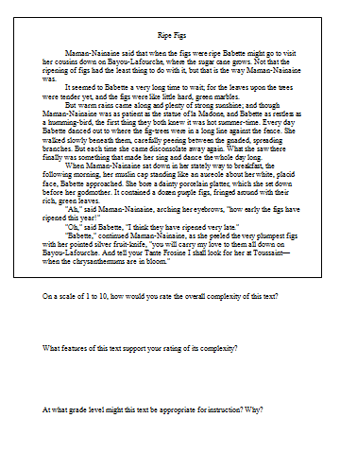

Ripe Figs by Kate Chopin
  As a small group, read “Ripe Figs” and answer the three questions provided….
Notes:
Carole: Ripe Figs H/Out
Follow directions on screen…

Slide 38
Discussion
  On a scale of 1 to 10, how would you rate the overall complexity of this text?
  What features of this text support your rating of its complexity?
  At what grade level might this text be appropriate for instruction? Why?
Notes:
Carole:
Hold onto your answers as we work through all 3 steps of the TC process… I will share the answers later…

Slide 39
Determining Text Complexity
Page 31, Elementary
Page 57, Secondary
Determine the quantitative measures of the text.
Analyze the qualitative measures of the text.
Reflect upon the reader and task considerations.
Recommend placement in the appropriate text complexity band.
Qualitative
Quantitative
Reader and Task
Notes:
Carole
Overview of the Protocol
Measuring Text Complexity: Three Factors found in standards
Page 31 - Standard 10: Range, Quality, and Complexity of Student Reading K–5
Page 57 - Standard 10: Range, Quality, and Complexity of Student Reading 6-12

Slide 40
Step 1: Quantitative Measures
  Measures such as:
  Word length
  Word frequency
  Word difficulty
  Sentence length
  Text length
  Text cohesion
Qualitative
Quantitative
Reader and Task
Notes:
Carole
(Share Ben/Benjamin story)
Quantitative measures stand as proxies for semantic and syntactic complexity:
Word difficulty (frequency, length)
Sentence length and syntax
Some newer measures also measure text cohesion and other features of vocabulary

Slide 41
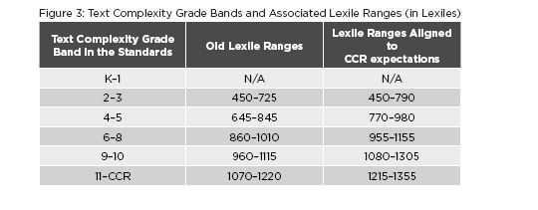
This Chart Demonstrates the Lexile Ranges for
Text Complexity Grade Bands
CCSS Appendix Pg. 8
Notes:
Carole OTHER INFORMATION ABOUT JOBS…
Realigned Upward from earlier levels
Remember, however, that the quantitative measures aspect is only the first of three “legs” of the text complexity triangle.
To Kill A Mockingbird:
Lexile is 870 – Grade Band Level 4-5
Qualitative Measures such as: VERY IMPORTANT
Levels of meaning
Levels of purpose
Structure
Organization
Language conventionality
Language clarity
Prior knowledge demands
Task and Reader Considerations: THE TEACHER
RECOMMENDED PLACEMENT IS GRADES 9-10
The Common Core Standards devote as much attention to the text complexity of what students are reading as it does to how students read.
As students advance through the grades, they must both develop their comprehension skills and apply them to increasingly complex texts. The proportion of texts that students read each year should come from a particular text complexity grade band.

Slide 42
Step 2: Qualitative Measures
  Measures such as:
  Levels of meaning
  Levels of purpose
  Structure
  Organization
  Language conventionality
  Language clarity
  Prior knowledge demands
Qualitative
Quantitative
Reader and Task
Notes:
Carole:
Qualitative measures are on a continuum (not grade/band specific) and most useful working in conjunction with quantitative measures.

Slide 43
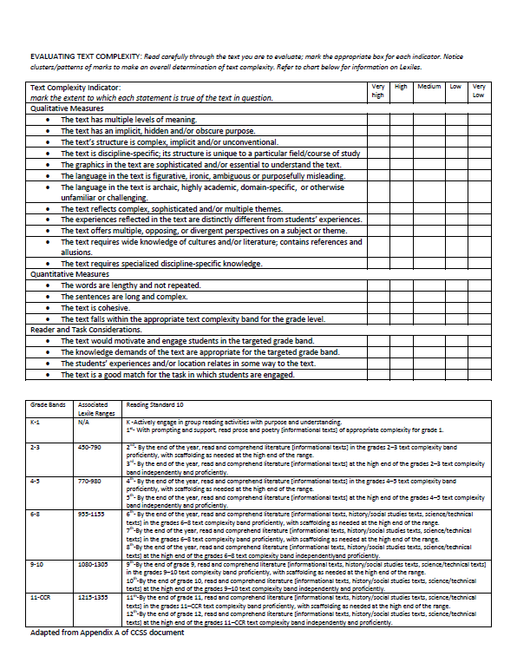
Qualitative Measures Resource
Notes:
Use this H/Out to determine the qualitative measure of Ripe Figs
Does having a specific resource to guide you help? Are you still focused in the same grade band as the Lexile level?

Slide 44
Step 3: Reader and Task Considerations
  Considerations such as:
  Motivation
  Knowledge and experience
  Purpose for reading
  Complexity of task assigned regarding text
  Complexity of questions asked regarding text
Qualitative
Quantitative
Reader and Task
Notes:
Carole: Reader-Task-Text H/Out

Slide 45
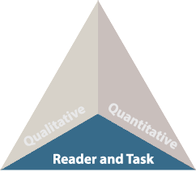
Matching Reader, Task, and Text
Utilize your professional judgement and instructional goals for each specific text to design lessons based on your knowledge of students' individual needs.
Notes:
Carole

Slide 46
Step 4: Recommended Placement
After reflecting upon all three legs of the text complexity model we can make a final recommendation of placement within a text and begin to document our thinking for future reference.
Qualitative
Quantitative
Reader and Task
Additional Resource:
“What Makes This Text Complex?”
achievethecore.org
Notes:
RIPE FIGS: What’s your decision for recommended placement?
ANSWER: “Ripe Figs” – Kate Chopin – 286 words – Lexile 1030 – upper end of Grade 6-8 band
What Makes This Text Complex H/Out
Schimmel Shine; Kennedy Speech; J Harker’s Journal H/Outs ????

Slide 47


BRAIN BREAK!!!
10 Minutes
Notes:
Carole
Keeping Students at the Heart of the Work While Preparing Them for College and Career!
Transitioning to Writing…

Slide 48
Text Types and Purposes
Production and Distribution of Writing
Produce clear and coherent writing
Planning, revising, editing, rewriting
Research to Build and Present Knowledge
Conduct short/sustained research projects
Gather information from multiple sources
Use technology to produce, publish, interact and collaborate
Draw evidence from literary/informational texts
Write narratives to develop real or imagined experience
Write informative/explanatory texts to examine and convey complex ideas
Write arguments to support claims
Range of Writing: Write routinely for range of tasks, purposes, and audiences (10)
Notes:
WRITING STANDARD #10: Write routinely over extended time frames (time for research, reflection, and revision) and shorter time frames (a single sitting or a day or two) for a range of discipline-specific tasks, purposes, and audiences
Strands

Slide 49

From…To…
One BIG Change in the Writing Standards: Building Student’s Argumentative Skills from Elementary to Secondary
Stating opinions
Supporting with evidence
Supporting with textual evidence
What differentiates argument from opinion?
The use of textual evidence!
Notes:
Carole
One big change in the writing standards is the shift from opinion/persuasion to argumentation…
Opinion and Argument: A Vertical Leap H/O (NEED ACTIVITY)
This is our continuum grades K-12: Building student’s skills from elementary to secondary.
BUT CAN WE WANT UNTIL 6TH GRADE TO BEGIN ASKING STUDENTS TO PROVIDE TEXTUAL EVIDENCE, NO!
Let’s talk about grades 4-5…

Slide 50


A Vertical Leap
.
Notes:
Carole: Vertical LEAP H/Out
Think-Pair-Share
Read text, identify where the noticeable increase in expectations are for certain grade levels

Slide 51
Argumentative Writing… | Informational/Explanatory Writing…
uses FACTS and OPINIONS to convince the reader that the author is right includes a type of thesis; the difference is that the thesis of argumentative writing is called a CLAIM. seeks to persuade by convincing the reader to perform an action or convince the reader of their point of view. the student’s job is to give reasons for believing or doing something with supporting evidence. | uses FACTS to explain to an audience a given topic/issue will include a THESIS STATEMENT; the author will explain the thesis to the reader in the body paragraphs does not allow for your own view about the topic/issue the student’s job is to EXPLAIN. That is it!
Narrative Writing is Embedded into Both
Adapted from: https://prezi.com/f9xymf6sfrki/informative-vs-argumentative/
Notes:
Carole
Transitioning into the 3 Modes of Writing, but for MS/HS these are the most important modes!!

Slide 52
Notes:
Carole: HANDOUT
Read and Discuss at Your Table
Write Steps Handout!
Thinking about O/A Writing…
Persuasive Writing is the “transitional step” to Argumentative Writing
Too many college students flounder because they have no idea how to track down information, incorporate it into their writing, or cite the sources from which they took it.

Slide 53
http://www.smekenseducation.com/Argumentative-v-Persuasive-Writ.html
Notes:
Carole: HANDOUTS: One on Screen and the E-Pals Graphic Organizer
Interpreting expectations among the types of argument (e.g., opinion, persuasive, argument, etc.) can be difficult.
Begin first by outlining the subtle, but significant differences among them. This chart is helpful to compare what students already know about persuasive writing as you introduce them to the new and less familiar concepts of argumentative writing.
Another Resource: O/A: A Vertical Leap (Writing Standard 1-Teacher friendly language…)

Slide 54
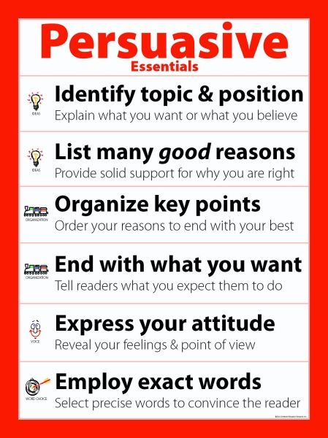
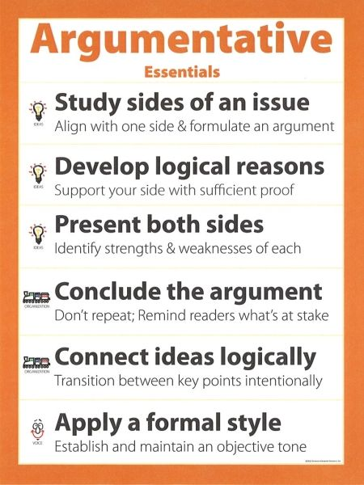
Subtle, but Significant Differences…
VS
Notes:
Carole H/Out

Slide 55

Informative/Explanatory Writing
CCR Writing Anchor Standard #2
Write informative/explanatory texts to examine and convey complex ideas and information clearly and accurately through the effective selection, organization, and analysis of content.
SKILLS:
SELECTING, ORGANIZING, and ANALYZING
IMPORTANT QUALITIES: ACCURACY AND CLARITY
Notes:
3 main skills identified in Writing Standard 2: SELECTING, ORGANIZING, AND ANALYZING
2 important qualities identified ACCURACY AND CLARITY

Slide 56

Informative/Explanatory writing seeks to accurately convey information
Purposes are:
  to increase readers’ knowledge of a subject
  to help readers better understand a procedure or process
  to provide readers with an enhanced comprehension of a concept
Notes:
Carole
GATHERING GRID H/O
The gathering grid supports students, helping them to organize their thoughts, as they dialogue in response to a question. The quality of the question and the fidelity to the protocol determine the results.
The Gathering Grid can be used at any point in the teaching/learning cycle.
Any level students can use and benefit from this strategy.
Responses can range from drawings, charts, graphs, strings of letters, to full paragraphs depending on the question, the student’s learning style and ability.
Helps students summarize data/information as the research…
Can find more detailed gg’s on the internet

Slide 57

Informational Text Features
Print Features
  Table of Contents
  Index
Organizational Aids
  Bold Print
  Italics
  Bullets
Graphic Aids
  Diagrams
  Graphs
  Maps
Illustrations
  Photos
  Magnification
Informational Text Organizational Structures
Definition
Description
Procedural-Sequential
Synthesis
Analysis
Comparison
Cause/Effect
Notes:
Carole
Informational text features help the reader more easily navigate the text and often provide additional information to help them comprehend the content
Teaching students text organizational structures and features used by authors of informational text has been shown to improve comprehension of informational text and provide the scaffolding and support students need in order to write their own information texts.

Slide 58

How does Informative/Explanatory writing differ from Argumentative writing?
Compare these two writing prompts:
  Was Alexander the Great truly great?
  How did Alexander the Great hellenize the Middle East?
Notes:
Carole
Both W.CCR.1 and W.CCR.2 call for writing that provides information, and Appendix A provides some help in keeping the two straight.
Appendix A states that these two modes of writing are dominant in postsecondary education, and they are also dominant in the standards of well-performing countries (p. 41).
Arguments seek to make people believe that something is true or to persuade people to change their beliefs or behavior.
Explanations…start with the assumption of truthfulness and answer questions about why or how. Their aim to make the reader understand rather than persuade him or her to accept a certain point of view.”
THIS IS IMPORTANT: CONNECT TO TEXT-DEPENDENT QUESTIONS!!!!
Compare the two prompts:
Notice how the first prompt brings up a debatable point; to tackle it, the writer will have to analyze available evidence, come to her own conclusion, and then marshal the evidence to advance her claim. In the second prompt, the spread of hellenism is not debatable. The writer simply needs to summarize the tactics that Alexander used to spread Greek culture.

Slide 59
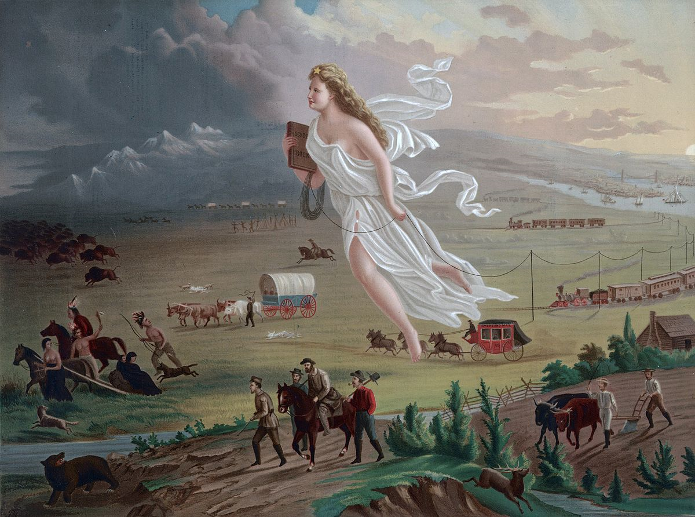
Was it Destiny to move West?
1
2
Visual Literacy Strategy:
Crop It!
What does the imagery say about westward expansion?
What type of transportation was used to settle the West?
What were the challenges to westward expansion?
What technology played a role in westward expansion?
3
4
Notes:
Kim
What kind of clues help us identify place?
What helps us recognize time?

Slide 60
Was it Destiny to move West?
www.c3teachers.org
Inquiry Design Model
Based on a Summative Performance Task (usually argumentation)
Question is ‘staged’
3-4 supporting questions, dissected through primary sources
‘Daily’ formative performance task
Each table will complete their formative performance task, reading quickly through the resources.
How will these three questions with resources prepare the students to address the question, Was it Destiny to move West?

Slide 61
Literacy Design Collaborative (LDC) Rubrics
Create a Free Account!
www.ldc.org
Join Core Tools

Slide 62
Narrative Writing
CCR Writing Anchor Standard #3
Write narratives to develop real or imagined experiences or events using effective technique, well-chosen details, and well-structured event sequences.
“Good writing is seldom purely one form. This is especially true with the integration of narrative into other forms. Informational articles often contain a narrative. Opinion and arguments may contain a personal story to emphasize why certain evidence is more credible, important, or believable.” Author Unknown
Notes:
Carole
TEACH NARRATIVE BY FOLDING IN INFORMATIONAL FACT WHILE STILL ENCOURAGING BEAUTIFUL WRITING
Narratives are important because they form the intrapersonal and interpersonal glue that holds our whole world together. Storytelling helps us understand empathy.
Narratives help us understand the world around us and the world within us.
Sacrifice it and we sacrifice other elements dictated by the Common Core: creativity, critical-thinking, and character.
To address this shift, we need to focus more on creative non-fiction or fact-based narratives. After all, there's no reason why our narratives can't be based in fact.

Slide 63
Kentucky Academic Standards: Narrative Writing
6th | Introduction establishes context, shifting time frames, precise vocabulary
7th | Conclusion reflections on experiences or events
8th | Shifting time frames and relationships among those events
9-10th | Multiple points of views, characters reflect on events, telling details
11-12th | Introduction emphasizes significance of events, control of tone
Notes:
Carole
KAS requires Narrative writing at all levels…, but there are some distinctions of narrative writing from 6-12 grade
The framework builds on previous grade’s skills, so this list only highlights what changes occur at each grade level

Slide 64



Appendices
Appendix C:
Annotated Writing Samples at Various Grade Levels
Appendix A:
Supplementary Materials and Glossary
Appendix B:
Text Exemplars and Sample Performance Tasks
www.corestandards.org
Notes:
3 Appendices:
A: Supplementary materials and a glossary (43 pages)
B: Text exemplars illustrating complexity. text complexity is measured by 3 factors (DON’T KNOW IF I WILL GO INTO ALL THIS ABOUT APPENDIX B , BUT I WILL HAVE IT IF NEEDED)
qualitative evaluation (levels of meaning, structure, language conventionality, and clarity, and knowledge demands)
quantitative evaluation (readability, and other scores of text complexity), and matching reader to text and task (reader variables such as motivation, knowledge and experience, and task variables such as purpose and complexity generated by task assigned or question posed)
quality and range of reading for grade levels (includes text types for K-5 and 6-12 bands in these broad categories: stories, dramas, poetry and literary nonfiction/(historical, scientific and technical texts for K-5 only)
Accompanying Sample Performance Tasks (183 pages)
C: Annotated samples demonstrating at least adequate performance in writing at various grade levels (106 pages)

Slide 65

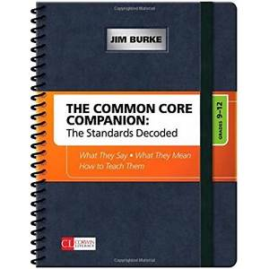
New Resource: Available for All Grade Levels
THE COMMON CORE COMPANION:
The Standards Decoded for Grades 6-8 and 9-12
What They Say – What they Mean – How to Teach Them
Jim Burke: Corwin Literacy

Slide 66
English II End-Of-Course: Field Test
Core Components:
Critical Analysis of literary and informational texts
Thoughtful critique and response to the thoughts of others
Construction of arguments based upon evidence
Careful consideration of relevant evidence
Three “Reasoning” Clusters:
Analyzing Literature
Engaging in Argument
Integrating Multiple Perspectives
Notes:
Carole
Analyzing Literature: Taylor Swift “Love Story”
Engaging in Argument: Address to the United Nations, Malala Yousafzai
Integrating Multiple Perspectives: 6 Sources given about Bass Fishing. One of the 6 is a visual image.

Slide 67
Where does On-Demand Writing
Appear in the Standards?
Range of Writing: Standard #10:
Write routinely over extended time frames (time for research, reflection, and revision) and shorter time frames (a single sitting or a day or two) for a
range of tasks, purposes, and audiences.

Slide 68
On-Demand Writing Assessment Purposes
To provide students the opportunity to demonstrate independently the communication skills they have developed through instruction
To reflect authentic reading and writing —understanding the role reading plays in the development of writing without testing reading ability
To use source material to promote authentic content in writing
To reflect the type of writing required for college/job readiness, reflected in the CCSS (KCAS)
“Students mastering Standard 10 are able to communicate clearly and will be prepared for Kentucky’s writing assessment.”
KDE Three Modes of Writing Guidelines: Page 2

Slide 69

Resource: My Website
Carole Mullins, NBCT
KVEC Literacy Instructional Specialist
carole.mullins@hazard.kyschools.us
www.kvecelatln.weebly.com

Slide 70

Resource: Icurio.com

Slide 71
Claims Driving Design: ELA/Literacy
Students are on-track or ready for college and careers
Students build and present knowledge through research and the integration, comparison, and synthesis of ideas.
Reading Literature
Students read and comprehend a range of sufficiently complex texts independently
Students write effectively when using and/or analyzing sources.
Reading Informational Text
Vocabulary Interpretation and Use
Written Expression
Conventions and Knowledge of Language
Notes:
Intent of the Standards, therefore, these are the areas that will be emphasized through assessment.

