Slide 1
Reading and Writing Grades 6-12 Presented by: The KVEC/ARI English/Language Arts: Professional Action Network www.kvecelatln.weebly.com Conducted by ARI Literacy Fellows: Diedra Carpenter, Rachel Holbrook Ed.D., Rebecca King and Sonya Slone, NBCT
November 17, 2016
Notes:
Carole
Welcome and Introductions
HANDOUT: ELA Notes

Slide 2
Agreements for Learning
Be open to new ways of thinking about the instructional shifts needed to implement classroom instruction utilizing the KAS for English/Language Arts.
During group work be respectful of others’opinions and points of view.
Don’t forget your e-manners (phones on silent, use of electronic devices, etc.).
Keep side conversations to a minimum.
Recognize that this is very important work and deserves
your full attention and commitment!
Notes:
Carole
Review Information on Slide

Slide 3
What is meant by College and Career Readiness (CCR) Anchor Standards?
…the acquisition of the knowledge and skills a student needs to enroll and succeed in credit-bearing, first-year courses at a postsecondary institution (such as a two- or four-year college, trade school, or technical school) without the need for remediation. (ACT)
The standards were built on this vision for every single student who graduates from high school.
Notes:
Carole
Reference the revised Bloom’s Taxonomy (RBT)
25 verbs that create collegial understanding of student behavior and learning outcome
Used in development of CCS
Handout located on KVEC ELA website with specific information and list of verbs

Slide 4
Six Instructional Shift Demands of the KAS ELA/Literacy Standards
Increase reading of Informational Texts K-12
Attend to TEXT COMPLEXITY – close and careful reading of more complex texts
Emphasize Academic Vocabulary – words that help students access complex text in all subject areas
Focus on TEXT DEPENDENT QUESTIONS – those that REQUIRE close reading of the text (vs ‘text-free’—which rely on prior knowledge instead of the actual text)
Focus on WRITING FROM SOURCES – Argumentation with Evidence and narrative writing to Inform
Emphasize Content Area Literacy – All subject areas teaching students the same reading/writing skills
Notes:
Carole
HANDOUT: CCS Shifts
FOR STUDENTS TO BE COLLEGE AND CAREER READY…
Percentages affect elementary teachers the most… High Schools need to clarify the percentages across the curriculum (ALL teachers are literacy teachers)
Appendix B addresses this… There is now more text available that has been through the 3 step process… STRATEGY OF CLOSE READING!
Teachers constantly using strategies to increase student’s ability to access more complex text
Refer participants to handout: REALLY EMPHASIS staying connected to text…
Refer participants to handout: Understanding this is important for ON-DEMAND writing
… necessary to be College and Career Ready. All subject areas have Literacy Standards!! There are 10 Reading and 10 Writing Standards for specific to subjects other than English. They are basic skills that make us LITERATE in discussing/writing about ANY topic.
TEXT COMPLEXITY, TD QUESTIONS AND WRITING FROM SOURCES = ON-DEMAND WRITING

Slide 5
Distribution of Communicative Purposes by Grade in the NAEP Writing Framework
GRADE | TO PERSUADE Opinion/Argument | TO EXPLAIN Informative/ Explanatory | TO CONVEY EXPERIENCE Narrative
4 | 30% | 35% | 35%
8 | 35% | 35% | 30%
12 | 40% | 40% | 20%
It follows that writing assessments aligned with the Standards should adhere to the distribution of writing purposes across grades outlined by NAEP.
ELA CCSS Page 5
Notes:
Carole
Impact of Shift 1 in terms of the 3 Modes of writing and WRITING ASSESSMENTS…
As with reading, the percentages in the table reflect the sum of student writing, not just writing in ELA settings.

Slide 6
Shifts at the Heart of the Standards
Complexity: Regular practice with complex text and its academic language.
Evidence: Reading and writing grounded in evidence from text, literary and informational.
Knowledge: Building knowledge through content rich nonfiction.
Notes:
Carole
The CCSS Shifts Build Toward College and Career Readiness for All Students

Slide 7
“Read like a detective, write like a reporter.”
Notes:
Carole
Mantra—we need students that “read like detectives and write like reporters” (Coleman)

Slide 8
Common Core You Tube Videos
Videos Produced by
James B. Hunt, Jr. Institute for Educational
Leadership and Policy
And the Council of Chief State School Officers (CCSSO)
Example:
Writing to Inform and Make Arguments (3:36)
A handout with links to videos located at:
www.kvecelatln.weebly.com
Nov. 17th ELA Meeting
Notes:
Carole
12 You Tube Videos – explaining intent of standards, etc. – longest one is about 10 minutes. Presenters worked on standards development
Refer to handout on website

Slide 9
Teaching Students to Ask Their Own Questions
Question Formulation Technique
(QFT)
www.rightquestion.org
Notes:
Rebecca

Slide 10
Domain 3: Instruction 3b – Questioning & Discussion Techniques
Notes:
Let’s begin by looking at the KY FfT… We will focus on the summary and descriptors

Slide 11
Notes:
Rebecca
HANDOUTS:
Q-focus Design
QFT Small Group Worksheet
KAS and QFT
QFT Planning Tool Resource located on website

Slide 12
Students Learn To:
Produce their own questions
Improve their questions
Strategize how to use their questions
Reflect on what they have learned and how they learned it
Notes:
Rebecca

Slide 13
Rules for Producing Questions
1. Ask as many questions as you can
2. Do not stop to answer, judge or discuss
3. Write down every question exactly as stated
4. Change any statements into questions
Notes:
Rebecca
Table Tents (I have these and will bring them)
Handout to create these is on website

Slide 14
Question Focus
Teachers must change their instructional practices to meet the rigor of the KAS for English Language Arts/Literacy.
Notes:
Rebecca

Slide 15
Producing Questions
Ask questions
Follow the rules
Ask as many questions as you can.
Do not stop to answer, judge, or discuss.
Write down every question exactly as stated.
Change any statements into questions.
Number the questions
Teachers must change their instructional practices to meet the rigor of the KAS English Language Arts/Literacy.
Notes:
Rebecca

Slide 16
Categorizing Questions: Closed/Open
Definitions:
Closed-ended questions can be answered with a “yes” or “no” or with a one-word answer.
Open-ended questions require more explanation.
Directions: Identify your questions as closed-ended or open-ended by marking them with a “C” or an “O”.
Notes:
Rebecca

Slide 17
Improve Questions
Take one closed-ended question and change it into an open-ended question.
Take one open-ended question and change it into a closed-ended question.
CLOSED
OPEN
OPEN
CLOSED
Notes:
Rebecca
Ask participants to change questions from one type to another. Emphasize that they need to change both!

Slide 18
Prioritize Questions
Review your list of questions
Choose the three questions you consider most useful in informing instructional changes teachers can make to meet the shifts in KAS for Eng/LA.
While prioritizing, think about your Question Focus:
After prioritizing consider…
Why did you choose those three questions?
Where are your priority questions in the sequence of your entire list of questions?
Teachers must change their instructional practices to meet the rigor of the KAS English Language Arts/Literacy.
Notes:
Rebecca

Slide 19
Share
Questions you changed from open/closed
Your three priority questions and their numbers in your original sequence
Rationale for choosing priority questions
What you will do with the questions
Notes:
Rebecca

Slide 20
Close Reading Activity
Locate “Text Codes” Handout in your packet.
Use these text codes to read “Common Core Shifts for English Language Arts/Literacy” article which is also in your packet.
As you read, keep in mind the questions generated using the Question Formulation Technique. Be sure to mark answers if you encounter them.
Notes:
Rebecca
HANDOUTS:
Text Codes
ELA Shifts Article

Slide 21
Did reading the article with a specific question in mind affect your reading experience? How?
Round Robin Discussion Partners
Instructions:
Four Partners will be given 45 seconds each to discuss their answer to the questions.
Begin with Partner #3 and move clockwise.
Only talk when it is your turn unless you need to encourage a partner with a “thinking question”.
When time is up, the next partner will begin.
Notes:
Sonya
This strategy advocates DISCUSSION among students and addresses KY Framework for Teaching: Instruction
3b: Questions and Discussion Techniques
3c: Engaging Students in Learning

Slide 22
Formative Assessment Strategy
Notes:
Sonya
Kagan Strategy: Take Off - Touch Down is a simple strategy to use for review or getting to know students that also incorporates simple, structured movement.
Students stand and sit to answer questions as the teacher polls the class.
This strategy addresses KY Framework for Teaching: Instruction
3b: Questions and Discussion Techniques
3c: Engaging Students in Learning

Slide 23
www.kvecelatln.weebly.com
24 Formative Assessment Strategies
Notes:
Sonya
Refer to Handout of 24 Formative Assessment Strategies shared by teachers across the KVEC region during the ELA Network is available to participants on the website www.kvecelatln.weebly.com

Slide 24
Notes:
10:20 – 10:30

Slide 25
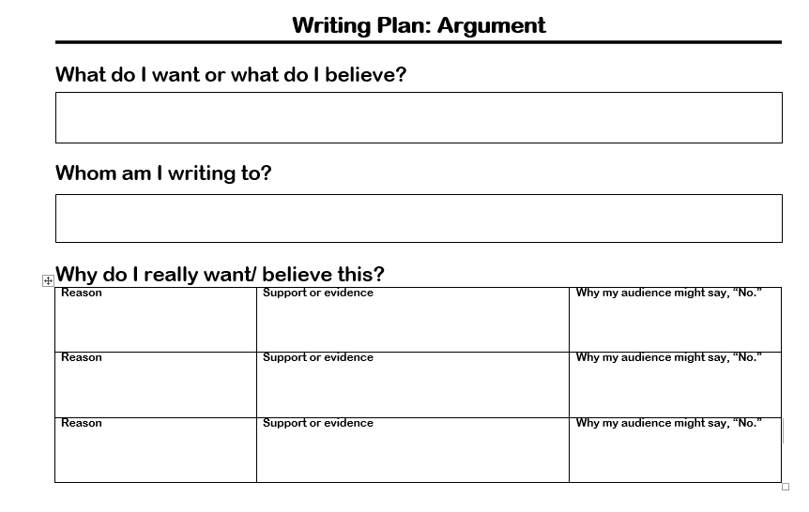
Notes:
Sonya
HANDOUT: Writing Plan: Argument
This slide has action. The highlighted sections will appear to show the hashtag.

Slide 26
Planning and Prewriting
Who is My Audience?
Why – Purpose – Thesis
What – Format

Slide 27
Paragraph
…a paragraph that breaks a topic down into three points that illustrates exactly what the topic means. It contains
One clear idea, expressed in a topic sentence
Three reasons, points, or details which support that one idea
An example for EACH reason, point, or detail
A conclusion which summarizes or somehow ends the paragraph
Notes:
Sonya
HANDOUT: Power Paragraph
It gets its name from the three points and eight sentences that become its framework

Slide 28
Three colors to annotate:
One color to highlight the topic sentence and the concluding sentence
One color to highlight the THREE main topics
One color to highlight the supporting statements
Notes:
Sonya

Slide 29
The main reason students need uniforms is that uniforms make life easier for everyone.
First of all, if children and teens wore uniforms, they would be on time for school.
Picking out clothes for school would be a snap since they wouldn’t have to make decisions about what to wear.
Uniforms would make things easier for parents too.
If all kids wore khakis and button-down shirts, parents wouldn’t have to buy them so many different kinds of clothes.
Finally, uniforms would make things easier for teachers.
If students wore uniforms to school, there wouldn’t be so many fights on the playground because everyone would have the same clothes and no one would get teased because of what he or she wore.
So you see, if students wore uniforms to school, it would be easier on everyone.
Notes:
Sonya

Slide 30
The main reason students need uniforms is that uniforms make life easier for everyone. First of all, if children and teens wore uniforms, they would be on time for school. Picking out clothes for school would be a snap since they wouldn’t have to make decisions about what to wear. Uniforms would make things easier for parents too. If all kids wore khakis and button-down shirts, parents wouldn’t have to buy them so many different kinds of clothes. Finally, uniforms would make things easier for teachers. If students wore uniforms to school, there wouldn’t be so many fights on the playground because everyone would have the same clothes and no one would get teased because of what he or she wore. So you see, if students wore uniforms to school, it would be easier on everyone.
Notes:
Sonya

Slide 31
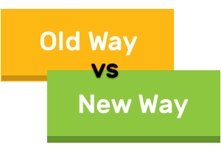
www.kvecelatln.weebly.com
Writing Chart
Argument vs Persuasive Writing
Presenting An Argument
Notes:
Sonya
Here are 3 Additional Resources related to Argumentative Writing that are located on the KVEC ELA website: Nov. 17th ELA Meeting

Slide 32
Let’s tackle it head on!
Notes:
Rachel
HANDOUTS for use throughout activity:
Prompt
Short Articles
Student Responses
Scoring Rubric
Remind participants that in the previous session they looked at the scoring guide. Now, they are going to actually learn how to put meaningful on-demand practice into play in their classroom.

Slide 33
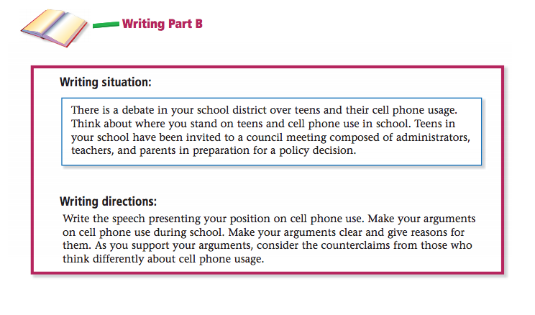
Notes:
Rachel
HANDOUTS:
Prompt
Short Articles
Have participants refer to their handouts. (They will read the text from pages 20 and 21 of the released On-demand for 11th grade.)
Encourage participants to use the prompt analysis and planning strategy (hashtag) that Sonya introduced.

Slide 34
You will have 45 minutes to complete your on-demand and then we will analyze your work, using the same strategies that you would use in the classroom with your own students.
Notes:
Rachel
HANDOUTS:
Prompt
Short Articles
All participants 45 minutes to work. Display timer on screen.

Slide 35
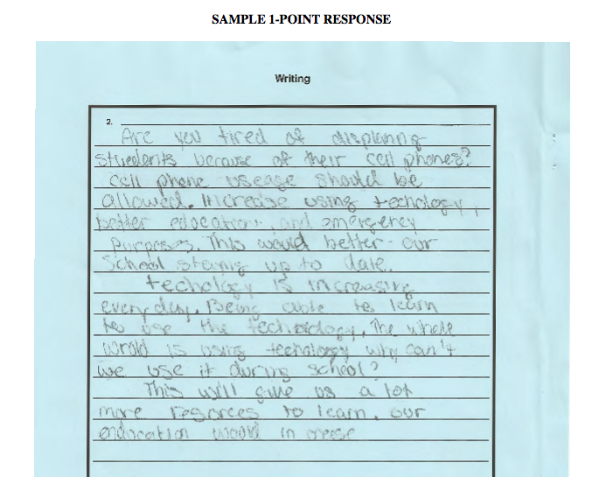
Notes:
Rachel
HANDOUTS:
Student Responses
Scoring Rubric
Before going over scores, participants will read and score these copies. (Their copies DO NOT have scores at the top.) We will then go over each and the rationales.

Slide 36
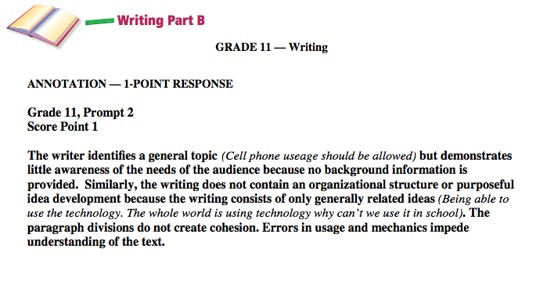
Notes:
Rachel
HANDOUTS:
Student Responses
Scoring Rubric

Slide 37
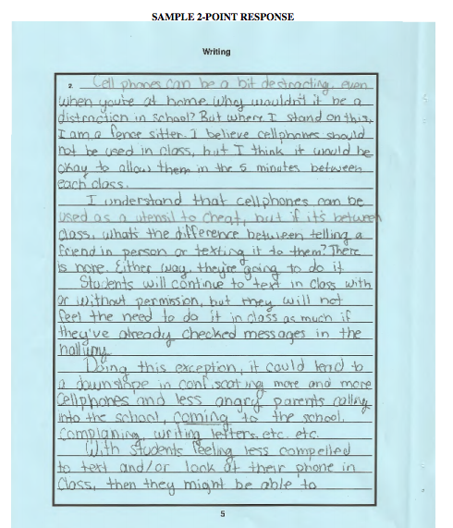
Notes:
Rachel
HANDOUTS:
Student Responses
Scoring Rubric

Slide 38
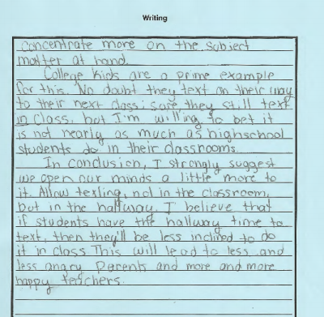
Notes:
Rachel
HANDOUTS:
Student Responses
Scoring Rubric

Slide 39
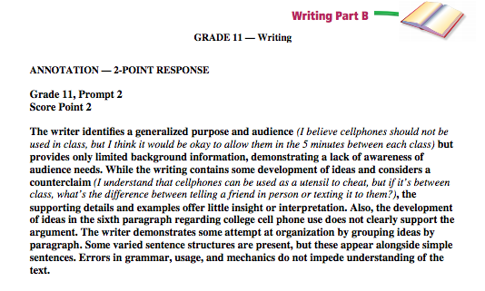
Notes:
Rachel
HANDOUTS:
Student Responses
Scoring Rubric

Slide 40
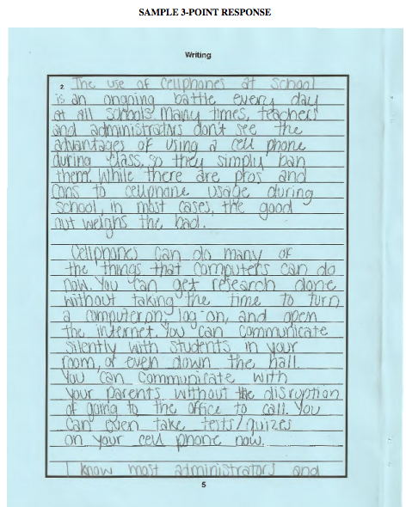
Notes:
Rachel
HANDOUTS:
Student Responses
Scoring Rubric

Slide 41
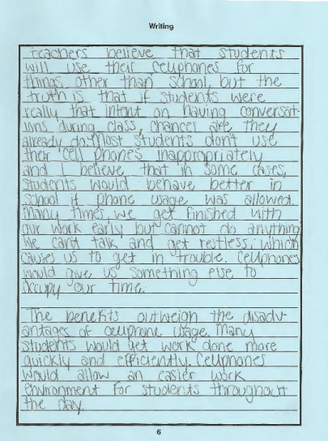
Notes:
Rachel
HANDOUTS:
Student Responses
Scoring Rubric

Slide 42
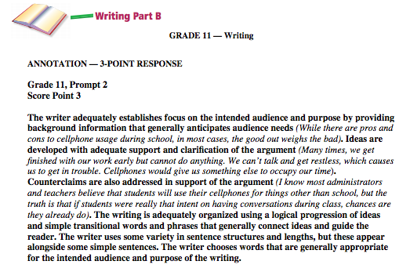
Notes:
Rachel
HANDOUTS:
Student Responses
Scoring Rubric

Slide 43
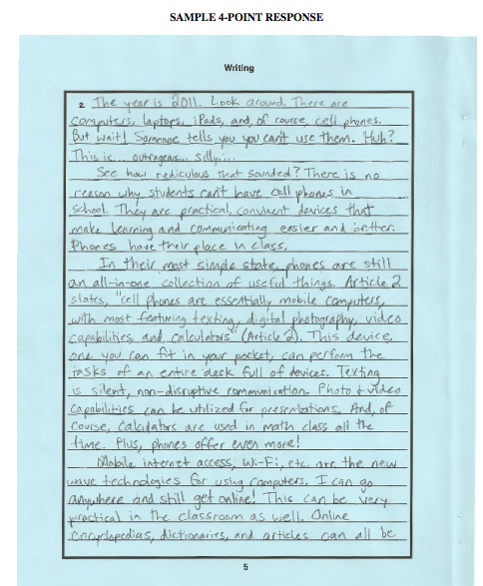
Notes:
Rachel
HANDOUTS:
Student Responses
Scoring Rubric

Slide 44
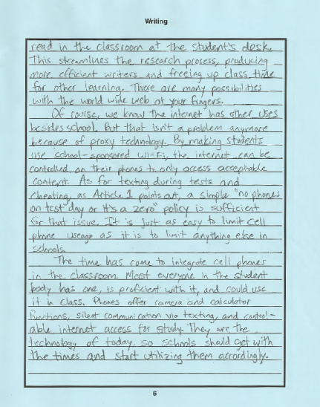
Notes:
Rachel
HANDOUTS:
Student Responses
Scoring Rubric

Slide 45
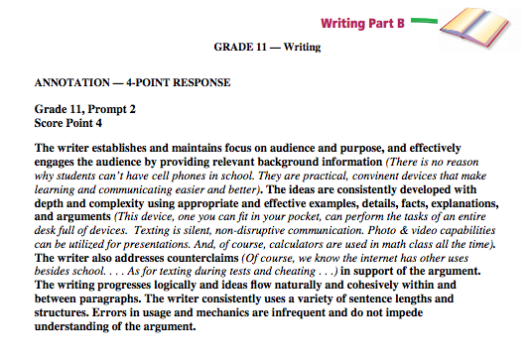
Notes:
Rachel
HANDOUTS:
Student Responses
Scoring Rubric

Slide 46
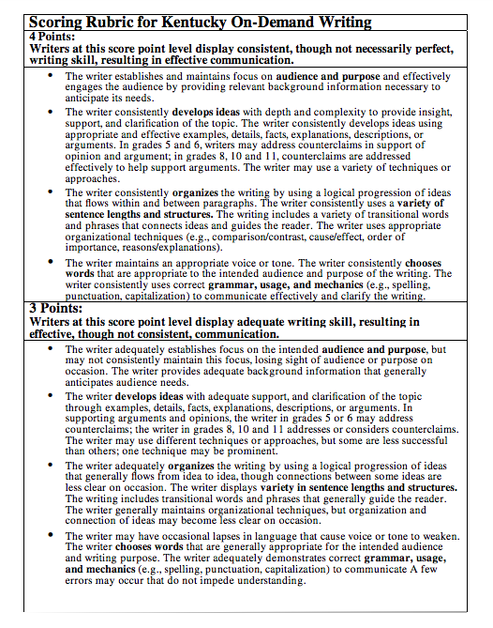
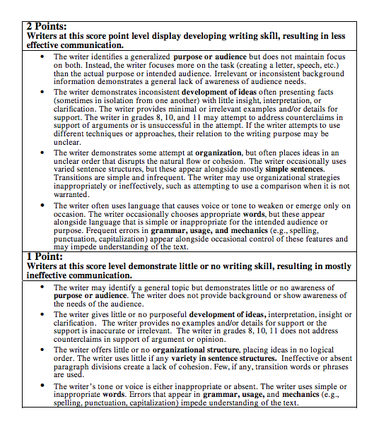
Self-Scoring On-Demands
Notes:
Rachel
HANDOUTS:
Student Responses
Scoring Rubric for OD Response
Analysis of On-Demand Response
Guide participants to annotate their own work using the language in bold from the scoring rubrics. (Participants should have a copy of the rubric in their handouts to use for reference.) They can now compare their own work to the samples that we just read.

Slide 47
Time for Feedback!
Notes:
Carole
Charts posted around room for participants…
Give feedback on what they liked/learned so far today (plus) and what they are confused about or still need help with (delta).

Slide 48
12:00 – 12:45
Notes:
Lunch

Slide 49
How do you address text evidence in your classroom?
What do you have students do with evidence once they identify it?
Notes:
Dee Dee
HANDOUT: Inside/Outside Circle Instructions
The Inside-Outside Circle (Kagan, 1994) is a technique in which students move around and interact with each other. It can be used as a cooperative strategy and a summarizing strategy. Emphasize how older strategies can be used, but that they are aligned to the new standards. Kagan was used in 1994.
This strategy advocates DISCUSSION among students and addresses KY Framework for Teaching: Instruction
3b: Questions and Discussion Techniques
3c: Engaging Students in Learning
How do you address text evidence in your classroom?
What do you have them do with that evidence once they identify it?
Share out:
What was a new strategy that you picked up from a partner that you feel like you could go back and try?

Slide 50
Soldiers and Heroes
Text and Lessons for
Teaching Literature
Using multiple texts and text dependent questions.
Notes:
Rebecca/Rachel
HANDOUTS: Resource Pages 271-278

Slide 51
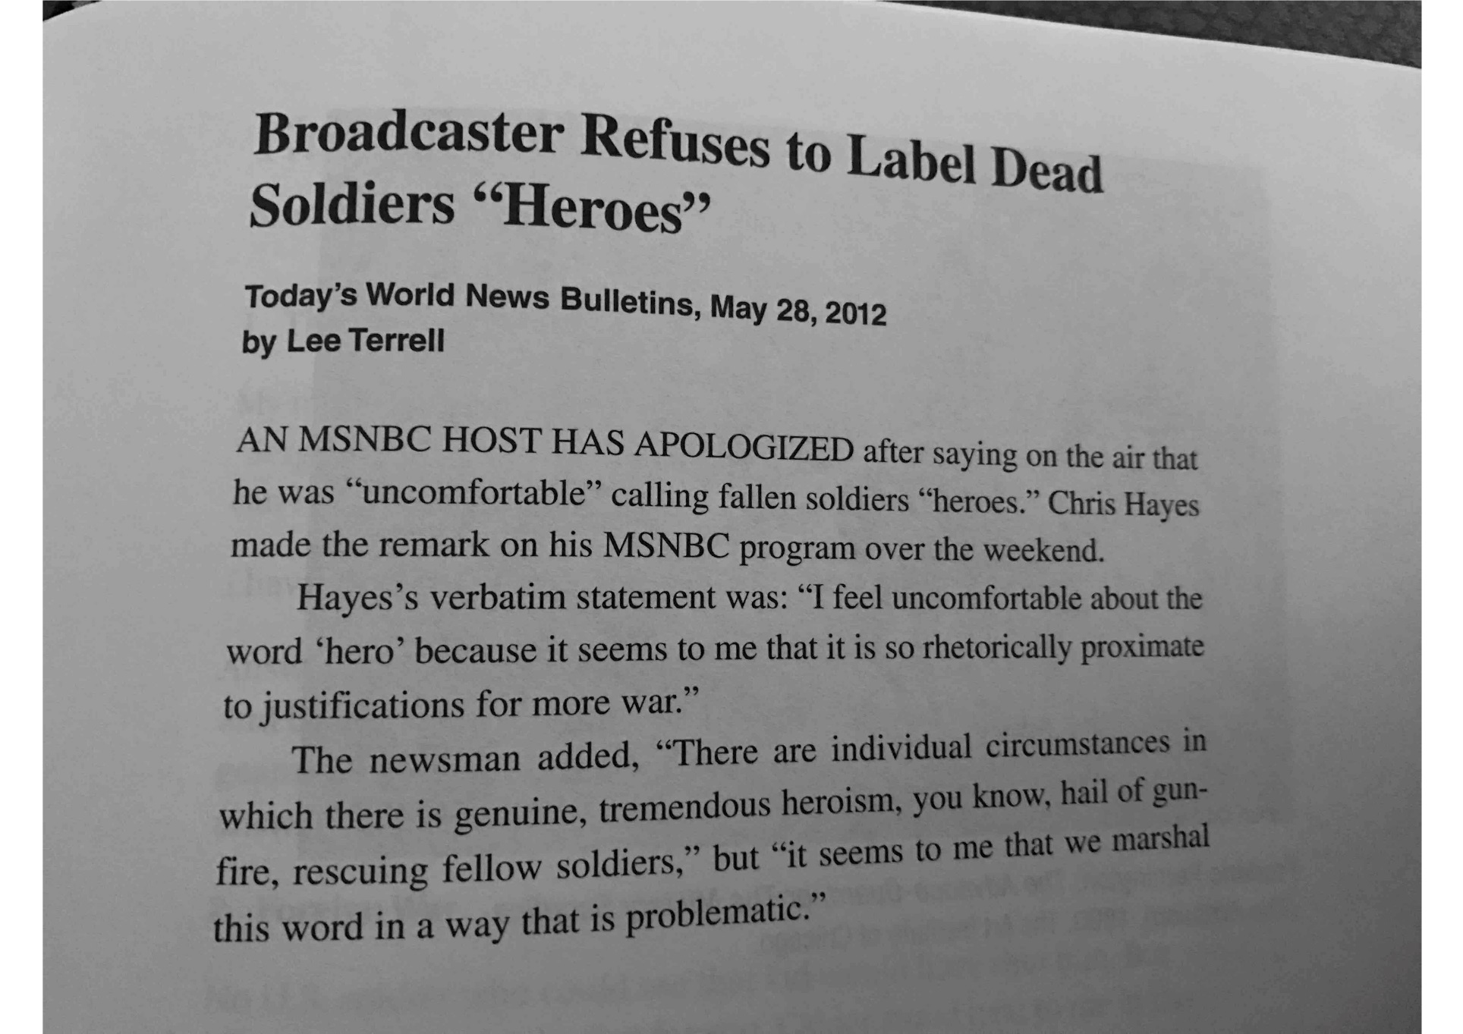
What makes a soldier a hero?
Notes:
Rebecca/Rachel
HANDOUTS: Resource Pages 271-278
Project the news items and read it aloud.
Have participants do a quick Pair Share.
Then evoke and list their thoughts about questions like these: What is the definition of a hero? Should all U.S. soldiers be called heroes? The soldiers of other countries? WWII Nazis? The drug armies of southeast Asia? What makes the difference?
Create this list under the heading “What makes a soldier a hero?”
Take some time and care in creating this list, and then update it regularly throughout the lesson that follows.
The culminating activity will be to revisit the list and see how students’ definitions of heroism may have changed or broadened.

Slide 52
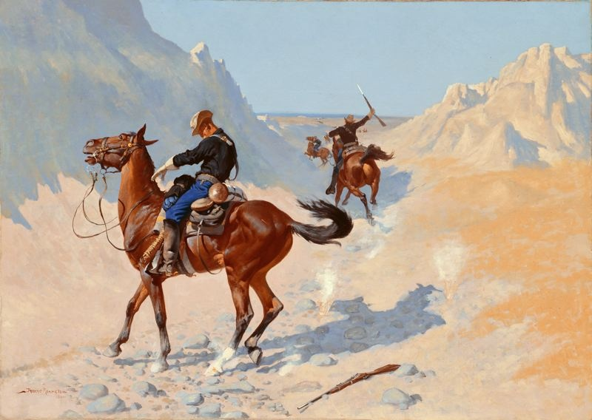
Notes:
Rebecca/Rachel
HANDOUTS: Resource Pages 271-278
Project the image of the cavalrymen of the American frontier, telling participants it was painted in 1890 by Frederic Remington, one of the most respected artists of the American West.
Have them study the picture in pairs, looking patiently for details for at least one full minute, trying to figure out what has happened in the painting.
Then have participants make up and share their own titles for the picture, using details in the image to support their decisions. Remington actually gave this painting a triple title: The Advance-Guard, or the Military Sacrifice (the Ambush).
According to the painter, the soldier has been fatally wounded in an Indian ambush, but because of this sacrifice, his comrades can live to fight another day.
Reveal these titles one at a time, asking participants to talk about how each one confirms or changes their understanding of the painting. And finally discuss: Is this fallen (or falling) solider a hero?

Slide 53
“The News from Iraq” by Sara Holbrook
Notes:
Rebecca/Rachel
HANDOUTS: Resource Pages 271-278
Participants will have a copy.
Read and reread the Holbrook poem.
This is a form called a “cut-up” in which the author patches together lines from different sources, voices, and documents.
As Holbrook explains in her acknowledgement, the poem was partly built on email correspondence that a military family shared with her.
Use the appropriate steps from Stop, Think, and React to ensure that participants understand this complex poem.
They should stop at the three indicated points to make notes as they go, then gather to discuss their thinking.
Revisit and revise the class list on what makes a soldier a hero.

Slide 54
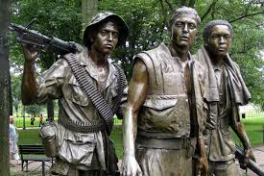
“Three Soldiers” by Bruce Holland Rogers
Notes:
Rebecca/Rachel
HANDOUTS: Resource Pages 271-278
Read aloud the Rogers piece. Here’s a sergeant’s eye-view of the troops he is directly responsible for. After you read it aloud, ask students to talk about what information or understanding this adds to the ongoing investigation of soldiering and heroism. Revise the chart as needed.

Slide 55
“Heroes” by Tim O’Brien
Notes:
Rebecca/Rachel
HANDOUTS: Resource Pages 271-278
Participants read the Tim O’Brien speech.
To finish the set, participants read an untitled speech that O’Brien gave upon accepting the PEN/Faulkner Award in 1979 for his first novel, Going After Cacciato.
He speaks as a combat veteran and writer, and also talks about himself as a young man in the Vietnam era, trying to decide whether to become a soldier or flee to Canada. In the last lines of the speech he directly addresses the topic of who is, and isn’t a hero.
After reading, have students compare his definition of a hero to the whole-class list, making revisions to the chart as needed.

Slide 56
Where do you stand?
Text and Lessons for Teaching Literature
“Soldiers and Heroes”
Teacher Instructional Pages Handout
Notes:
Rebecca/Rachel
HANDOUTS: Resource Pages 271-278 AND Pages 267-270
Based on their study of all readings in the text set, have participants line up on a continuum that expresses their level of agreement with the proposition “All soldiers are heroes.”
Line up along five points: all are heroes, some are heroes, unsure, a few are heroes, none are heroes.
Participants should be ready to talk about why they are standing where they are. (Find instructions in Lesson 7.4, The Human Continuum pg. 158 and be sure to include “folding the line,” so participants must talk with classmates holding different positions.
When finished, click remote and reminder to distribute HANDOUT will appear…

Slide 57
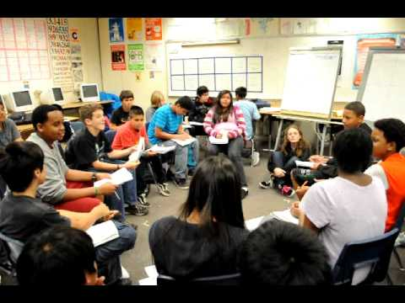
Socratic Seminar
Notes:
Rebecca
Socratic video #1 – N-Word
https://www.teachingchannel.org/videos/teaching-the-n-word
(Video can’t be downloaded because it was embedded in the website. It is hyperlinked to the title.)

Slide 58
A Socratic Seminar Experience
Where questions, not answers, are the driving force in thinking.
Notes:
Rebecca
HANDOUT: Socratic Seminar Graphic Organizer
This strategy advocates STUDENT QUESTIONING AND DISCUSSION among students and addresses KY Framework for Teaching: Instruction
3b: Questions and Discussion Techniques
3c: Engaging Students in Learning

Slide 59
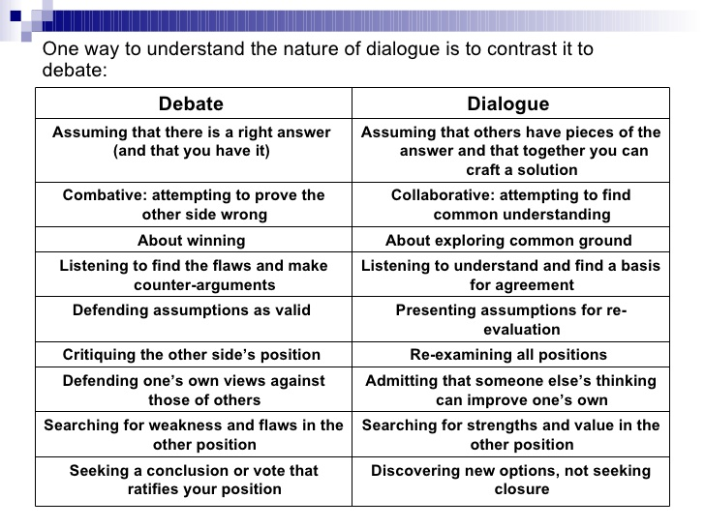
Notes:
Rebecca

Slide 60
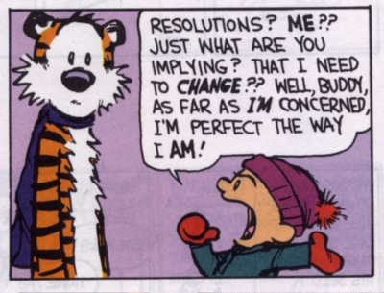
Use Appropriate Persuasive Language
Notes:
Rebecca
HANDOUT: Socratic Seminar Appropriate Language

Slide 61
Recommended Resource
Notes:
Rebecca
HANDOUT: They say, I say templates

Slide 62
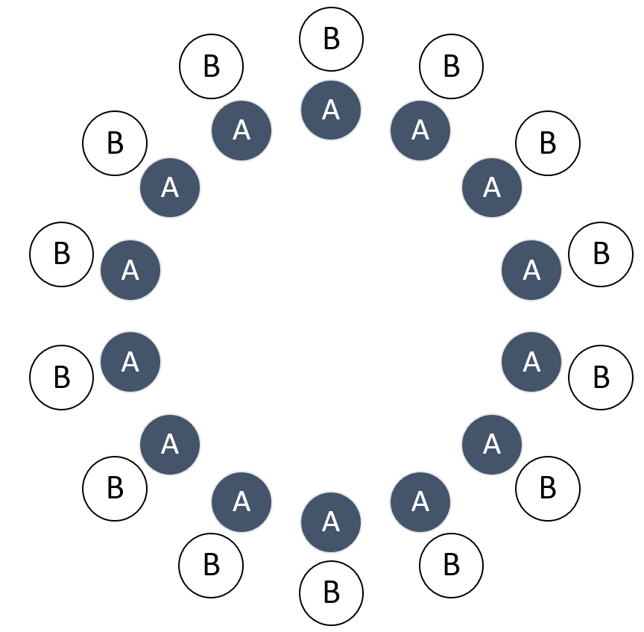
Inner/Outer Circle
Instructions:
If you are a #1, you will be in the inner circle, and if you are a #2, you be in the outer circle for today’s activity.
If you are a #3 or #4, you will observe the process.
Notes:
Rebecca

Slide 63
Round One
Notes:
Rebecca

Slide 64
Round Two
Notes:
Rebecca

Slide 65
Seminar Debrief
What ideas do you agree with?
What ideas do you disagree with?
What questions were left unanswered?
What did you contribute to the discussion?
What do you wish you had said?
Who where the top three contributors to the discussion?
What is your overall evaluation of the seminar?
Notes:
Rebecca
HANDOUT: AVID Socratic Seminar Pages 168, 170 and 172

Slide 66
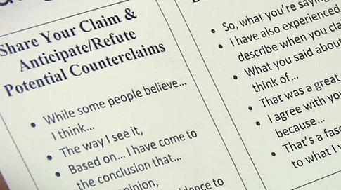
Socratic Seminar
Notes:
Rebecca
Socratic video #2 – Claim and Counterclaim
https://www.teachingchannel.org/videos/using-socratic-seminars-in-classroom
This video will be shown after Rebecca conducts an actual Socratic seminar.
(Video can’t be downloaded because it was embedded in the website. It is hyperlinked to the title.)

Slide 67
Time to Reflect 3-2-1
List three best practices you learned today that will impact reading/writing instruction in your classroom.
1.
2.
3.
Name 2 things you will try within the next few weeks.
1.
2.
How will you share this information with your colleagues?
Notes:
Carole and Rebecca
HANDOUTS: ELA Notes/Reflection and TTR to leave with us
Use Rally Robin to complete 3-2-1 Reflection. In pairs, participants will take turns generating responses to 3-2-1 instructions.
Pairs will leave one copy on the table at the end of the day. Distribute Certificates.

Slide 68
Contact Information
Carole Mullins, KVEC Literacy Instructional Specialist
carole.mullins@hazard.kyschools.us
Diedra Carpenter, ARI Literacy Fellow, Magoffin County, Herald Whitaker Middle School Curriculum Coach diedra.carpenter@magoffin.kyschools.us
Rebecca King, NBCT, ARI Literacy Fellow, Pikeville Independent High School 11th and 12th grade AP Language & AP Literature rebecca.king@pikeville.kyschools.us
Sonya Slone, NBCT, ARI Literacy Fellow, Allen Central High School 10th-12th English sonya.slone@floyd.kyschools.us
Rachel Holbrook, Ed.D., NBCT, ARI Literacy Fellow, Johnson County Schools Technology Integration Specialist & Johnson County Middle School Language Arts rachel.holbrook@johnson.kyschools.us
Notes:
Carole
Closing

