Slide 1
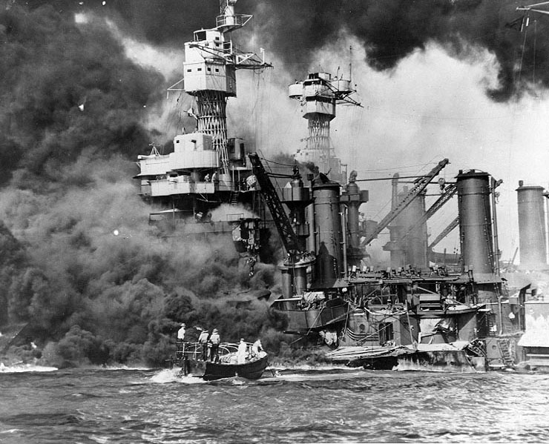
Questions that matter in the social studies classroom.
Crafting
Notes:
Now that we have a better understanding of QFT, let’s start thinking about what it could look like in our classrooms. If you recall, the proposed inquiry practices begin with questioning. This practices sets out a vision that students and teachers would be co-constructing questions suitable for inquiry. While students would be asked to practice writing questions, we know that teachers’ questions will likely guide curricular decisions. What is crucial is that students understand the questions under investigation; questions can’t live on a whiteboard or up on a wall or worse, in just a lesson plan—these questions cannot be ornamental, but rather they need to live in the classroom. The hope or intent is that an instructional space would be created that would allow students to explore the questions and to build a series of questions (supporting questions) to guide the inquiry.

Slide 2
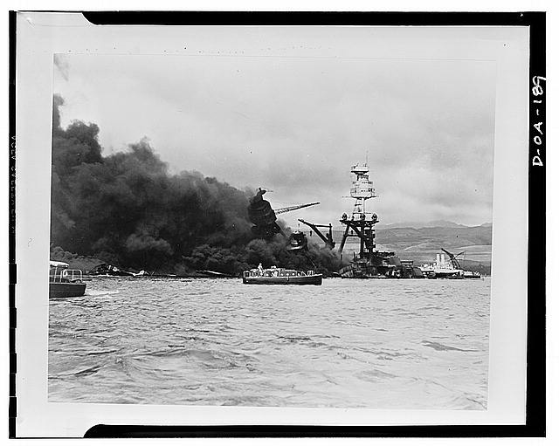
Remembering Pearl Harbor
(Franklin D. Roosevelt Library, NLR-PHOCO-A-8150(29))

Slide 4
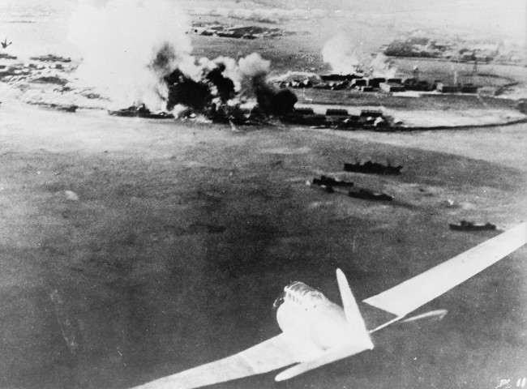

Slide 5
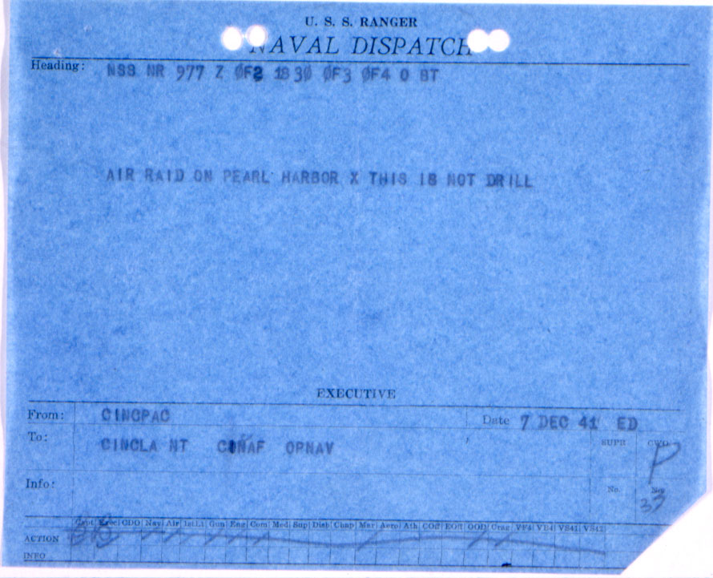

Slide 7
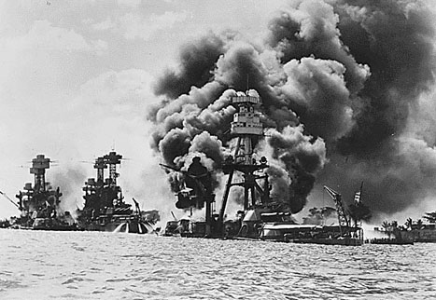

Slide 8
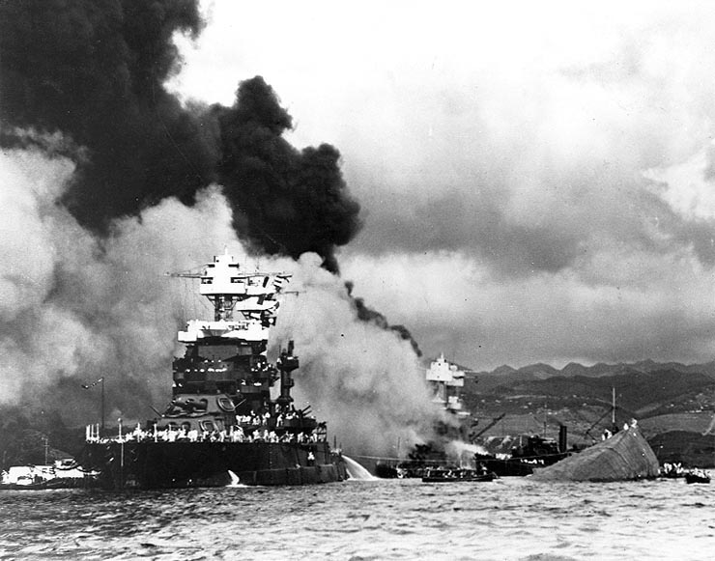

Slide 12
Q-Focus

Slide 13
Producing Questions – 5 min.
Ask Questions
Remember the Q-Focus
Number the Questions
Notes:
They’ll ask questions independently for 5 minutes.

Slide 14
Categorizing Questions: Closed/Open
Definitions:
Closed-ended questions can be answered with a “yes” or “no” or with a one-word answer.
Open-ended questions require
more explanation.
Directions: Identify your questions as closed-ended or open-ended by marking them with a “C” or an “O”.

Slide 15
Change Closed to Open -Ended Questions (Divergent Thinking)
Directions: Take one closed-ended question and change it into an open-ended question
CLOSED-ENDED
OPEN-ENDED

Slide 16
Change Open to Closed -Ended Questions (Convergent Thinking)
Directions: Take one open-ended question and change it into an closed-ended question
OPEN-ENDED
CLOSED-ENDED

Slide 17
Prioritizing Questions
Review your list of questions
Choose the three questions you consider most important
While prioritizing, think about your Q-Focus:
*Pictures and captions
*Roosevelt’s “Day of Infamy” speech

Slide 18
Share
Your three priority questions and their numbers in your original sequence.
Rationale for choosing priority questions.
THEN:
Create a TABLE LIST of QUESTIONS from your shared priority questions.

